Slide 1
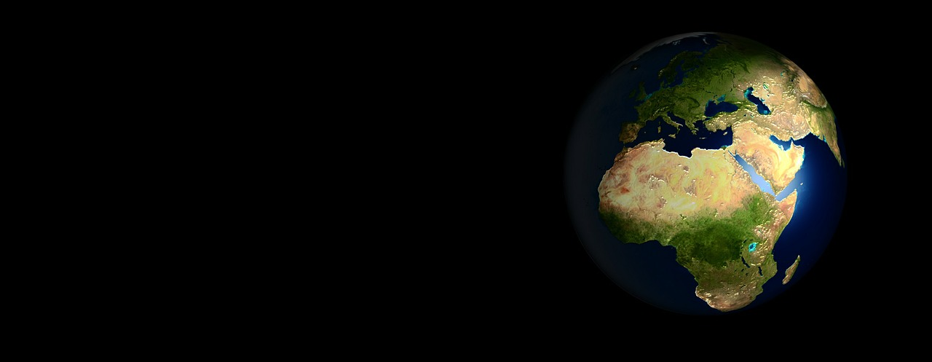
Sense of Ought
Biblical View
“One cannot remove and replace moral laws at one's convenience. If they exist at all, they will occasionally restrict one’s freedom to act however one pleases. If they do not exist at all, pity the weak victims whom these laws fail to protect or avenge.” (Joel Furches)

Slide 2
In their own words:
“We affirm that moral values derive their source from human experience. Ethics is autonomous and situational needing no theological or ideological sanction. Ethics stems from human need and interest. To deny this distorts the whole basis of life. Human life has meaning because we create and develop our futures. Happiness and the creative realization of human needs and desires, individually and in shared enjoyment, are continuous themes of humanism. We strive for the good life, here and now.” (Humanist Manifesto II, 1973)

Slide 3
“The philosopher who finds no meaning in the world is not concerned exclusively with a problem in pure metaphysics; he is also concerned to prove that there is no valid reason why he personally should not do as he wants to do.”
“For myself, as, no doubt, for most of my contemporaries, the philosophy of meaninglessness was essentially an instrument of liberation ... from a certain system of morality.” (Aldous Huxley, Ends and Means)

Slide 4
When Richard Dawkins was asked about moral standards, he was certain that they couldn’t come from the Bible, but, he asked, “What’s to prevent us from saying Hitler wasn’t right? I mean, that is a genuinely difficult question.”

Slide 5
Atheist Jean-Paul Sartre:
“… when we speak of ‘abandonment’ … we only mean to say that God does not exist, and that it is necessary to draw the consequences of his absence right to the end.”

Slide 6
“The existentialist … finds it extremely embarrassing that God does not exist, for there disappears with Him all possibility of finding values in an intelligible heaven. There can no longer be any good a priori, since there is no infinite and perfect consciousness to think it. It is nowhere written that ‘the good’ exists, that one must be honest or must not lie, since we are now upon the plane where there are only men. Dostoevsky once wrote, ‘If God did not exist, everything would be permitted’; and that, for existentialism, is the starting point. Everything is indeed permitted if God does not exist, and man is in consequence forlorn, for he cannot find anything to depend upon either within or without himself.” (Existentialism is a Humanism)

Slide 7
Sartre’s response to the objection that “your values are not serious, since you choose them yourselves” (from Existentialism is a Humanism):
“To that I can only say that I am very sorry that it should be so; but if I have excluded God the Father, there must be somebody to invent values. We have to take things as they are. And moreover, to say that we invent values means neither more nor less than this; that there is no sense in life a priori. Life is nothing until it is lived; but it is yours to make sense of, and the value of it is nothing else but the sense that you choose.” ...
“what man needs is to find himself again and to understand that nothing can save him from himself, not even a valid proof of the existence of God.”

Slide 8
Atheist Bertrand Russell wrote: “That man is the product of causes which had no prevision of the end they were achieving; that his origin, his growth, his hopes and fears, his loves and his beliefs, are but the outcome of accidental collocations of atoms; that no fire, no heroism, no intensity of thought and feeling, can preserve an individual life beyond the grave; that all labour of the ages, all the devotion, all the inspiration, all the noonday brightness of human genius, are destined to extinction in the vast death of the solar system, and that the whole temple of Man’s achievement must inevitably be buried beneath the debris of a universe in ruins – all these things, if not quite beyond dispute, are yet so nearly certain, that no philosophy which rejects them can hope to stand. Only within the scaffolding of these truths, only on the firm foundation of unyielding despair, can the soul’s habitation henceforth be safely built.” (Why I Am Not a Christian)

Slide 9
Robert Ingersoll said at his brother’s graveside:
“He had not passed on life’s highway the stone that marks the highest point, but, being weary for a moment, lay down by the wayside, and, using his burden for a pillow, fell into that dreamless sleep that kisses down his eyelids still. While yet in love with life and raptured with the world, he passed to silence and pathetic dust.

Slide 10
“Yet, after all, it may be best, just in the happiest, sunniest hour of all the voyage, while eager winds are kissing every sail, to dash against the unseen rock, and in an instant hear the billows roar above a sunken ship. For, whether in mid-sea or ’mong the breakers of the farther shore, a wreck at last must mark the end of each and all. And every life, no matter if its every hour is rich with love and every moment jeweled with a joy, will, at its close, become a tragedy as sad and deep and dark as can be woven of the warp and woof of mystery and death…

Slide 11
…Life is a narrow vale between the cold and barren peaks of two eternities. We strive in vain to look beyond the heights. We cry aloud, and the only answer is the echo of our wailing cry. From the voiceless lips of the unreplying dead there comes no word; but in the night of death hope sees a star, and listening love can hear the rustle of a wing.
He who sleeps here, when dying, mistaking the approach of death for the return of health, whispered with his last breath: “I am better now.” Let us believe, in spite of doubts and dogmas, and tears and fears, that these dear words are true of all the countless dead.”

Slide 12
This book is mainly intended to be interesting, but if you would extract a moral from it, read it as a warning. Be warned that if you wish, as I do, to build a society in which individuals cooperate generously and unselfishly towards a common good, you can expect little help from biological nature. Let us try to teach generosity and altruism, because we are born selfish. Let us understand what our own selfish genes are up to, because we may then at least have the chance to upset their designs, something that no other species has ever aspired to.” (Richard Dawkins, The Selfish Gene)

Slide 13
“In a universe of electrons and selfish genes, blind physical forces and genetic replication, some people are going to get hurt, other people are going to get lucky, and you won't find any rhyme or reason in it, nor any justice. The universe that we observe has precisely the properties we should expect if there is, at bottom, no design, no purpose, no evil, no good, nothing but pitiless indifference.”
― Richard Dawkins, River Out of Eden: A Darwinian View of Life

Slide 14
Are moral values real or illusory?
“Morality is a biological adaptation no less than are hands and feet and teeth.”
“Considered as a rationally justifiable set of claims about an objective something, it [ethics] is illusory. I appreciate that when somebody says ‘Love thy neighbor as thyself,’ they think they are referring above and beyond themselves. Nevertheless, to a Darwinian evolutionist it can be seen that such reference is truly without foundation. Morality is just an aid to survival and reproduction and has no being beyond or without this.”

Slide 15
“Morality is an ephemeral product of the evolutionary process, just as are other adaptations. It has no existence or being beyond this, and any deeper meaning is illusory.” (Ruse, Michael. “Evolutionary Theory and Christian Ethics: Are They in Harmony?”)

Slide 16
“If moral statements are about something, then the universe is not quite as science suggests it is, since physical theories, having said nothing about God, say nothing about right or wrong, good or bad. To admit this would force philosophers to confront the possibility that the physical sciences offer a grossly inadequate view of reality. And since philosophers very much wish to think of themselves as scientists, this would offer them an unattractive choice between changing their allegiances or accepting their irrelevance.” (David Berlinski, The Devil’s Delusion, 35)

Slide 17
Free Will?
“You may feel like you've made choices, but in reality your decision to read this piece, and whether to have eggs or pancakes, was determined long before you were aware of it — perhaps even before you woke up today. And your ‘will’ had no part in that decision. So it is with all of our other choices: not one of them results from a free and conscious decision on our part. There is no freedom of choice, no free will. And those New Year's resolutions you made? You had no choice about making them, and you'll have no choice about whether you keep them.” …
“Our brains are simply meat computers that, like real computers, are programmed by our genes and experiences to convert an array of inputs into a predetermined output.” (Jerry Coyne, atheist)

Slide 18
“There is no intelligent design in the natural world. When mammals die, they are really and truly dead. No ultimate foundations for ethics exist, no ultimate meaning in life exists, and free will is merely a human myth. These are all conclusions to which Darwin came quite clearly. Modern evolutionary biology not only supports Darwin's belief in evolution by descent, and his belief in natural selection, but all of the implications that Darwin saw in evolution have been strongly supported by modern evolutionary biology.” William Provine, atheist

Slide 19
Sam Harris in his book Free Will:
“Free will is an illusion. Our wills are simply not of our own making. Thoughts and intentions emerge from background causes of which we are unaware and over which we exert no conscious control. We do not have the freedom we think we have.
Free will is actually more than an illusion (or less), in that it cannot be made conceptually coherent. Either our wills are determined by prior causes and we are not responsible for them, or they are the product of chance and we are not responsible for them.” (p. 5)

Slide 20
“You have not built your mind. And in moments in which you seem to build it—when you make an effort to change yourself, to acquire knowledge, or to perfect a skill—the only tools at your disposal are those that you have inherited from moments past.
Choices, efforts, intentions, and reasoning influence our behavior—but they are themselves part of a chain of causes that precede conscious awareness and over which we exert no ultimate control. My choices matter—and there are paths toward making wiser ones—but I cannot choose what I choose. And if it ever appears that I do—for instance, after going back and forth between two options—I do not choose to choose what I choose. There is a regress here that always ends in darkness. I must take a first step, or a last one, for reasons that are bound to remain inscrutable.

Slide 21
“Many people believe that this problem of regress is a false one. Certain compatibilists insist that freedom of will is synonymous with the idea that one could have thought or acted differently. However, to say that I could have done otherwise is merely to think the thought “I could have done otherwise” after doing whatever I in fact did. This is an empty affirmation. It confuses hope for the future with an honest account of the past. What I will do next, and why, remains, at bottom, a mystery—one that is fully determined by the prior state of the universe and the laws of nature (including the contributions of chance). To declare my “freedom” is tantamount to saying, “I don’t know why I did it, but it’s the sort of thing I tend to do, and I don’t mind doing it.” (39-40)

Slide 22
Good without God?
What is the basis of moral outrage?

