Slide 1
Churches Of The Past:
Corinth

Slide 2
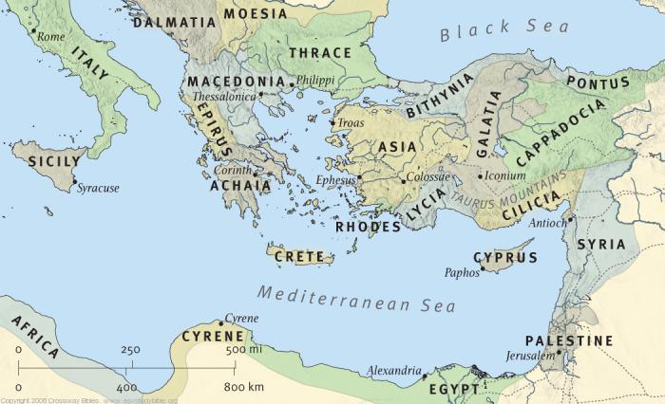
Jerusalem, Antioch, Philippi, Thessalonica, And Now Corinth

Slide 3
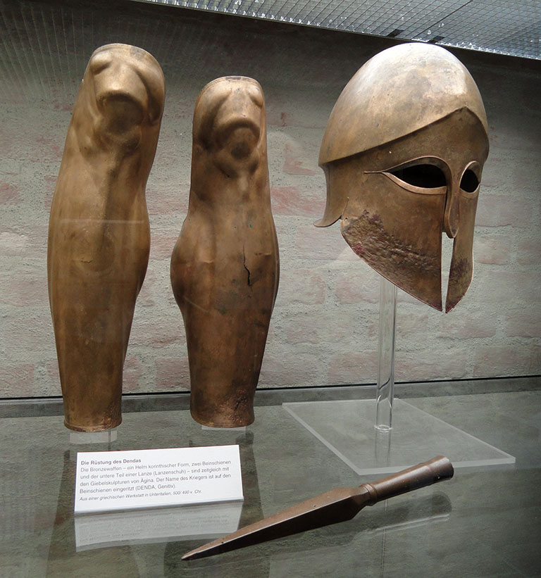
A Secular-Cultural History
“light of all Greece” (Pro lege man. 5)
“a certain corruption and degeneration of both morals and social institutions…” (Republic 2.7-9).
“bridge of the sea” (Nim. Odes VI.40)
Primarily Gentiles, but some Jews

Slide 4
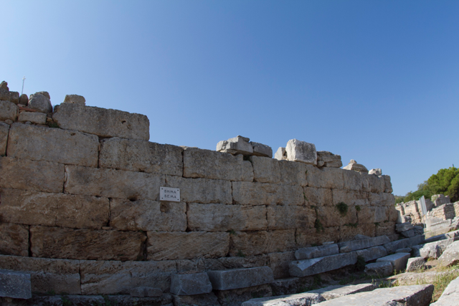
A Church-Biblical History
Started Like Any Other Church: With Preaching! (1Cor. 2:2; 15:1-4)
Conversion of Souls (Acts 18:8; 1Cor. 6:11)
Paul Received Assistance from Other Churches While Here (2Cor. 11:8f).

Slide 5
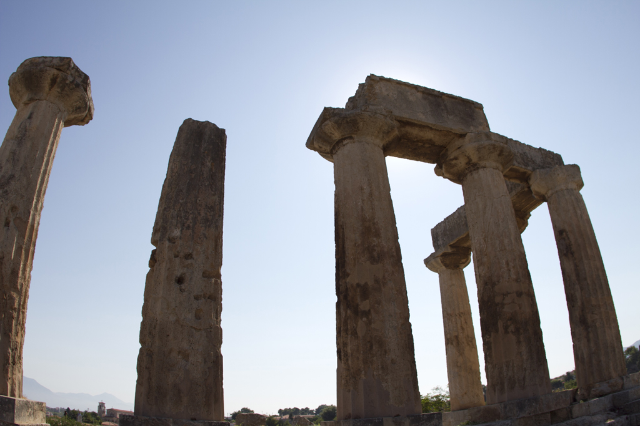
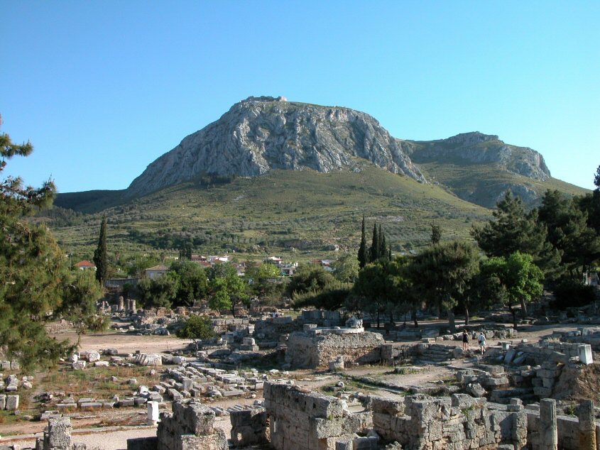
Corinth – Vices We Need To Avoid
Internal Division
Tolerance of Sin
Selfishness
Disorder
Self-Precedence
Lost Identity

Slide 6
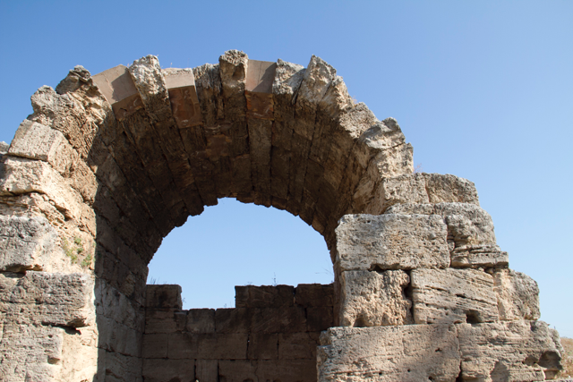
Corinth – Virtues We Need
They Were Teachable
They Were Responsive In Benevolence
They Strove For Loyalty

Slide 7
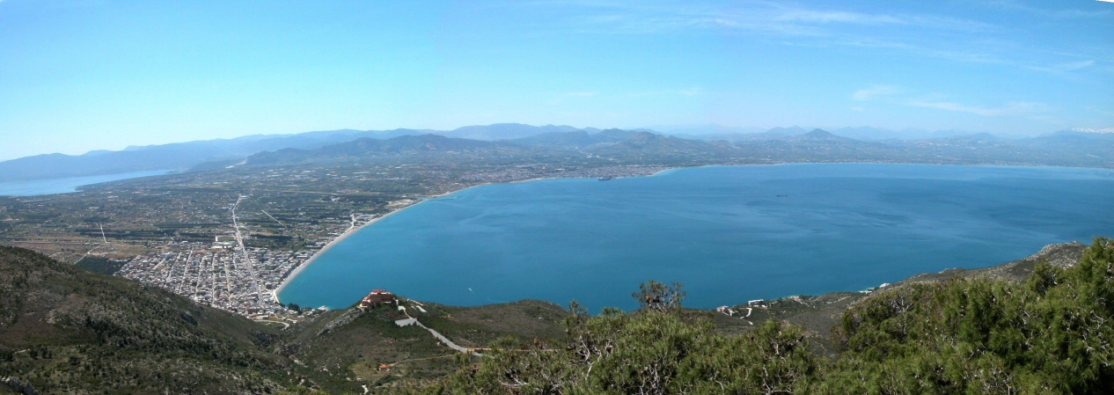
Two Final Exhortations:
Many of the errors at Corinth were corrected after Paul wrote to them. Let us see our vices and correct them.
This can be done if we obey the exhortations Paul gave them (1Cor. 15:58; 16:13f; 2Cor. 7:1).

