Slide 1
Churches Of The Past:
Thessalonica

Slide 2
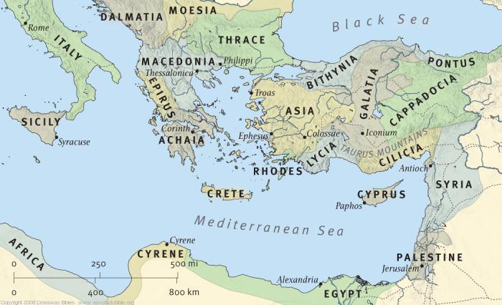
Jerusalem, Antioch, Philippi, And Now Thessalonica

Slide 3
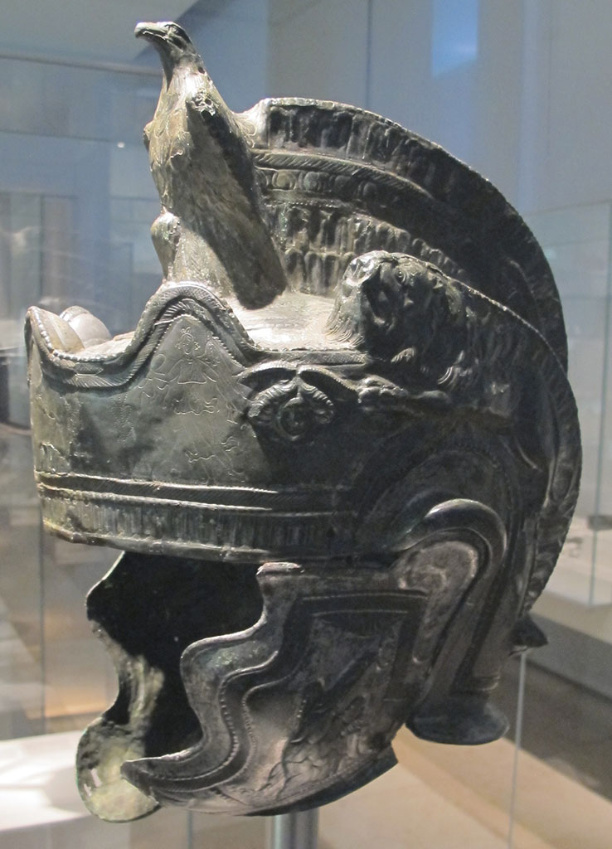
A Secular-Cultural History
Prominent city in Thessalonica named after step-sister of Alexander the Great
Granted status and privileges of a free city after demonstrating loyalty to Antony and Octavian (Pliny, NH, iv. 36)
Most populous town in Macedonia (Pliny, NH, vii. 323, 330)
Called the “Mother of all Macedon” by the poet Antipater (Jacobs, Anthol. Graec., II, p. 98, no. 14)
Called the greatest city of Macedonia (Lucian, Asinus, 46)
It was a harbor with large import/export trade and was the principle station on the Via Egnatia

Slide 4
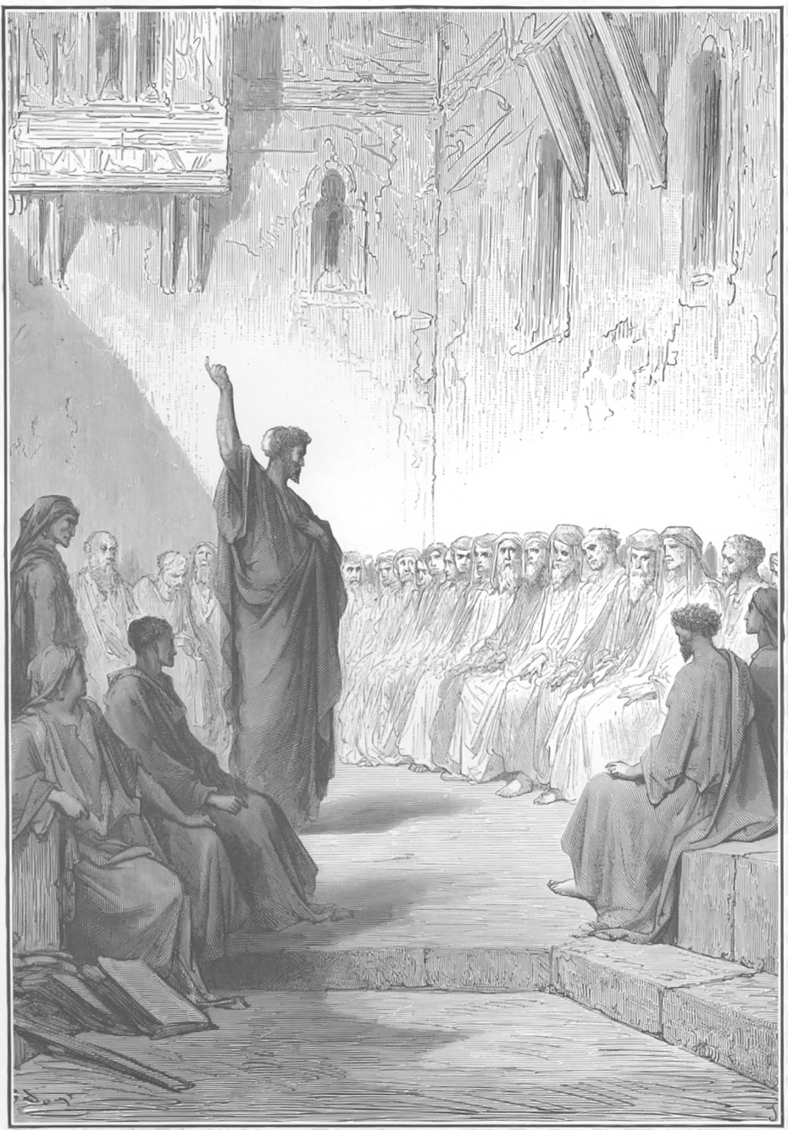
A Church-Biblical History
Started Like Any Other Church (Acts 17:2)
Preaching (Particularly the OT)
Miracles (1Thess. 1:5)
Conversion of Souls (Acts 17:4)
Primarily Pagan Gentiles (1Th. 1:9)
Few Jews from the Start. Why?
Early Problems
Jews Antagonize (Acts 17:5, 8, 10)
Paul Forced to Leave (2Th. 3:7-8)
The Church Didn’t Cease!

Slide 5
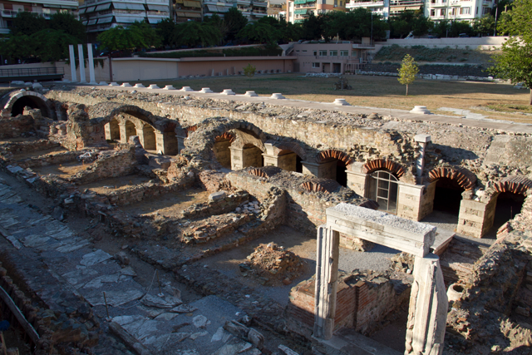
Character of the Church
A Church Worthy Of Commendation
A Church That Preached The Gospel
A Church That Suffered For The Gospel
A Church That Overcame With Faith And Love

Slide 6
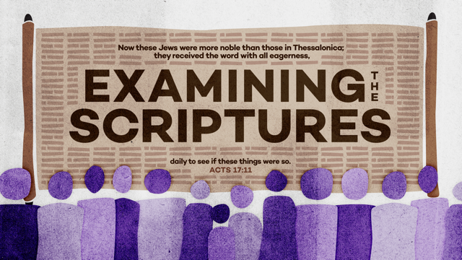
So Who Are You? The Decision You Make Now Will Determine Your Destiny! It Will Show Who You Really Are!

