Slide 1
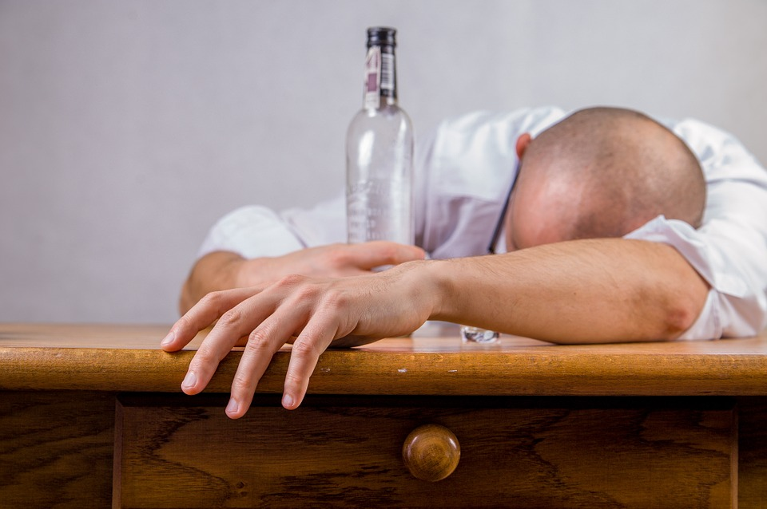
Undeniable Reasons Not To Drink

Slide 2
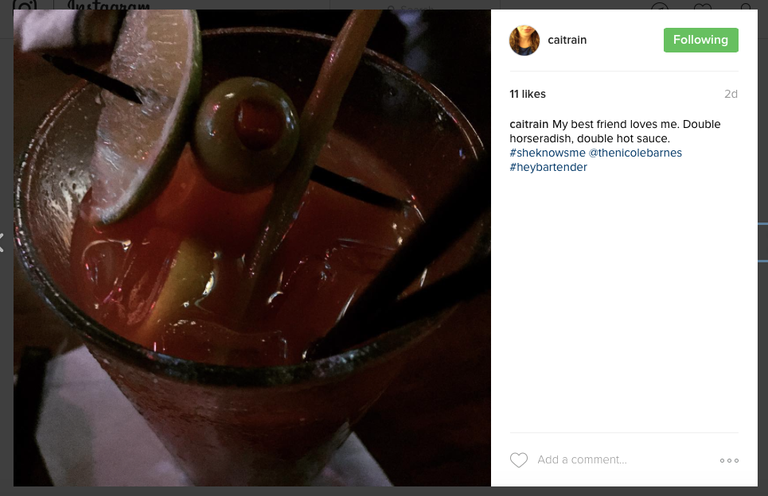
A Real Issue for Christians

Slide 3
God demands my sobriety
God is holy; drunkenness is not (1Pet. 4:1-3).
God’s command is clear (Rom. 13:13f).
God’s command makes great practical sense.
No drunkards enter God’s Kingdom (1Cor. 6:10f).
Alcohol doesn't help me run the race that Jesus has marked before me to finish with more accuracy. It does the polar opposite. If it could hinder my walk or dishonor the lordship of Jesus Christ, I need to forsake it.

Slide 4
My Family Needs My Sobriety
Physical Family:
Spiritual Family:
Show me a family for whom alcohol has made a positive difference in their lives.
Alcohol has ruined many, many marriages.
What I do in moderation, my children do in excess.
Don't want your teenagers to drink? Yep, same reasons apply to you.
My family to withdraw if I choose drunkenness
I don't want to make my brother/sister stumble in the name of exercising my "Christian liberties."
Alcohol is a waster!
If I don't start drinking, I'll never have to stop!

Slide 5
My Non-Christian Friends Need My Sobriety
1Pet. 4:3-5 –Non-Christians should be shocked!
Alcohol severely tarnishes my evangelism (1Tim. 5:14; 6:1; et al).
Even the unsaved know I shouldn't drink. Bible in one hand, beer in the other—any lost person could point this out as a confusing contradiction. I have never heard anyone say, "Wow, that gin and tonic made me feel so Christ-like!”
I want to avoid all appearances of evil. Alcohol doesn't bring others closer to the Lord when they see me drinking, but further away. When the world sees us drinking, it sends the message that Jesus isn't enough (cf. Rom. 12:2).
If Christians are told not to associate with drunkards (1Cor. 5:11), how much more should we be sober to influence those outside the church?

Slide 6
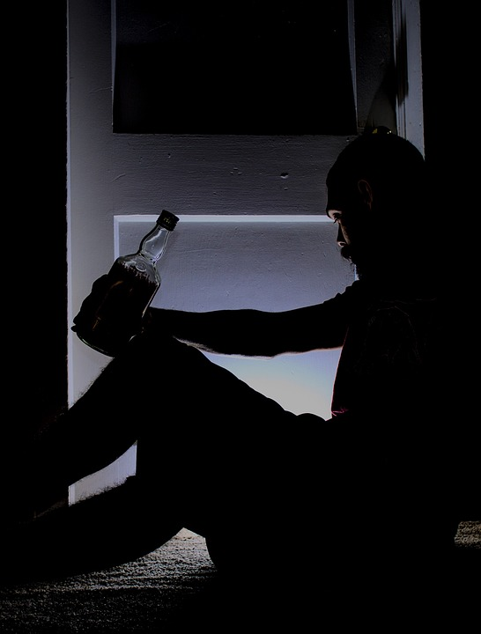
My Life Is Better Overall With Sobriety
Alcohol has one assignment: destruction.
Alcohol pretends to be that which it is not.
Alcohol leaves me worse, not better
No one has ever said, "If only I had taken a drink, things wouldn't have gotten out of control."

Slide 7
Who has woe? Who has sorrow? Who has contentions? Who has complaining? Who has wounds without cause? Who has redness of eyes? Those who linger long over wine, Those who go to taste mixed wine. Do not look on the wine when it is red, When it sparkles in the cup, When it goes down smoothly; At the last it bites like a serpent And stings like a viper. Your eyes will see strange things And your mind will utter perverse things. And you will be like one who lies down in the middle of the sea, Or like one who lies down on the top of a mast. “They struck me, but I did not become ill; They beat me, but I did not know it. When shall I awake? I will seek another drink.” (Proverbs 23:29-35)

