Slide 1
Churches Of The Past:
Ephesus

Slide 2
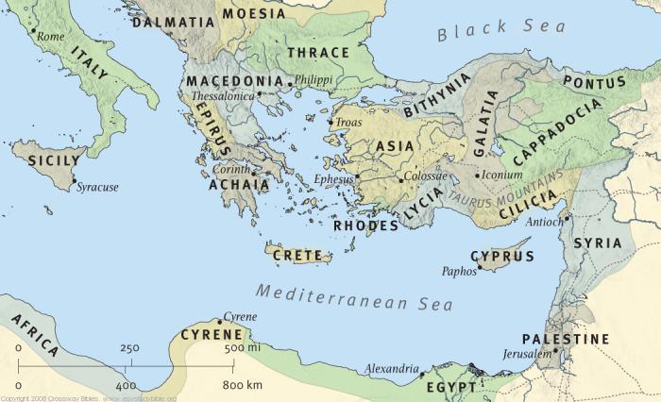
Jerusalem, Antioch, Philippi, Thessalonica, Corinth, & Ephesus

Slide 3
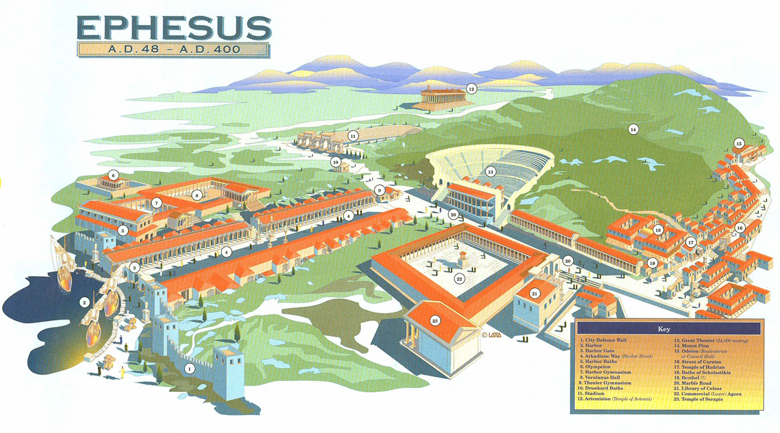

Slide 4
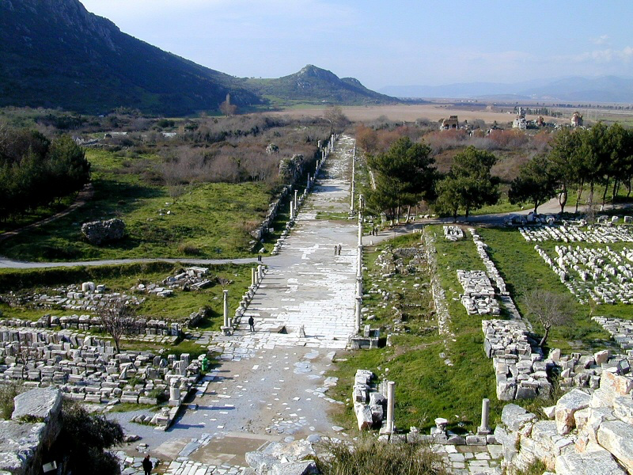
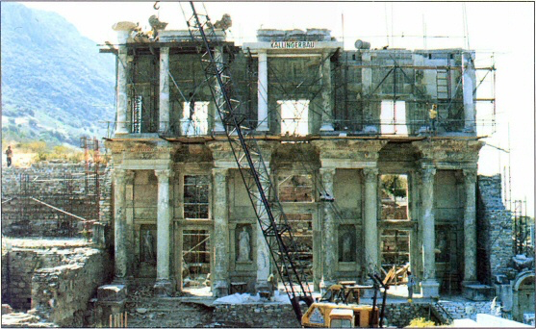
A Secular-Cultural History
Most important city of Asia Minor
Built on a natural harbor (Pliny the Elder)
Largest commercial center W of Taurus mountains (Strabo)

Slide 5
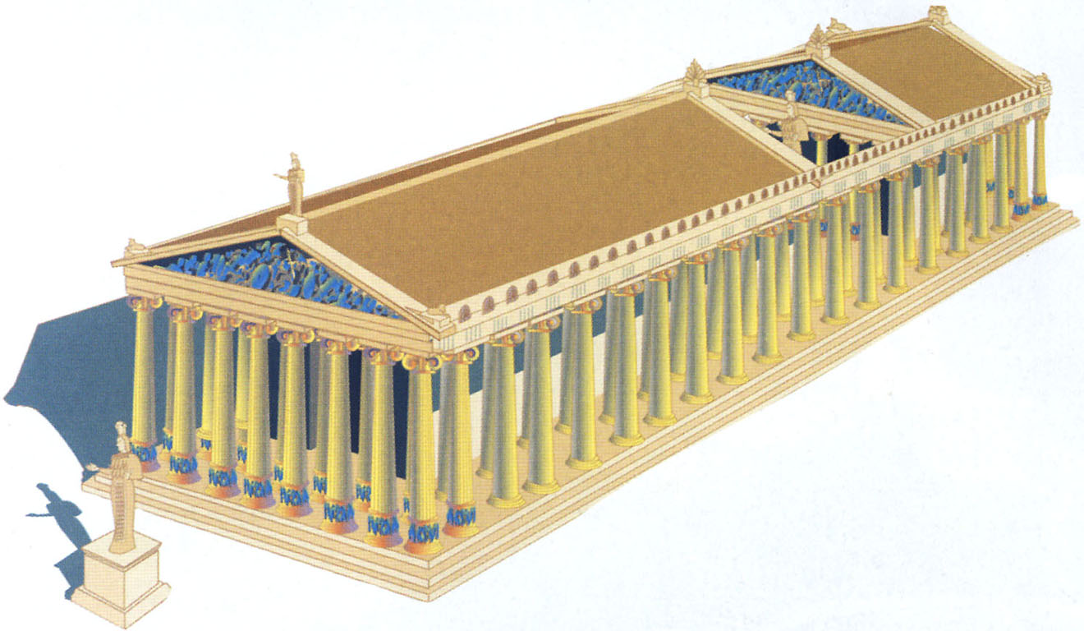
A Secular-Cultural History
Temple of Artemis/Diana
Largest Edifice In Hellenistic World
1st Of A Large Scale To Be Constructed Entirely Of Marble
Ancient Wonder

Slide 6
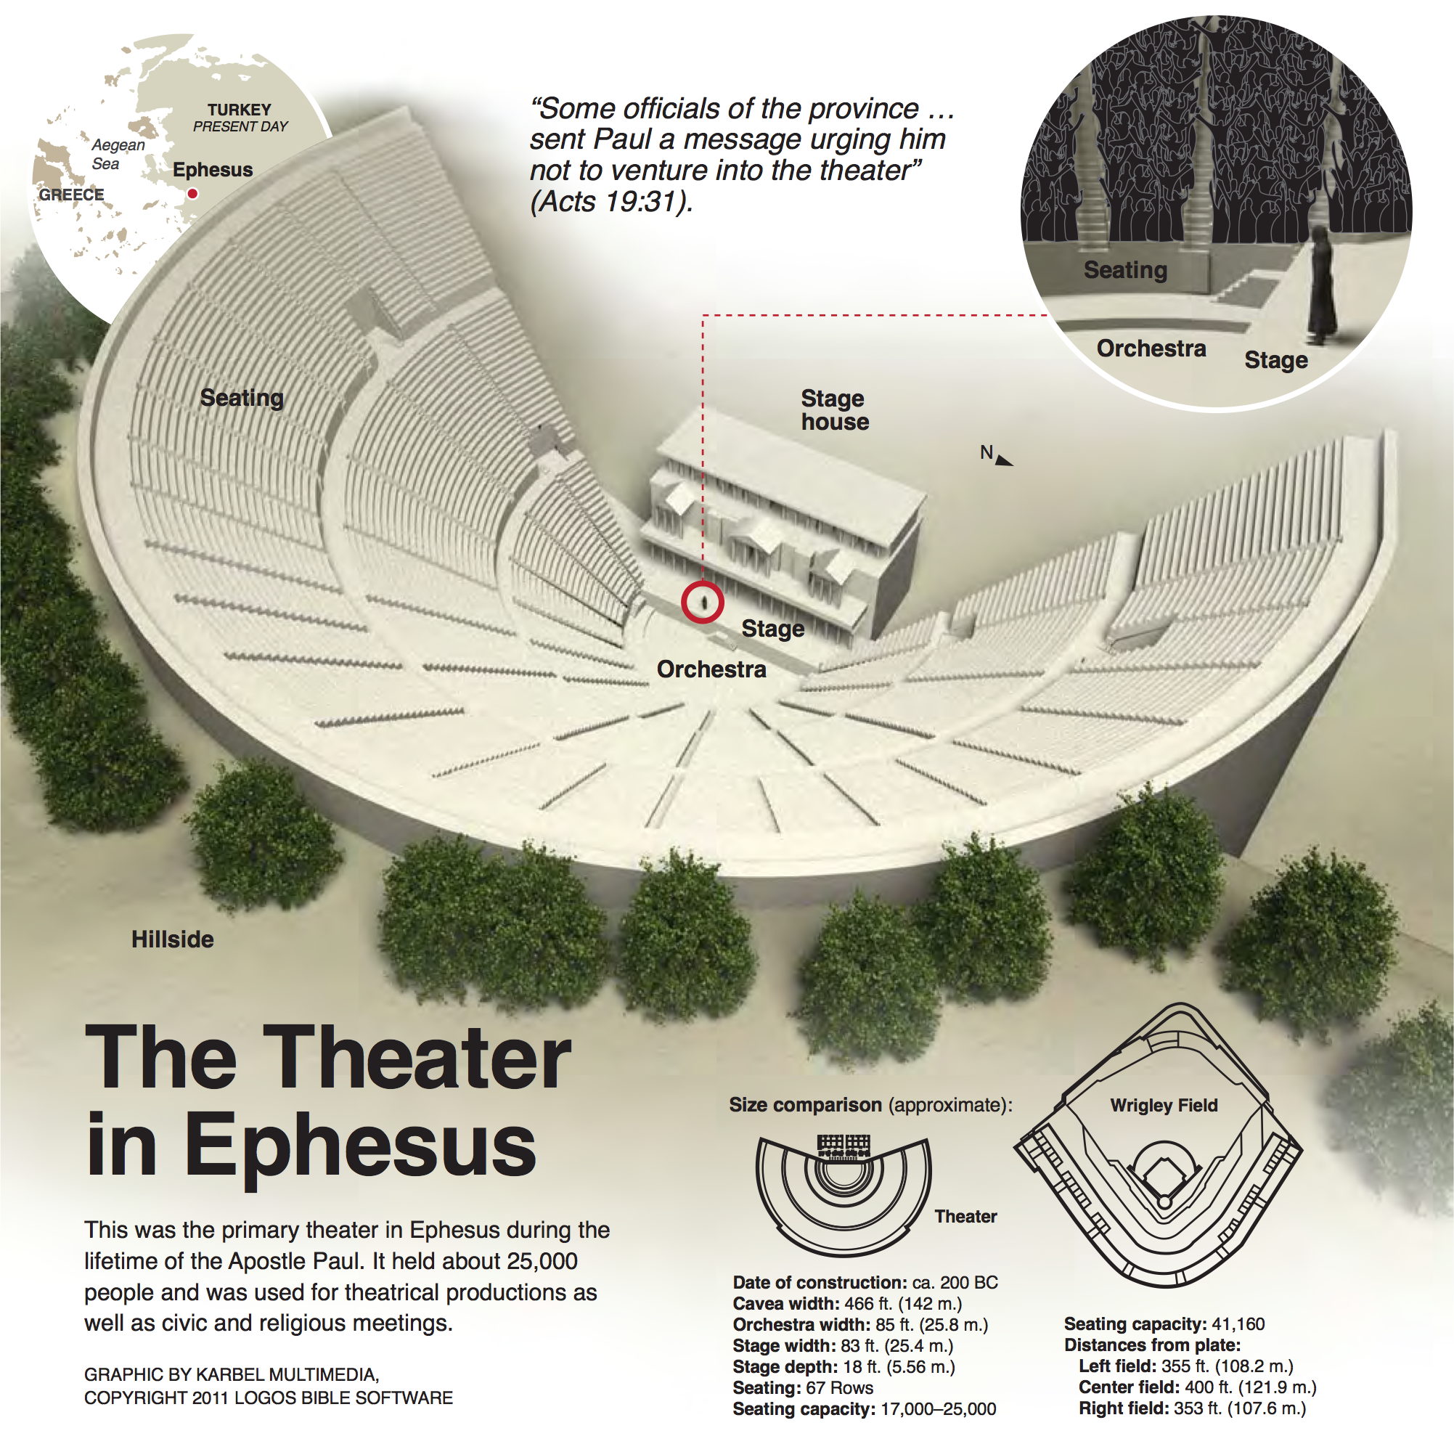
A Secular-Cultural History
The Theater

Slide 7
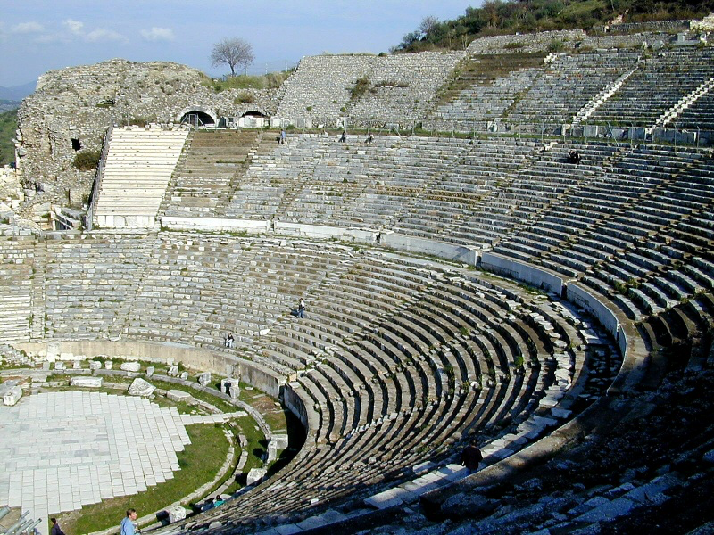
A Secular-Cultural History
The Theater

Slide 8
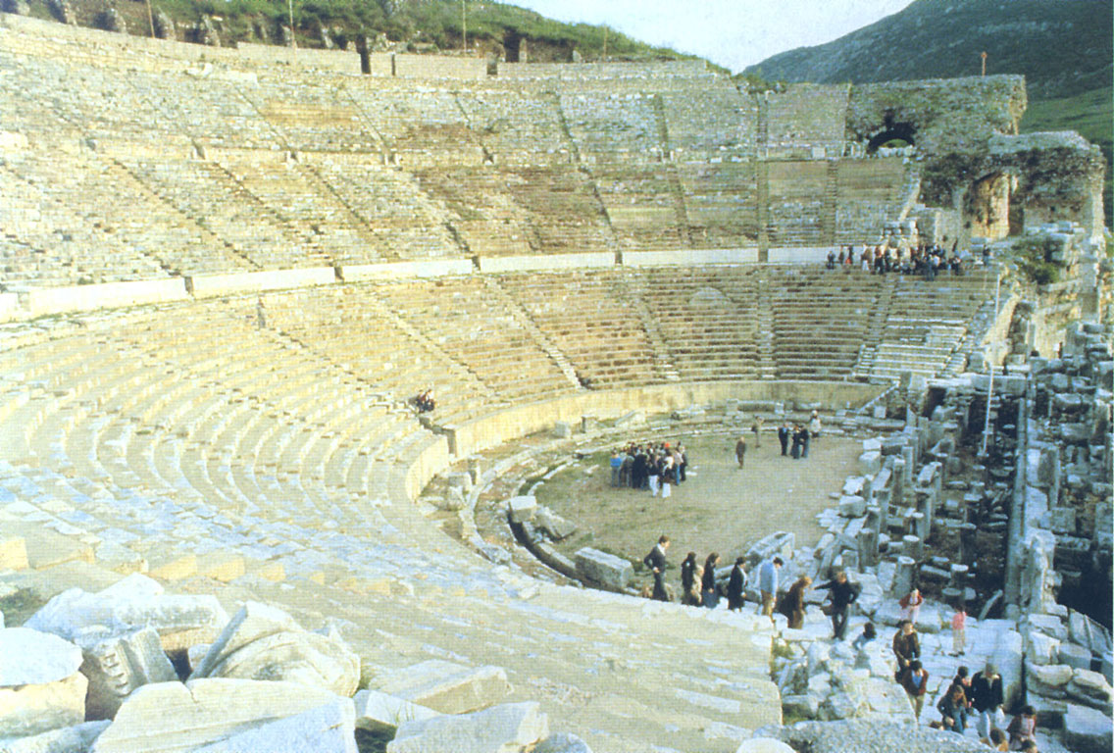
A Secular-Cultural History
The Theater

Slide 9
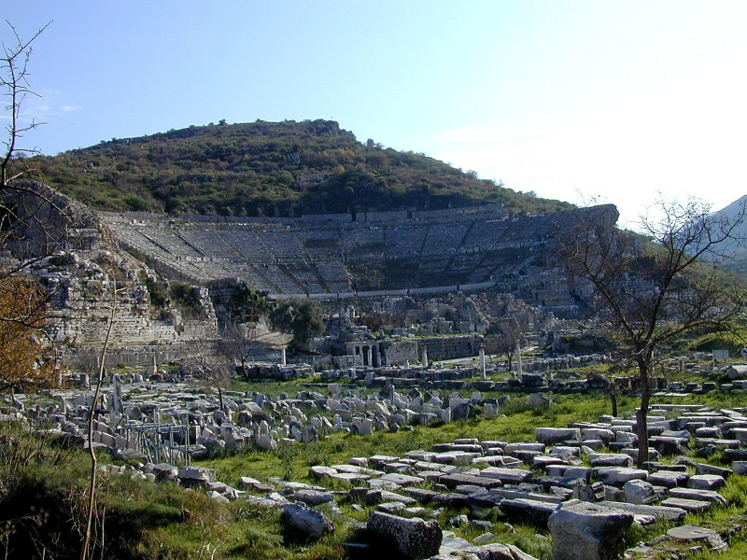
A Secular-Cultural History
The Theater

Slide 10
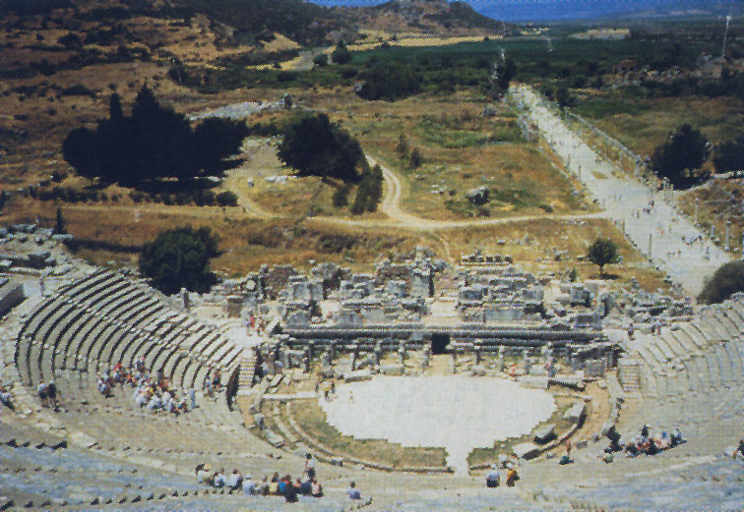
A Secular-Cultural History
The Theater

Slide 11
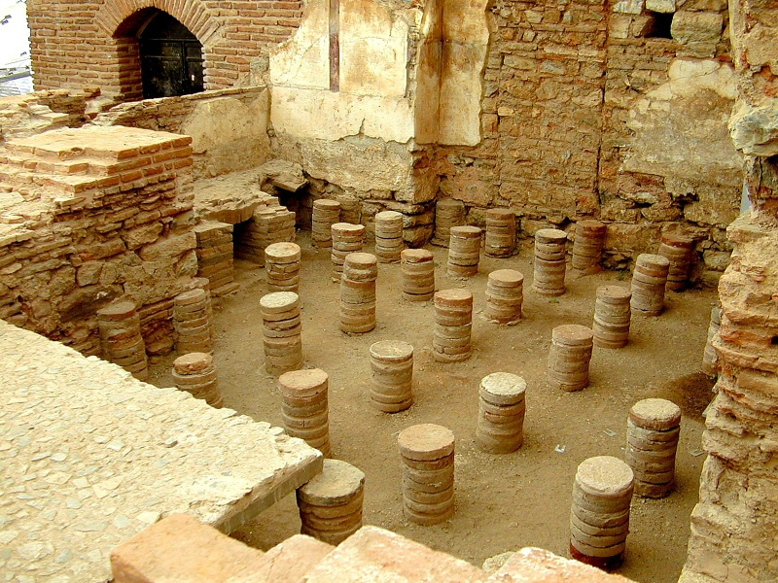
A Church-Biblical History
The 2nd Preaching Tour
The 3rd Preaching Tour
Paul’s Preaching for Three Years
The Results

Slide 12
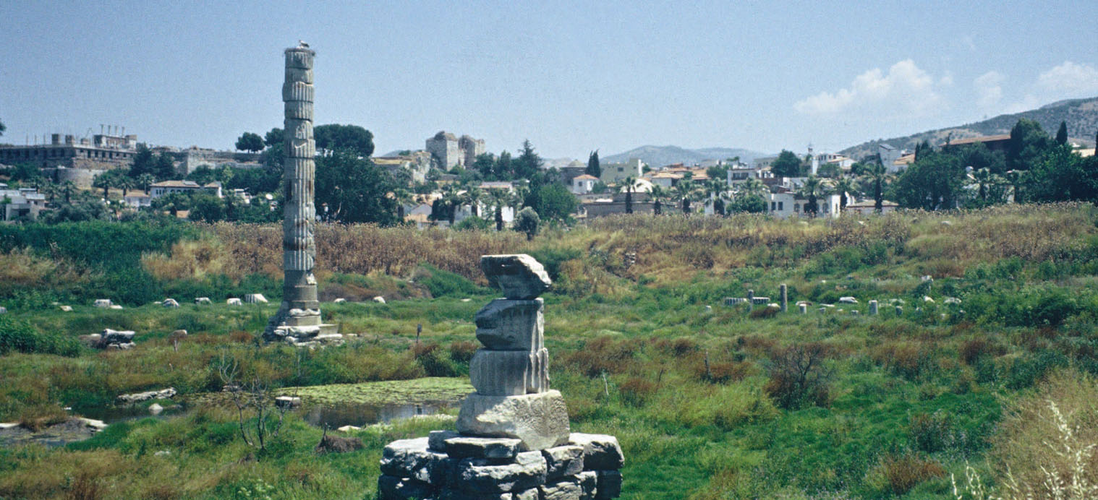
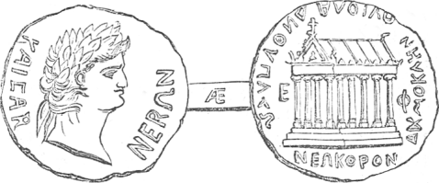
Character of the Church
Strong Conviction
Diligent in Study
Didn’t Tolerate Evildoers
Severe w/ Heretics, Tender w/Paul
Evangelistic
Imperfect/Faulted

Slide 13
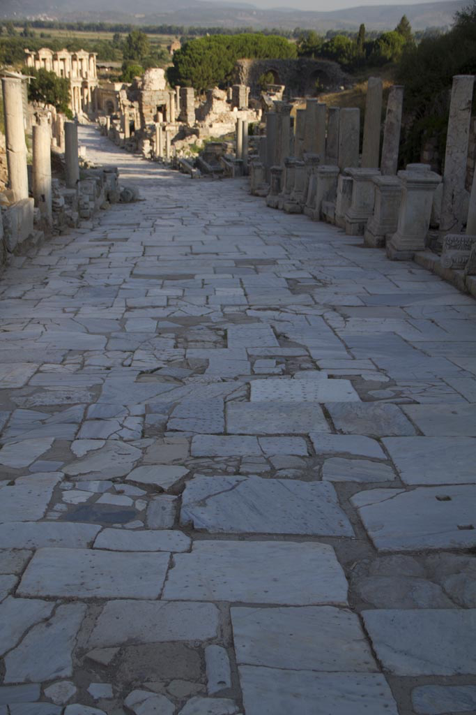
Final Exhortations:
Help The Poor And Weak (Acts 20:35).
Walk Worthy Of Our Calling (Eph. 4:1; Titus 2:11f; Rev. 2:10).
Take Up The Armor Of God (Eph. 6:11).
When In Sin, Repent And Do The First Works (Rev. 2:5).

