Slide 1
Divine Foreknowledge

Slide 2
The Foreknowledge of God
Can God foreknow the future?
Prophecies prove that He can! (Is. 53)
Does God choose not to know the future? (Jer. 7:31; 32:35)
The question of whether or not God chooses to foreknow all things is moot, but statements establish the fact of foreknowledge (Acts 2:23).

Slide 3
The Freedom of Man
Since God can know the future, is man at liberty in those things? Man does not have unlimited freedom, but he does have freedom.
Judas is often used to show that men have no choice. However, Judas himself recognized his responsibility (Matt. 27:3-4).

Slide 4
Harmonizing The Two
Some maintain that man does not know how to harmonize them.
Some have argued that God can change His mind (cf. 2Kgs. 20; Is. 38:1-5).

Slide 5
Example 1: Pharaoh
The Hardening of Pharaoh’s Heart In Exodus
God | 4:21 | 7:3 | 9:12 | 10:1 | 10:20 | 10:27 | 11:10 | 14:4 | 14:8
Pharaoh | 8:15 | 8:32 | 8:34
Unclear | 7:13 | 7:22 | 8:19 | 9:35

Slide 6
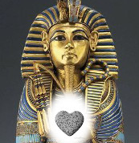
Example 1: Pharaoh
Pharaoh freely chose to reject God (Ex. 4:22-23).
God’s acts are always consistent with His principles of conduct. God must be right.

Slide 7
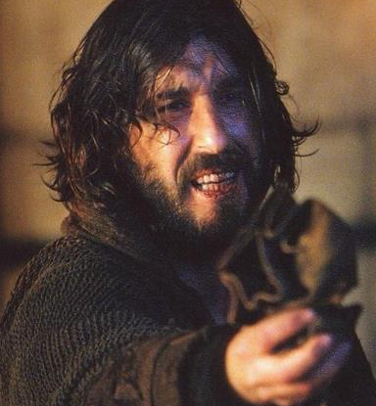
Example 2: Judas
Did Judas ever even have a chance?
Was he predestined to damnation?
Only in the sense that God has determined that all who die in their sins will be lost.

Slide 8
You must make a choice. God has not determined your choices for you. No one is responsible for the choices you make but yourself. Why not accept the gospel of Christ? (James 3:10)

