Slide 1
Churches Of The Past:
Philippi

Slide 2
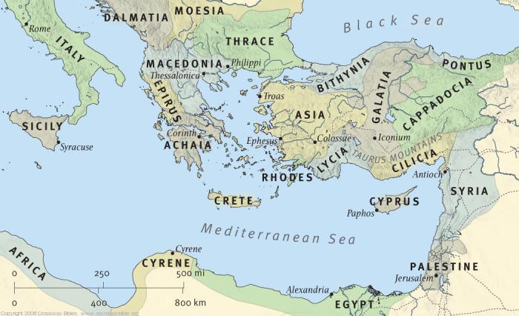
A Secular-Cultural History
Roman Colony
Location on the Via Egnatia
Battles, Soldiers, Gentiles

Slide 3
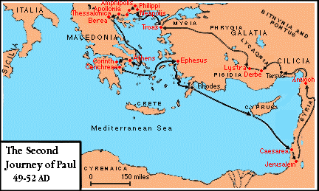
A Church-Biblical History
The 1st Known Church in Europe
Second Missionary Journey
Conversions of Lydia and the Jailor

Slide 4
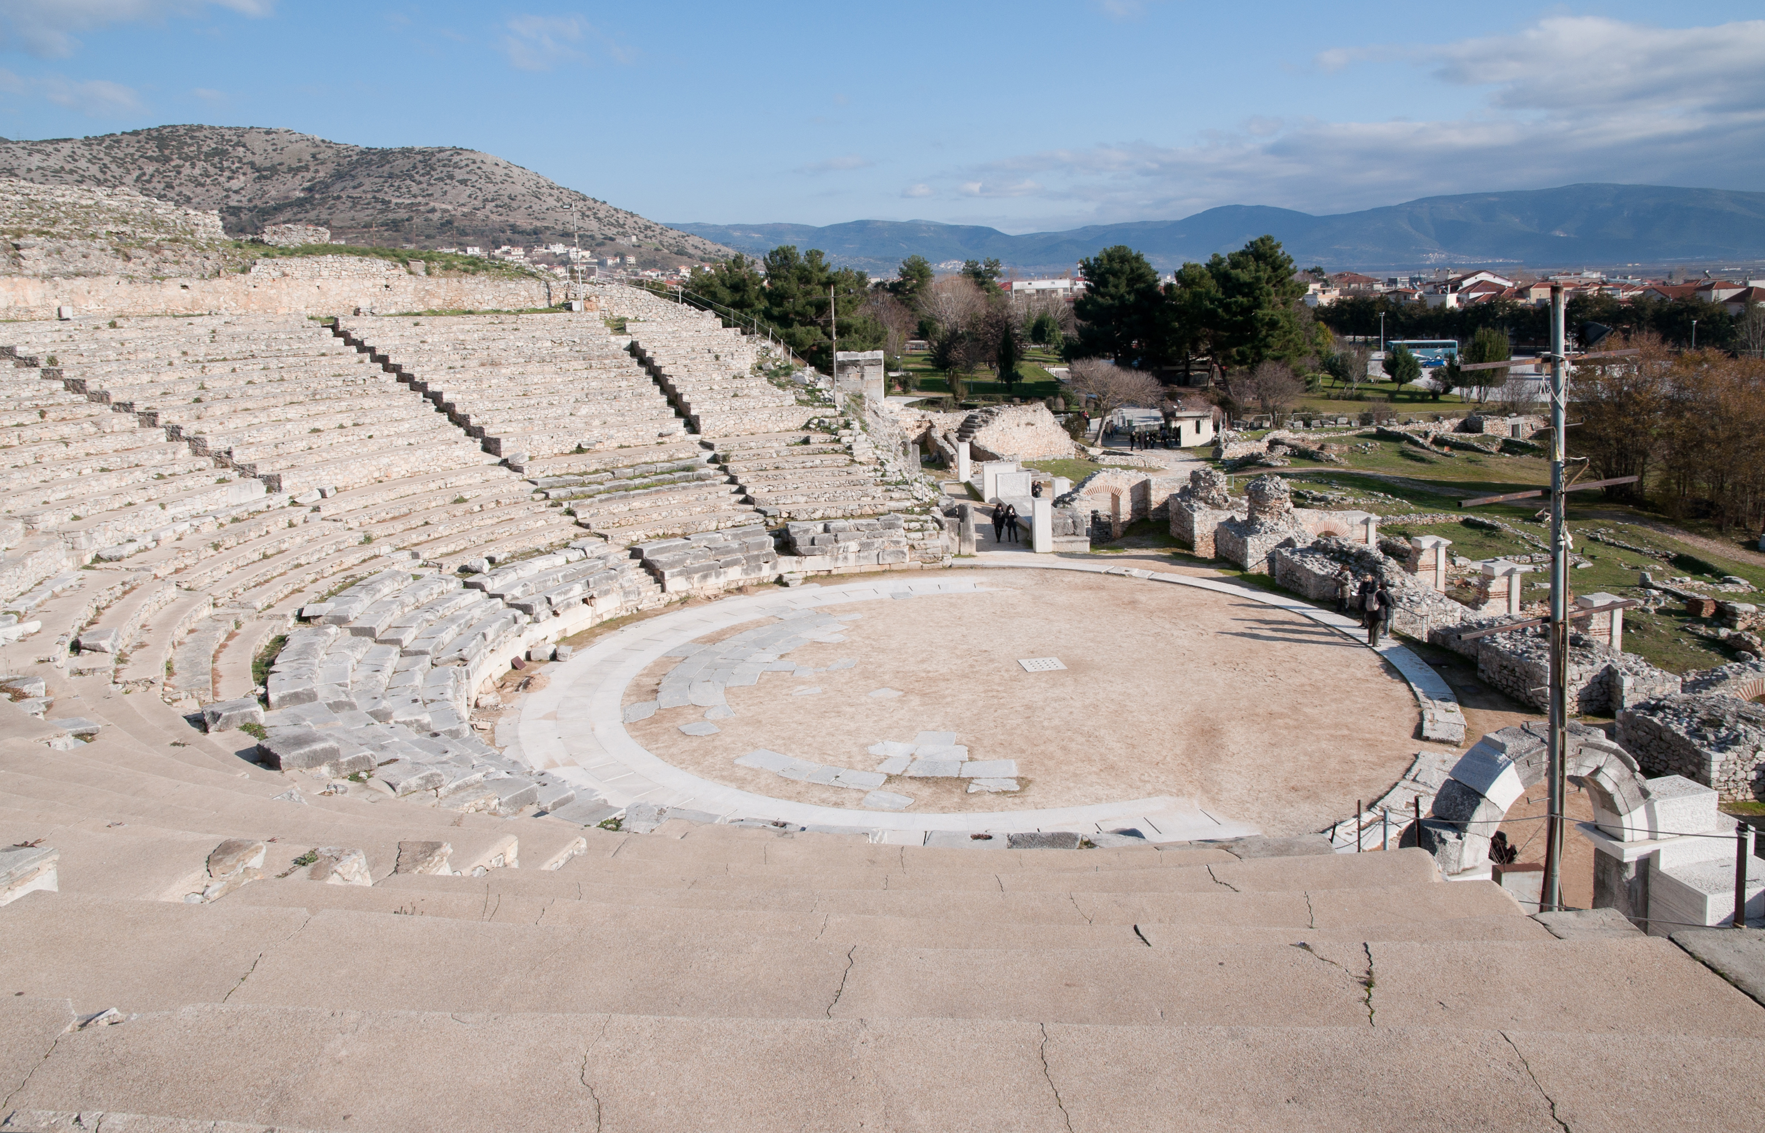
Character of the Church
A Church Worthy of Thanksgiving
A Church of Liberal Givers
An Evangelistic Church
A Church Worthy of Confidence

Slide 5
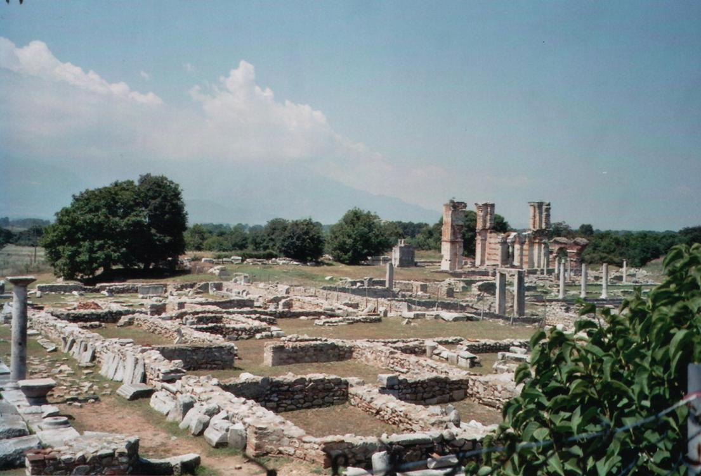
Character of the Church
A Consecrated Church
A Church with Strong Ties of Unity
An Organized and Functional Church
A Happy Church

Slide 6
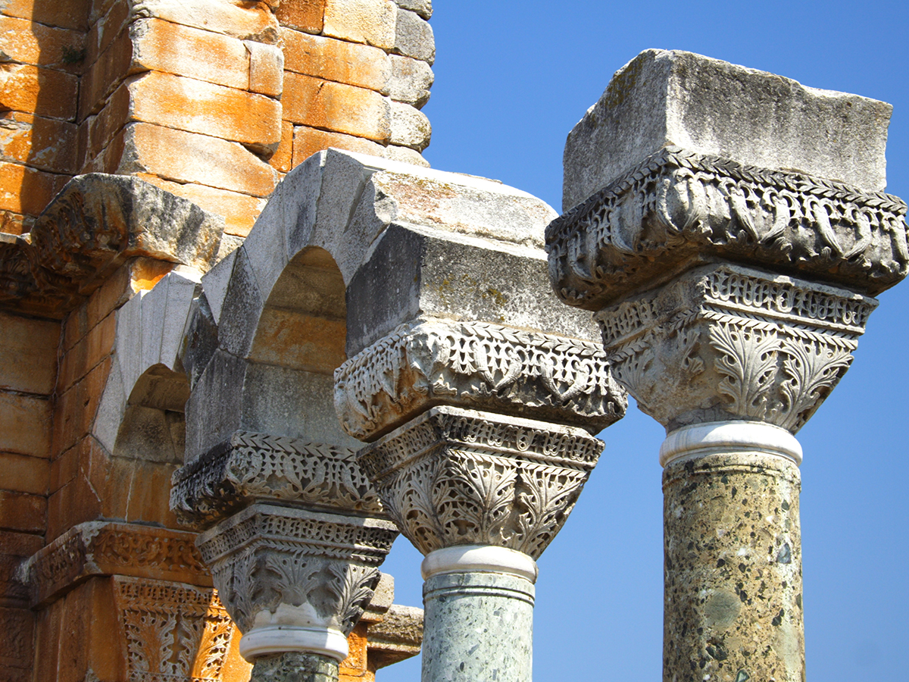
Paul Enjoins Them
Every church needs more teaching and admonition.
Admonitions to Philippi:
Paul’s Prayer (1:9-11)
Unity &Humility (2:1-4)
Salvation (2:12-16)
Confidence (3:3)
Purity of Thought (4:8-9)

