Slide 1
Too Proud To Receive

Slide 2
Pride Shutters The Mind
Resistance To The Word
Scribes And Pharisees
Patterns, Preconceptions, Prejudices

Slide 3
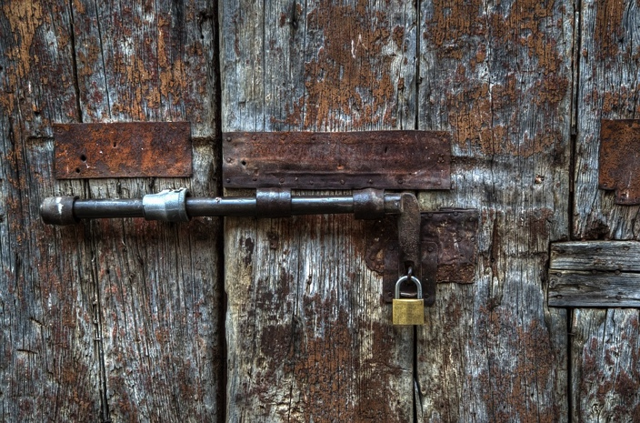
Pride Locks The Heart
Pride Makes Prisoners
The Grace Of Humility

Slide 4
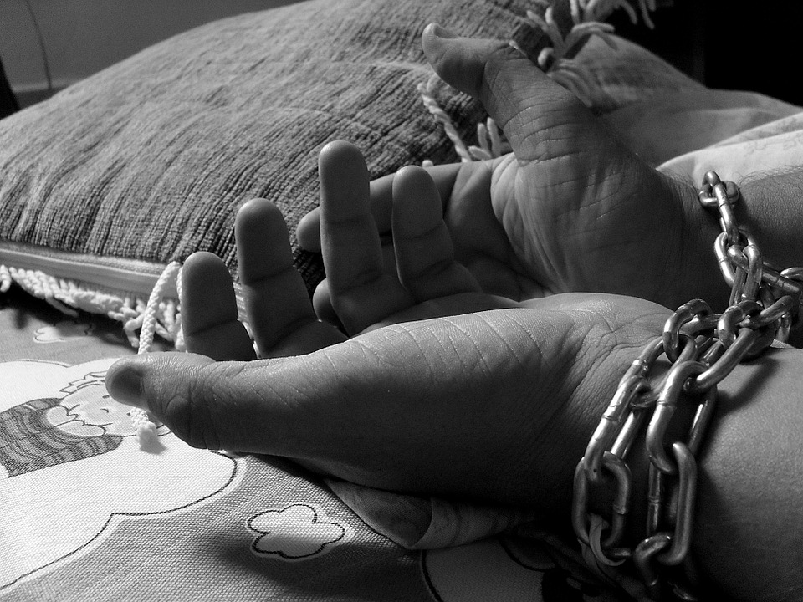
Pride Weakens The Hand
The Desire For Power Is Part Of Life’s Motivation
The Poor In Spirit Have A Sense Of Stewardship

Slide 5
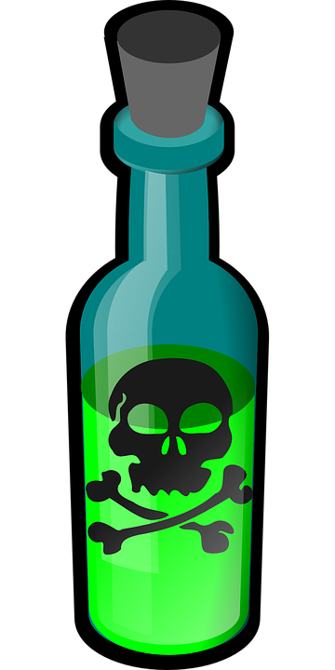
Pride Corrupts The Conscience (I)
Pride Poisons Even Our Virtues
The Pharisee And Publican
Pride is so dementing, it is able to train our consciences to judge others in need as being unworthy of service and it can even cause us to be unwilling to accept service ourselves!

Slide 6
Pride Corrupts The Conscience (II)
“People are illogical, irrational & self-centered!”
Love them anyway!
“If you do well, people will accuse you of selfish ulterior motives!”
Do well anyway!
“The good you do today will be forgotten tomorrow!”
Do good anyway!

Slide 7
Pride Corrupts The Conscience (III)
“Honesty & frankness make you vulnerable!”
Be honest anyway!
“People really need help, but may attack you if you do help them!”
Help them anyway!
“Give the world the best you have & you’ll get kicked in the teeth!”
Give the world the best you have anyway!

Slide 8
Pride Corrupts The Conscience (IV)
“They offered to help me in the past and never showed up!”
Give them another chance anyways!
“Their help in the past didn’t help the situation or made things worse!”
Let them help anyways!
“They need more help than I do!”
Allow them to help anyways!

Slide 9
The poor in spirit have no pride to shutter their mind, to lock their heart, to weaken their hands, or to corrupt their conscience. They thus obey (Mark 16:16; Acts 2:38).

