Slide 1
Marriage & Its Responsibilities

Slide 2
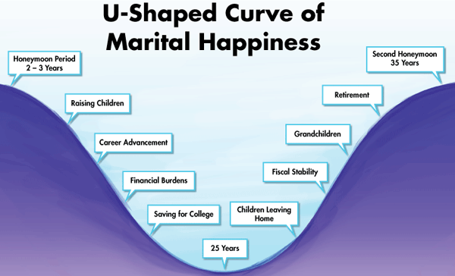

Slide 4
Reasons for Getting Married
Complementation (Gen. 2:18)
Biological Satisfaction (1Cor. 7:2-3)
Physiologically
Psychologically
Mentally
Emotionally
Attitudinally

Slide 5
Husband’s Responsibilities
Love (Eph. 5:25)
Physicality (1Cor. 7:3)
Headship (Eph. 5:23)
No Bitterness (Col. 3:19)
Honor Wife (1Pet. 3:7)
Provision (1Tim. 5:8)

Slide 6
Wife’s Responsibilities
Love (Titus 2:4-5)
Physicality (1Cor. 7:3)
Subjection (Col. 3:18)
Reverence (Eph. 5:33)
Keep House (Titus 2:15)

