Slide 1
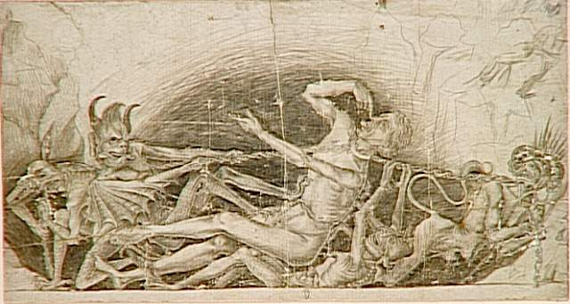
Demons, Possession, & Their Work Today

Slide 2
C.S. Lewis, The Screwtape Letters, Preface
“There are two equal and opposite errors into which our race can fall about the devils. One is to disbelieve in their existence. The other is to believe, and to feel an excessive and unhealthy interest in them. They themselves are equally pleased by both errors and hail a materialist or a magician with the same delight.”

Slide 3
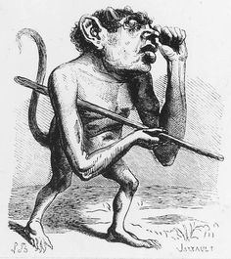
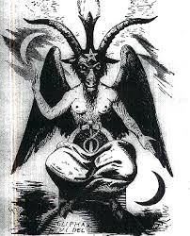
What Are Demons?
Etymology?
Origin?
Danger In Dogmatism
Immaterial, Intelligent
Malignant
Possessed Fear

Slide 4
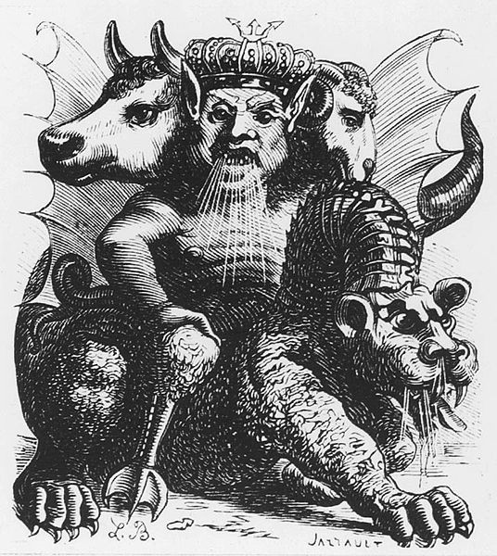
Bible Demon Possession
Agents Of Satan
Brought On Diseases (Sometimes)
Showed Itself Visibly/ Discernable By All
Why So Much Freedom?

Slide 5
Do Demons Still Possess People Today?
NO! However, demons are still very much active!

Slide 6
Ephesians 6:10-18
“...Put on the full armor of God, so that you will be able to stand firm against the schemes of the devil. For our struggle is not against flesh and blood, but against the rulers, against the powers, against the world forces of this darkness, against the spiritual forces of wickedness in the heavenly places. Therefore, take up the full armor of God, so that you will be able to resist in the evil day...taking up the shield of faith with which you will be able to extinguish all the flaming arrows of the evil one...”

Slide 7
What Does This Look Like?
On A Personal Level
On A Religious Level
Distraction
Manipulation (2Cor. 11:13-15)
Psycho-Cognitive (2Cor. 10:3-5; 11:3; 2Tim. 2:24-26; Jms. 4:13-16)
Physical-Sexual (Gal. 5:1, 13, 17; Eph. 2:1-3; 1Pet. 4:1-5; Rom. 6)
Emotional (James 3:15; Eph. 4:26; James 4:1-4; 1Cor. 15:33; 2Cor. 5:7)
False Ideas Regarding Church, God, & Spirituality (Rev. 16:14; 2Th. 2:9)
False Religion (2Cor. 11:4; Gal. 1:6-9; 1Tim. 4:1; Lev. 17:17/Dt. 32:17; 1Cor. 10:20f; Rev. 9:20)

Slide 8
“The recent fascination with Satan and demons is in reaction to an earlier disbelief. Christians should beware of excessive gullibility as well as extreme oversimplification. Knowledge about Satan and evil angels will alert us to the danger and subtlety of satanic temptation. We should not become too absorbed in satanic forces. Satan and demonic forces are active, but they are limited. We must remember that the main thrust of Christianity is on the availability of God’s power to deliver us.” A Study of Demons, Bill Mcllvain, 1996, page 5

