Slide 1
Is Belief In God Reasonable?
Anthropic Constants

Slide 2
“For thus says the Lord, who created the heavens (He is the God who formed the earth and made it, He established it and did not create it a waste place, but formed it to be inhabited), ‘I am the Lord, and there is none else. I have not spoken in secret, in some dark land...’” (Isaiah 45:18-19)

Slide 4
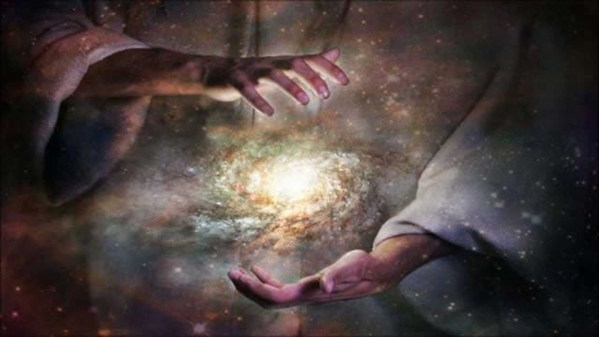

Slide 5
Anthropic constants are HIGHLY PRECISE and INTERDEPENDENT environmental conditions that make life possible.

Slide 6
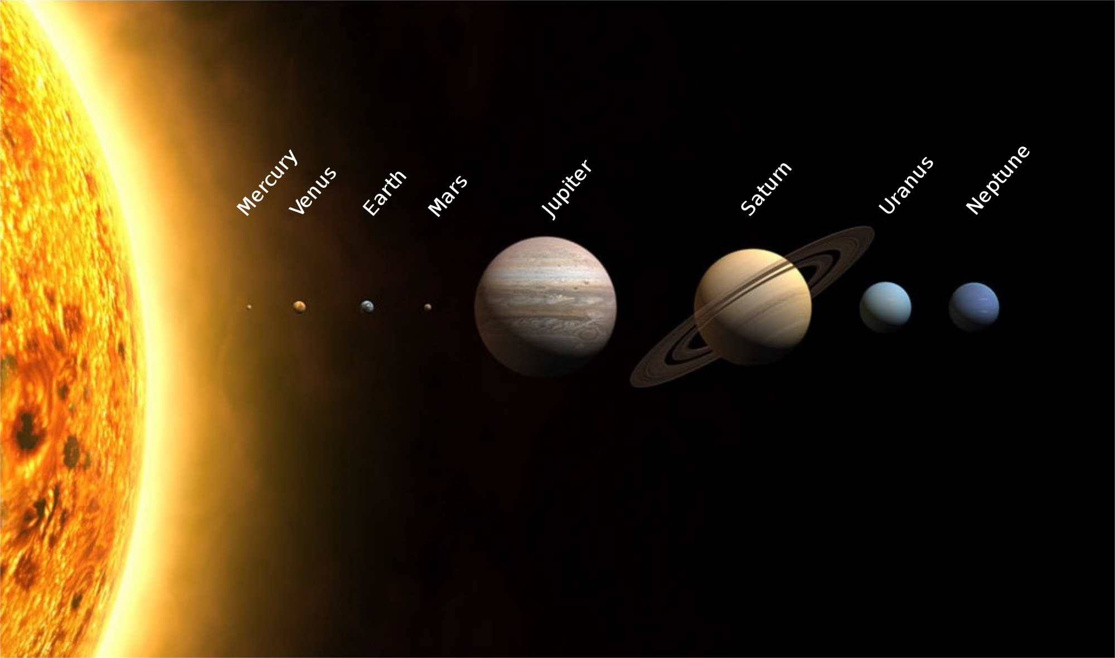
Our Designed Solar System
Key Passages: Genesis 1:14-19; Colossians 1:16-17

Slide 7
Illustrations (Job 26:7)
If gravitational force were different by 0.000000000000000000- 00000000000000000001% then our sun would not exist.
Position Of The Celestial Bodies & Their Gravity
Interplay Between Planetary Centrifugal Force & Planetary Gravitational Force
The Speed Of Light
Strong And Weak Nuclear Forces

Slide 8
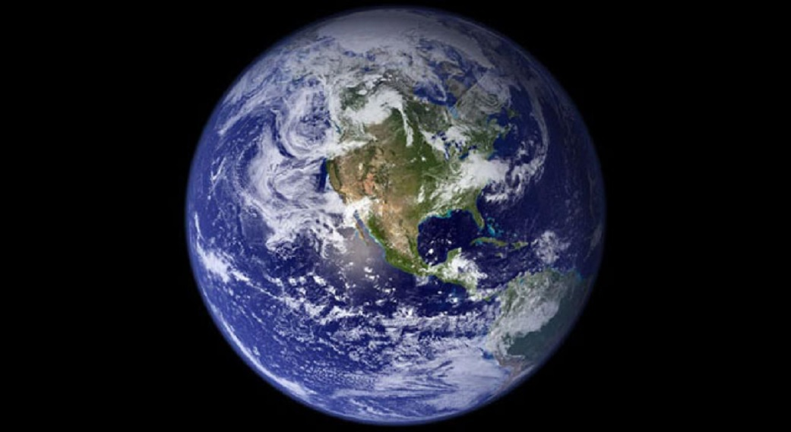
Our Designed Earth
“The heavens are the heavens of the Lord, but the earth He has given to the sons of men.” (Ps. 115:16)

Slide 9
Illustrations:
Time Of Earth’s Rotation (Ps. 19:4-6; Eccl. 1:5)
Tilt Of The Earth (Ps. 104:5; Prov. 8:29; Is. 40:21)
The Thickness Of Earth’s Crust (Job 38:4; Ps. 18:7)
Seismic Activity (Job 9:5f; Ps. 60:2; Nah. 1:5)

Slide 10
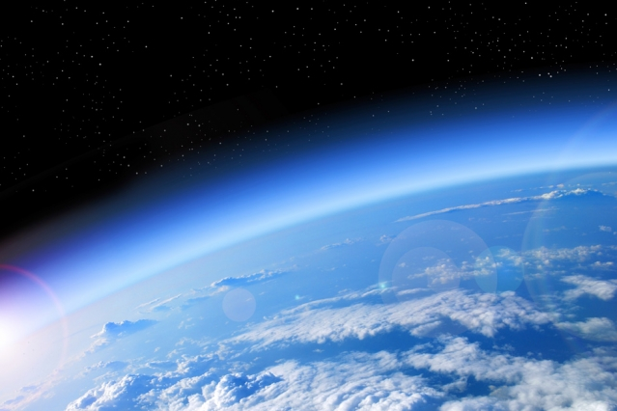
Our Designed Atmosphere
Key Passage: Genesis 1:6-8

Slide 11
Illustrations:
Atmospheric Transparency (Ps. 104:2; Is. 40:22)
Atmospheric Composition (Gen. 2:7; Ps. 150:6)
Atmospheric Water Vapor Levels (Gen. 1:6-8; Job 36:29; 2Pet. 3:5)
Atmospheric Discharge Rate (Ps. 135:7//Jer. 10:13; 51:16; Job 28:26; 36:30, 32; 37:3f, 11, 15; 38:35)

Slide 12
“Here is cosmological proof for the existence of God—the design argument of Paley—updated and refurbished. The fine-tuning of the universe provides prima facie evidence of deistic design.” (Cosmologist Ed Harrison)

Slide 13
“Although Jesus Christ existed in the form of God, He did not regard equality with God a thing to be grasped, but emptied Himself, taking the form of a bond-servant, and being made in the likeness of men. Being found in appearance as a man, He humbled Himself by becoming obedient to the point of death, even death on a cross. For this reason also, God highly exalted Him, and bestowed on Him the name which is above every name, so that at the name of Jesus every knee will bow, of those who are in heaven and on earth and under the earth, and that every tongue will confess that Jesus Christ is Lord, to the glory of God the Father.” (Phil. 2:6-11)

