Slide 1
Is Belief In God Reasonable?
The Designed Man

Slide 2
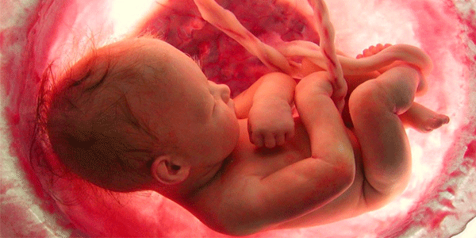
“For You formed my inward parts; You wove me in my mother’s womb. I will give thanks to You, for I am fearfully and wonderfully made; wonderful are Your works, and my soul knows it very well. My frame was not hidden from You, when I was made in secret, and skillfully wrought in the depths of the earth; Your eyes have seen my unformed substance; and in Your book were all written the days that were ordained for me, when as yet there was not one of them.” (Ps. 139:13-16)

Slide 3
Appreciation For The Body
“The information content of the human brain...would fill some twenty million volumes, as many as in the world’s largest libraries. The equivalent of twenty million books is inside the heads of every one of us. The brain is a very big place in a very small space...The circuitry of a machine more wonderful than any devised by humans.” (Carl Sagan)

Slide 4
Appreciation For The Body
Rudolf Virchow, M.D., called the human body “the most miraculous masterpiece of nature” and called it “a pleasure to study...and to learn about the smallest vessel and the smallest fiber.”

Slide 5
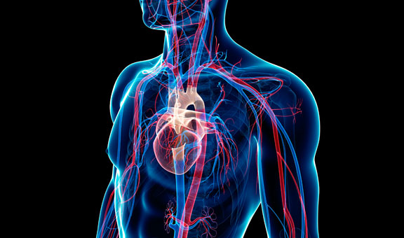
Appreciation For The Body
“Your body is a complete marvel. The more you study its anatomy and how each part works in harmony, the more you will be convinced that you didn't just evolve. You were designed from the beginning by the hand of a Master.” (Toni Sorenson Brown)

Slide 6
Darwin’s Challenge
“If it could be demonstrated that any complex organ existed which could not possibly have been formed by numerous, successive, slight modifications, my theory would absolutely break down.” (Charles Darwin, Origin of Species, 154)

Slide 7
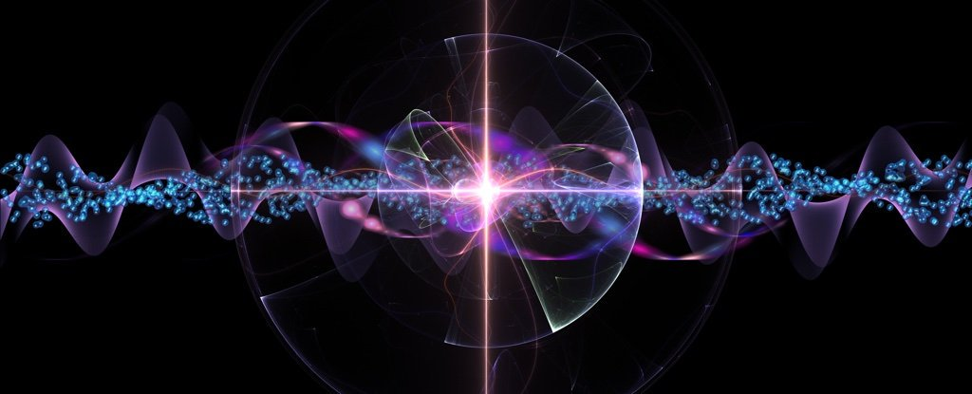
Starting Considerations:
We are made of 7 octillion atoms!
We are made of 100s of trillions of cells!
There are a trillion nerves powering our memory!
If uncoiled, our DNA would stretch 10 billion miles!
DNA contains a 6 billion letter code!

Slide 8
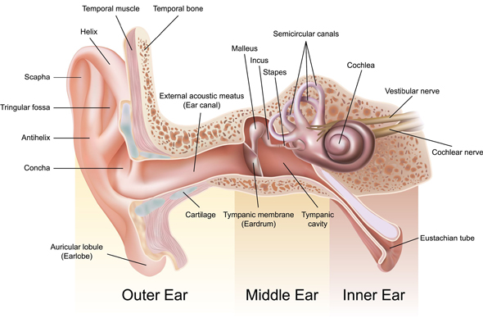
Further Considerations:
The Ear (Prov. 20:12; Ps. 94:9; 1Cor. 12)

Slide 9
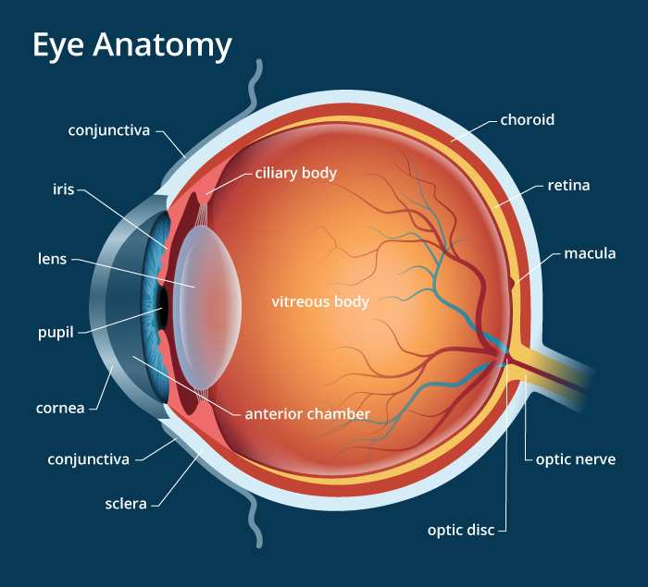
Further Considerations:
The Eye (Prov. 20:12; Ps. 94:9; 1Cor. 12)

Slide 10
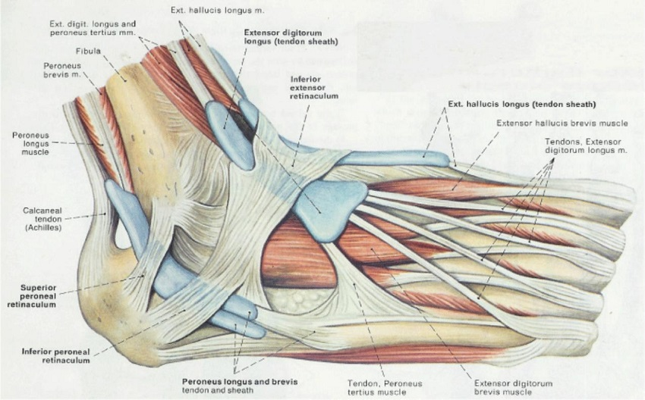
Further Considerations:
Appendages (Gen. 1; 1Cor. 12)

Slide 11
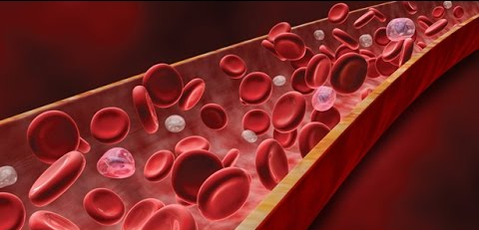
Further Considerations:
The Blood (Lev. 17:11//Deut. 12:23)

Slide 12
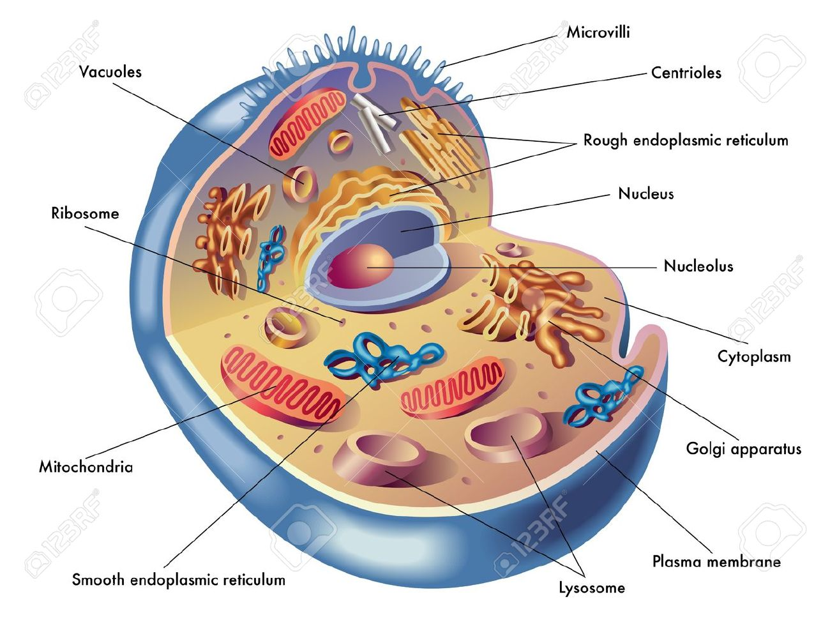
Further Considerations:
The Cell (Col. 1:15-17; John 1:3)

Slide 13
Further Considerations:
Bacteria (Col. 1:15-17; John 1:3)

Slide 14
What About “Bad Design”?
“What About Imperfection?”
“What About Vestigial Organs?”
“What About “Junk DNA”?”
Overlooks A Biblical Answer
To Question God’s Design Is Dangerous And Ignorant! (Is. 29:16; 45:9-10; Rom. 9:20-21).

Slide 15
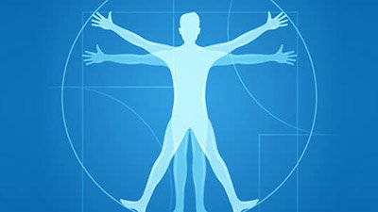
“My soul knows it very well.”
There is a God!

