Slide 1
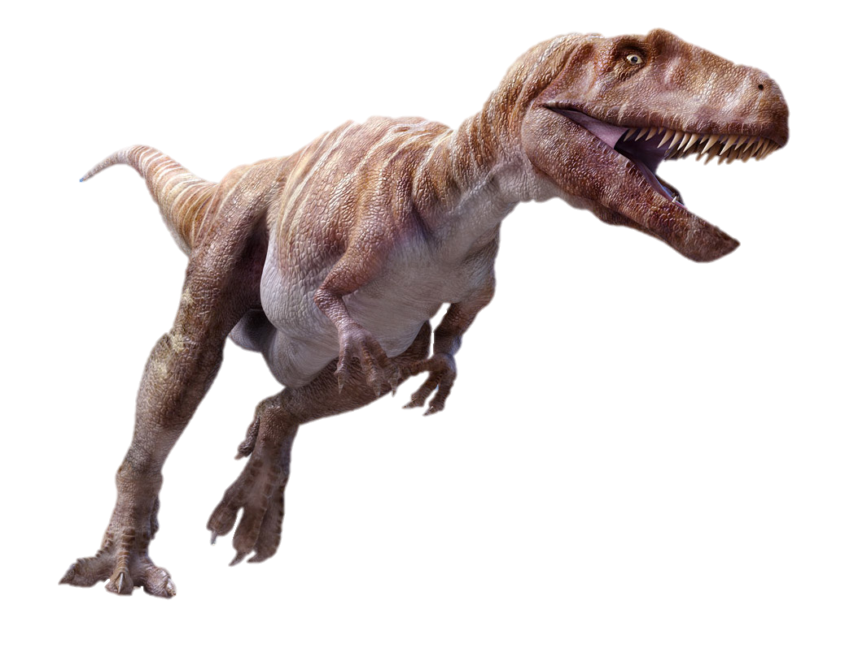
Dinosaurs: Friend Or Foe Of Christians?

Slide 2
The Actual Truth
“Modern Bible scholars, for the most part, have become so conditioned to think in terms of the long ages of evolutionary geology that it never occurs to them that mankind once lived in the same world with the great animals that are now found only as fossils” (Morris, Henry M. (1988), The Remarkable Record of Job (Grand Rapids, MI: Baker), p. 115)

Slide 3
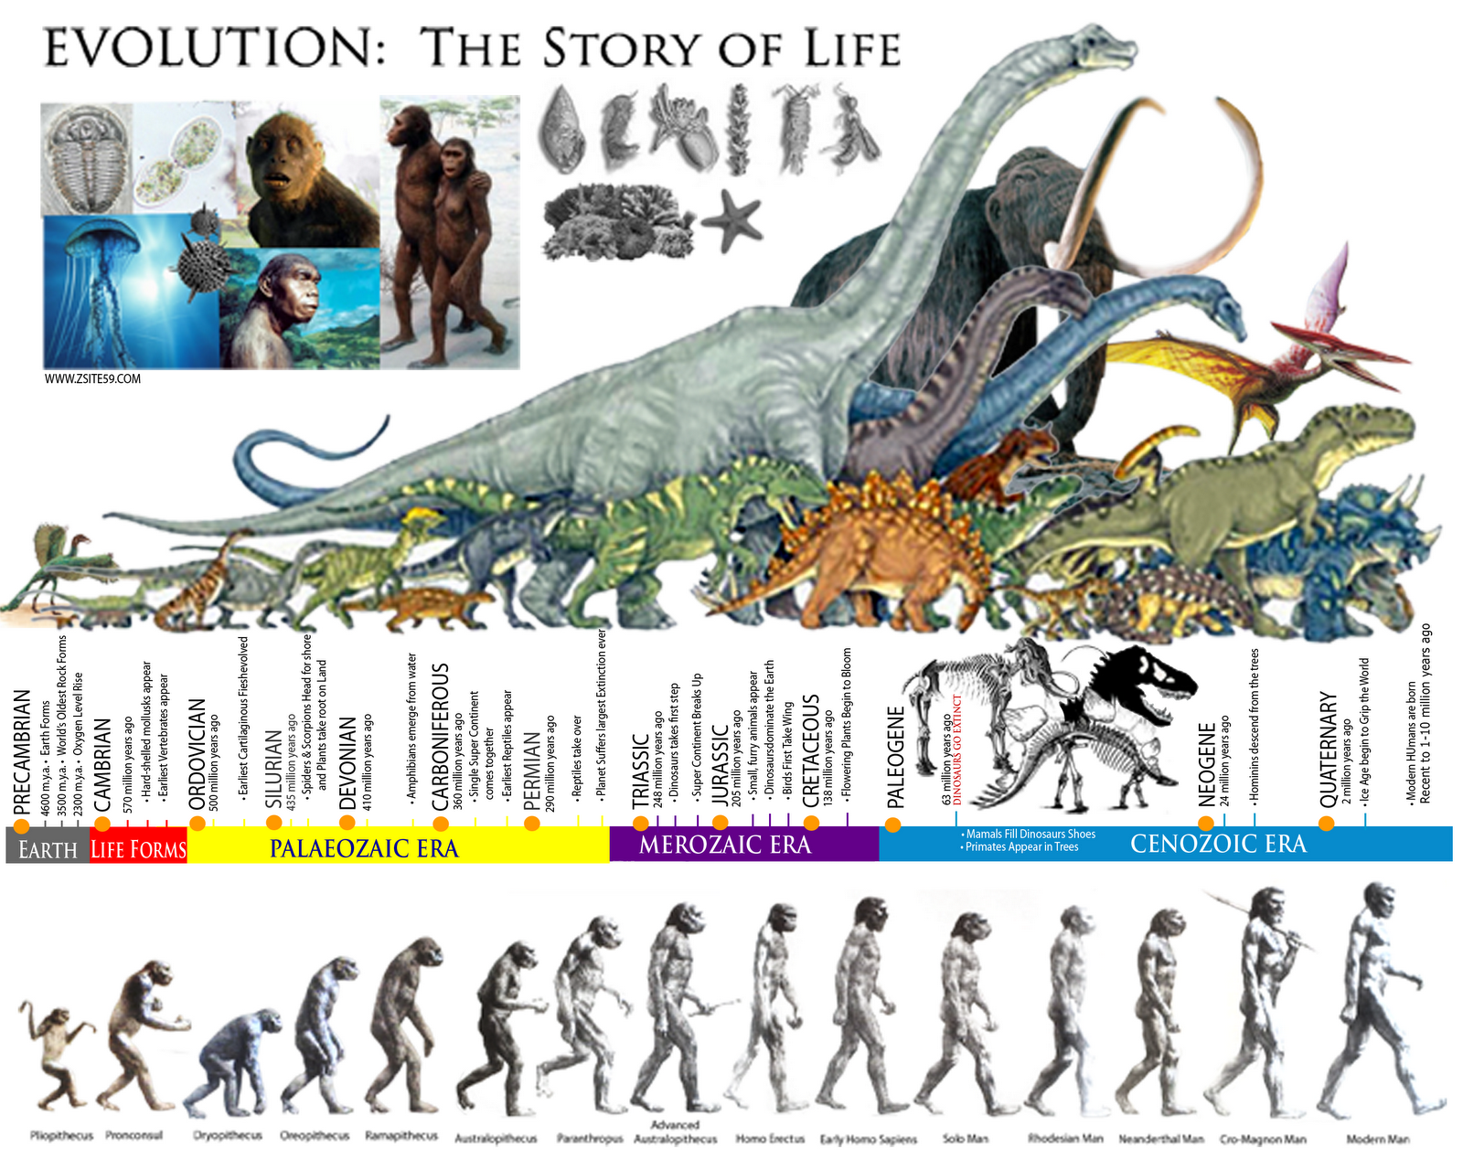
The Evolutionary Timetable
Dinosaurs Extinct 63 MYA
Humans Evolved 1-2 MYA

Slide 4
What Is Sold As Truth:
An article in the January 1993 National Geographic boldly proclaimed: “No human being has ever seen a live dinosaur” (“Age of the Dinosaurs,” 1993, 183[1]:142).
“Did people and dinosaurs live at the same time? No! After the dinosaurs died out, nearly 65 million years passed before people appeared on Earth.” (US Geological Survey)

Slide 5
If Coexistence Could Be Shown:
According to Louis Jacobs, Southern Methodist University, Former President of the Society of Vertebrate Paleontology: “Such an association [co-occurrence of men and dinosaurs] would dispel an Earth with vast antiquity. The entire history of creation, including the day of rest, could be accommodated in the seven biblical days of the Genesis myth. Evolution would be vanquished." (In Quest of the African Dinosaur, p.261)

Slide 6
If Coexistence Could Be Shown:
"Creationists have stated that humans and dinosaurs were contemporaries in time...Were this momentous statement true the names of its discoverers would thunder down the corridors of time as individuals who made one of the most outstanding discoveries of the twentieth century.” (Ernst Mayr, Harvard)
“Finding [dinosaur footprints, side by side with humans] would counter evidence that humans evolved long after the dinosaurs became extinct and back up...[the] claim that all species, including man, were created at one time.” (NOVA TV Special “God, Darwin And The Dinosaurs”)

Slide 7
Marco Polo Saw Dinosaurs
“Leaving the city of Yacho, and travelling ten days in a westerly direction, you reach the province of Karazan, which is also the name of its chief city.... Here are seen huge serpents, ten paces in length, and ten spans in the girt of its body. At the fore part, near the head, they have two short legs, having three claws like those of a tiger...

Slide 8
Marco Polo Saw Dinosaurs
“...with eyes larger than a fourpenny loaf (pane da quattro denari) and very glaring. The jaws are wide enough to swallow a man, the teeth are large and sharp, and their whole appearance is so formidable, that neither man, nor any kind of animal, can approach them without terror.” (The Travels Of Marco Polo The Venetian)

Slide 9
Marco Polo Saw Dinosaurs
“By their motion in this way along the shore, and their vast weight, they make a deep depression, as if a heavy beam had been drawn along the sands. Those whose employment is to hunt them observe the track by which they are most frequently accustomed to go, and fix into the ground several pieces of wood armed with sharp iron spikes, which they cover with the sand in such a manner as not to be perceptible. When therefore the animals make their way towards the places they usually haunt, they are wounded by these instruments, and speedily killed.” (The Travels Of Marco Polo The Venetian)

Slide 10
Angkor Carvings (Cambodia)

Slide 11
Sumatran Art (Indonesia)

Slide 12
Hongshan Jade Carvings (China)

Slide 13
Mesopotamian Cylinder Seal Of Uruk

Slide 14
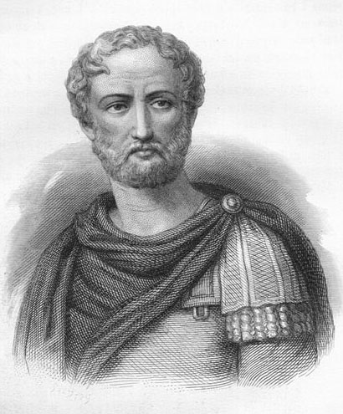
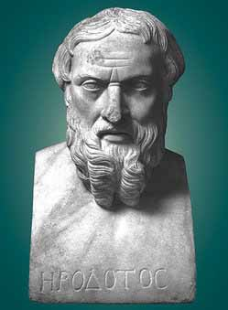
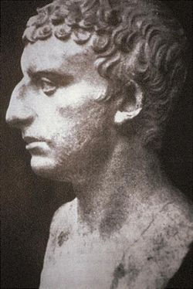
European Written History
Pliny The Elder
Herodotus
Josephus

Slide 15
Coexistent Footprints (Russia)

Slide 16
Richard Bell Tomb Engravings

Slide 17
Nile Mosaic Of Palestrina (Italy)

Slide 18
Hunt Mosaic From Pompeii

Slide 19
Girifalco Pottery Stegosaurus

Slide 20
Bronze Figurine (Mali)

Slide 21
Mokele-mbembe (Congo)

Slide 22
The Yarru, As Described By The Kuku Yalanji Tribe (Queensland)

Slide 23
The Kachina Natural Bridge (Utah)

Slide 24
Havai Supai Canyon (Arizona)

Slide 25
The Granby Idol (Colorado)

Slide 26
Ankylosaurus Painting (Ontario)

Slide 27
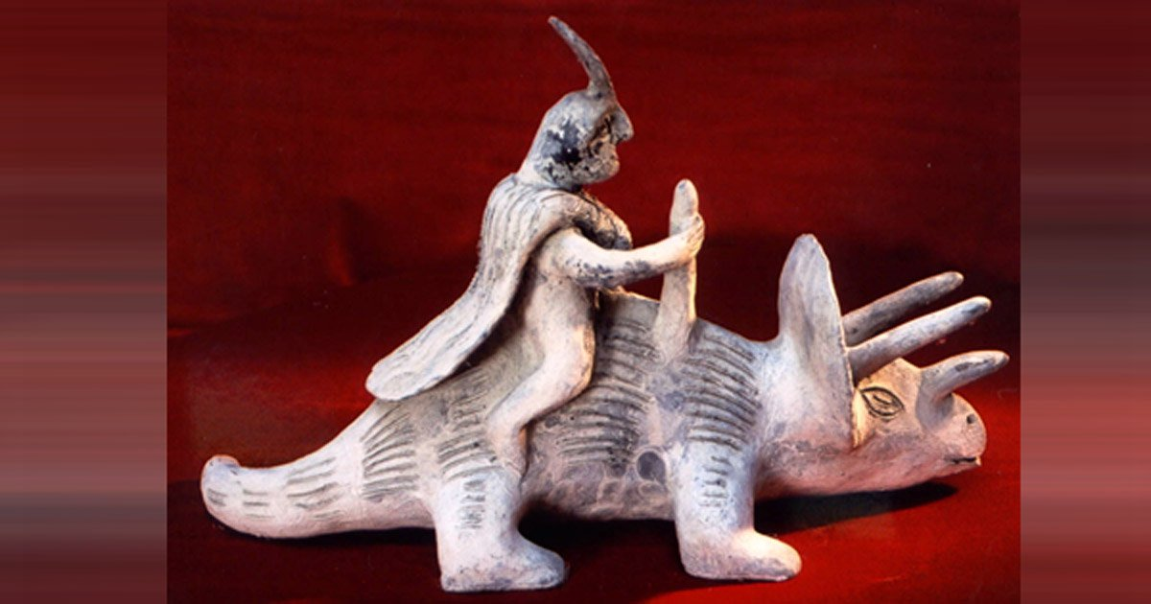
Acambaro Figurines (Mexico)

Slide 28
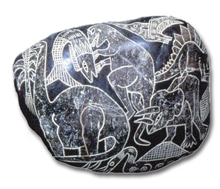
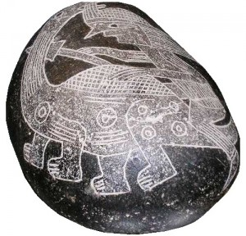
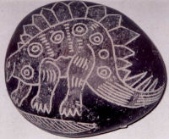
Ica Burial Stones (Peru)

Slide 29
What About The Bible? What Does It Have To Say About Dinosaurs?

Slide 30
Genesis 1:20-25
Then God said, “Let the waters abound with an abundance of living creatures, and let birds fly above the earth across the face of the firmament of the heavens.” So God created great sea creatures and every living thing that moves, with which the waters abounded, according to their kind, and every winged bird according to its kind. And God saw that it was good. And God blessed them, saying, “Be fruitful and multiply, and fill the waters in the seas, and let birds multiply on the earth.” So the evening and the morning were the fifth day. Then God said, “Let the earth bring forth the living creature according to its kind: cattle and creeping thing and beast of the earth, each according to its kind”; and it was so. And God made the beast of the earth according to its kind, cattle according to its kind, and everything that creeps on the earth according to its kind. And God saw that it was good.

Slide 31
Two Specific Dinosaurs
Behemoth (Job 40:15-24)
Leviathan (Job 41)
Herbivore
Massive
Incredibly Strong
Tail Like A Cedar Tree
Pre-Eminent
Spends Time In The Shade
Not Afraid Of Floods
Uncapturable
Uncapturable
Terrifying
Armored & Scaly
Mightily Strong
Large, Sharp Teeth
Breathes Fire
Spends Time In The Water
Flies?
Unique

Slide 32
Behemoth – “A Tail Like A Cedar”
Apatosaurus – 90ft long; tail had 82 bones
Argentinosaurus – 70ft tall, 100 tons, 120ft long, over 40ft tail
Diplodocus – 90ft long, 26ft long neck, 45ft long tail, tail was made of double beamed chevron bones on underside
Brachiosaurus – 85ft long
Supersaurus – 138ft long, 60ft tail
Seismosaurus – 130-170ft, kinked tail with wedge shaped vertebra; Hebrew word in Job 40 means “bent down”

Slide 33
Leviathan – Proof Of “Dragons”?
Dragons? This is nonsense mythology, right? Not necessarily! (Num. 21; Dt. 8:15)
Ubiquitous Belief In Dragons
On “Breathing Fire”
Compare the Bombardier Beetle
Compare the Spitting Cobra
All that would be needed are a pocket of combustible gasses and bioelectricity which is observed in plenty of species.

Slide 34
So What Happened To The Dinosaurs?

Slide 35
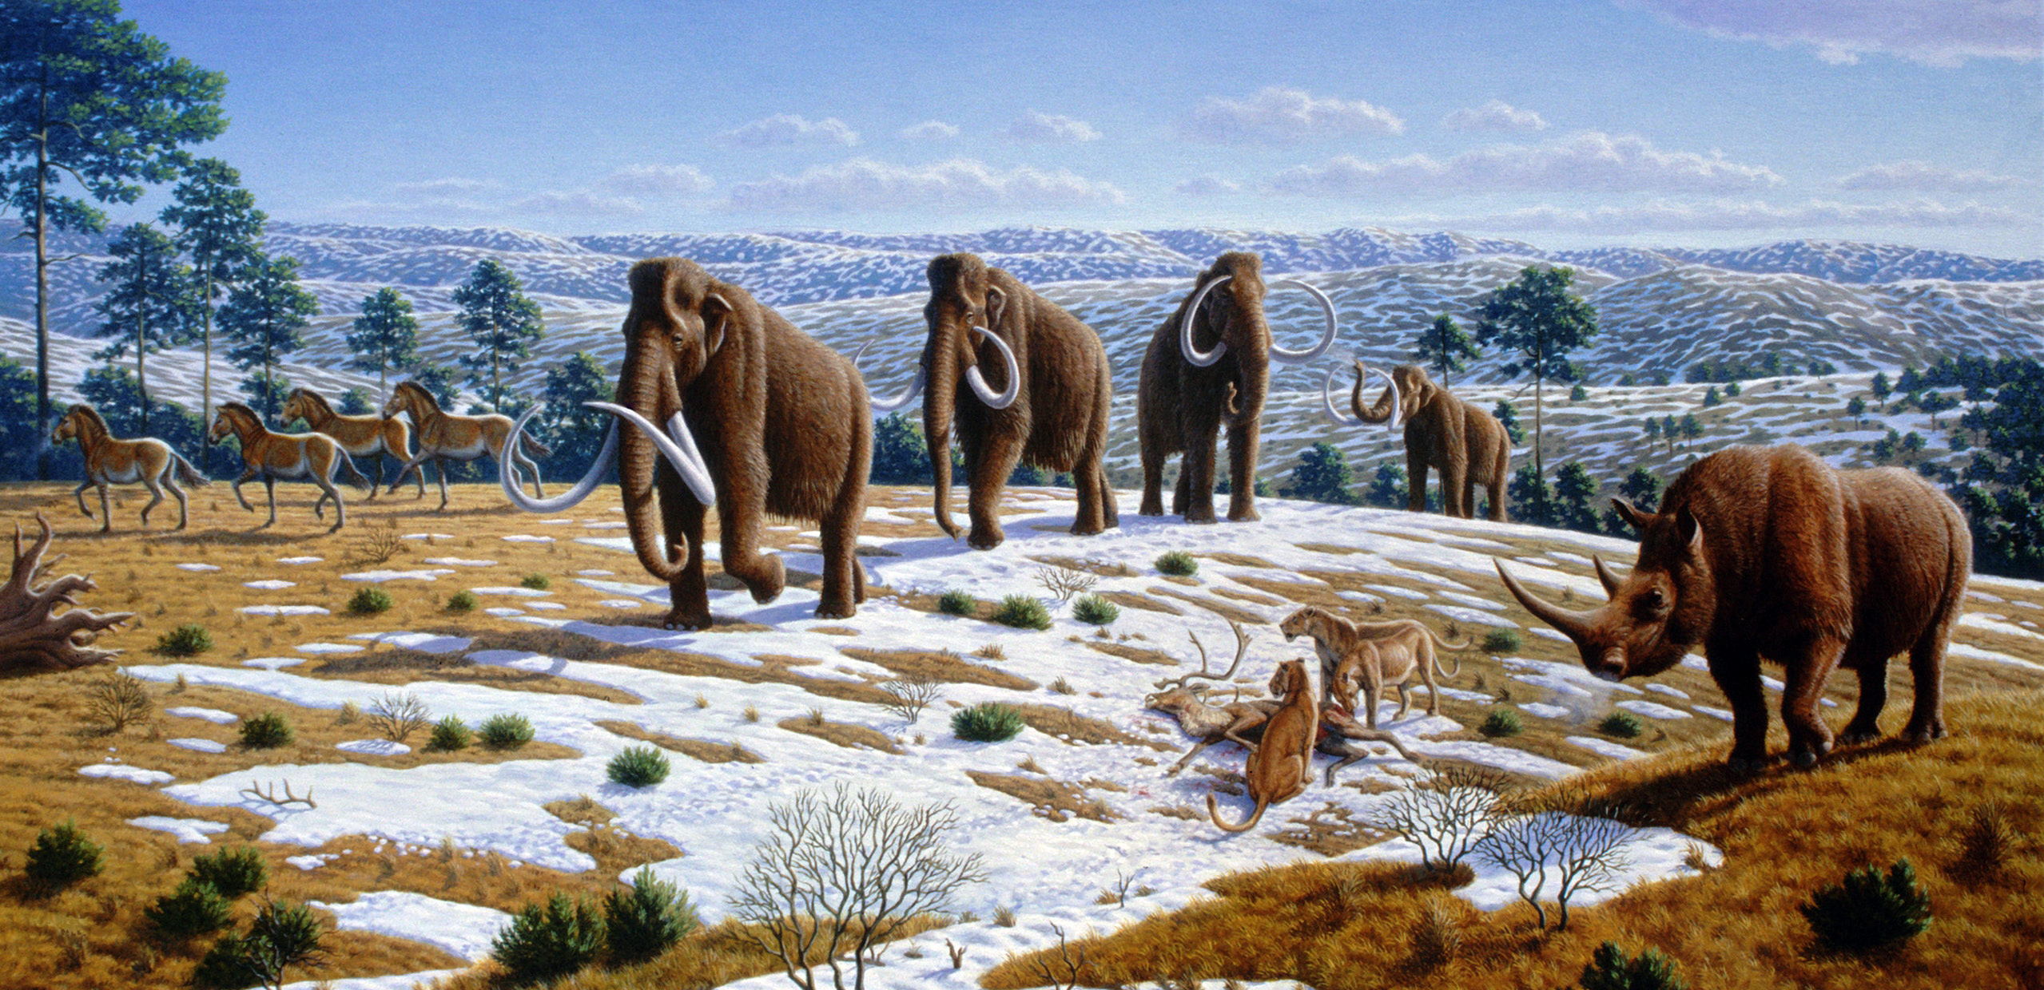
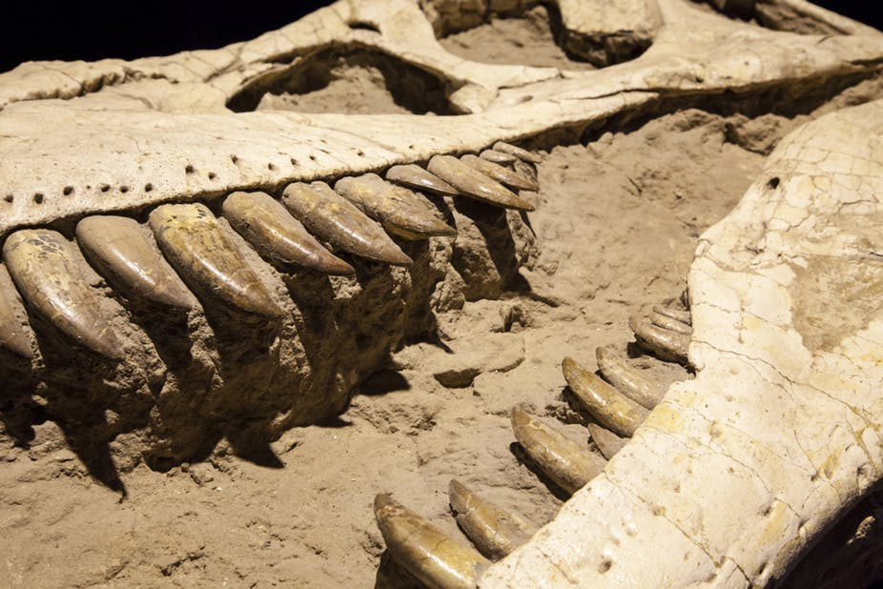
Tentative Answers:

Slide 36
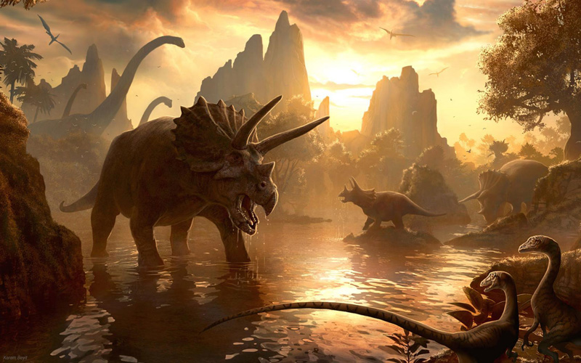
Do dinosaurs matter for Christians? YES!
Writing off dinosaurs will not answer critics; rather, it will feed and justify their criticisms!
Writing off any element of Creation belittles the Creator!

