Slide 1
Is Belief In God Reasonable? The Age Of The Earth

Slide 2
“The heart of the righteous ponders how to answer, but the mouth of the wicked pours out evil things.” (Proverbs 15:28)

Slide 3
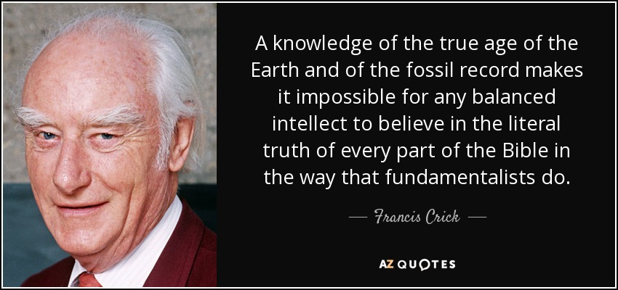
The Evolutionary Viewpoint
Universe = 13-14 Billion Years Old
Earth = 4.5 Billion Years Old
The Date Keeps Getting Older And Older!
“A knowledge of the true age of the Earth and of the fossil record makes it impossible for any balanced intellect to believe in the literal truth of every part of the Bible the way that fundamentalists do.”
- Francis Crick, Co-Discoverer Of The Double Helix Structure of DNA

Slide 4
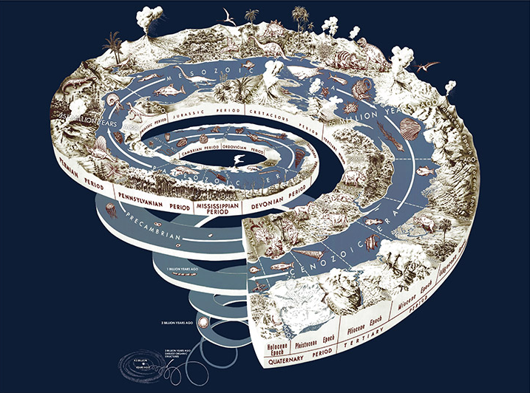

Slide 5
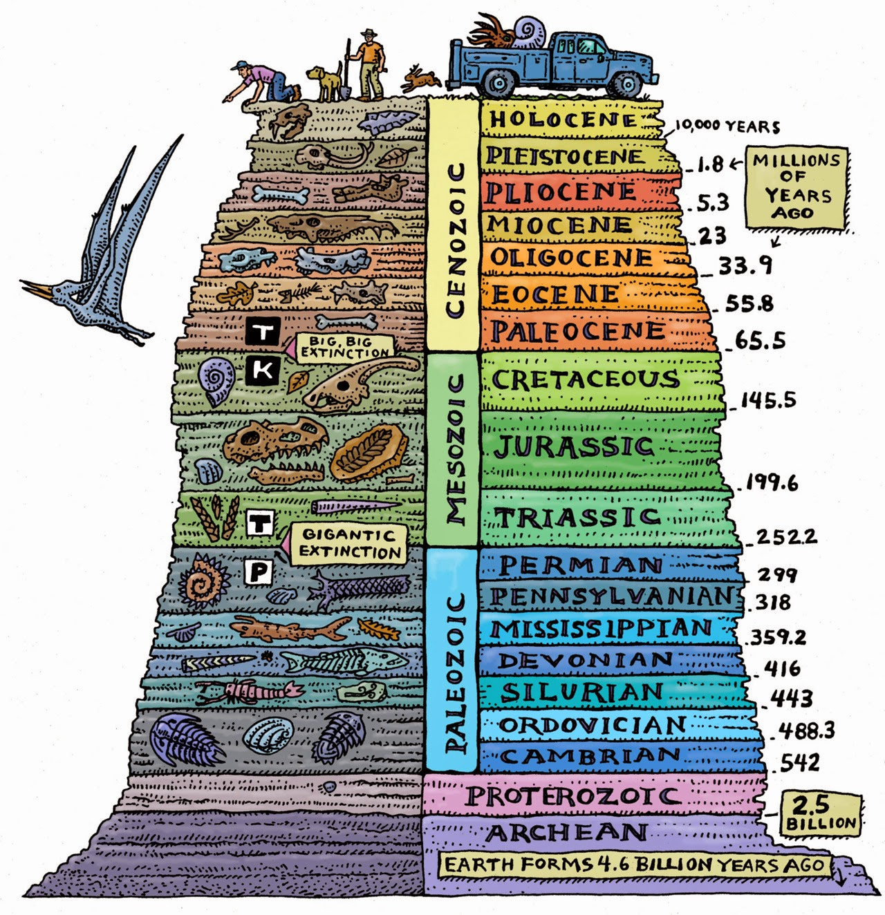

Slide 6
The Evolutionary Viewpoint
Methods
Radiometric/Radioisotope Dating
Isochron Dating
Ice Core Dating
What Is Not Revealed About The Methods
Unreliable
Interpretive Bias

Slide 9
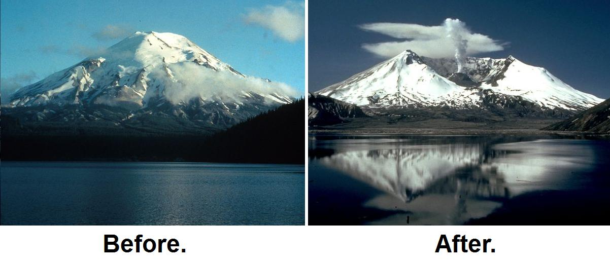
The Eruption Of Mount St. Helens, 1980

Slide 10
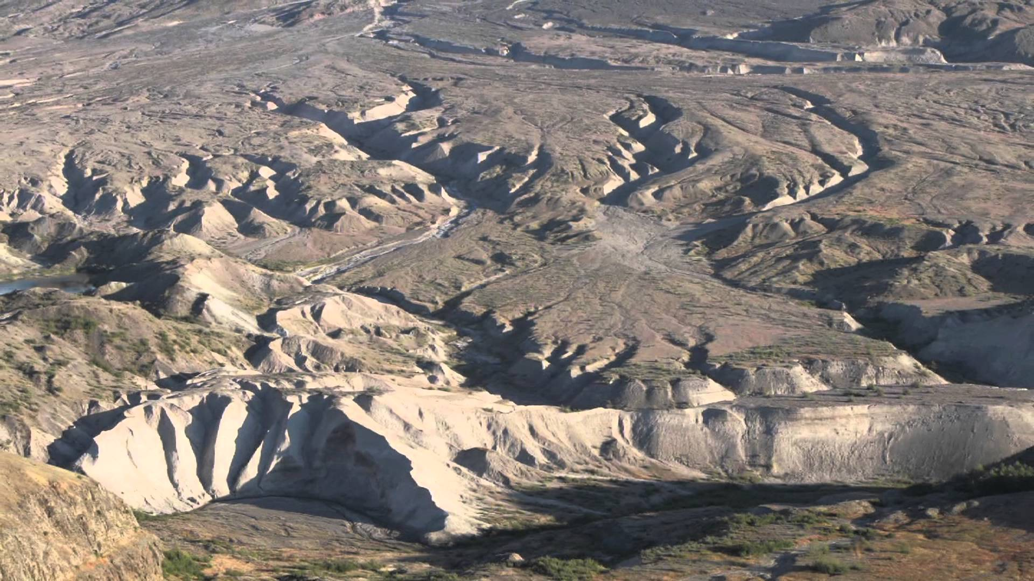

Slide 11
The Evolutionary Viewpoint
Methods
Radiometric/Radioisotope Dating
Isochron Dating
Ice Core Dating
What Is Not Revealed About The Methods
Unreliable
Interpretive Bias
Issues with sedimentation rates, Earth’s decreasing magnetic field, atmospheric Helium rates, short-period comets, population growth

Slide 12
“The Bible reveals that Creation speaks to us about the existence of God and some of the attributes of God, but it doesn’t tell us that we can work out a history of the world just by looking at the Creation. We cannot trust
what sinful scientists, who are using anti-biblical assumptions to interpret the cursed Creation. We cannot use their interpretation to interpret the Bible. Rather we must use the Bible to interpret the world we live in.” (Terry Mortenson, MDiv, PhD History of Geology)

Slide 13
The Biblical Viewpoint
Universe = 6,000 Years Old
Earth = 6,000 Years Old
Commonly Called “Young-Earth Creationism”

Slide 14
The Biblical Viewpoint
Biblical Evidence
5 Days Older Than Man (Gen. 1:24-31)
Genealogies (Gen. 4-5; 10-11; 1Chron. 1-8; Matt. 1; Luke 3)
Usage Of “Days” In Bible Narrative
Unanimous Treatment Of Genesis As Factual (Jesus, Paul, As Well As Others)

Slide 15
The Biblical Viewpoint
Scientific Evidence
Population Studies/Genetics
Erosion
Shrinkage Of The Sun
Cosmic Dust
Spiral Galaxies
Difficulty: The Earth Appears Old

Slide 16
What About “Theistic Evolution”?
Basic Idea – God used evolution to create.
The Reason – Evolution is viewed as fact.
The Means – Gap Theory; Day-Age Theory
Critical Failure – Macroevolution and Genesis 1 are irreconcilable and mutually exclusive.
“The outcome of letting Scripture interpret Scripture is a young earth and universe.”
- Andrew Snelling, PhD Geology, Director of Research at Answers In Genesis

Slide 17
Why Does It Matter?
The age of the earth determines how we read and interpret the Bible!
The Bible clearly teaches the age of the earth to be 6,000 years!
Compromising God’s truth is perilous! (Deut. 4:2; Prov. 30:6; Rev. 22:18-19)
Studying Creation produces a sense of awe in us! God created the universe out of nothing in 6 days!

Slide 18
What Are You Thinking In Response To This Lesson?

