Slide 1
Is Belief In God Reasonable?
What The Fossil Record Does NOT Show

Slide 2
Preliminary Questions:
Is the winning of souls important to us?
Is keeping our loved ones in the faith important to us?
If you had the opportunity to eliminate one of the biggest catalysts for rebellion to God, would you?
If you had to learn some things that challenged you, would it be worth it?

Slide 3
“Chance and design are antithetical concepts and the decline in religious belief can probably be attributed more to the propagation and advocacy by the intellectual and scientific community of the Darwinian version of evolution than to any other single factor.”

Slide 4
We’re Also Protecting Ourselves
“I say this so that no one will delude you with persuasive argument...See to it that no one takes you captive through philosophy and empty deception, according to the tradition of men, according to the elementary principles of the world, rather than according to Christ.” (Colossians 2:4, 8)

Slide 5
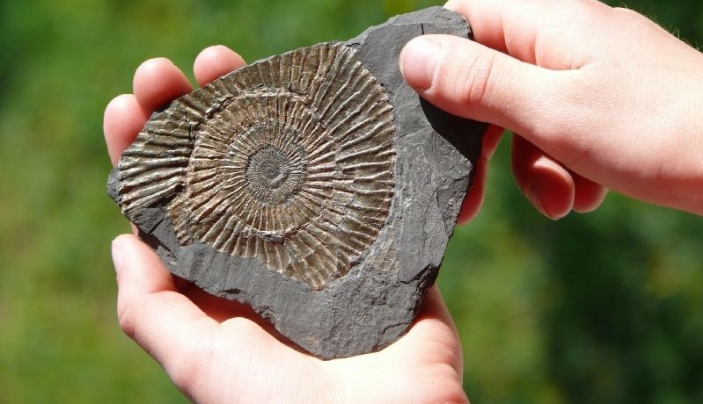
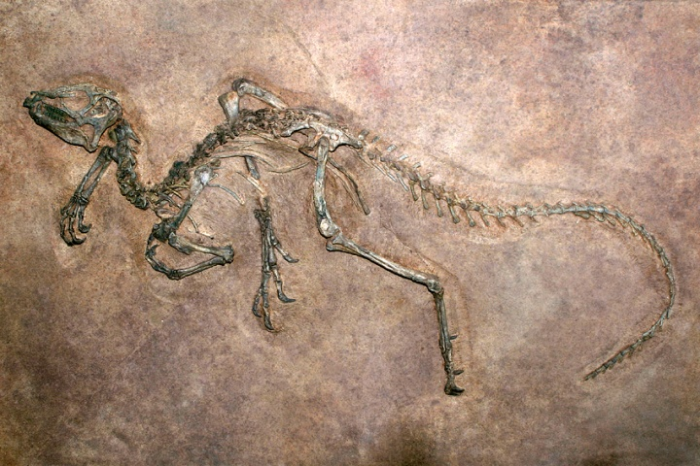
Belief In
GOD
Studied In Their Proper Order, Will Lead To

Slide 6
A Few Key Terms (Prov. 26:5; 2Cor. 10:3-5)
The Geologic Column
Cambrian Layer/Explosion
Macroevolution vs. Microevolution
Transitional Forms
Homology vs. Similarity

Slide 7
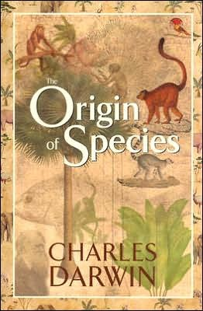
Does NOT Support Evolutionary Expectation & Timeline (Prov. 18:17)
“He [Darwin] prophesied that future generations of paleontologists would fill in these gaps by diligent search….It has become abundantly clear that the fossil record will not confirm this part of Darwin’s predictions. Nor is the problem a miserably poor record. The fossil record simply shows that this prediction was wrong.” (Eldridge, Niles, The Myths of Human Evolution, 1984, pp.45-46.)

Slide 8
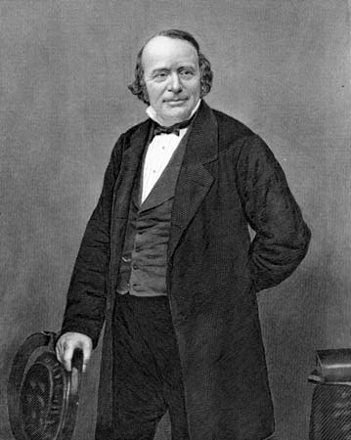
Does NOT Support Evolutionary Expectation & Timeline (Prov. 18:17)
The problem is not mere incompleteness, but rather SELECTIVE incompleteness. The transitional forms are what is missing!
Louis Agassiz, and others, pointed this out to Darwin and he admitted it was fatal to his theory if in time the transitional forms were still the missing element. This has been shown!

Slide 9
Does NOT Support Evolutionary Expectation & Timeline (Prov. 18:17)
Unjustified philosophical leaps abound!
Extrapolating without basis from similarity to homology
Highly imaginative leaps are taken from a major lack of data that is only bridged by colossal speculations.
95% of the fossils we have are marine invertebrates. Vertebrates make up a small fraction of 1%. Primates make up a tiny fraction of that tiny fraction of 1%!

Slide 10
Alleged Transitional Forms
(Is. 41:21-24; Romans 1:25; 3:4; 2Tim. 2:23)

Slide 11
Does NOT Show Reptile-Bird Transition
Archaeopteryx
Sinosauropteryx
Archaeoraptor
Sinornithosaurus

Slide 12
Does NOT Show Reptile-Bird Transition
“The idea of feathered dinosaurs and the theropod origin of birds is being actively promoted by a cadre of zealous scientists acting in concert with certain editors at Nature and National Geographic who themselves have become outspoken and highly biased proselytizers of the faith. Truth and careful scientific weighing of evidence have been among the first casualties in their program, which is now fast becoming one of the grander scientific hoaxes of our age. There is not one undisputed example of a dinosaur with feathers. None. The public deserves to know this.” (Storrs Olson, Smithsonian Institute, in an open letter 11/1/99).

Slide 13
Does NOT Show Horse Evolution
God Created The Horse! (Job 39:19-25)

Slide 14
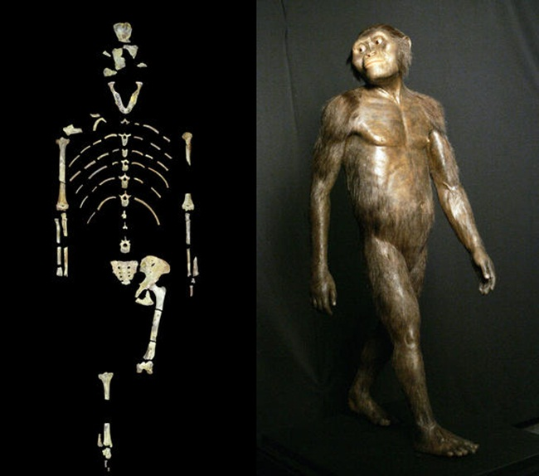
Does NOT Show Ape-Man Transition
Option 1: Upscale Apes
Example: “Lucy”
Australopithecus Afarensis
In reality, a 3 foot chimp
Laetoli Footprints
St. Louis Zoo’s Editorializing

Slide 15
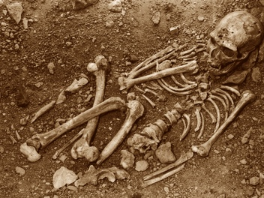
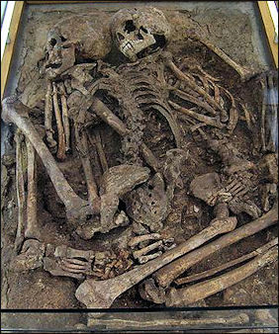
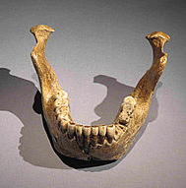
Does NOT Show Ape-Man Transition
Option 2: Downscale Actual Humans
Neanderthal (Modern Arthritic Man)
Heidelberg Man
(Modern Jawbone)
Cro-Magnon (Modern Man)

Slide 16
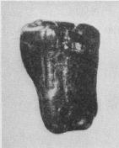
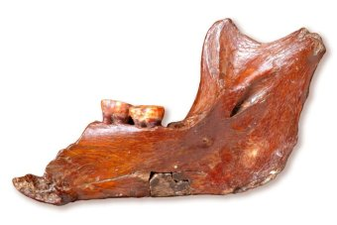
Does NOT Show Ape-Man Transition
Option 3: Make Stuff Up!
Nebraska Man
(An extinct pig’s tooth)
Piltdown Man
(Jawbone of an orangutan)

Slide 17
Man > Animals
(Psalm 8:4-5; Genesis 1:26-28)

Slide 18
Man > Animals
“Theories about the evolution of man describe a history of development taking many millions of years. It is a history filled with slow progression and countless deaths of ape-like creatures trying to evolve into the first human. This is a completely different history than the one recorded in the Bible in which Adam is formed from the dust as a fully-grown man, then Eve is formed from Adam’s rib as a fully-grown woman. There is no way to reconcile these two histories.” (Is Genesis History: Bible Study, “Man, Life, & Science”, 55)

Slide 19
The Lord made all things according to their kinds. Macroevolution does NOT fit the bill. God does! (Revelation 4:11)

