Slide 1
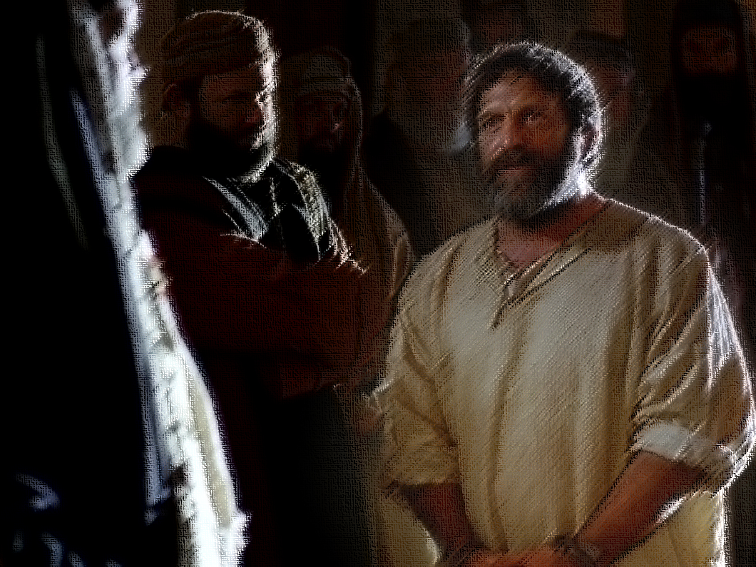
The Tragedy of
Rebellion
Acts 7:2–53
Against God
Notes:
In 1937, architect Frank Lloyd Wright built a house for industrialist Hibbard Johnson. One rainy evening Johnson was entertaining notable guests for dinner when the roof began to leak. The water seeped through directly above Johnson himself, dripping steadily onto his bald head. Irate, he called Wright in Phoenix, Arizona. “Frank,” he said, “you built this beautiful house for me, and I enjoy it very much. But I have told you the roof leaks, and right now I am with some friends and distinguished guests; and it is leaking right on top of my head.” Wright’s reply was heard by all the guests: “Well, Hib, why don’t you move your chair?”
Egotism is a problem. When difficulties or inconveniences arise, too often our pride blinds us to the solution. Spiritually, the solution is always to turn to God. Unfortunately, we—like ancient Israel—may ignore or reject the Lord. This is indeed tragic, as the longest sermon in Acts highlights.

Slide 2
Introduction
The longest sermon recorded in Acts was preached by Stephen, a disciple who mightily proclaimed Jesus as the Christ – Acts 6:8; see vv. 3, 5.
The Jews could not refute Stephen’s teaching so instead they attacked him personally, accusing him of blasphemy against God, Moses and the Law, and the temple – 6:9–14.
Stephen calmly responded to the Sanhedrin, recounting chronologically and thematically Israel’s tragic history of rebellion – 6:15–7:1.
Notes:
Point #2: The Jews may have wrongly inferred from Stephen’s preaching that he did not believe in the God of the OT and that Christians rejected Moses and the OT because he was preaching Jesus as God and the gospel as superseding the Law. Only the claim that the temple would be destroyed may have been correctly interpreted. Regardless, the Jews were misrepresenting Christianity and ignoring the fulfillment of the Law in Christ.

Slide 3
History and Defense
Stephen recounted Israel’s history to defend against the accusations that had been made against him and to show that it was the Council that was acting like their stubborn ancestors – Acts 7:51–53.
Stephen denied that he was blaspheming God. He connected himself and his hearers with the God of the Old Covenant and with the patriarchs – 7:2–16.
Stephen denied that he was blaspheming Moses and the Law, unlike their fathers. He showed that God had predicted Christ and the gospel – Acts 7:17–43.

Slide 4
History and Defense
Stephen denied that he was blaspheming the temple, unlike their fathers who had corrupted the temple and unlike the Council who misunderstood its purpose – Acts 7:44–50; see vv. 39–43.
In sum, the ancient Israelites had been a rebellious people, and their rebellion had resulted in suffering, idolatry, misunderstanding, and apostasy.

Slide 5
Rebuke and Parallel
The Council was acting like their fathers. Though they had accused Stephen of blasphemy, they were the ones who were guilty – Acts 7:51–53.
The Law and the Prophets should have prepared the Jews for Christ, but instead they betrayed and murdered him – vv. 52–53; see v. 37.
The Council’s problem—of which we too must beware—was that their hearts were closed, leading them to reject the Spirit – v. 51; see 1 Corinthians 2:6–8, 14; Colossians 2:11–14.
Notes:
Point #3: In The Chronicles of Narnia: The Magician’s Nephew, C. S. Lewis describes the terrible consequences of stubborn unbelief. The great lion Aslan (Jesus) is creating Narnia and Uncle Andrew refuses to listen:
When the great moment came and the Beasts spoke, he [Uncle Andew] missed the whole point, for a rather interesting reason. When the Lion had first begun singing, long ago when it was still quite dark, he had realized that the noise was a song. And he had disliked the song very much. It made him think and feel things he did not want to think and feel.
Then, when the sun rose and he saw that the singer was a Lion ("only a lion," as he said to himself) he tried his hardest to make himself believe that it wasn't singing and never had been singing; only roaring as any lion might in a zoo in our own world. Of course it can't really have been singing, he thought, I must have imagined it. I've been letting my nerves get out of order. Who ever heard of a lion singing?
And the longer and more beautifully the Lion sang, the harder Uncle Andrew tried to make himself believe that he could hear nothing but roaring. Now the trouble about trying to make yourself stupider than you really are is that you very often succeed. Uncle Andrew did. He soon did hear nothing but roaring in Aslan's song. Soon he couldn't have heard anything else even if he had wanted to.
And when at last the Lion spoke and said, "Narnia awake," he didn't hear any words: he heard only a snarl. And when the beasts spoke in answer, he heard only barkings, growlings, bayings, and howlings.

Slide 6
Rebuke and Parallel
Though we may not rebel against God as blatantly as the Council, we must guard ourselves against hardheartedness – Titus 1:16; see 1 Timothy 5:8.
What is the solution to the problem of rebellion? The answer is easy but difficult—we must submit to God and his word – James 1:19–27; 4:7–10.

Slide 7
Conclusion
The Council had falsely accused Stephen, but he was ultimately vindicated, God providing him a glimpse into heaven itself – Acts 7:54–56.
Though the Council dragged Stephen outside of the city and stoned him, he entrusted himself to Jesus and asked that his enemies be forgiven – vv. 57–60.
Whose example will we follow? The stubborn rejection of Christ by the Council, or the humble submission of Stephen?

Slide 8
The Tragedy of
Rebellion
Acts 7:2–53
Against God

