Slide 1
Is Belief In God Reasonable?
How Can Scientific People Still Be Unreasonable?!

Slide 2
A Summation Of Scientific Evidence That We Have Covered

Slide 3
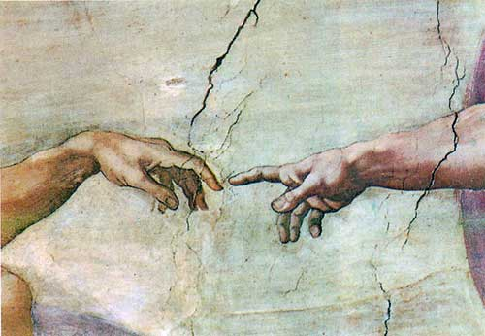
#1: God, Science, Origins
Fields Of Study: Anatomy, Physics, Epistemology, Cosmology, etc.
Key Passages: Genesis 1:1; Hebrews 11:3

Slide 4
#2: Intro To Intelligent Design
Fields Of Study: Engineering, Biology, Astronomy, Mathematics, etc.
Key Passages: Hebrews 3:4; Psalms 8:1-4; 19:1

Slide 5
#3: Anthropic Constants
Fields Of Study: Astronomy, Physics, Meteorology, Geology, etc.
Key Passages: Isaiah 45:18-19; Colossians 1:16-17

Slide 6
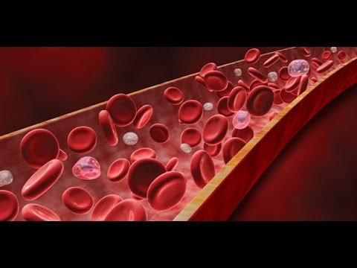
#4: The Designed Man
Fields Of Study: Anatomy, Physiology, Biology, Biomechanics, Biophysics, Biochemistry, Neurology, Audiology, Ophthalmology, Orthopedics, Hematology, Genetics, etc.
Key Passages: Psalms 139:13-16; Proverbs 20:12

Slide 7
#5: The Age Of The Earth
Fields Of Study: Geology, Geophysics, Physical Science, Chronology, Hebrew Language, Population Genetics, Astrophysics, Astronomy, etc.
Key Passages: Genesis 1:24-31; Psalms 33:6; 119:99; Proverbs 21:30

Slide 8
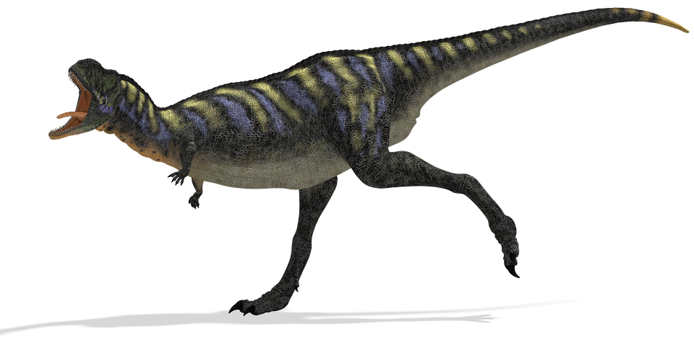
#6: Dinosaurs: Friend Or Foe Of Christians?
Fields Of Study: Paleontology, Archaeology, Art, etc.
Key Passages: Genesis 1:20-25; Job 40:15-24; 41

Slide 9
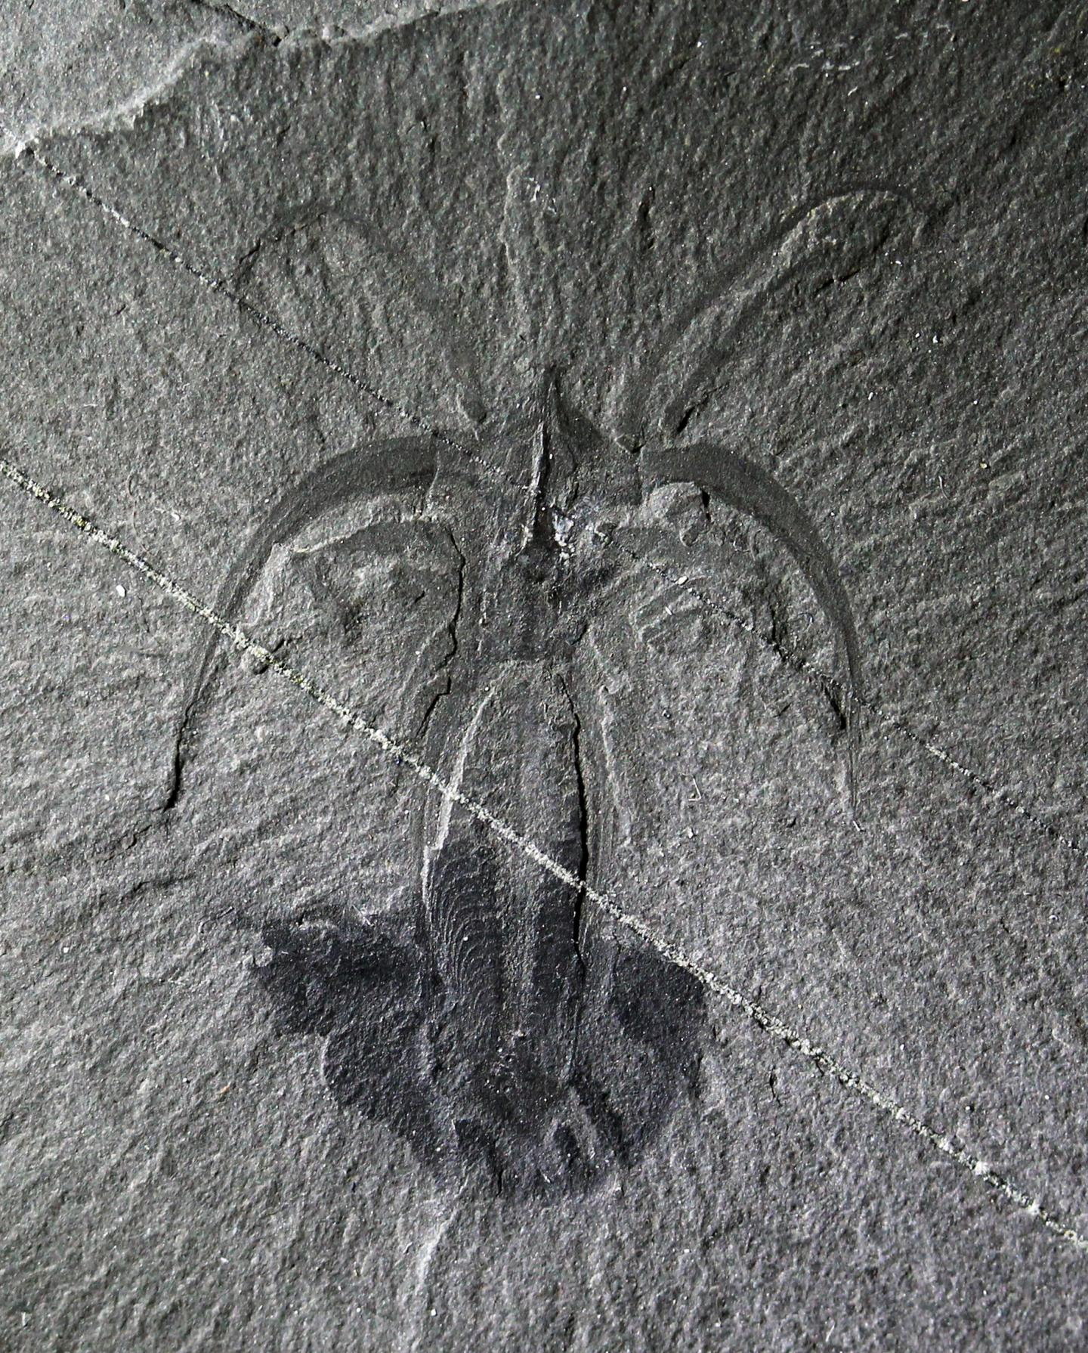
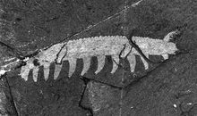
#7: What The Fossil Record Does NOT Show
Fields Of Study: Anatomy, Physics, Epistemology, Cosmology, etc.
Key Passages: Genesis 1:1; Hebrews 11:3

Slide 10
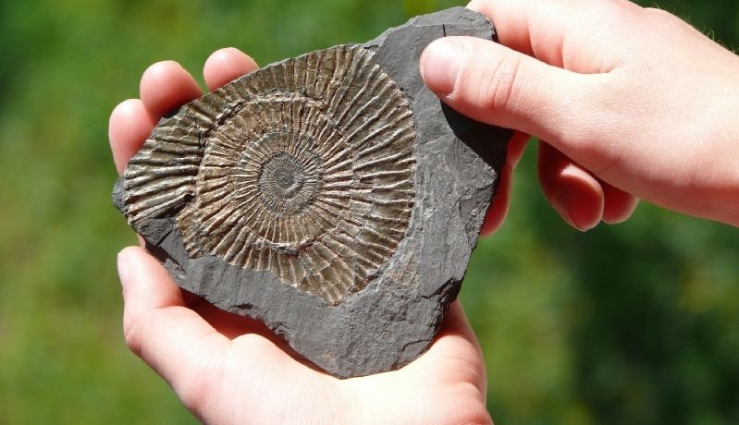
#8: What The Fossil Record DOES Show
Fields Of Study: Anatomy, Physics, Epistemology, Cosmology, etc.
Key Passages: Genesis 1:1; Hebrews 11:3

Slide 11
So, What’s The Problem? Because It’s Not A Lack Of Evidence!

Slide 12
Major Obstacles Remaining:
Intellectual Issues (e.g. Confusion, Deception, Ego)

Slide 13
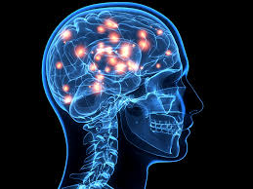
Intellectual Issues Revealed
Scientists “will go to extraordinary lengths...to defend a theory just as long as it holds scientific intrinsic appeal.” (Michael Denton, MD, PhD Biochemistry)
“Evolution is a theory universally accepted, not because it can be proved true, but because the only alternative, Special Creation, is clearly impossible.” (Dr. M.S. Watson, the late zoologist of London University)
“Knowledge makes arrogant, but love edifies. If anyone supposes that he knows anything, he has not yet known as he ought to know.”
- 1 Corinthians 8:1-3

Slide 14
Major Obstacles Remaining:
Intellectual Issues (e.g. Confusion, Deception, Ego)
Emotional Issues (e.g. Shame, Fear, Etc.)

Slide 15
Emotional Issues Illustrated
“Of course there are many who accept evolution simply because they do not know any better. It is shoved down their throats in school, and to oppose it can become quite uncomfortable. They will be ridiculed and told that only the ignorant or deluded do not accept evolution, and who wants to appear stupid or crazy!” (Dr. Bo Kirkwood, Creation Versus Evolution, 71-72)
“It’s not a battle between religion and science; it’s a battle over authority. These individuals are trying to explain the world without God so they don’t have to be morally accountable to Him.” (Terry Mortenson, PhD History of Geology, NAD1)

Slide 16
Emotional Issues Illustrated
“My reservations concern not so much this book but the whole subject of paleoanthropology. But introductory books – or book reviews – are hardly the place to argue that perhaps generations of students of human evolution, including myself, have been flailing about in the dark: that our data base is too sparse, too slippery, for it to be able to mold our theories. Rather the theories are more statements about us and ideology than about the past. Paleoanthropology reveals more about how humans view themselves than it does about how humans came about. But that is heresy.” (David Pilbeam’s review of Mary Leaky’s Origins in American Scientific, May-June, 1978.)

Slide 17
Major Obstacles Remaining:
Intellectual Issues (e.g. Confusion, Deception, Ego)
Emotional Issues (e.g. Shame, Fear, Etc.)
Will Issues (e.g. Pride, Stubbornness, Idolatry, Etc.)

Slide 18
“,,,most will not accept creation simply because they just can’t! They hold a naturalistic viewpoint and cannot entertain the supernatural, no matter what evidence they are shown. Since they cannot accept creation, they are therefore blinded by evolution...But when one accepts the possibility of creation, the evidence for it is overwhelming.” (Dr. Bo Kirkwood, Creation Versus Evolution, 70)

Slide 19
“It necessarily follows that chance alone is at the source of every innovation, and of all creation in the biosphere. Pure chance, absolutely free but blind, at the very root of the stupendous edifice of evolution: this central concept of modern biology is no longer one among many other possible or even conceivable hypotheses. It is today the sole conceivable hypothesis, the only one that squares with observed and tested fact. And nothing warrants the supposition - or the hope - that on this score our position is ever likely to be revised.”

Slide 20
“We take the side of science in spite of the patent absurdity of some of the constructs. In spite of its failure to fulfill many of its extravagant promises of health and life, in spite of the tolerance of the scientific community for unsubstantiated just-so stories, because we have a prior commitment, a commitment to materialism. It is not that the methods and intuitions of science somehow compel us to accept a natural explanation of the phenomenal world, but on the contrary, we are forced by our prior adherence to natural causes to create an apparatus of investigation and a set of concepts that produce material explanations, no matter how mystifying to the uninitiated. Moreover, that materialism is absolute, for we cannot allow a Divine Foot in the door.” (Richard Lewontin, Harvard Geneticist in 1997 New York Review Of Books)

Slide 21
“If [God] does exist, I personally want nothing to do with him.”
“I want atheism to be true...It isn’t just that I don’t believe in God...I don’t want there to be a God. I don’t want the universe to be like that.”
Physicist Victor Stenger
Philosopher Thomas Nagel

Slide 22
“Why did the scientific community jump at Darwin’s ideas?” (Merv Griffin)
“I suppose the reason why we leapt at the Origin of Species was that the idea of God interfered with our sexual mores.” (Julian Huxley)

Slide 23
So, How Should We Respond?
If people won’t listen, why do we even try?
“Therefore, my beloved brethren, be steadfast, immovable, always abounding in the work of the Lord, knowing that your toil is not in vain in the Lord.” (1 Corinthians 15:58)
“but sanctify Christ as Lord in your hearts, always being ready to make a defense to everyone who asks you to give an account for the hope that is in you, yet with gentleness and reverence” (1 Peter 3:15)

Slide 24
So, How Should We Respond?
As Paul At Mars Hill
As Ezekiel To Israel

Slide 25
God Is Real. Heaven And Hell Are Real. Sin And Salvation Are Real.

