Slide 1
Is Belief In God Reasonable?
What The Fossil Record DOES Show

Slide 2
An Informed, Empowered, And Passionate Defense For Reasonable Faith
“Fear not, for I am with you; be not dismayed, for I am your God. I will strengthen you, Yes, I will help you, I will uphold you with My righteous right hand. Behold, all those who were incensed against you shall be ashamed and disgraced; they shall be as nothing, and those who strive with you shall perish. You shall seek them and not find them—Those who contended with you. Those who war against you shall be as nothing, as a nonexistent thing. For I, the Lord your God, will hold your right hand, saying to you, ‘Fear not, I will help you.’” (Isaiah 41:10-13)
“but sanctify Christ as Lord in your hearts, always being ready to make a defense to everyone who asks you to give an account for the hope that is in you, yet with gentleness and reverence” (1 Peter 3:15)

Slide 3
Points Covered Previously:
Does NOT Support Evolutionary Timeline And Expectation
Does NOT Show Validity Of Alleged Transitional Forms

Slide 4
Basic Facts In The Fossil Record (Genesis 1:11-12, 21, 24-25)

Slide 5
Top-Bottom Order
Disparity (Major Differences) Precedes Diversity (Minor Differences)
God Created According To Kinds (מִין)
Examples: Ursids (Bears), Cannids (Dogs), Felids (Cats), Equuids (Horses)
The Bible tells us that we start with several basic and very different “kinds” that diversify through species. Evolution expects and requires the opposite (cf. Isaiah 45:9-10)

Slide 7
“The course of appearance of taxa in the fossil record is top-down. What is more dramatic is that the number of phyla, which should increase by stages over long periods of time, actually decreases...Darwin’s assumptions have been literally ‘overturned’ in the fact of the fossil record, and paleontology has definitely and clearly invalidated his theory.”

Slide 8
Explosive Origins
Complexity FROM THE BEGINNING (cf. Isaiah 40:26)
“...the principal ‘types’ seem to appear rapidly and fully equipped with the signature features of the respective new level of biological organization. No intermediate ‘grades’ or intermediate forms between different types are detectable.” (Koonin, Eugene, “The Biological Big Bang Model for the Major Transitions in Evolution,” Biology Direct, 2007, 2:21.)
“The animal forms that arose in the Cambrian not only did so without any clear material antecedent; they came on the scene complete with digital code, dynamically expressed integrated circuitry, and multi-layered, hierarchically organized information storage and processing systems.” (Stephen C. Meyer, Darwin’s Doubt, 381).

Slide 9
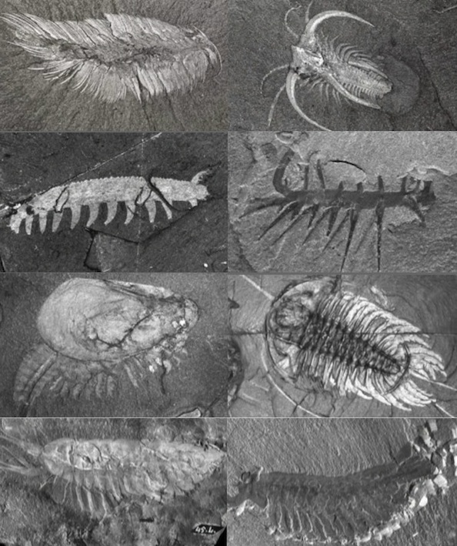
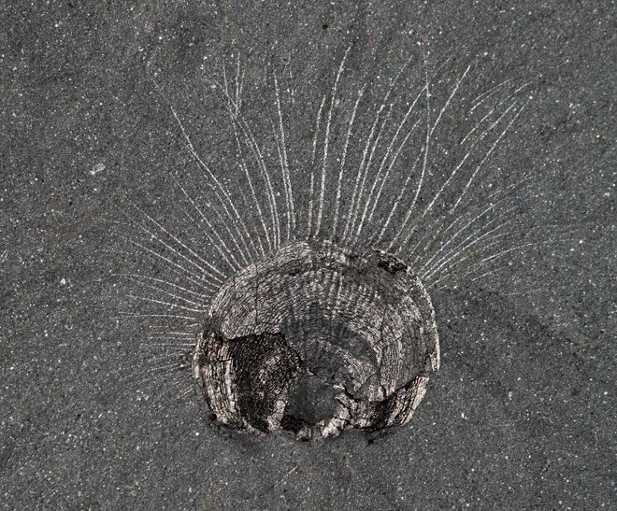
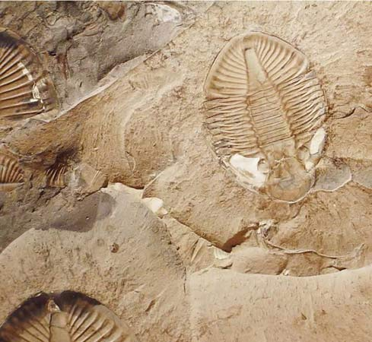
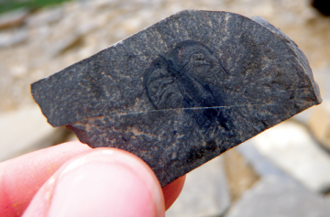
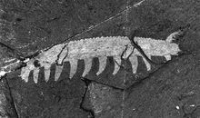
Burgess Shale, BC, Canada

Slide 10
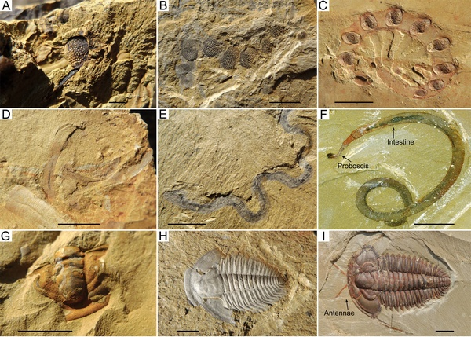
Maotianshan Shale, China

Slide 11
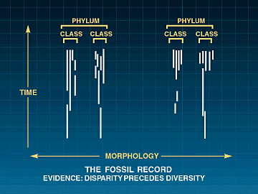
Discontinuity & Stasis
Animals exist with a form, then are extinct or extant with same form. No transitions between kinds.

Slide 12
“It is as though they [fossils] were just planted there, without any evolutionary history. Needless to say this appearance of sudden planting has delighted creationists.…Both schools of thought (Punctuationists and Gradualists) despise so-called scientific creationists equally, and both agree that the major gaps are real, that they are true imperfections in the fossil record. The only alternative explanation of the sudden appearance of so many complex animal types in the Cambrian era is divine creation and (we) both reject this alternative.”

Slide 13
“...intelligent design also explains the observed stasis in the fossil record...Cambrian species tend to persist unchanged in their basic forms over time. Animal body plans that define the higher taxa, including classes and phyla, also remain especially stable in their basic architectural design, showing ‘no directional change’ over geological history after their first appearance in the Cambrian. As a result, the morphological disparity between distinct animal body plans remains unbridged.”

Slide 14
Soft-Tissue Preservation
Unfeasible By Macroevolution

Slide 15
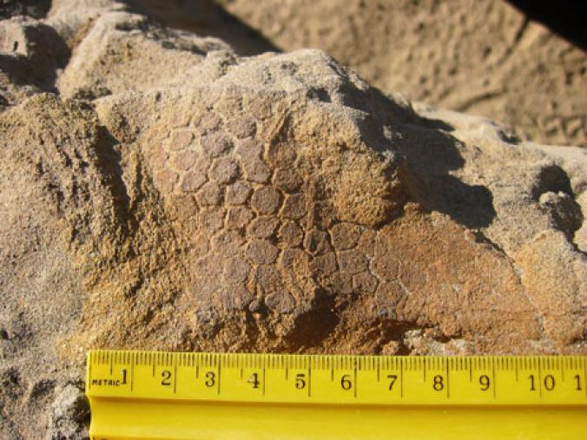
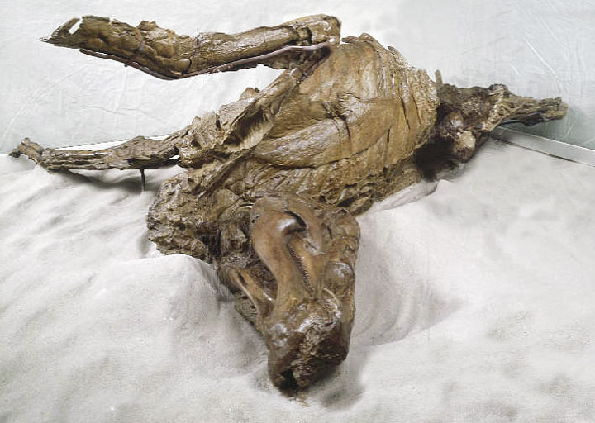
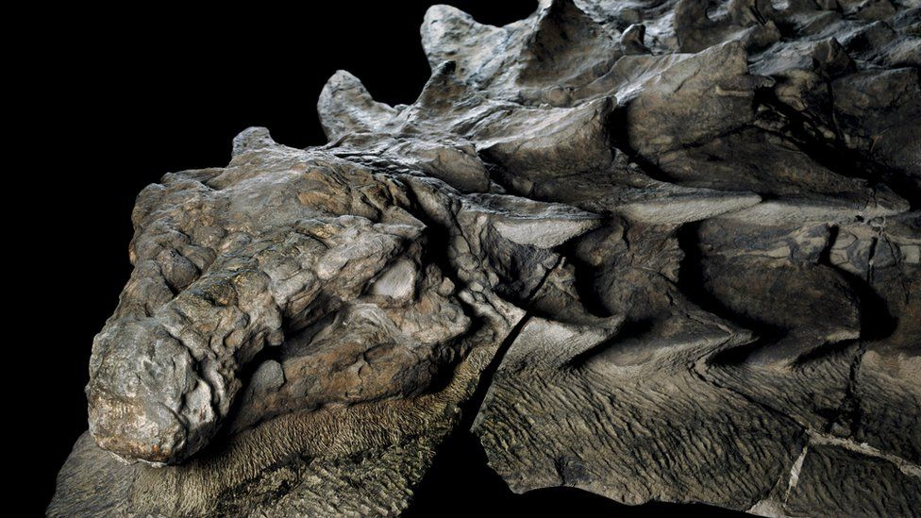
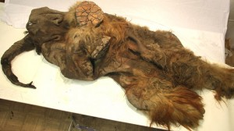
Examples Of Soft-Tissue Preservation
“Dakota”
“Leonardo”
“Four-Legged Tank”
“Yuka”

Slide 16
Examples Of Soft-Tissue Preservation

Slide 17
Variation WITHIN Kinds
Genesis 1:11-12, 21, 24-25; Acts 17:24-31

Slide 18
Examples Of Variation

Slide 19
Evidence For Noah’s Flood
Genesis 6-8

Slide 20
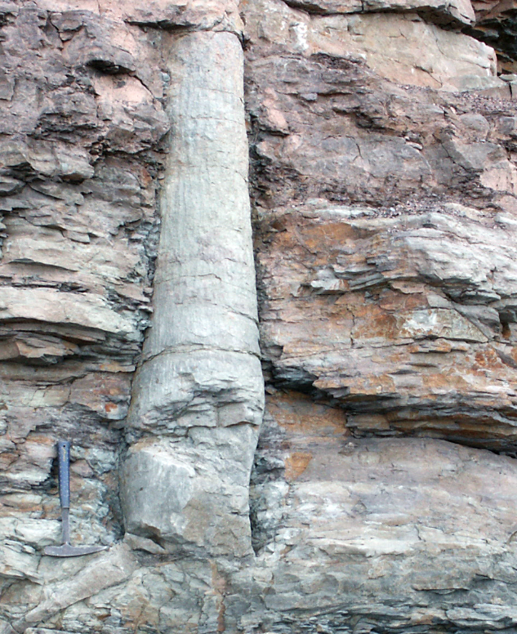
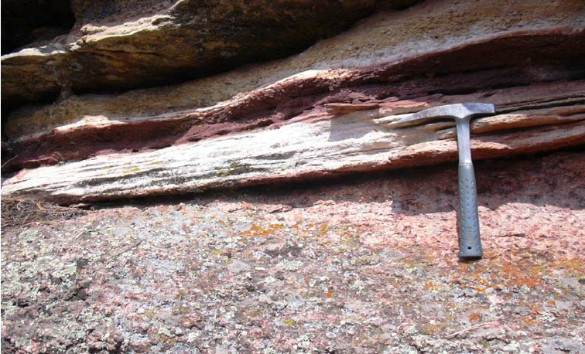
Rapid Deposition
Polystrate Fossils
Of Sediment Layers
Of Erosional Boundaries
Bent And Folded Strata
Waving Patterns On Strata Made By Massive Underwater Erosion

Slide 21
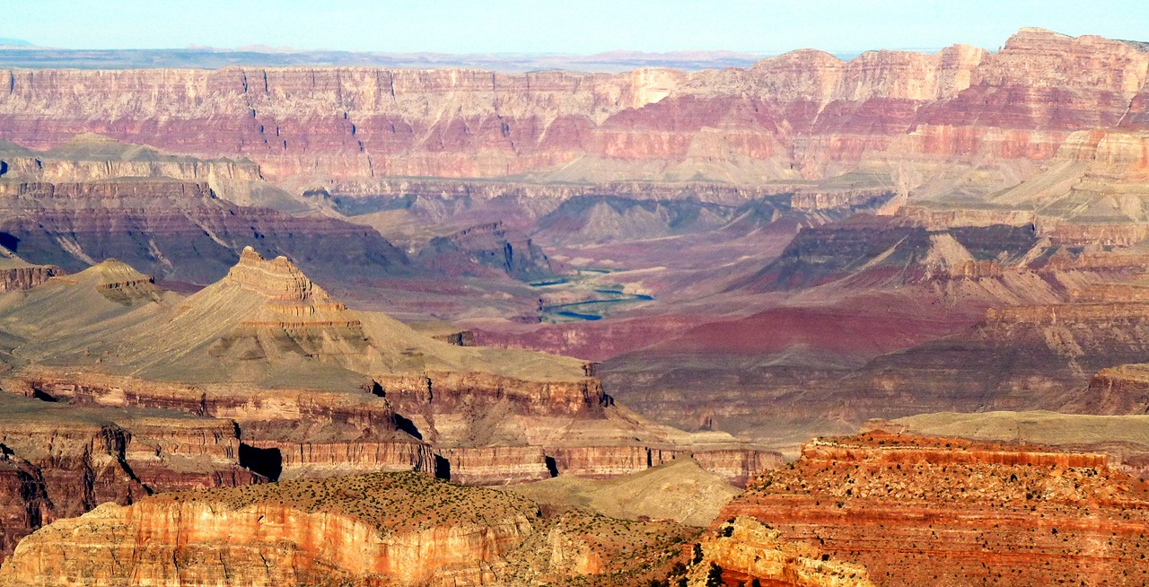

Slide 22
Nature Of The Fossils
Layering: shallow water invertebrates, amphibians, reptiles, mammals, birds
This order aligns with what would be expected based on the description of the Flood in Genesis 6-8.
Footprints in the record separated by “millions of years” from the animal that made them?
Long transport of animals and sediments
“All the fountains of the great deep burst open, and the floodgates of the sky were opened.”

Slide 23
Will We Learn From Those Before Us?
“As the thief is shamed when he is discovered, so the house of Israel is shamed; they, their kings, their princes and their priests and their prophets, who say to a tree, ‘You are my father,’ and to a stone, ‘You gave me birth.’ For they have turned their back to Me, and not their face; but in the time of their trouble they will say, ‘Arise and save us.’ “But where are your gods which you made for yourself? Let them arise, if they can save you in the time of your trouble; for according to the number of your cities are your gods, O Judah.” (Jeremiah 2:26-28)

Slide 24
Will We Learn From Those Before Us?
“Know this first of all, that in the last days mockers will come with their mocking, following after their own lusts, and saying, “Where is the promise of His coming? For ever since the fathers fell asleep, all continues just as it was from the beginning of creation.” For when they maintain this, it escapes their notice that by the word of God the heavens existed long ago and the earth was formed out of water and by water, through which the world at that time was destroyed, being flooded with water. But by His word the present heavens and earth are being reserved for fire, kept for the day of judgment and destruction of ungodly men.” (2 Peter 3:3-7)

