Slide 1
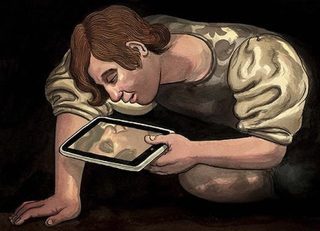
The Folly Of Viewing Worship As Entertainment
ME
SELF
FLESH
I

Slide 3
Man’s Propensity To Change God To Suit His Own Desires
“Her priests have done violence to My law and have profaned My holy things; they have made no distinction between the holy and the profane, and they have not taught the difference between the unclean and the clean; and they hide their eyes from My Sabbaths, and I am profaned among them.” (Ezekiel 22:26)
“Professing to be wise, they became fools, and changed the glory of the incorruptible God into an image made like corruptible man” (Romans 1:22-23).
“Oh that there were one among you who would shut the gates, that you might not uselessly kindle fire on My altar! I am not pleased with you,” says the Lord of hosts, “nor will I accept an offering from you” (Malachi 1:10)

Slide 4
How Do We Worship?
Discourse has become clouded by an increasing emphasis on AV technology, “seeker-friendly services”, and the influence of the entertainment industry. Worship has been supplanted by “Christian entertainment”.

Slide 5
How Do We Worship?
Not all worship is acceptable to God (Malachi 1:10; Matthew 15:9//Mark 7:7; Colossians 2:23)
People expect God to conform to their will (Proverbs 15:12)
The emphasis is how can the worship service be more entertaining to people to please themselves and not God. But worship to God is holy and sacred! (Hebrews 13:15)
It’s not about pleasing our flesh (Galatians 1:10). Our goal is to please God!

Slide 6
Worship Is God-Centered!
Worship is God-centered, NOT man-centered. When our worship is to please God instead of ourselves, our worship will be much more meaningful and spiritually uplifting to us AND acceptable to God!
More and more, people want to tell God how He should be worshipped. Yet, the most often heard comments about worship are about our own comfort, desires, and self-focus. Israel illustrates this folly (e.g. Numbers 25:1-2; Malachi 1:13)
All Of Self And None Of Thee
-OR-
None Of Self And All Of Thee

Slide 7
Modern Innovations Versus Holy Will
Modern worship, the co-mingling of worship and entertainment, is a self-centered endeavor that fails to guard the holy from the unholy. A rock concert, with the lights, loud music and celebrity, with the name of Christ and a few Hallelujahs thrown in does NOT make worship. It is a substitute for worship (John 4:24)
Examples from the Bible (Exodus 30:37-38; Leviticus 10:3; 1 Samuel 2:12-17; et al)
Many churches today offer entertainment and call it holy music and they offer pop psychology, humanist reasoning, and self-help lessons and call it the gospel.

Slide 8
Vanity In Worship
When manmade doctrines are taught as the will of God, their worship is made vain. Entertainment-based “worship” is aimed directly at the fleshly part of man (Matthew 15:7-9; Mark 7:6-7).
What about “love feasts”? (Jude 12)
Not festal parties (1 Corinthians 11:22)
Those who justify “love feasts” in worship find themselves breaking the spirit of worship. Worship is NOT about me; it’s ALL about God!

Slide 9
Worship Is A Privilege!
To a carnal mind, God-sanctioned worship seems distasteful, drudgery, old-hat, boring (2 Corinthians 2:14-16)
A transformation of the mind will change that outlook! (Romans 12:1-2)

