Slide 1
Melchizedek Priesthood
Thomas Massengill

Slide 2
Matthew 28: 18-20
“And Jesus came and spoke to them, saying, ‘All authority has been given to Me in heaven and on earth. Go therefore and make disciples of all the nations, baptizing them in the name of the Father and of the Son and of the Holy Spirit, teaching them to observe all things that I have commanded you; and lo, I am with you always, even to the end of the age.’ Amen.”

Slide 3
2 Peter 2: 1
“But there were also false prophets among the people, even as there will be false teachers among you, who will secretly bring in destructive heresies, even denying the Lord who bought them, and bring in themselves swift destruction.”

Slide 4
Matthew 7: 15-20
“‘Beware of false prophets, who come to you in sheep’s clothing, but inwardly they are ravenous wolves. You will know them by their fruits. Do men gather grapes from thornbushes or figs from thistles? Even so, every good tree cannot bear bad fruit, nor can a bad tree bear good fruit. Every tree that does not bear good fruit is cut down and thrown into the fire. Therefore by their fruits you will know them.”

Slide 5
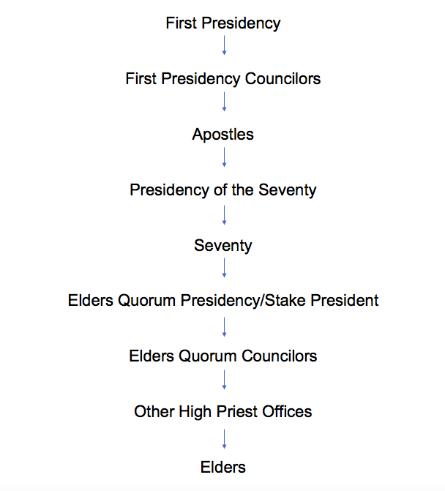

Slide 6
Elder’s Priesthood Organization
“Elders are called to teach, expound, exhort, baptize, and watch over the Church. All Melchizedek Priesthood holders are elders. They have the authority to bestow the gift of the Holy Ghost by the laying on of hands. Elders should conduct meetings of the Church as they are led by the Holy Ghost. Elders may administer to the sick. and bless little children. Elders may preside over Church meetings when there is no high priest present.”

Slide 7
D&C 20: 38-45
“An apostle is an elder, and it is his calling to baptize; And to ordain other elders, priests, teachers, and deacons; And to administer bread and wine—the emblems of the flesh and blood of Christ— And to confirm those who are baptized into the church, by the laying on of hands for the baptism of fire and the Holy Ghost, according to the scriptures; And to teach, expound, exhort, baptize, and watch over the church; And to confirm the church by the laying on of the hands, and the giving of the Holy Ghost; And to take the lead of all meetings. The elders are to conduct the meetings as they are led by the Holy Ghost, according to the commandments and revelations of God.”

Slide 8
D&C 42: 44
“And the elders of the church, two or more, shall be called, and shall pray for and lay their hands upon them in my name; and if they die they shall die unto me, and if they live they shall live unto me.”

Slide 9
1 Peter 3: 12
“For the eyes of the Lord are on the righteous. And His ears are open to their prayers; But the face of the Lord is against those who do evil.”

Slide 10
D&C 20: 70
“Every member of the church of Christ having children is to bring them unto the elders before the church, who are to lay their hands upon them in the name of Jesus Christ, and bless them in his name.”

Slide 11
D&C 107: 11
“An elder has a right to officiate in his stead when the high priest is not present.”

Slide 12
Elder’s Priesthood Organization cont...
“Worthy brethren may receive the Melchizedek Priesthood and be ordained elders when they are at least 18 years old.”

Slide 13
Titus 1: 5-9
“For this reason I left you in Crete, that you should set in order the things that are lacking, and appoint elders in every city as I commanded you- if a man is blameless, the husband of one wife, having faithful children not accused of dissipation or insubordination. For a bishop must be blameless as a steward of God, not self-willed, not quick-tempered, not given to wine, not violent, not greedy for money, but hospitable, a lover of what is good, sober-minded, just, holy, self-controlled, holding fast the faithful word as he has been taught, that he may be able, by sound doctrine, both to exhort and convict those who contradict.”

Slide 14
Elders
D&C
Bible
Teach, Expound, Exhort, Baptize
Watch over church
Bestow gift of the Holy Ghost
Conduct meetings
Administer to sick
Bless children
Preside over church when no high priest present
18 years of age
Shepherd over flock
Blameless
One wife with reverent children
Sober-minded
Strong example
Hospitable
Able to teach who is not a novice
No alcohol, violence, greed, quarrelsome, covetous, and pride

Slide 16
High Priest’s Priesthood Organization
“A high priest is given the authority to officiate in the Church and administer spiritual things. He may also officiate in all lesser offices. Stake presidents, mission presidents, high councilors, bishops, and other leaders of the Church are ordained high priests.”

Slide 17
D&C 107: 10
“High priests after the order of the Melchizedek Priesthood have a right to officiate in their own standing, under the direction of the presidency, in administering spiritual things, and also in the office of an elder, priest (of the Levitical order), teacher, deacon, and member.”

Slide 18
D&C 107: 12
“The high priest and elder are to administer in spiritual things, agreeable to the covenants and commandments of the church; and they have a right to officiate in all these offices of the church when there are no higher authorities present.”

Slide 19
D&C 68: 19
“But, as a high priest of the Melchizedek Priesthood has authority to officiate in all the lesser offices he may officiate in the office of bishop when no literal descendant of Aaron can be found, provided he is called and set apart and ordained unto this power, under the hands of the First Presidency of the Melchizedek Priesthood.”

Slide 20
Romans 7: 4-6
“Therefore, my brethren, you also have become dead to the law through the body of Christ, that you may be married to another-to Him who was raised from the dead, that we should bear fruit to God. For when we were in the flesh, the sinful passions which were aroused by the law were at work in our members to bear fruit to death. But now we have been delivered from the law, having died to what we were held by, so that we should serve in the newness of the Spirit and not in the oldness of the letter.”

Slide 21
1 Peter 5: 1-4
“The elders who are among you I exhort, I who am a fellow elder and a witness of the sufferings of Christ, and also a partaker of the glory that will be revealed: Shepherd the flock of God which is among you, serving as overseers, not by compulsion but willingly, not for dishonest gain but eagerly; nor as being lords over those entrusted to you, but being examples to the flock; and when the Chief Shepherd appears, you will receive the crown of glory that does not fade away.”

Slide 22
Hebrews 4: 14-16
“Seeing then that we have a great High Priest who has passed through the heavens, Jesus the Son of God, let us hold fast our confession. For we do not have a High Priest who cannot sympathize with our weaknesses, but was in all points tempted as we are, yet without sin. Let us therefore come boldly to the throne of grace, that we may obtain mercy and find grace to help in time of need.”

Slide 24
Seventy’s Priesthood Organization
“Seventies are special witnesses of Jesus Christ to the world and assist in building up and regulating the Church under the direction of the First Presidency and Quorum of the Twelve Apostles”

Slide 25
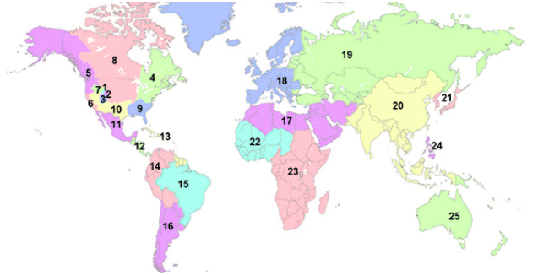

Slide 26
Luke 10: 1,17
“After these things the Lord appointed seventy others also, and sent them two by two before his face into every city and place where He Himself was about to go… The seventy returned with joy, saying, ‘Lord, even the demons are subject to us in Your name.’”

Slide 28
Presidency of the Seventy Organization
“Most presidencies in the Church have a presidency of three: a president and two counselors. However, in accordance with scripture, all are presidents in the Presidency of the Seventy—none are counselors”

Slide 29
D&C 107: 93-94
“And it is according to the vision showing the order of the Seventy, that they should have seven presidents to preside over them, chosen out of the number of the seventy; And the seventh president of these presidents is to preside over the six;”

Slide 31
Apostle’s Priesthood Organization
“An Apostle is a special witness of the name of Jesus Christ in all the world. The Apostles administer the affairs of the Church throughout the world. Those who are ordained to the office of Apostle in the Melchizedek Priesthood are usually set apart as members of the Quorum of the Twelve Apostles. Each one is given all the keys of the kingdom of God on earth, but only the senior Apostle, who is President of the Church, actively exercises all of the keys. The others act under his direction.”

Slide 32
D&C 107: 23
“The twelve traveling councilors are called to be the Twelve Apostles, or special witnesses of the name of Christ in all the world—thus differing from other officers in the church in the duties of their calling.”

Slide 33
Acts 1: 20
“For it is written in the Book of Psalms: ‘Let his dwelling place be desolate, and let no one live in it’; and, ‘Let another take his office.’”

Slide 34
Psalms 109: 6-13
“Set a wicked man over him, and let an accuser stand at his right hand. When he is judged, let him be found guilty, And let his prayer become sin. Let his days be few, And let another take his office. Let his children be fatherless, and his wife a widow. Let his children continually be vagabonds, and beg; Let them seek their bread also from desolate places. Let the creditor seize all that he has, And let strangers plunder his labor. Let there be none to extend mercy to him, Nor let there be any to favor his fatherless children. Let his posterity be cut off, And in the generation following let their name be blotted out.”

Slide 36
First Presidency’s Priesthood Organization
“the Church is led by 15 apostles, who are also regarded as prophets, seers, and revelators. The man who has been an apostle the longest is the President of the Church, and by inspiration he selects two other apostles as counselors. These three function as the First Presidency, which is the highest governing body of the Church.”

Slide 37
First Presidency’s Priesthood Organization cont...
“As members of The Church of Jesus Christ of Latter-day Saints, we are blessed to be led by living prophets—inspired men called to speak for the Lord, as did Moses, Isaiah, Peter, Paul, Nephi, Mormon, and other prophets of the scriptures. We sustain the President of the Church as prophet, seer, and revelator—the only person on the earth who receives revelation to guide the entire Church. We also sustain the counselors in the First Presidency and the members of the Quorum of the Twelve Apostles as prophets, seers, and revelators.”

Slide 38
Galatians 1: 6-10
“I marvel that you are turning away so soon from Him who called you in the grace of Christ, to a different gospel. Which is not another; but there are some who trouble you and want to pervert the gospel of Christ. But even if we, or an angel from heaven, preach any other gospel to you than what we have preached to you, let him be accursed. As we have said before, so now I say again, if anyone preaches any other gospel to you than what you have received let him be accursed. For do I now persuade men, or God? Or do I seek to please men? For if I still pleased men, I would not be a bondservant of Christ.”

Slide 39
Colossians 1: 18
“And He is the head of the body, the church, who is the beginning, the firstborn from the dead, that in all things He may have the preeminence.”

Slide 40
Ephesians 5: 23-24
“For the husband is head of the wife, as also Christ is head of the church; and He is the Savior of the body. Therefore, just as the church is subject to Christ, so let the wives be to their own husbands in everything.”

