Slide 1
Understanding The Years Of Silence

Slide 2
400+ Years Of Silence
New Testament Written
Old Testament Written
Moses
Malachi
Revelation
B.C.
A.D.
1450 B.C.
400 B.C.
100 A.D.

Slide 3
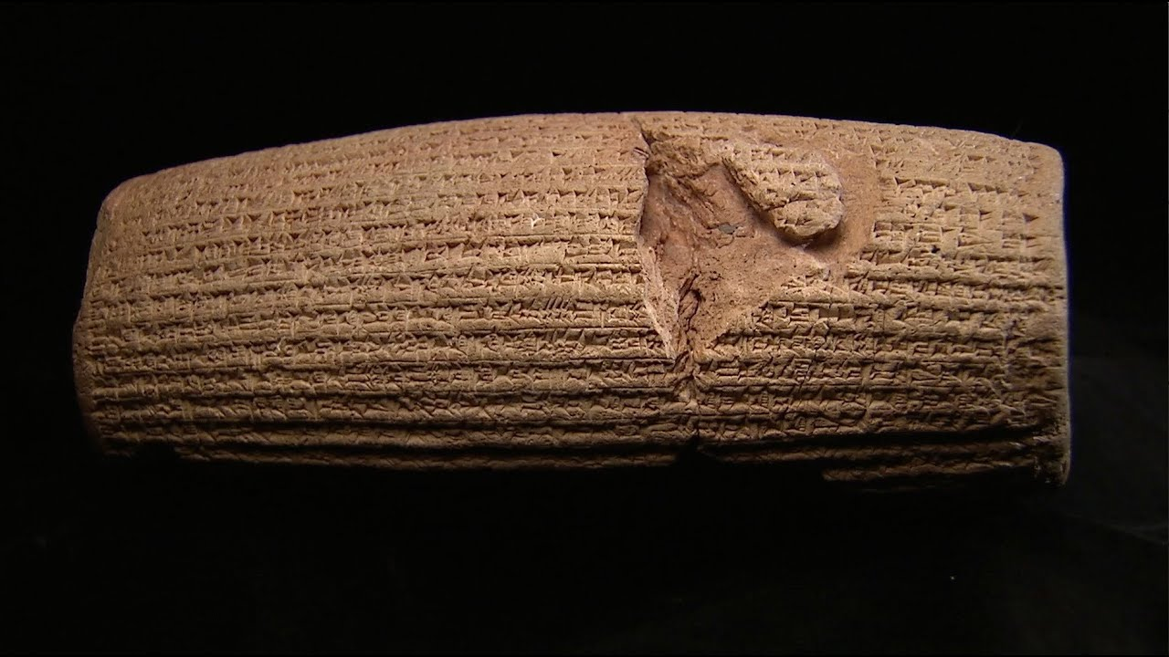
The Jews In 400 B.C.
200 Years Prior, Judah Taken Captive
70 Years Of Exile Ended By Cyrus’ Decree
130 Years Of Returning Exiles
By 400 B.C., A Small, Jewish State Under Persian Control

Slide 4
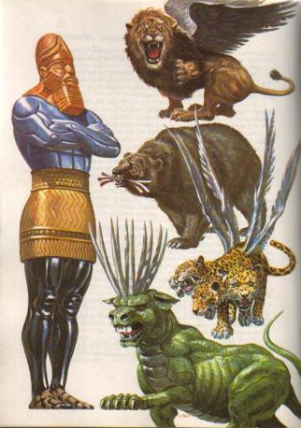
What Is Happening Here?
Fulfillment Of Daniel 2 & 7

Slide 5
What Is Happening Here? Fulfillment Of Daniel 8 & 11

Slide 6
What Is Happening Here? Fulfillment Of Daniel 9

Slide 7
The Inter-Testament Periods
The Persian Period (397-333 B.C.)
The Greek Period (333-323 B.C.)
The Egyptian Period (323-204 B.C.)
The Syrian Period (204-165 B.C.)
The Maccabean Period (165-63 B.C.)
The Roman Period (63 B.C. And Onward)

Slide 8
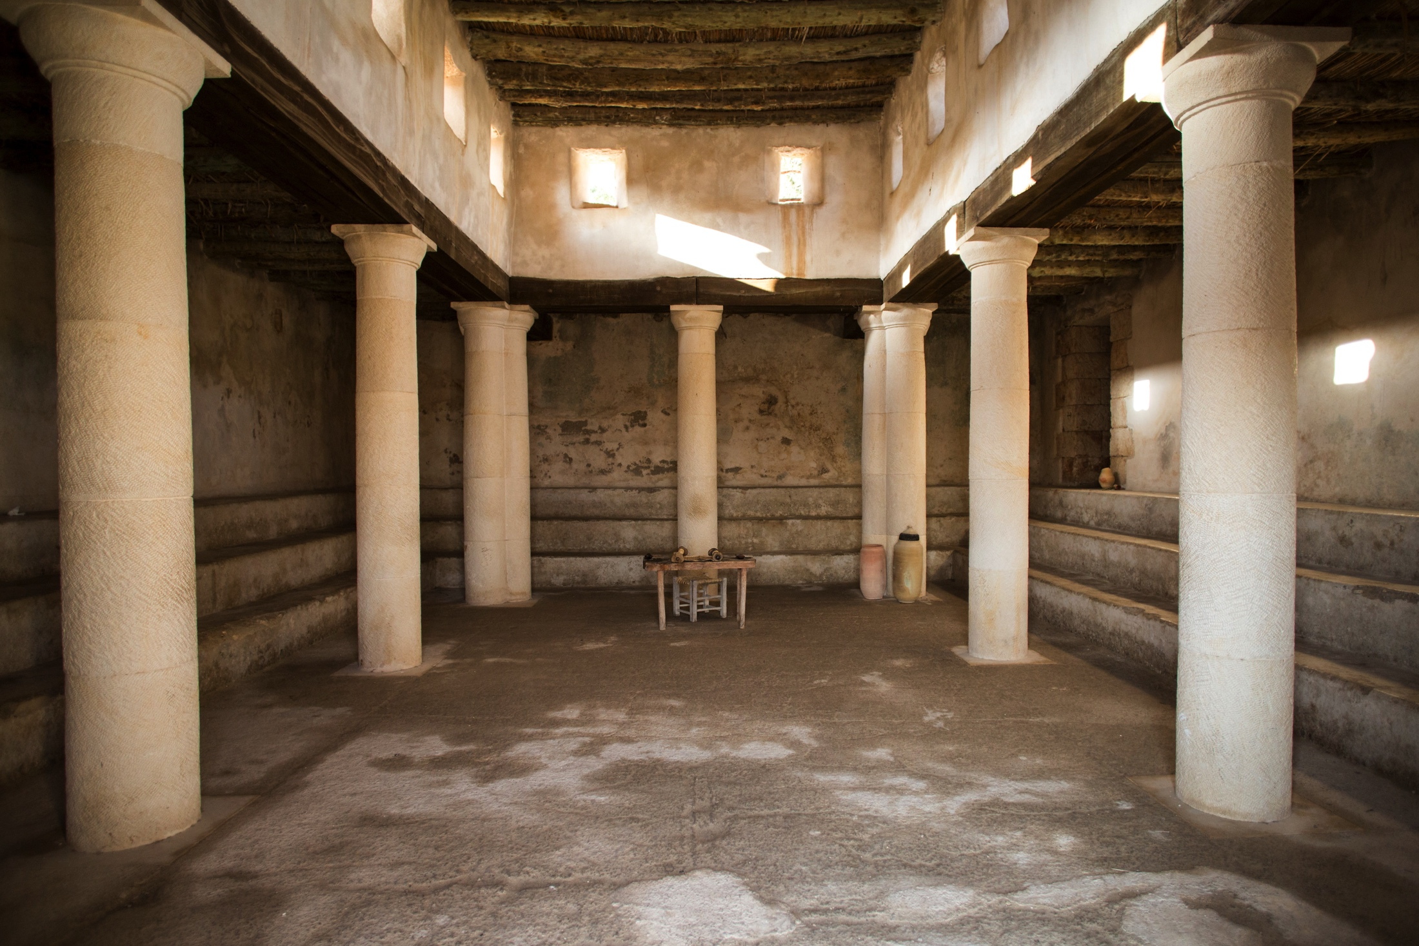
Synagogues

Slide 9
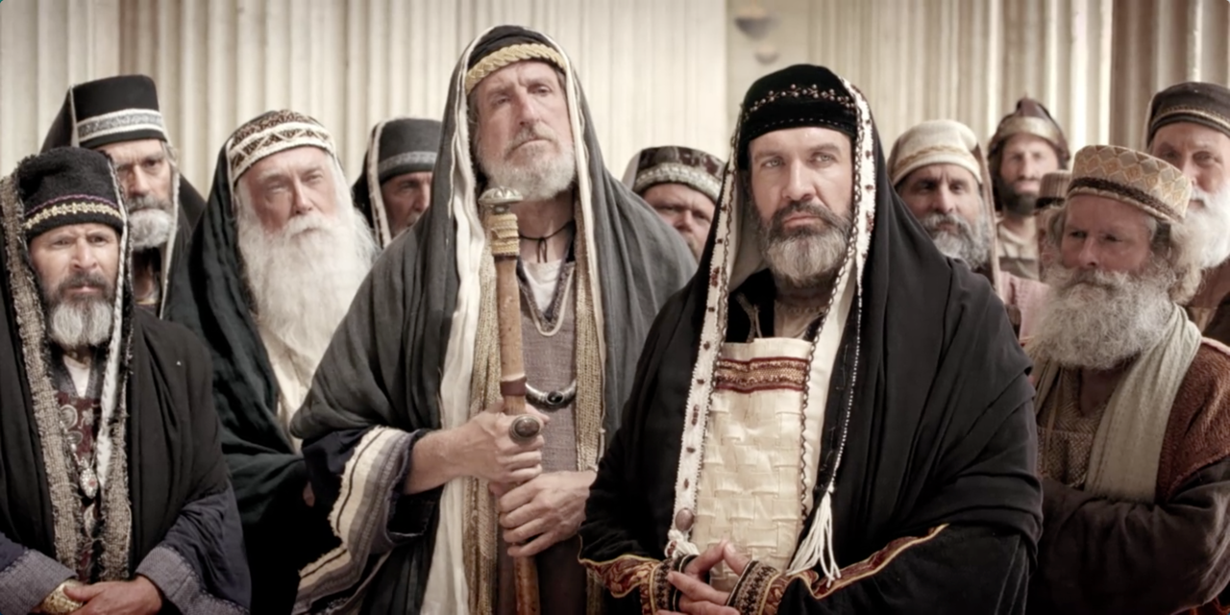
Development Of Sects
Scribes
Pharisees
Sadducees
Herodians

Slide 10
The Sanhedrin Council

Slide 11
Why Study Such Things?

