Slide 1
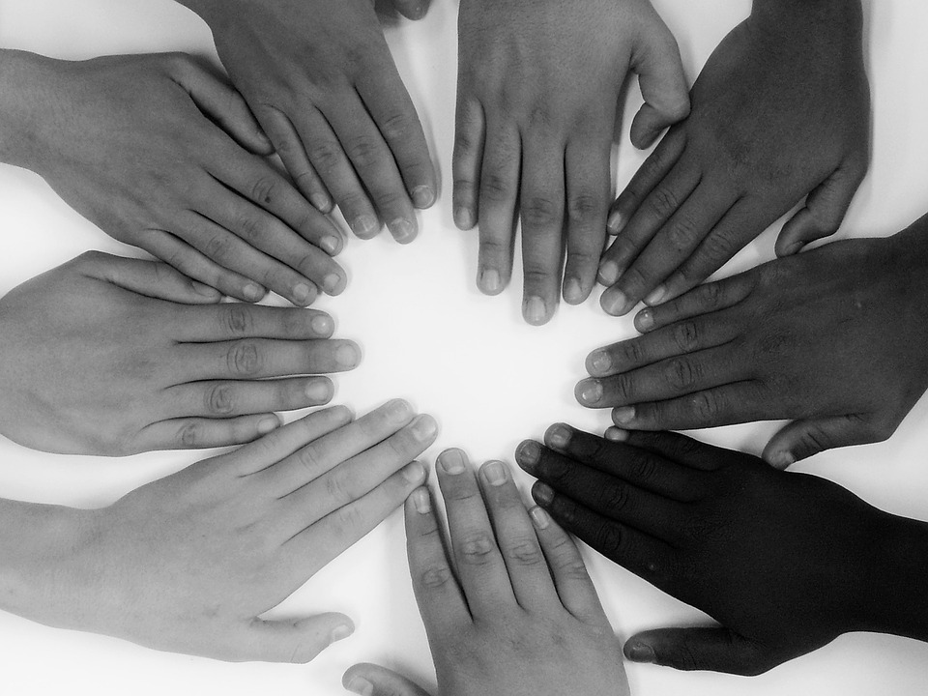
God Made EVERY Nation From ONE Person

Slide 2
We need to transform how we see each other by looking at God’s history.

Slide 4
Scientific Study Shows This!
“The ancestral form of the language family that includes Greek is called Proto-Indo-European. We do not know what the people who spoke this form called their language, since they left no records. They probably lived in southeastern Europe more than five thousand years ago. Eventually groups of Proto-Indo-European speakers broke off from the main community in repeated migrations, gradually spreading throughout Europe and western Asia from India to Britain. Separated from one another, they developed mutually unintelligible varieties of the original tongue. Greek, Latin, Sanskrit, and Russian are varieties of Indo-European, as are English, French, and German. Although these languages may be related, the changes that took place in them are quite different.” David Alan Black, Linguistics for Students of New Testament Greek (Grand Rapids: Baker, 1995), 144.

Slide 5
Scientific Study Shows This!
“The Tower of Babel explains why everyone doesn’t speak the same language today. There are over 6,900 spoken languages in the world today. Yet the number of languages emerging from Babel at the time of the dispersion would have been much less than this—likely less than 100 different language families...Both Vistawide World Languages and Cultures and Ethnologue companies that provide statistics on language, agree that only 94 language families have been so far ascertained. With further study in years to come, this may change, but this figure is well within the range of families that dispersed from Babel (Genesis 10).” (Bodie Hodge, “Was the Dispersion at Babel a Real Event?,” The New Answers Book 2)

Slide 6
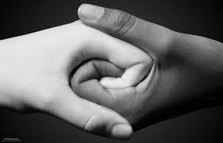
Scientific Study Shows This!
Father (English); pater (Greek); pater (Latin); pitar (Sanskrit)
Is (English); esti (Greek); est (latin); asti (Sanskrit)
Three (English); treis (Greek); tres (Latin); trayas (Sanskrit)

Slide 7
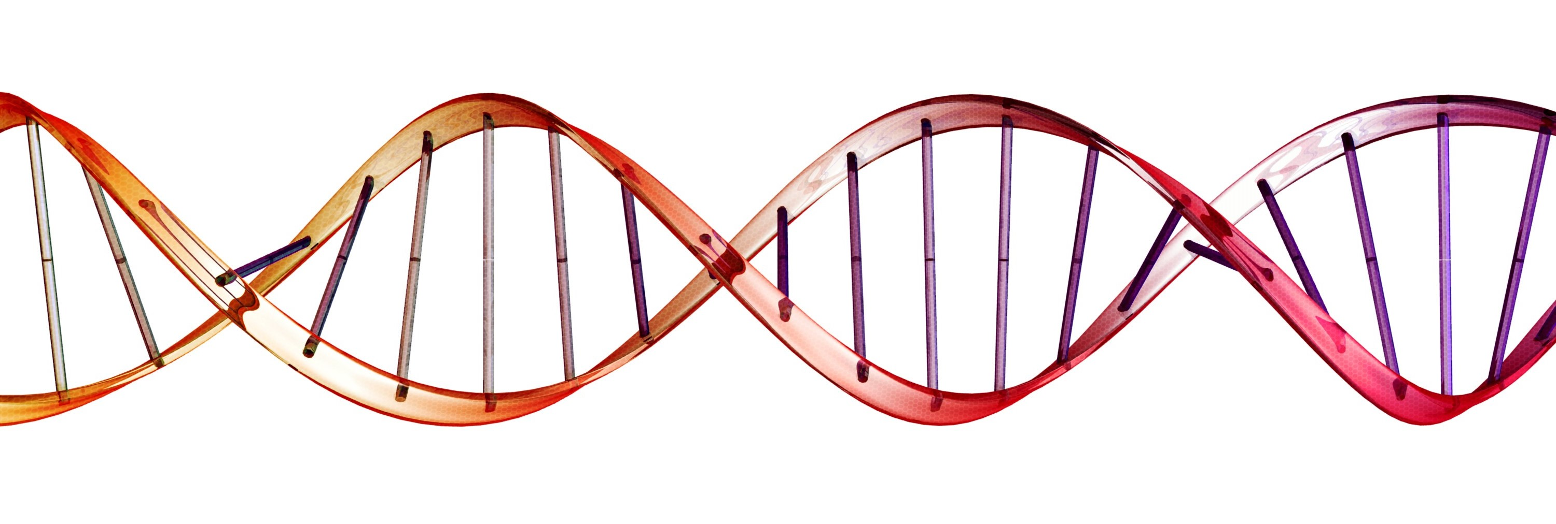
Scientific Study Shows This!
“There is simplicity and all inclusiveness to the number three – the triangle, the Holy Trinity, three peas in a pod. So it’s perhaps not surprising that the Family of Man is divided that way, too. All of Earth’s people, according to a new analysis of the genomes of 53 populations, fall into just three genetic groups . . . Population geneticists expected to find dramatic differences . . . [but] that’s not what scientists have found. Dramatic genome variation among populations turns out to be extremely rare.”

Slide 8
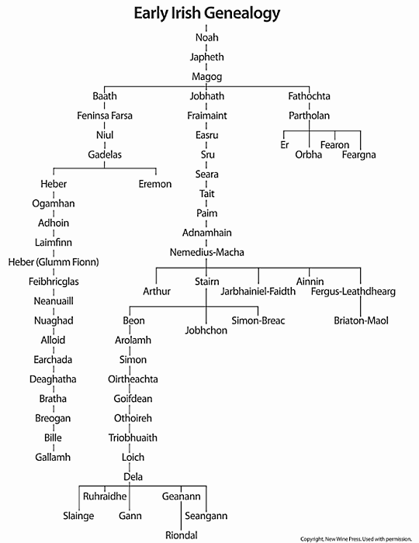
Scientific Study Shows This!

Slide 9
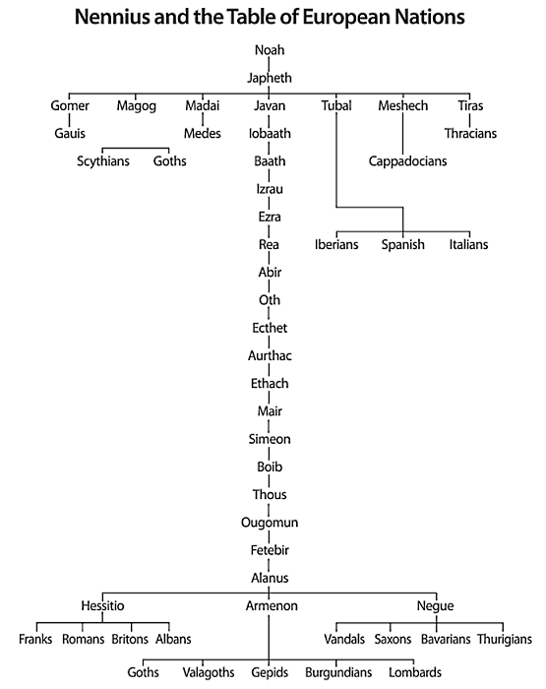
Scientific Study Shows This!

Slide 10
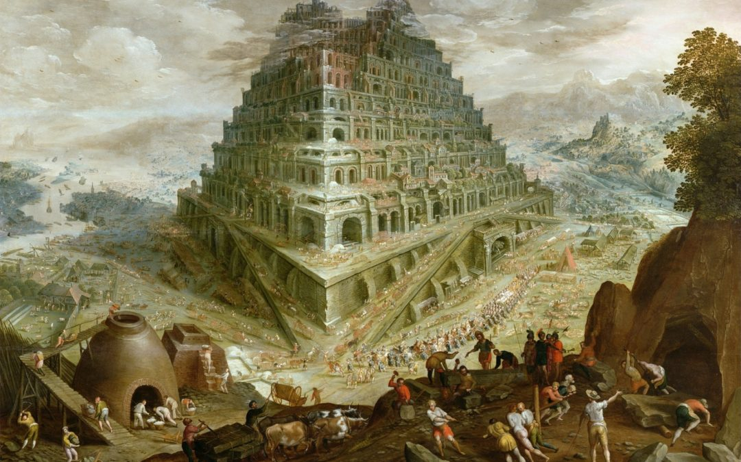
The Bible Explains This Common Ancestry!
Adam & Eve (Gen. 1-2)
Cain, Abel, & Seth (Gen. 4-5)
Noah (Gen. 6-9)

Slide 11
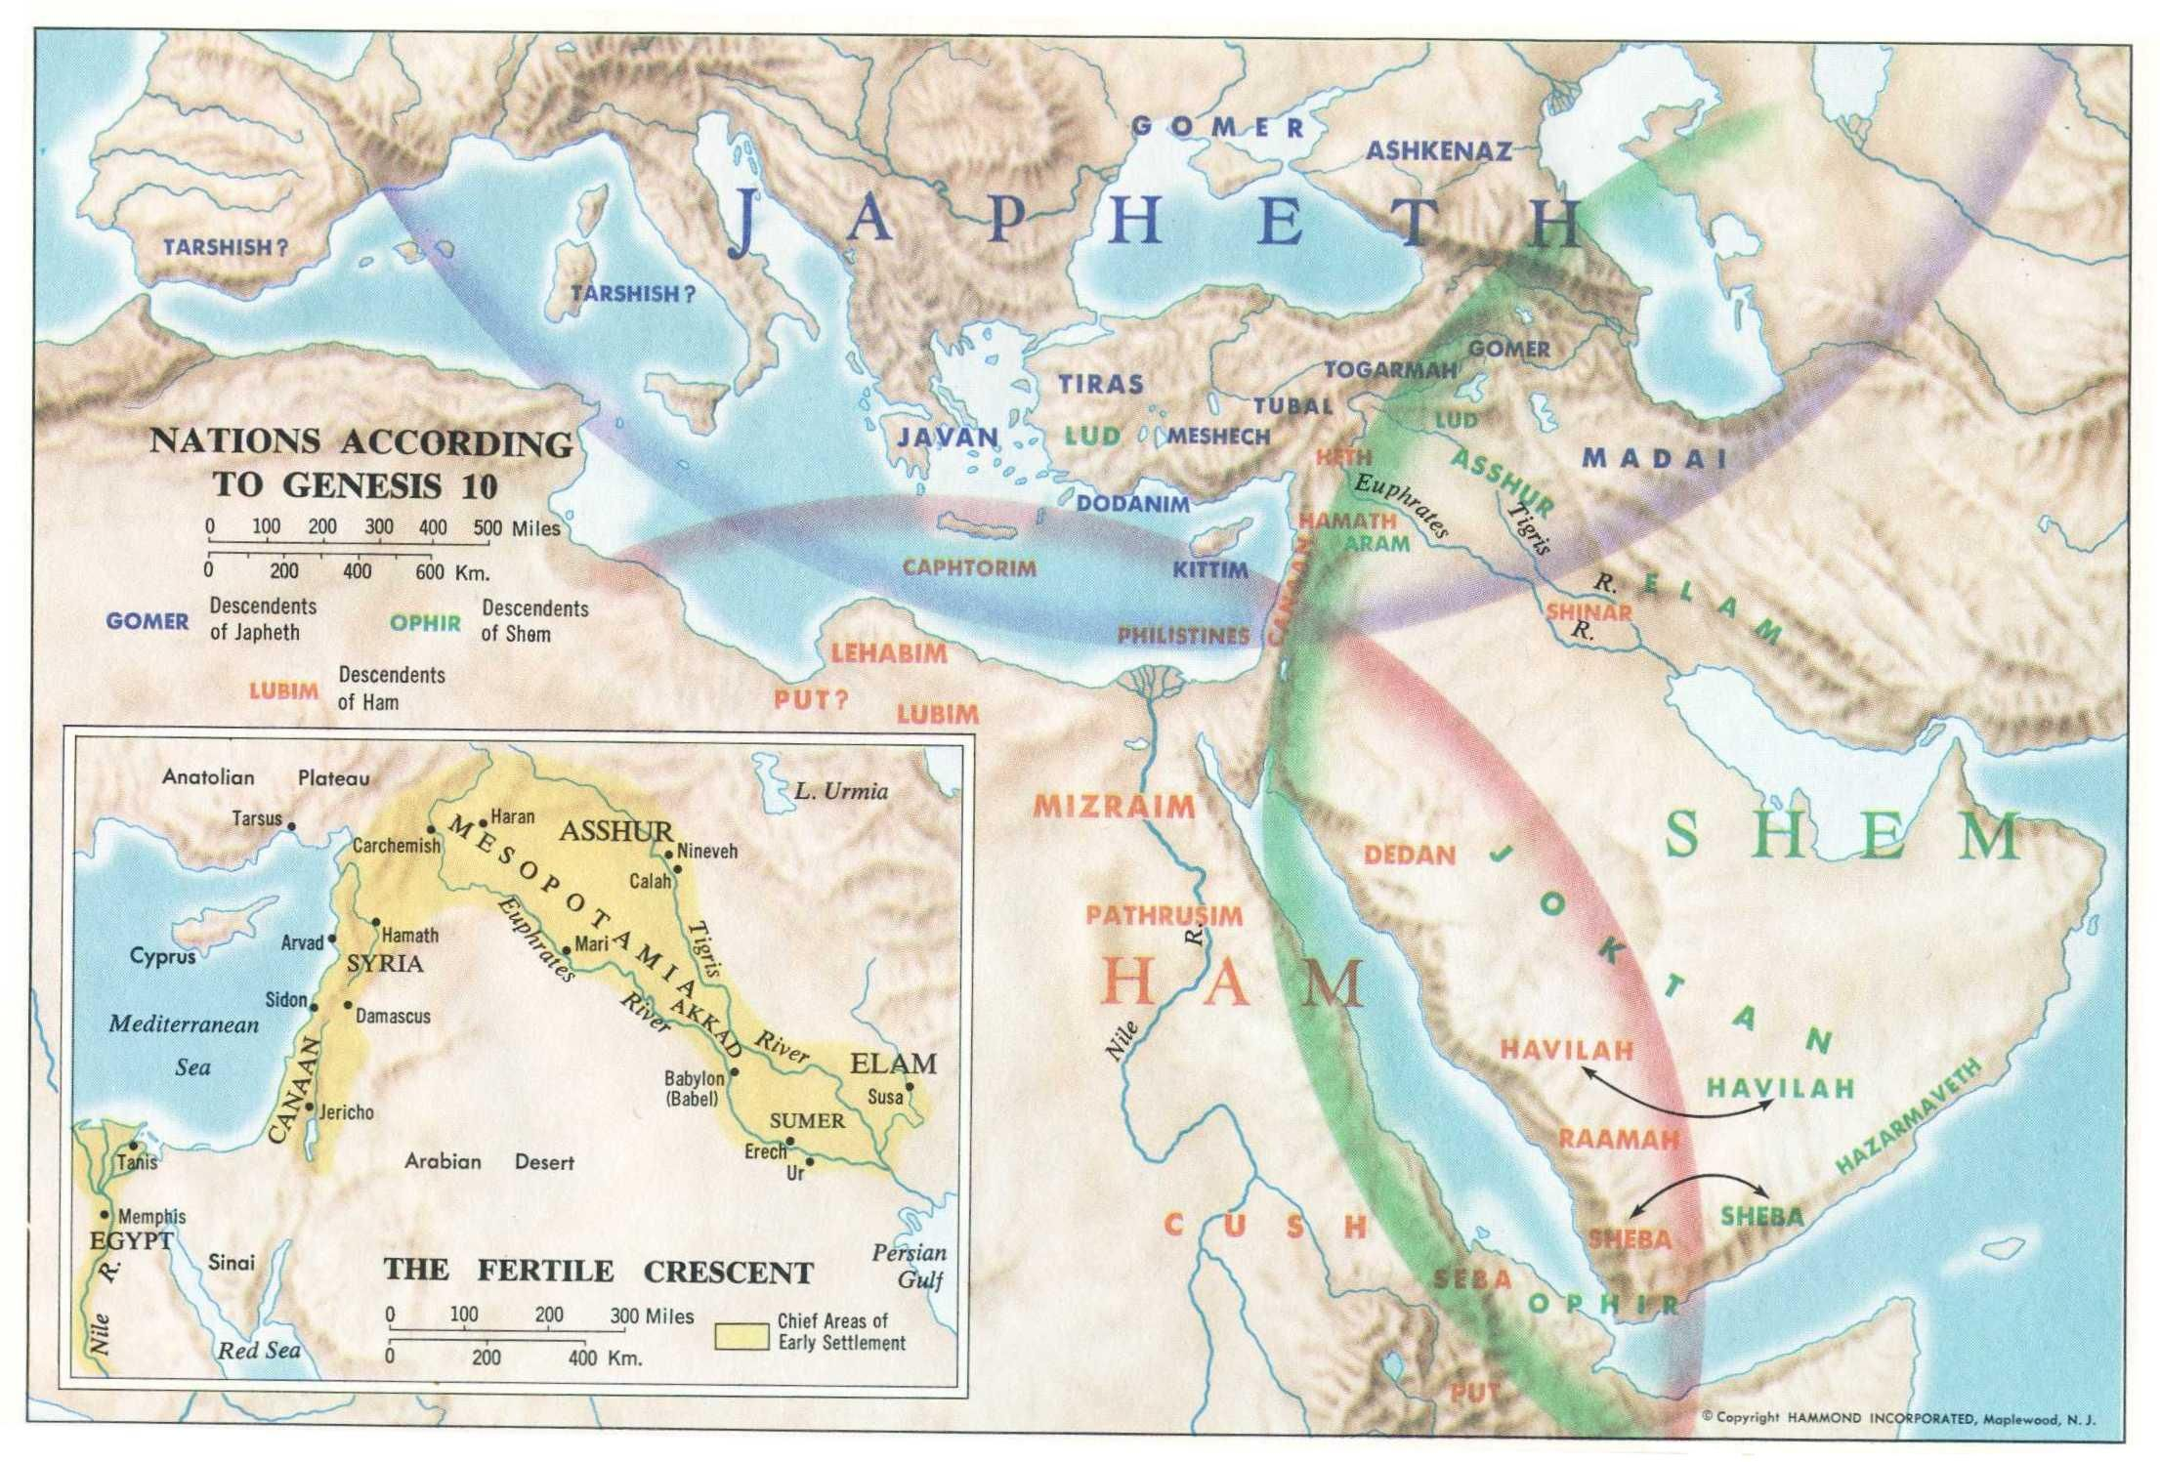

Slide 12
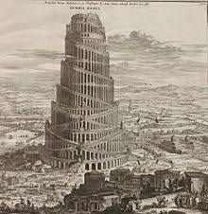
Patriarch #1: Japheth (Gen. 10:2-5)
Becomes Europe
Notable Names:
Ashkenaz (Hebrew: Germany)
Riphath (Hence, Europe)
Tagarmah (Hence, Germany)
Tarshish (Spain)
Dodanim/Rodanim (Rhodes)
Meshech (Hence, Moscow)
Tiras (Hence, Etruscans)

Slide 13
Patriarch #2: Ham (Gen. 10:6-20)
Becomes Africa
Notable Names:
Cush (Ethiopia)
Nimrod (Mesopotamia)
Babylon, Shinar (Babylon)
Accad (Hence, Akkadians)
Nineveh (Assyria)
Mizraim (Hebrew: Egypt)
Put (Libya)
Canaan & Children (Canaan)

Slide 14
Patriarch #3: Shem (Gen. 10:21-31)
Becomes Middle East/East
Notable Names:
Asshur (Assyria)
Asshur In Ham’s Line Too!
Eber (Hence, Hebrews)
Peleg (Time Of Dispersion)
Lud (Hence, Lydia)
Aram (Hence, Aramaic)

Slide 15
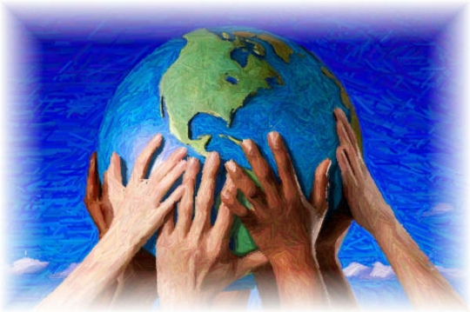
What Does This Mean For Us Today?
Through God’s oversight, Earth was populated. This process means we ALL have the SAME origin!
As such, no person is inherently more valuable or worthy, better or purer, than any other!
Common origin is a fact. However, cultural differences are also to be acknowledged & celebrated!

Slide 16
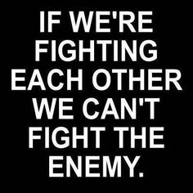
“Eve was the mother of all the living” (Genesis 3:20)
“From Shem, Ham, and Japheth, the whole Earth was populated.” (Genesis 9:18-19)
“He made from one person every nation of mankind.” (Acts 17:26)

