Slide 1
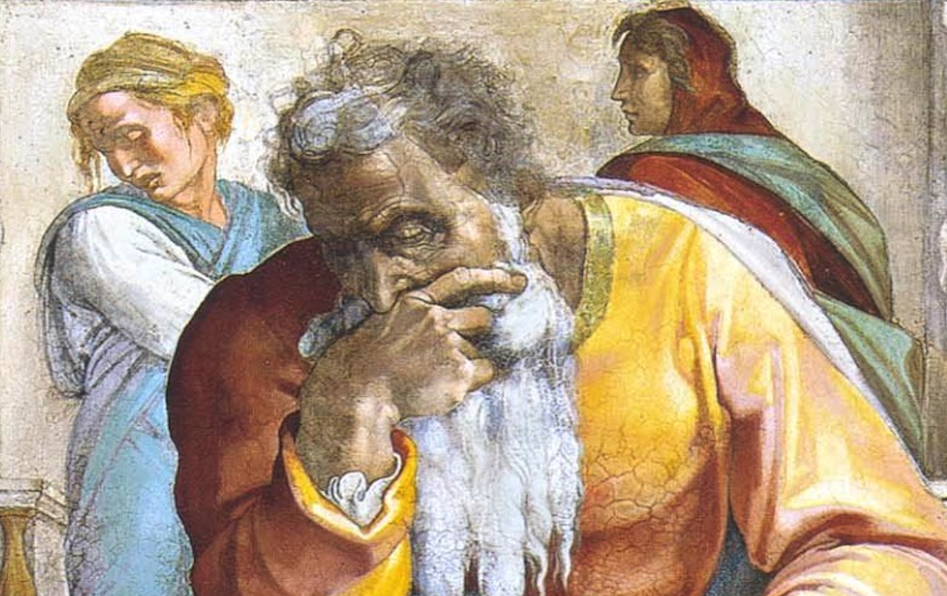
Introduction To Jeremiah

Slide 2
Basic Facts
Longest Book of the Bible (33,002 words)
Personal Background
Priestly Family (cf. Ezekiel & Zechariah)
From Anathoth, 2-3 miles NE of Jerusalem
Name means “YHWH Hurls/Exalts”
Date: 627 to post-586 B.C.
Kings: Josiah, Jehoahaz, Jehoiakim, Jehoiachin, Zedekiah
Prophets: Zephaniah, Nahum, Habakkuk, Daniel, Ezekiel

Slide 3
About Jeremiah’s Work
Prophet
Priest
Preacher
Writer
Intercessor
Statesman
Counselor

Slide 4
“The Weeping Prophet”
Sorrow (2:5, 8, 11, 13, 19; 5:30f; 6:10-16)
Broken heart (4:19f; 8:21f; 9:1; 13:17; 23:9)
Grief (15:10; 20:14-18)
Plots to kill him in hometown (11:18-23)
Propaganda against him (18:18)
Scourged and put in stocks (19:14-20:6)
Fellow prophet killed (26:20-24)
Imprisoned (37:11-15)
Taken from dungeon to court of the guard and fed only bread (37:16-21)
Cast in muddy cistern/pit (38:1-13)
He was seen as a traitor for suggesting defection/surrender to Babylon.

Slide 5
Messianic Prophecies
His Coming
30:24; 48:47; 49:6, 39/30:21/31:15
His Purpose
23:5-8; 30:9; 33:14-16/33:17f/31:31-34; 50:5/31:38-40
His Effect
31:29f/3:14-18; 31:6; 32:36-44/31:35-37/31:7/30:22; 31:1, 7, 14, 33; 32:38; 33:24

Slide 6
Outline
Chapter 1: Jeremiah’s Call
Chapters 2-20—Prophecies Concerning Judah & Jerusalem During Josiah’s Reign (627-608 B.C.)
Chapters 21-39—Prophecies of Specific Events During the Reign of Jehoiakim (608-597 B.C.) and Zedekiah (597-586 B.C.)
Chapters 40-44—Jeremiah’s Ministry to Judah After the Fall of Jerusalem (post-586 B.C.)
Chapters 45-51—Prophecies Against Foreign Nations
Chapter 52—The Fall of Jerusalem (586 B.C.)

Slide 7
Lessons We Are Going To Learn!
God judges ALL wickedness.
Patient perseverance.
Stand for the truth even when everyone else lies.
Never replace God with false gods.
Let God’s Word be a burning fire in your soul.
You will have people who hate and despise you, but you will also have people who step up in big ways for you (e.g. Ebed-Melech).
Leadership isn’t always what it should be. Even though that is the case, that does not justify evil actions, or inaction when action should be taken.

