Slide 1
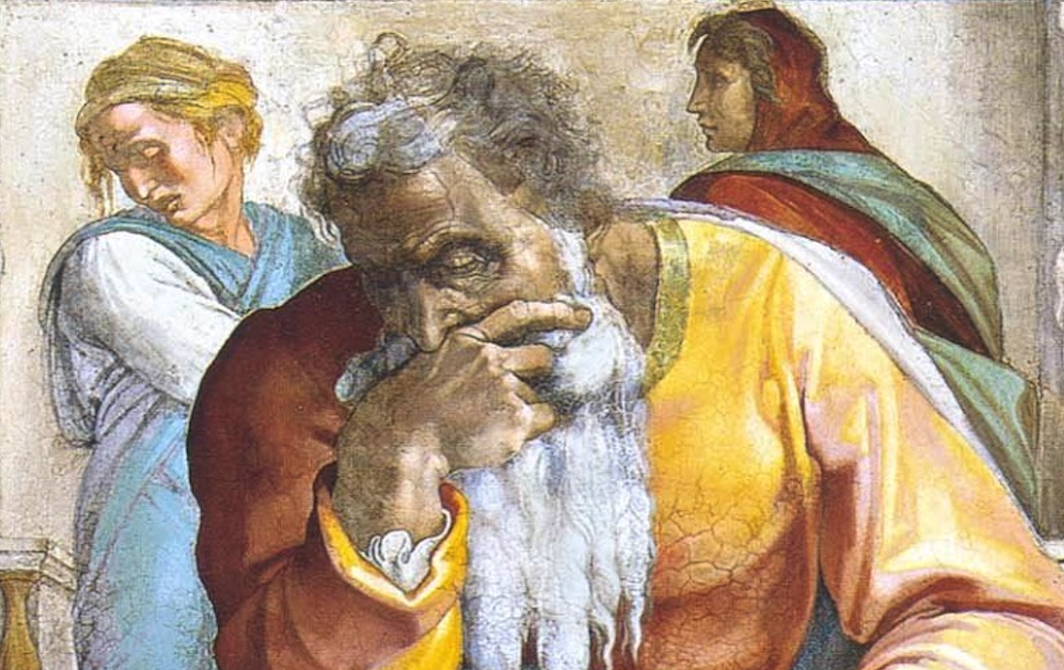
Jeremiah: Chapters 1-2

Slide 2
R.K. Harrison, “Jeremiah & Lamentations,” TOTC, 47
“Jeremiah is the most notable of the Hebrew prophets because of the almost impossible mission which God assigned to him. His task was to try to recall the people of Judah to an observance of divine law at a time when they were poised on the brink of national and spiritual catastrophe. For many years the influence of pagan Canaanite worship had exerted a corrupting effect upon the Judeans, as it had done earlier in the northern kingdom. Religious apostasy had been followed by social and moral decay...

Slide 3
R.K. Harrison, “Jeremiah & Lamentations,” TOTC, 47
...and it fell to Jeremiah to present the implications of the Sinai covenant fearlessly in a desperate attempt to stem the tide of destruction. But because the nation was indifferent and rebellious by turns, Jeremiah soon found that he had acquired a reputation for pessimism and gloom. For his fidelity to his vocation he was rejected, hated, persecuted, and even feared by those whom he was most anxious to recall to covenant spirituality. Such a prophetic mission demanded a keen and continuing sense of vocation, supported by courage, faith and determination.”

Slide 4
Chapter 1: Jeremiah’s Calling
Historical Prologue (1:1-3)
The Appointment of Jeremiah (1:4-10)
Signs of God’s Assurance (1:11-19)

Slide 5
Chapter 1: Thought Questions
Does 1:5 prove Calvinistic predestination? Why not? Compare Judg. 13:5; Lk. 1:15.
What challenges do youthfulness, agedness, and middle-agedness respectively hold in our service to God?
How do we reconcile that Jeremiah, a messenger of God, is given authority to tear down (1:10), yet Paul says (seemingly) the exact opposite (2Co. 10:8; 13:10)?
How are Jeremiah and Moses’ call to be prophets very similar? See Ex. 4:1-17.

Slide 6
Chapter 1: Applications
God’s Word must be spoken, in season and out of season (2Tim. 4:1-4). It is always profitable, in judgment against sin or in messages of blessing for righteousness (cf. Acts 20:26f; 2Tim. 3:16f).
Standing for what is right will cause you to be hated by some. Even so, God’s side is the side to remain on as it ensures protection and blessing. Though trials and thorns will persist in this life, we must aim our sights on the rewards of the next life (cf. Rom. 8:18, 28, 31-39; 2Cor. 4:8f).
Whatever fears we may have in ministry to God, He has prescribed a remedy for those fears (Mt. 10:28).

Slide 7
R.K. Harrison, “Jeremiah & Lamentations,” TOTC, 49f
“The command ‘fear not’ was given on many occasions in Scripture to the Lord’s servants, including Abraham (Gn. 15:1), Moses (Nu. 21:34; Dt. 3:2), Daniel (Dn. 10:12,19), Mary (Lk. 1:30), Simon (Lk. 5:10) and Paul (Acts 27:24). Fear is one of the most paralysing of human emotions, and can only be dispelled fully by the love of Christ (cf. 1 Jn. 4:18). [Verse 8 of chapter 1] indicates that God always supports His servants in the missions assigned to them (cf. Ex. 3:12). While Jeremiah will not be free from opposition and even physical danger, he will survive all difficulties, because God will be with him to sustain him.”

Slide 8
Chapter 2: God’s Indictment
They Rejected His Love (2:1-8)
They Exchanged Glory For Shame (2:9-13)
They Reap What They Sow (2:14-19)
Israel’s Rebellion Illustrated (2:20-28)
Senseless Claims Of Innocence (2:29-37)

Slide 9
Chapter 2: Thought Questions
What is the importance of recalling the things that God has done in our past? Why is this so imperative?
What New Testament passage speaks of exchanging the glory of God for corruptible things? Compare and contrast the two passages.
What other prophet(s) describe the sort of denial that we see in this passage?
Judah is said to have had more gods/idols than cities. What other cities, discussed in the New Testament, were historically known for that?

Slide 10
Chapter 2: Applications
Youthful vigor in the faith can quickly dissolve into abject ungodliness. Let us always remember that God is the “guide of our youth.”
God is to be blessed and honored even in judgment. He is faithful even when people are faithless (2Tim. 2:13).
The conscience may quickly be seared and the spiritual senses dulled (1Tim. 4:2; Heb. 5:12-14). One may find himself or herself denying things that have no logical basis or foundation. Make sure to strengthen your senses of discernment each and every day.

Slide 11
R.K. Harrison, “Jeremiah & Lamentations,” TOTC, 61
“Jeremiah reflects a situation common to many ages in noting that the apostate offenders demand immediate and effectual divine help when calamity strikes. They thus testify, however inadvertently, to God’s existence and His ability to help them, undeserving as they are. A merciful and loving God has made provision for such people (cf. Lk. 6:35).”

