Slide 1
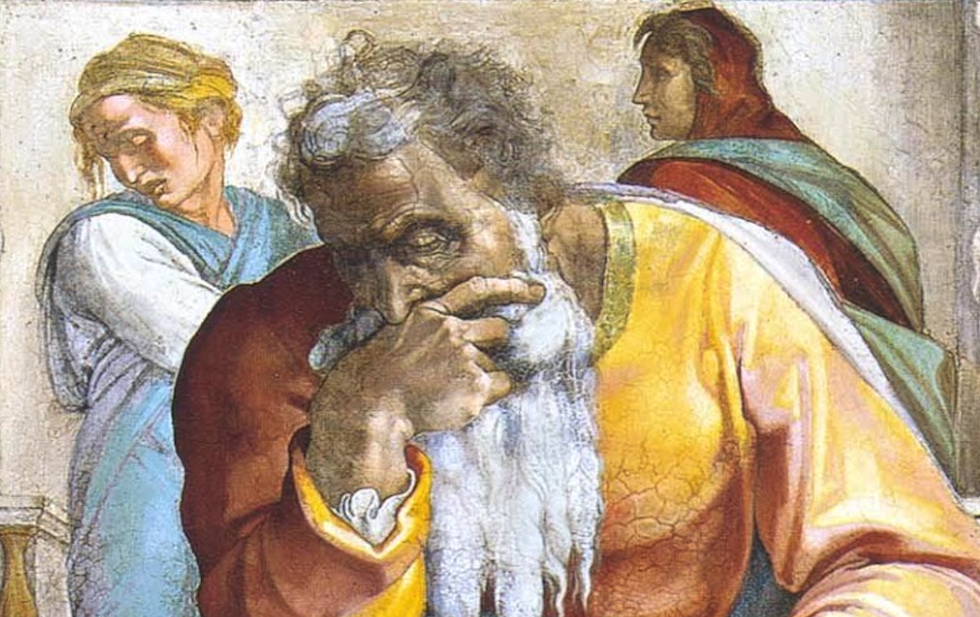
Jeremiah: Chapters 3-4

Slide 2
John Humphries, “The Books of Jeremiah and Lamentations,” Truth Commentaries, 27
“Jeremiah charges the people with committing spiritual adultery against God. They had gone after the idols of the nations around them. God called the nation back to him, but the people would not listen to the warnings of the Lord. Neither Israel nor Judah was proving faithful to the Lord. Whatever manifestation of repentance Judah was exhibiting, it was insincere. But then, in the midst of the words of God’s wrath against the people, the Lord holds out messianic hope for Israel. In the last portion of the chapter, the ungodly nation’s impenitence is contrasted with the humble prayer of the righteous remnant.”

Slide 3
Chapter 3: Repent & Live!
God’s Call To Repentance (3:1-5)
Two Profligate Sisters (3:6-11)
Invitation For Israel To Repent (3:12-13)
Mercy & Blessings For Penitent (3:14-18)
Idols = Shame; YHWH = Salvation (3:19-25)

Slide 4
Chapter 3: Thought Questions
What does it mean to have a “harlot’s forehead”? (3:3; cf. Is. 58)
Explain the future exaltation of Jerusalem as the “throne of the LORD”? (3:17; cf. Ex. 25:22)
Is confidence in religious relics a good substitute for God? (cf. 1Sam. 4:3-8, 21f)
Which Minor Prophet provides the backdrop for much of this chapter?

Slide 5
Chapter 3: Applications
No disparity between lip and life should ever exist
Immorality is akin to stupidity
Genuine repentance cannot be feigned. Rote form and service are meaningless (Harrison, 66-67)
Punishment for the sins of others should deter!
In 3:17, God speaks of all drawing to Jerusalem, including the nations. This clearly is a prophecy of reconciliation of Jews & Gentiles in the gospel.

Slide 6
John Humphries, “The Books of Jeremiah and Lamentations,” Truth Commentaries, 37
“A plea is made to the people for them to repent and thus avoid being taken away into exile. Nevertheless, Jeremiah gives warning of an imminent invasion that will devastate the land. The Jews were bringing this upon themselves because of their wickedness. Calls for repentance sound again and again in the chapter. Jeremiah is brokenhearted as he sees, through the prophetic eye, the complete devastation of the beloved homeland and the people’s utter helplessness to resist the invading armies.”

Slide 7
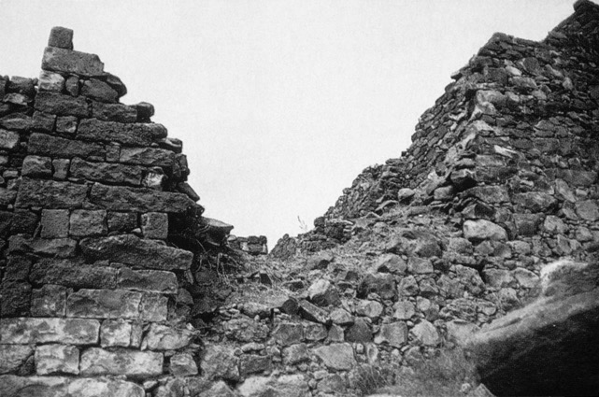
Chapter 4: Repent Or Die!
Call for Genuine Repentance (4:1-4)
The Desolation to Come (4:5-18)
Jeremiah’s Grief (4:19-31)

Slide 8
R.K. Harrison, “Jeremiah & Lamentations,” TOTC, 69)
“The MT my heart moans (hmh) inside me points to a profoundly disturbed physical condition due to shock...One calamity now follows on the heels of another. There is no escape, for everything is devastated in a moment, as though by fire. The prophet wonders anxiously how much longer he can stand the emotional strain of contemplating his countrymen streaming to the fortified towns for refuge and quivering with terror as the warning trumpet blasts, for he knows that the latter will be of no uncertain import.”

Slide 9
Chapter 4: Thought Questions
What passages speak of figurative circumcision of God’s people and what do they indicate? (4:4)
What should be our reaction to advantages/grace? (4:3f; Rom. 2:25-29; 6:1)
What NT passages uses similar references to spiritual washing and what do they imply? (4:14)
Despite 11th hour beautification, how would her former paramours react?

Slide 10
Chapter 4: Applications
A “renewal of vows” can redirect our waning zeal (4:2).
“Inner cleansing is the only alternative to destruction by fire, a theme prominent also in New Testament thought (cf. Mt. 13:42, 50; 25:41; 1 Cor. 3:13, etc.).” (Harrison, 69)
All the knowledge in the world, w/o God, is meaningless (4:22; cf. Prov. 1:7).
Mastery in sin plagued Judah and it plagues us today (see J. Humphries, 29, 45f).

Slide 11
John Humphries, “The Books of Jeremiah and Lamentations,” Truth Commentaries, 49
“Why, of why, do people continue in sin, refuse to repent, and get themselves into such helpless and hopeless circumstances (Prov. 1:20-33)? Why will we not listen to God instead of blundering along in our own rebellious way that eventually leads us into heartache and destruction (Jer. 10:23)?”

