Slide 1
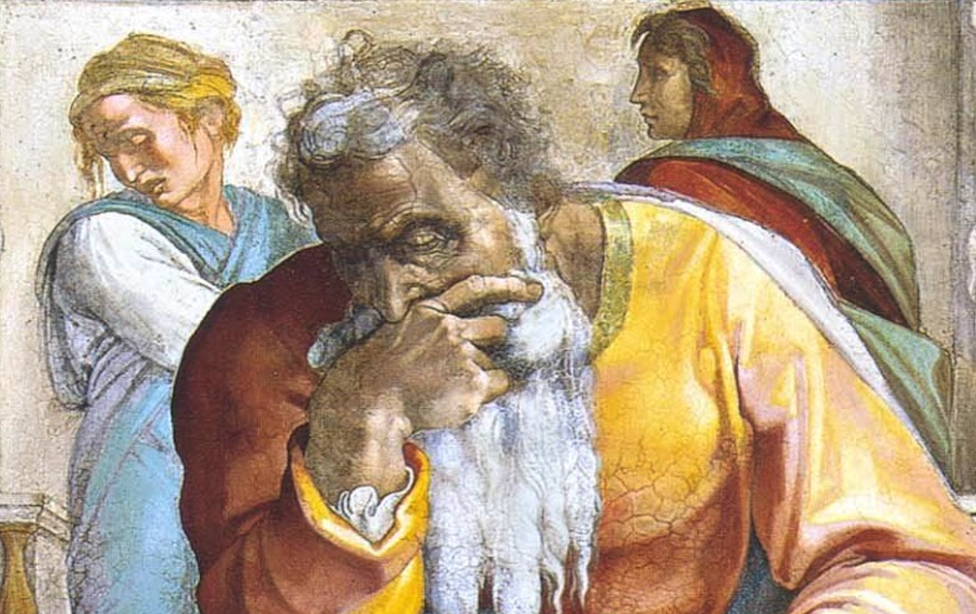
Jeremiah: Chapters 5-6

Slide 2
John Humphries, “The Books of Jeremiah and Lamentations,” Truth Commentaries, 50
“Jeremiah looks in vain for godly men who would stand with him against the forces of wickedness in the land. Violence and immorality permeate the society. The false prophets and the people are in denial concerning the danger of falling into the hands of the Babylonians. Time and again, Jeremiah appeals to the people to repent. However, they refuse to listen to God’s warning exhortations. The children of Israel hypocritically continue to come to the temple and engage in very expensive rituals as if nothing were wrong. The false prophets, the self-serving priests, and the worldly people of Judah are happy with the status quo. But in the end, as judgment falls upon the sinful kingdom of Judah, they will thrash about for help from some source, but it will be too late for the nation.”

Slide 3
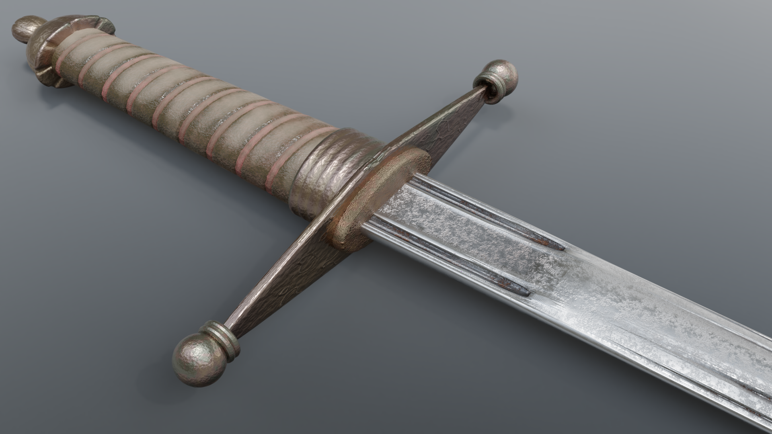
Chapter 5: Necessity For Impending Judgment
Faces Harder Than Flint (5:1-6)
Sexual Impurity (5:7-9)
Lying About God (5:10-18)
Revolting & Rebellious Hearts (5:19-24)
Forsaking Social Justice (5:25-29)
Loved Lawlessness (5:30-31)

Slide 4
R.K. Harrison, “Jeremiah & Lamentations,” TOTC, 75
“All had sinned in breaking the yoke of the law, and were like animals which had snapped the ties securing the heavy yoke to their necks. As the servants of sin they deemed themselves free from the righteousness of the law (cf. Rom. 6:20). Jeremiah, by contrast desired them to be free from sin and become servants of righteousness (cf. Rom. 6:20).”

Slide 5
Chapter 5: Thought Questions
What is the intended goal of divine discipline? (cf. 5:3) What passages can you think of that relate to this?
What about God’s Word makes it consuming and what about people’s response makes them consumable? (cf. 5:14) What does this tell us about today?
How is Babylon described in chapter 5? (cf. Is. 28:11; 22:19; 47:6; Hab. 1:5-11)
What sorts of good things might be withheld from us b/c of our sins? (cf. 5:25)
Compare translations for 5:30. Which are preferable?

Slide 6
Chapter 5: Applications
Don’t preach simply to tickle the ears of people; preach to storm the will in the hour of need (cf. Mic. 2:11; 3:11; 2Tim. 4:2-4; Acts 20:26f; Col. 1:28).
Consonance between life and lips (Ps. 34:12ff; 1Pet. 3:10f; Heb. 13:15f)
What connections may be made between 5:10f & Jn. 15:1-6? (cf. Matt. 3:8)
Scrupulous honesty in all social relationships (Mk. 10:19; 1Thess. 4:6; Titus 2:10)
“...under the new covenant the willful and rebellious cannot expect to fare any differently from their old covenant precursors.” (Harrison, 78)

Slide 7
John Humphries, “The Books of Jeremiah and Lamentations,” Truth Commentaries, 67
“The picture is that of a powerful enemy force invading the land ‘out of the north.’ Preparation is made for defense, but to no avail. The nation of Judah will be conquered. Again, Jeremiah tells the people why this is happening to them and makes another appeal for them to return to the ways of God. They continue to refuse the exhortations to repent, so their wickedness remains. The efforts to ‘refine’ them have failed. Therefore, they will face the Lord’s wrath as ‘rejected silver.”

Slide 8
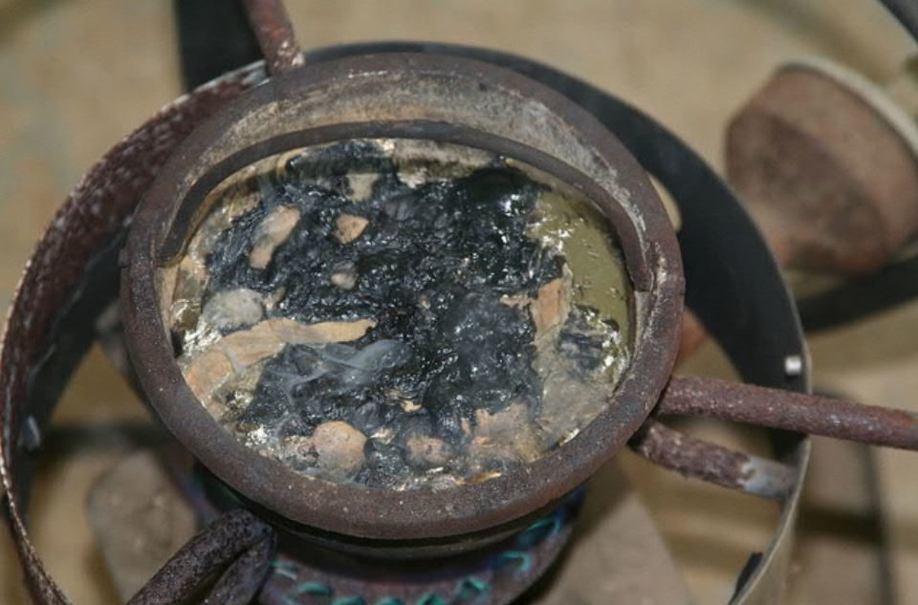
Chapter 6: Rejection of a Worthless People
War Is Coming! Flee! (6:1-9)
Hope Found in the Old Paths (6:10-30)
Deception of the False Prophets (6:10-16)
Refusal to Repent Made Them Dross (6:17-30)

Slide 9
LA Mott Jr, Thinking Through Jeremiah, 57
“In refining, the alloy containing the gold or silver is mixed with lead, and fused in a furnace on a vessel of earth or bone-ash; a current of air is turned upon the molten mass (not upon the fire); the lead then oxidizes, and acting as a flux, carries away the alloy, leaving the gold or silver pure (J. Napier, The Ancient Workers in Metal, 1856, pp. 20, 23). In the case here imagined by the prophet, so inextricably is the alloy mixed with the silver, that, though the bellows blow, and the lead is oxidized in the heat, no purification is effected: only impure silver remains.”

Slide 10
Chapter 6: Thought Questions
How might “love” or “peace” be falsely defined & compound judgment? (cf. 6:14)
What does it mean to not be able to blush? (cf. 6:15) What positive role does shame serve for believers? How can it be negatively applied?
What does it mean to walk in the old paths? (cf. 6:16) How does this relate to us today? Does this passage mean that tradition is on par with Scripture? Where else do we find the expression, “and you will find rest for your souls”?
How do we cope with the frustration of sharing the gospel with hardened people? How do we cope with false teachers undoing our efforts?

Slide 11
Chapter 6: Applications
Religion without delight in God’s Word is poisonous (cf. Matt. 13:13-15).
Covetousness mixes up our values (cf. Luke 12:15-21).
We should beware false prophets/teachers (cf. Matt. 7:21-23; Luke 6:46; 1Jn. 4:1).
Shame serves a vital purpose (cf. 2Cor. 7:10; Rom. 2:21-25).

