Slide 1
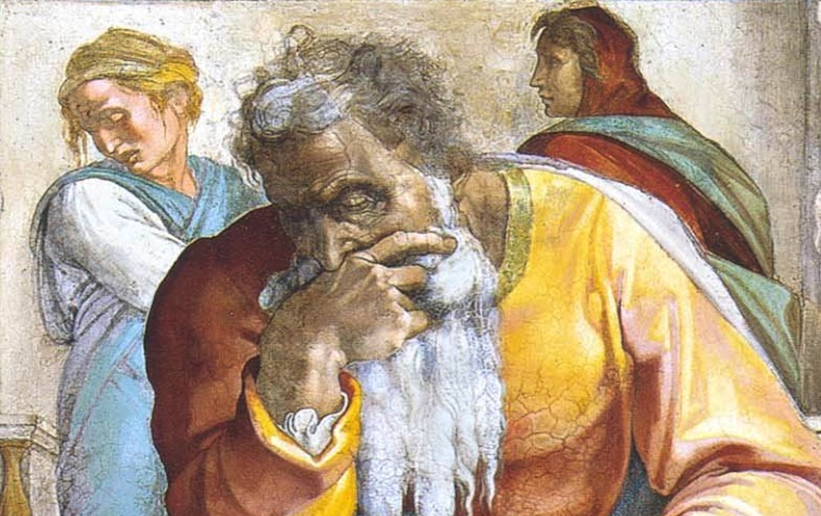
Jeremiah: Chapters 7-8

Slide 2
John Humphries, “The Books of Jeremiah and Lamentations,” Truth Commentaries, 77
“Jeremiah goes to the temple and delivers a powerful rebuke to the worshippers assembled there. The people’s hypocritical worship is not acceptable to the Lord. They are warned that righteous conduct and sincere devotion to God must accompany worship. The Jews are clearly warned that they do not have a guarantee that God will bless them just because they have the temple and observe the rituals of worship...

Slide 3
John Humphries, “The Books of Jeremiah and Lamentations,” Truth Commentaries, 77
“...In fact, God is threatening to destroy the temple, just as he destroyed the ancient tabernacle at Shiloh. In spite of being constantly warned by God’s prophets, the people of Judah refuse to worship God properly. Instead, they continue to walk in the ways of their own hearts as they zealously pursue the worship of the idols. Accordingly, the horror of war is on the way as a judgment from the Lord.”

Slide 4
Chapter 7: God’s House Is Defiled
Misplaced Confidence in the Temple (7:1-7)
A Den of Thieves (7:8-11)
Remember Shiloh? (7:12-15)
Idol Worship (7:16-20)
Faithful Obedience Over Sacrifice (7:21-28)
The Valley of Slaughter (7:29-34)

Slide 5
Chapter 7: Thought Questions
Is there a place for “blistering” sermons? If so, when?
Is there ever an appropriate time to stop praying for someone? (cf. Ps. 66:18; Prov. 28:9; 15:29; Jn. 9:31)
This chapter idiomatically uses “rising early” to indicate repeated attempts. What principles can we derive from this concept and example?
In what ways might we make God’s house a den of thieves?

Slide 6
Chapter 7: Applications
Ritual form and pride in “having the truth” are poor substitutes for faithful and loving obedience to the Lord. We must worship correctly and have sound doctrine; we must also and equally (more?) important, have sound words and lives.
God will not force the truth on us while we are living.
“God has provided enough evidence in this life to convince anyone willing to believe, yet he has also left some ambiguity so as not to compel the unwilling.”
(Norman L. Geisler and Frank Turek, I Don’t Have Enough Faith To Be An Atheist (Wheaton: Crossway, 2004), 31).

Slide 7
John Humphries, “The Books of Jeremiah and Lamentations,” Truth Commentaries, 93
“Jeremiah continues his temple address by warning of the desecration of the Jews’ graves at the hands of their pagan captors. The people claim to have the Law of God and wise leadership, but this claim is lulling them into a false sense of security. Judah has utterly failed to respect and heed the warnings of God’s prophets, yet the people continue to desire the Lord’s favor. However, their vaunted wisdom must sincerely look to God and his word if the nation of Israel is to be truly blessed. The Jews foolishly continue to refuse to recognize the danger that faces them at the hands of the Babylonians. Jeremiah’s heart is broken as he looks ahead, through the prophetic eye, to their destruction and captivity.”

Slide 8
Chapter 8: Desecration & Destruction
Grave Desecration (8:1-3)
Abominable False Teaching (8:4-7)
Dead People Walking (8:8-13)
The Invading Army (8:14-17)
The Weeping Prophet (8:18-22)

Slide 9
Chapter 8: Thought Questions
Disturbing graves remains (for most) an abominable action. Why? And what significance does this have on the first few verses of chapter 8?
Is there anything instinctual about serving God? (8:7; cf. Eccl. 3:11; Rom. 2:14f)
What does 8:7 tell us about God as far as intelligent design?
What other passages speak of a salve or balm? What is God’s balm for sin?

Slide 10
Chapter 8: Applications
False teaching is deceitful and leads one into the gall of bitterness (cf. Heb. 3:12f).
Teachers have a HUGE responsibility on their shoulders (8:8-12; cf.2Tim. 2:15; James 3:1; 2Pet. 3:16).
We should be grieved over national malaise (8:18-23).
“The eyes of the Lord are on the righteous, and his ears attend to their cry. The face of the Lord is against those who do evil, to cut off the remembrance of them from the earth.” (Ps. 34:15f).
We need to follow God’s way for us and if we should ever diverge from the path He has given, let us migrate back to Him! (Is. 1:3).

