Slide 1
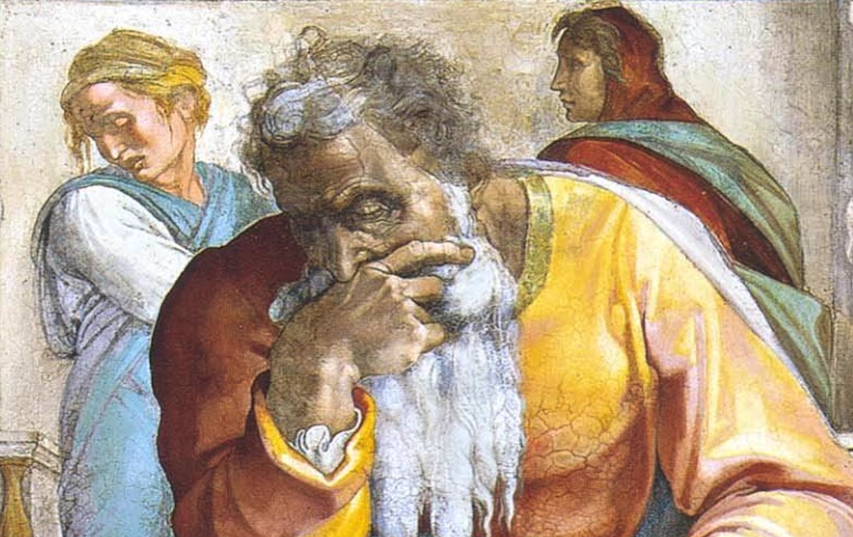
Jeremiah: Chapters 9-10

Slide 2
John Humphries, “The Books of Jeremiah and Lamentations,” Truth Commentaries, 102
“As Jeremiah continues his temple remarks, he is a man torn between sorrow and frustration. He is distressed over the thought of the people’s painful captivity, but he is frustrated at their rejection of his efforts to warn them concerning their evil ways. He observes rampant violence and gross immorality permeating the land that will eventually result in desolation for Jerusalem. Mourning women are called for, as the dead will be many. The Israelites are not to glory in wisdom, might, or riches; instead, they are to glory in the Lord. Jeremiah concludes the chapter by warning that Israel and the nations will be punished for being uncircumcised in heart.”

Slide 3
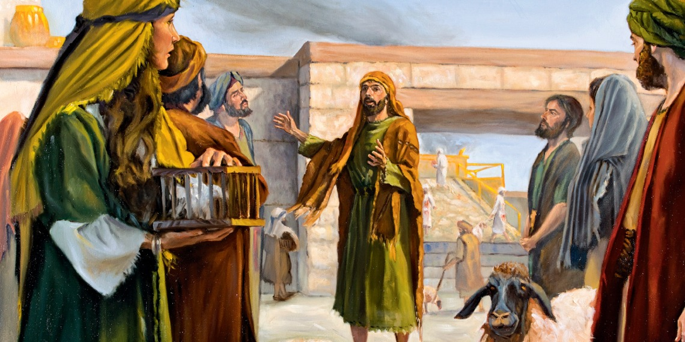
Chapter 9:
Judah Runs From One Evil To Another Evil (9:1-9)
Because Of This They Will Be Scattered (9:10-16)
Mourners Called In To Lament Judah (9:17-26)

Slide 4
Chapter 9: Thought Questions
What other Bible character(s) struggled with living amidst the unregenerate? (9:2) Have you ever felt like this and wanted to just get away from it all?
What two masters can one serve? (9:13-14)
Where is 9:24 either quoted or alluded to in the NT? Explain the context of each usage.
What characterizes God? What is said of God’s response to these characteristics? What should we take away from this?
Physical circumcision without spiritual circumcision was worthless (9:25f). What applications may we make from this? (cf. Col. 2:11-13; Deut. 10:16; 30:6; Jer. 4:4; Rom. 2:25-29)

Slide 5
Chapter 9: Applications
Brothers and sisters in God should be able to depend on each other! Contrast 6:28; 9:4; Prov. 3:29; 11:9; 25:18.
Note the contrast between the empowering nature of doing good and the call to not grow weary in these things (e.g. Gal. 6:10) versus Judah’s wearying of themselves to do evil (cf. Eph. 4:26-32; Ps. 36:3f).
Compare Ezek. 9 and Jer. 9:21f.
“Wisdom, power, and riches are to this day the sole glory of many and the object of envy to those who have them not. But true glory awaits those who understand the Lord and walk in intimate fellowship with Him (cf. Psa. 111:10).” (Harkrider, 34; commenting on 9:23-24)

Slide 6
John Humphries, “The Books of Jeremiah and Lamentations,” Truth Commentaries, 111
“Jeremiah concludes his temple remarks by warning the Jews not to learn and practice the pagan religions. The pagan practices merely come from the deceitful heart of man and take away from God the glory that is due him as creator and sustainer of the world. Any attempt to answer human spiritual needs which does not come from God’s revelation is nothing other than idolatry. Mankind cannot know the way to God apart from his revealed word. Any efforts to ignore God’s word will only result in his wrath, which will surely come upon the people.”

Slide 7
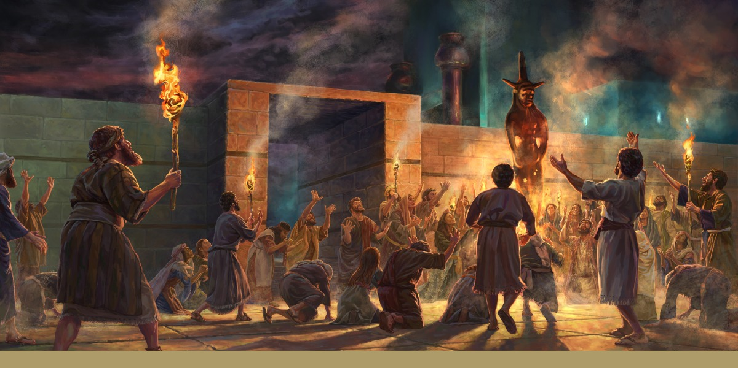
Chapter 10: Hosts vs. LORD of Hosts
Don’t Be Like Heathen Idol Worshippers! (10:1-5)
The LORD Is Living And True! (10:6-16)
Serving False Gods Brings Grief & Captivity (10:17-25)

Slide 8
Chapter 10: Thought Questions
What idols might we struggle with and how can we learn to see them for what they truly are? (cf. 10:1-5)
What is meant by a “discipline of delusion” or “doctrine of vanities” in vv. 8f?
Explain 10:16. What does it say and how does it read to you?
What is the danger of following one’s heart? (cf. 10:23; 17:9; Prov. 14:12)

Slide 9
Chapter 10: Applications
There are strong similarities between Isaiah 44:9-20 and Jeremiah 10:1-5.
Interest in astrology poses a legitimate danger to God’s people. We need to beware! (cf. 10:1-2; Deuteronomy 18:9-14). Do not worship the hosts instead of the LORD of hosts!
God is singularly unique (10:6-7; cf. Psalms 22:28; 86:8-10).

