Slide 1
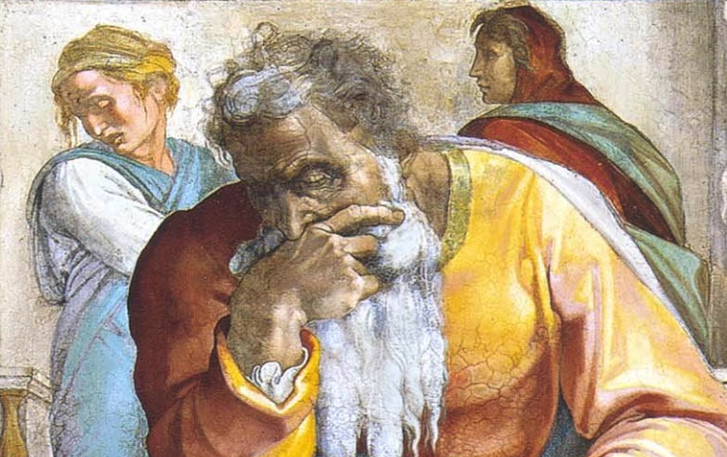
Jeremiah: Chapters 11-12

Slide 2
John Humphries, “The Books of Jeremiah and Lamentations,” Truth Commentaries, 125
“In the days of Jeremiah, the nation had turned away from God and had turned to the idols (Jer. 2:13, 20, 26-28; 5:7; 32:21-24). The curses of the broken covenant were descending upon them. Jeremiah continues to preach to them in order to warn the wicked and encourage the faithful remnant to remain true to the Lord (19:10-13; 31:7-9). It was not an easy task (12:5; 16:1-2; 20:7-10). However, the fire of God’s word was in his heart and he could not turn back from his task of preaching the word of God. When the word ‘came to Jeremiah from the Lord,’ he did not delay but went to the people with the unpopular messages. Although they did not appreciate it at the time, they would eventually come to know, one way or the other, that a ‘prophet has been among them’ (cf. Ezek. 33:33). ”

Slide 3
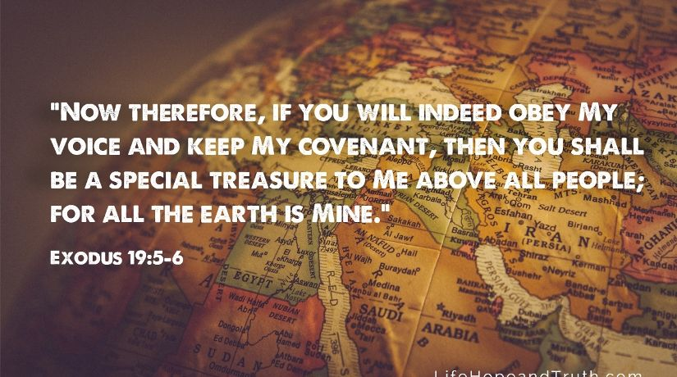
Chapter 11: “I Earnestly Protested”
Violation of the Covenant (11:1-8)
Like Father, Like Son: The Inadequacy of Empty Ritual (11:9-17)
Threats On Jeremiah’s Life (11:18-23)

Slide 4
Chapter 11: Thought Questions
What result did the persistent warnings of God accomplish? (11:7) How does God persistently warn us today? Elaborate.
What other passages in Jeremiah, and outside, command God’s people to not pray for others? (11:14)
Where else do we see God’s people likened unto an olive tree? (11:16) What is the point of this comparison in each context?
Why did the people of Anathoth seek Jeremiah’s life? (11:18-23) How does this relate to Jesus and other figures that are unwelcomed in their hometowns?
What Messianic significance does the section detailing threats on Jeremiah’s life hold? (11:18-23)

Slide 5
Chapter 11: Applications
God has taken us out of the iron furnace. That extraction bears responsibilities.
We should be incredibly grateful that God has grafted us Gentiles into the olive tree of His people. But we should never become arrogant to think that we cannot be taken back out and burned in the fire.
God despises rote worship. We need vigilance in our lives to ensure rote worship does not become our standard operating procedure.
Isolation, or even downright hostility, may occur from family and friends once conversion results (cf. 12:6).

Slide 6
John Humphries, “The Books of Jeremiah and Lamentations,” Truth Commentaries, 134
“The perplexing, age-old question concerning the prosperity of the wicked is raised. In response, God upholds the fact that he is just and will, therefore, deal with sinful conduct in his own time and in his own way, a lesson that all must learn and keep in mind (Hab. 2:2-4). Jeremiah is warned that he must not allow himself to become weary in his efforts to preach to a rebellious people, even though they threaten him and ‘surround’ him with violence (Hab. 1:4). God is not only just in his punishment of wickedness; he is also merciful and will bless the penitent souls who will turn to him. At the end of the chapter is a messianic message that promises God’s compassion for the converted among the nations, as well as for those in Israel who return to the Lord.”

Slide 7
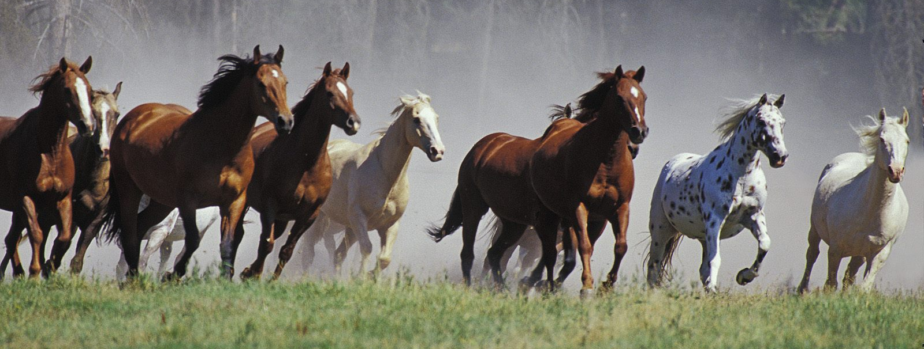
Chapter 12: “How Will You Run With Horses?”
“Why Do The Wicked Prosper?” (12:1-6)
Punishment for Covenant Violations (12:7-13)
Hope To Come In The Messiah (12:14-17)

Slide 8
Chapter 12: Thought Questions
What other passages convey a struggle in understanding the prosperity of the wicked? How does God answer each?
Given the ensuing judgment upon Judah and Jerusalem, what irony does Jeremiah’s question hold?
Does God ever forsake His people? (12:7) What other passages relate to this discussion?
Does 12:16 suggest that Gentile inclusion into the gospel call requires proselytizing to Judaism first? Why or why not? Support your answer.

Slide 9
Chapter 12: Applications
Our struggle to comprehend the seeming success of the wicked needs to be measured against the backdrop of the proven history of God’s faithfulness.
Just because we have run with footmen that does not mean that we are ready to run with the horses! Our arrogance can cloud our perception!
Just because someone says nice things to us, does not mean there is a truly strong relationship there. Let us be as wise as serpents and as harmless as doves!
God’s compassion is something He exercises again and again (12:15). Let’s praise Him always for this characteristic that we all benefit from daily!

