Slide 1
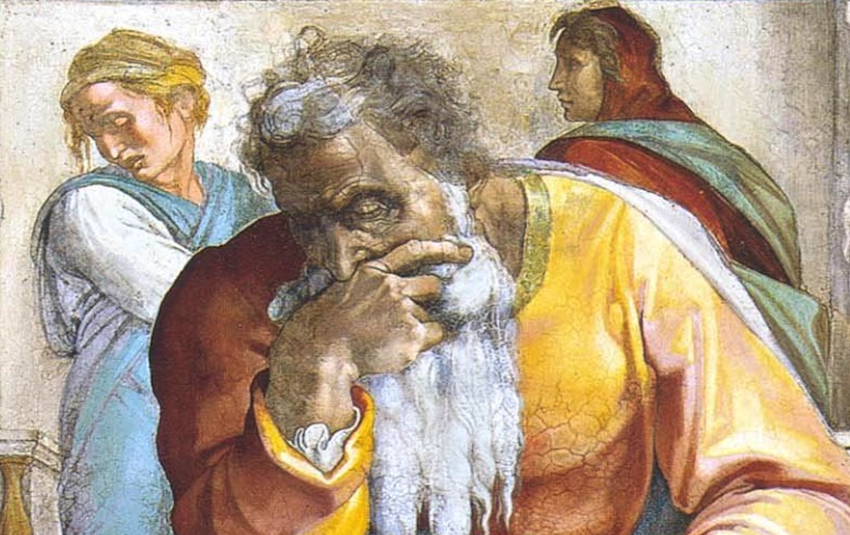
Jeremiah: Chapters 13-14

Slide 2
Jeremiah Memory Jogger
Calling Of Jeremiah
Broken Cisterns
A Harlot’s Forehead
Formless & Void
Lusty Horses
Old Paths
A Den Of Thieves
Forgot How To Blush
Mourning Women
Scarecrow In A Cucumber Field
Broken Covenant
How Will You Run With Horses?
Ruined Waistband
Severe Drought

Slide 3
John Humphries, “The Books of Jeremiah and Lamentations,” Truth Commentaries, 144
“Jeremiah carries out a symbolic action to demonstrate that Israel has become unfit to approach God as his people. From the throne on down, the Jews are to humble themselves before God in sincere repentance. However, because of the greatness of Judah’s sin and her impenitent pride, God will humble the nation at the hands of a powerful alien army approaching from the north.”

Slide 4
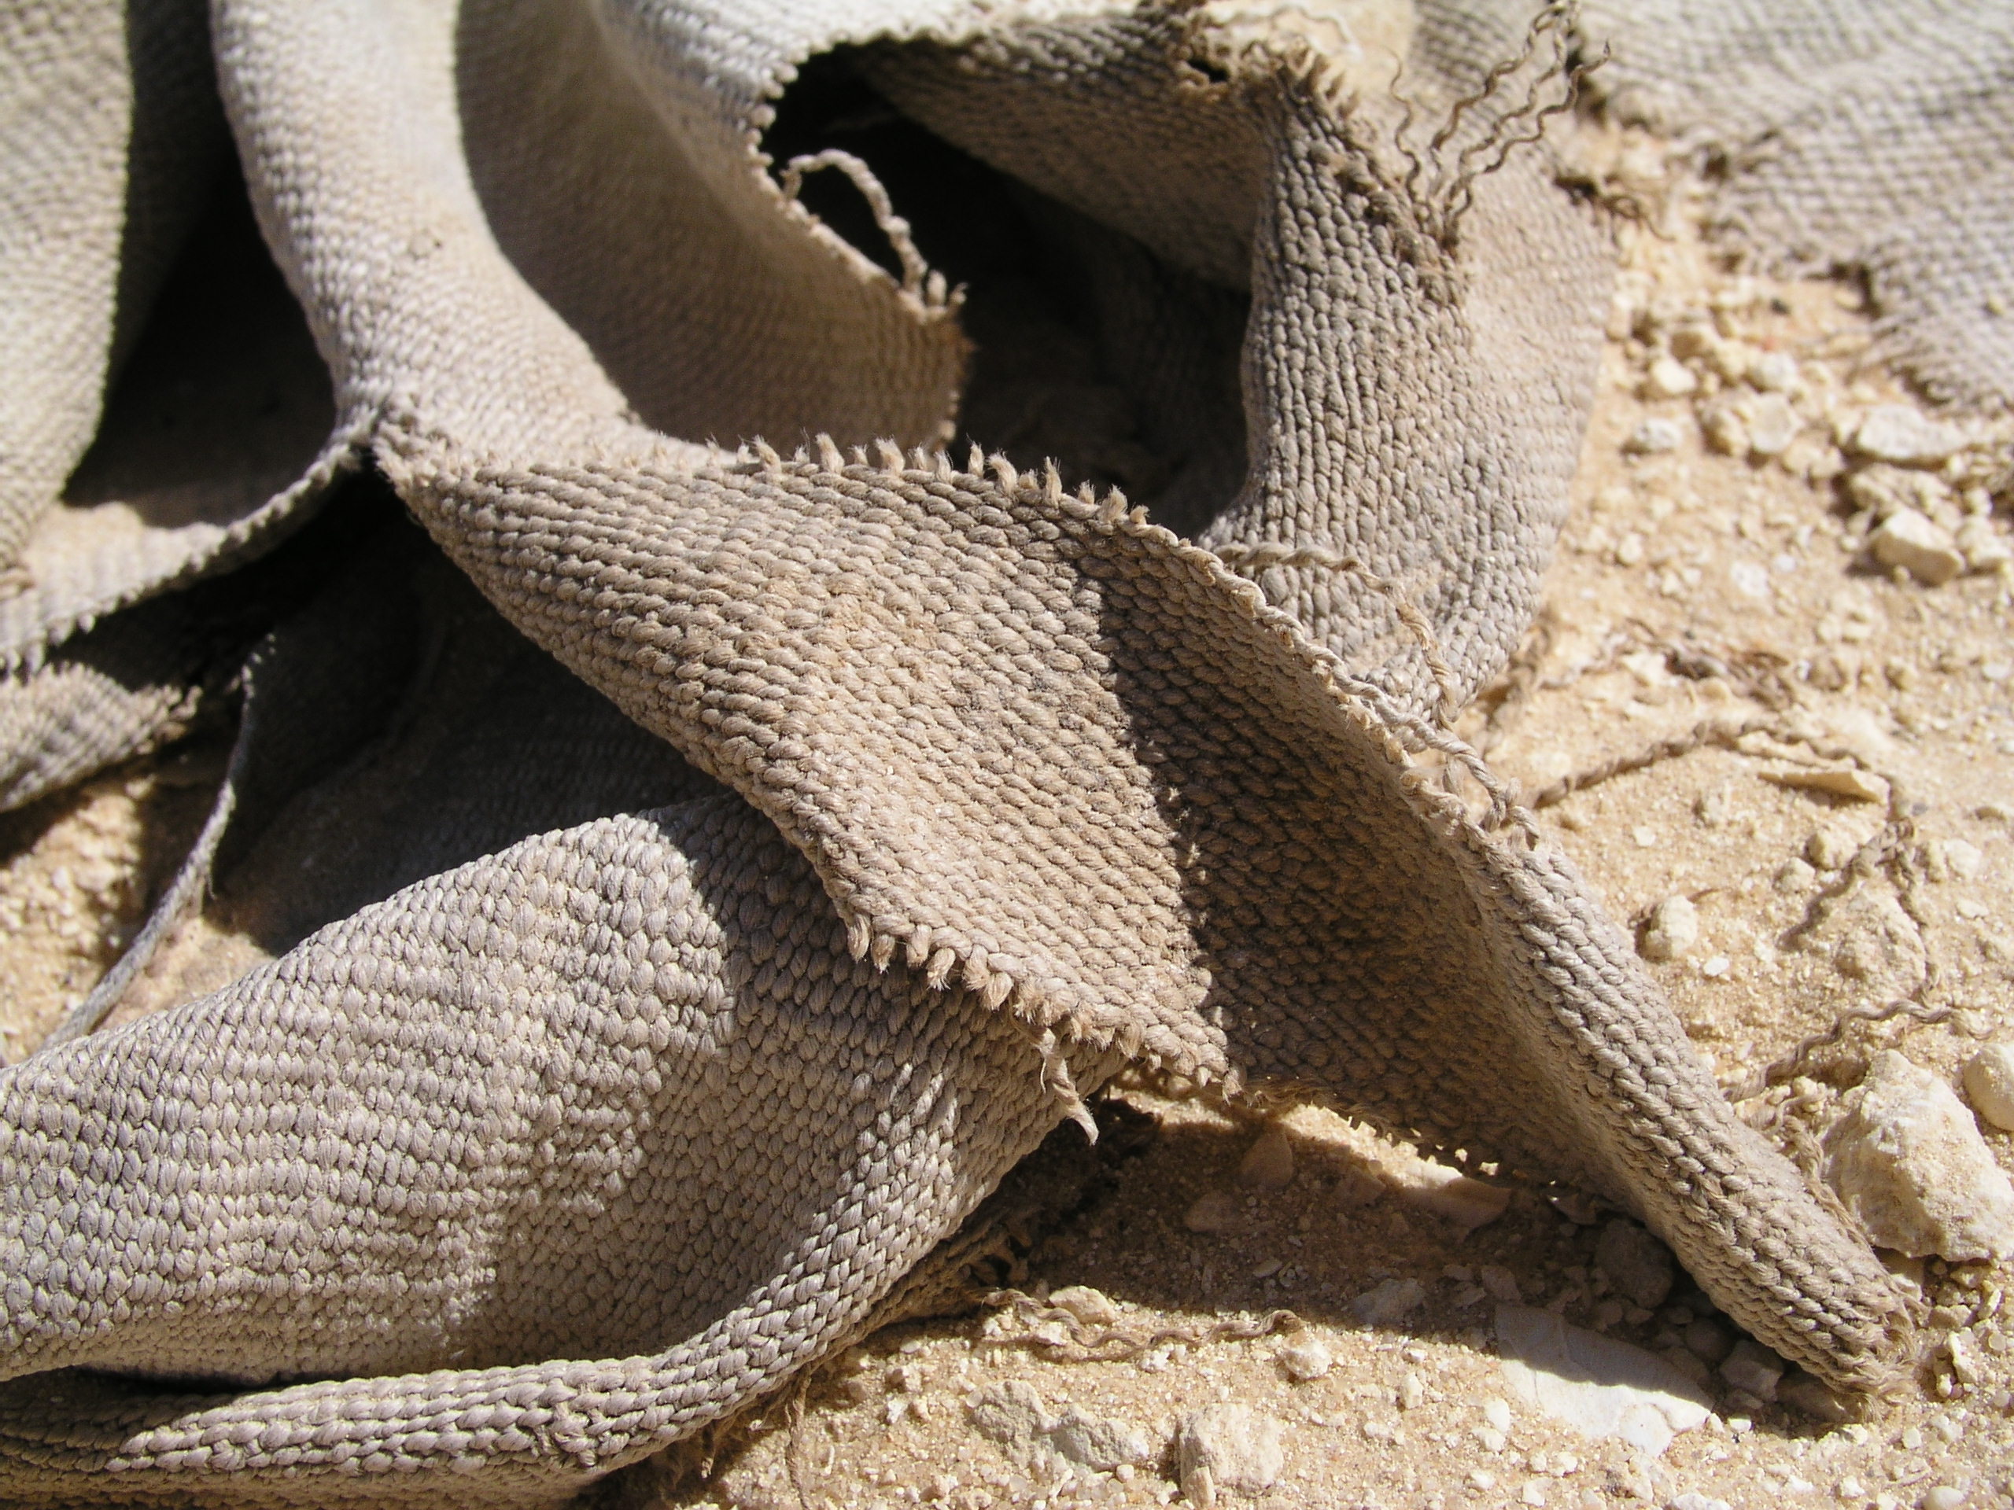
Chapter 13: The Worthless Waistband
Sign of the Worthless Loincloth (13:1-11)
The Cup Of Divine Wrath (13:12-14)
Their Pride Leads To Their Captivity (13:15-17)
Humbling Of The Royal Family (13:18-19)
Coming Captivity (13:20-27)

Slide 5
Chapter 13: Thought Questions
Approx. how far is Anathoth from the Euphrates? (13:4)
“Since God is love, how could He ‘not pity, not spare, nor have mercy’ when He destroyed them? (Jer. 13:14)” (Harkrider, 43)
What does it mean to have one’s “skirt removed” and “heels exposed”? (13:22)
Does 13:23 suggest total depravity? Why not?
What similarity exists between 13:24 and Ezek. 5:1-4?

Slide 6
Chapter 13: Applications
Potential
“The sincere servant of God often speaks words that sound unloving and harsh to a sinner who is being called to repentance. However, the speaker feels tender affection and is therefore burdened with grief when the word of God is rejected (cf. Acts 20:31).” (Harkrider 41 on 13:17)
Humility
Soft Hearts

Slide 7
John Humphries, “The Books of Jeremiah and Lamentations,” Truth Commentaries, 155
“The land is afflicted by a severe drought, indicating God’s displeasure toward his people. As the people and animals are suffering greatly, Jeremiah prays for the nation. God tells the prophet not to pray for the people, as the Lord rejects the people’s insincere worship. Also, the prophets are prophesying lies in the name of the Lord. God warns that judgment is on the way, and this brings further pleading from the prophet Jeremiah in the closing paragraph. Jeremiah’s words reflect the sentiment of the faithful remnant among the nation as the humble plea for mercy is directed to the Lord.”

Slide 8
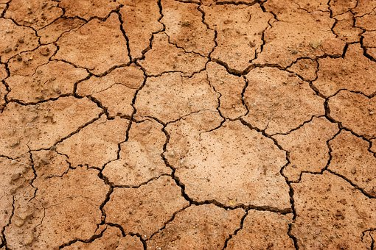
Chapter 14: “Have You Completely Rejected Judah?”
Severe Drought (14:1-6)
Jeremiah’s 1st Intercession (14:7-12)
Jeremiah’s 2nd Intercession (14:13-18)
Jeremiah’s 3rd Intercession (14:19-22)

Slide 9
Chapter 14: Thought Questions
Can natural phenomena direct our attention to God?
What danger lies in only looking to God in times of trouble? (14:10-12) What steps can we take to overcome this tendency?
Does the false teaching of others including preachers, teachers, elders, family members, etc. absolve us of personal responsibility? (14:16)
How could Jeremiah refer to Jerusalem as a “virgin”? (14:17-18)

Slide 10
Chapter 14: Applications
Worldly sorrow will not avail; godly sorrow will (14:1-6; cf. 2Cor. 7:10)
Many will persuade others that God will not judge (14:13-18; cf. 2Pet. 3). They may appeal to God’s love and grace to try and justify this. Many deny the entire doctrine of punishment in Hell and advocate for annihilationism. God has repeatedly shown that His love is wholly compatible with His judgment.
If the blind lead the blind, both will fall into the pit (Matt. 15:14).

