Slide 1
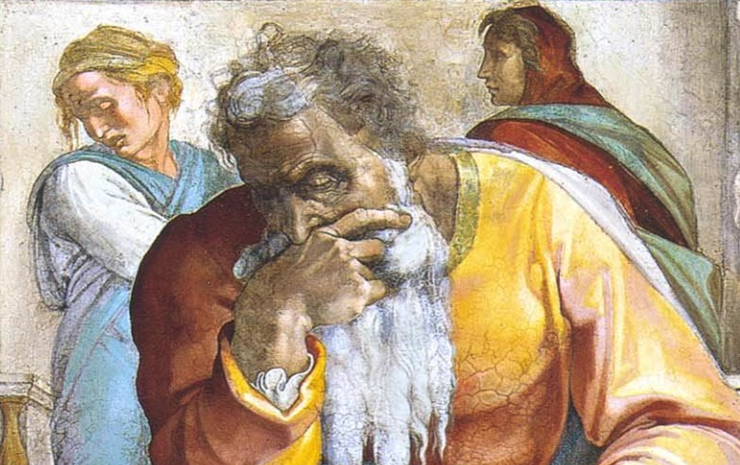
Jeremiah: Chapters 15-16

Slide 2
Jeremiah Memory Jogger
Calling Of Jeremiah
Broken Cisterns
A Harlot’s Forehead
Formless & Void
Lusty Horses
Old Paths
A Den Of Thieves
Forgot How To Blush
Mourning Women
Scarecrow In A Cucumber Field
Broken Covenant
How Will You Run With Horses?
Ruined Waistband
Severe Drought
Check Yourself!
No Wife For Jeremiah

Slide 3
John Humphries, “The Books of Jeremiah and Lamentations,” Truth Commentaries, 164
“The first four verses of chapter 15 are God’s response to Jeremiah’s prayer at the close of chapter 14. The answer to Jeremiah’s prayer is that God will not turn from his punishment of the people. The judgment of God against Israel will be severe, and none will escape. Jeremiah expresses the pain that he feels as a result of the harsh treatment that he has received at the hands of the rebellious people. After God again states his intention to punish the Jews, Jeremiah pleads for God to punish those who have been persecuting the prophet...

Slide 4
John Humphries, “The Books of Jeremiah and Lamentations,” Truth Commentaries, 164
...Jeremiah has been obedient to God in proclaiming his word to the people and has endured much pain in return for his efforts. Jeremiah wonders where the protection is that God promised him; has God let him down? God rebukes the prophet and calls upon Jeremiah to repent of his harsh (vile) words against the Lord. If the prophet will do this, he will be allowed to speak the word of God to the people. God will protect him and cause Jeremiah’s prophetic word to prevail over any opposition.”

Slide 5
Chapter 15: “Check Yourself”
God Is Adamant About Judgment
(15:1-9; carryover from 14:19ff)
The Embattled Prophet & God’s Reassurance (15:10-21)
Jeremiah’s Agony Over God’s Rejection (15:10-14)
Jeremiah’s Joy...And Pain At God’s Word (15:15-18)
God’s Reply
(15:19-21)

Slide 6
John Humphries, “The Books of Jeremiah and Lamentations,” Truth Commentaries, 173
“Twenty-six hundred years have passed since this servant of God did his abiding work. Jeremiah continued his valiant efforts in faithfully preaching against the worldliness of the society of his day and bravely enduring the opposition of those in positions of power, who had corrupted their office. We also see revealed in Jeremiah the broken heart of a man who loved his people and was distressed by their impending doom. These considerations should impress on our minds...

Slide 7
John Humphries, “The Books of Jeremiah and Lamentations,” Truth Commentaries, 173
...the fact that we are reading the message of a true prophet of God. To the thoughtful reader, the fact that Jeremiah candidly recorded his personal difficulties and shortcomings will surely indicate the presence of integrity and genuine humility in the prophet, a true man of God. The faithful prophets are truly among God’s noblemen. May we all be humbly and deeply impressed by their worthy example (Rom. 15:4).”

Slide 8
Chapter 15: Thought Questions
What connections may be made between 15:1 & events/passages like: the exodus from Egypt (sp. Ex. 13:21f), withdrawal of the Spirit from the Temple (Ezek. 8:4; 9:3, 18f; 11:22f), & rebuke of Laodicea (Rev. 3:20)?
What sort of behaviors of Manasseh had resulted in this condemnation? (15:4) Do the sins of the past have bearing on the present/future? What are the limitations on this, if any?
Does God ever get tired? (15:6) How are we to consider this and take it to heart?
What part of the Abrahamic covenant does 15:8 undo?

Slide 9
Chapter 15: Applications
Intercession May Fail (15:1)
National Premature Death (15:9)
Reverence In Lament (Ps. 55:22)
Callbacks Are Valuable (15:20)

Slide 10
John Humphries, “The Books of Jeremiah and Lamentations,” Truth Commentaries, 174
“Jeremiah is commanded to remain unmarried and to refrain from other social amenities. This is to impress upon the people that severe judgment from the Lord against the nation of Judah is approaching. The reason for the judgment against them is that the promise of restoration is given which will take place following the exile. In the meantime, the Jews are warned again that God knows their wicked hearts and that the judgment he will bring against them will be thorough and just. Finally, Jeremiah returns to the theme of 12:14-17 and looks to the conversion of the Gentiles in the days of the Messiah.”

Slide 11
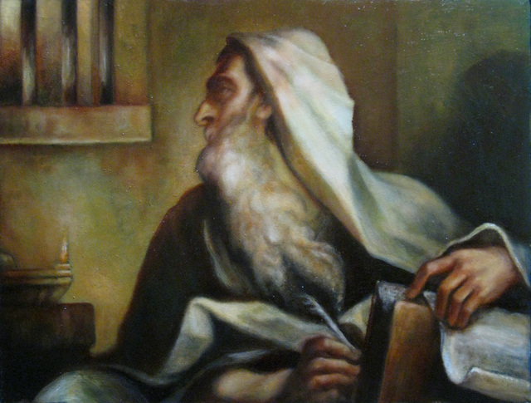
Chapter 16: “No Wife For Jeremiah”
Three Injunctions (16:1-9)
The Destiny Of Judah (16:10-18)
God’s Name Must Be Vindicated (16:19-21)

Slide 12
Chapter 16: Thought Questions
What significance is found in Jeremiah’s singleness & lack of social involvement? Are these limits lifted once judgment on Jerusalem is accomplished? (16:1-4)
What applications regarding sanctification can be derived from 16:1-4?
What similarities appear between the Last Supper/Lord’s Supper and 16:7?
What is the point of the imagery in 16:16?

Slide 13
Chapter 16: Applications
The Deceitful Heart (16:12)
God Is Deliverer (16:14-15)
Sin Is Not Hidden (16:17-18)
“Then They Shall Know That I Am The LORD” (16:21)

