Slide 1
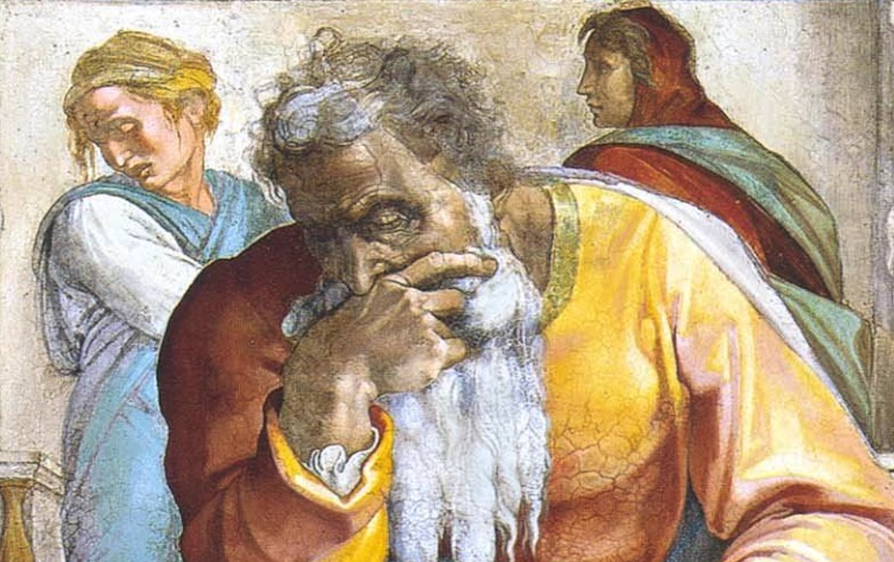
Jeremiah: Chapters 17-18

Slide 2
Jeremiah Memory Jogger
Calling Of Jeremiah
Broken Cisterns
A Harlot’s Forehead
Formless & Void
Lusty Horses
Old Paths
A Den Of Thieves
Forgot How To Blush
Mourning Women
Scarecrow In A Cucumber Field
Broken Covenant
How Will You Run With Horses?
Ruined Waistband
Severe Drought
Check Yourself!
No Wife For Jeremiah
Sabbath Discourse
The Potter & The Clay

Slide 3
John Humphries, “The Books of Jeremiah and Lamentations,” Truth Commentaries, 181
“The sin of idolatry is deeply entrenched in the kingdom of Judah and, being evident to God, will bring the fire of his judgment upon the nation. The man who puts his trust in God is contrasted with the man who places his trust in the arm of flesh. The deceitful nature of man’s heart and God’s ability to know the heart are discussed. Warning is given to those who obtain riches through wrongdoing and forsake the Lord. Jeremiah prays for his vindication as a prophet and for the punishment of those who persecute him. The Sabbath Day is presented as a test case concerning obedience to God.”

Slide 4
Chapter 17: Sabbath Discourse
Sin Indelibly Written & Idols Considered As Dear Children (17:1-11)
Jeremiah’s Prayer for Vindication (17:12-18)
Sabbath Discourse At The Gate (17:19-27)

Slide 5
Chapter 17: Thought Questions
Compare the illustration of 17:1 w/ 31:33. cf. 3:10; 12:2; 9:8; 14:14; 23:26; 17:13
Explain the enigmatic illustration used in 17:11.
Compare the prayer in 17:12-18 with former prayers of Jeremiah.
In what way(s) can we incorporate the use of imprecatory language in a scripturally approved manner? (17:18)

Slide 6
Chapter 17: Applications
Do not trust in earthly things to deliver (17:5; cf. Prov. 16:5, 18; 29:23; 1Pet. 5:5-7; 1Cor. 3:18-21)
Choices are what make the heart deceitful, not inherited curse (17:9; cf. Josh. 24:15; Eccl. 7:29; Jer. 10:23; Ezek. 18:4, 20; Matt. 18:1-3; 19:14; Rom. 3:23-25; 5:12; 6:16; 2Pet. 3:9).
Be careful not to refuse discipline because it is unpleasant (17:23). Correction is important and sometimes it has to tear deeply into us (cf. Heb. 12:6-11).

Slide 7
John Humphries, “The Books of Jeremiah and Lamentations,” Truth Commentaries, 193
“Jeremiah is sent to the potter’s house to learn an important lesson concerning God’s supreme authority as creator in his dealings with the nations. The prophet applies this illustration of the potter and the clay to Israel. However, the Jews reject the lesson about the potter’s house and make threats against Jeremiah. The prophet responds with an imprecation against those who are attacking him.”

Slide 8
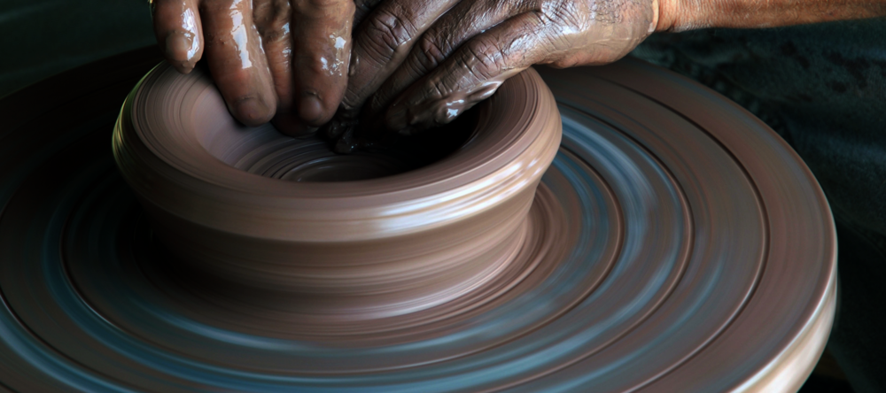
Chapter 18: The Potter & The Clay
The Potter’s Power Over The Clay (18:1-10)
Israel Is The Clay (18:11-17)
Plot Against Jeremiah (18:18-23)

Slide 9
Chapter 18: Thought Questions
Explain the usage and context of the potter and clay imagery as applied in Romans 9.
Did the Potter fail in his crafting of the clay or was the clay faulted in the illustration? How can we properly and improperly apply this imagery?
Does the national invitation in 18:5-10 have bearing on/application today?
Can we harmonize Jeremiah’s request for vengeance with Jesus’ forgiveness as extended from the Cross? Or with the requirement of Christians to love their enemies? (cf. Matt. 5:44; Rom. 12:20) If so, how?

Slide 10
Chapter 18: Applications
We Choose What Vessels We Want To Be!
God’s Power Is Definite & Its Exercise Can Be Fluid
God’s Face Brings Blessing (Num. 6:24-26)
Tickled Ears Find Destruction

