Slide 1
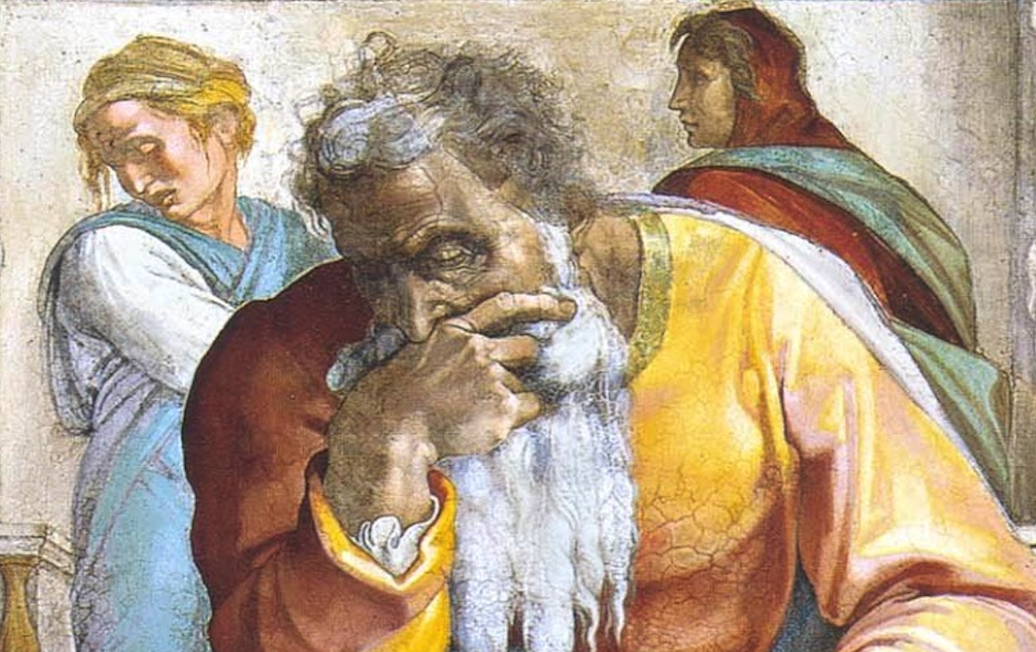
Jeremiah: Chapters 21-22

Slide 2
Outline:
Chapter 1: Jeremiah’s Call
Chapters 2-20—Prophecies Concerning Judah & Jerusalem During Josiah’s Reign (627-608 B.C.)
Chapters 21-39—Prophecies of Specific Events During the Reign of Jehoiakim (608-597 B.C.) and Zedekiah (597-586 B.C.)
Chapters 40-44—Jeremiah’s Ministry to Judah After the Fall of Jerusalem (post-586 B.C.)
Chapters 45-51—Prophecies Against Foreign Nations
Chapter 52—The Fall of Jerusalem (586 B.C.)

Slide 3
Jeremiah Memory Jogger:
Calling Of Jeremiah
Broken Cisterns
A Harlot’s Forehead
Formless & Void
Lusty Horses
Old Paths
A Den Of Thieves
Forgot How To Blush
Mourning Women
Scarecrow In A Cucumber Field
Broken Covenant
How Will You Run W/ Horses?
Ruined Waistband
Severe Drought
Check Yourself!
No Wife For Jeremiah
Sabbath Discourse
The Potter & The Clay
The Broken Bottle
Problems With Passhur
“Oh, Now You Want Help...”
Jeremiah @ The King’s House

Slide 4
John Humphries, “The Books of Jeremiah and Lamentations,” Truth Commentaries, 221f
“Chapter 21 records events that occurred during the days of Zedekiah near the end of his reign (v. 2; 52:4). Zedekiah (597-586 B.C.) was a regent king appointed by Nebuchadnezzar (2 Kings 24:17-20) when the Chaldean king had taken King Jehoiachin (597 B.C.) captive and deported him to Babylon (2 Kings 24:12; 25:27). It is possible that Zedekiah was not fully accepted by some of the Jewish leaders as the rightful heir to the throne (28:4). Zedekiah was a wicked man (2 Kings 24:19) and was receiving counsel from his advisors encouraging him to rebel against Babylon, which he eventually did (Jer. 27:9; 2 Kings 24:20)...

Slide 5
John Humphries, “The Books of Jeremiah and Lamentations,” Truth Commentaries, 221f
“...In his desperation, he appeals to Jeremiah to inquire of the Lord concerning the matter and see if the Lord will deliver the nation of Judah from the Babylonians. The Lord’s answer was not what the ungodly king wanted to hear. God will not turn from his judgment against the wicked people of Judah but will actually cause them to be defeated by the Babylonians. The Jews have only two choices: to surrender to the Babylonians and spare the city from destruction by fire or to continue to resist the Babylonians and be destroyed. Sadly, the city and temple will be burned to the ground.”

Slide 6
John Humphries, “The Books of Jeremiah and Lamentations,” Truth Commentaries, 221f
“The house of David is admonished to rule with justice and to stop living in the past, when God protected the city of Jerusalem from destruction at the hands of the enemy. The sins of Judah and Jerusalem have caused God to withdraw his protection from them, and judgment is on the way.”

Slide 7
Chapter 21: “Oh, Now You Want Help...”
Zedekiah’s Plea For God’s Help (vv. 1f; cf. 15:11; 37:3-10)
God Offers A Lesser Punishment For Submission (vv. 3-10)
Admonition For House Of David & People Of Judah (vv. 11-14)

Slide 8
John Humphries, “The Books of Jeremiah and Lamentations,” Truth Commentaries, 227
“In selfishly building and living for themselves (6:13; 8:10; 22:17; Luke 12:15-21), the people of Jerusalem were but building to feed the fire of God’s judgment upon them (Isa. 42:25; 47:14; 50:11). The house that was built with money stolen from another—burned. The house where schemes were hatched to do violence against another—burned. The house where the host of heaven (idolatry) was worshipped—burned. The house where an adulterous affair occurred—burned. The people of Jerusalem, along with their leaders, were building for the fire. The question today is for what are we building (1 Cor. 10:11; 2 Pet. 3:10-13)?”

Slide 9
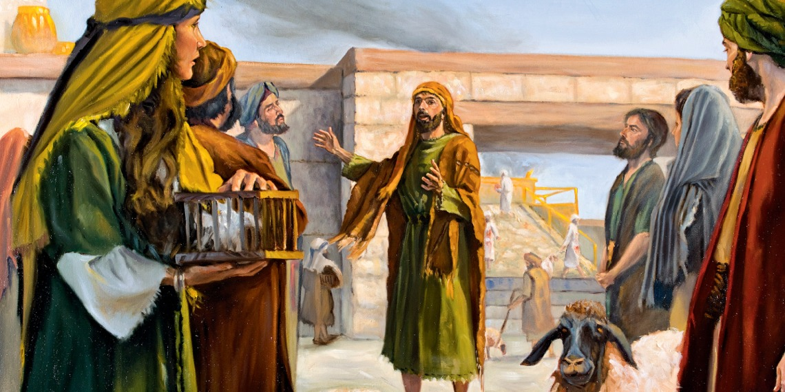
Chapter 21: Applications
God should be our trust and refuge and security in good times and in evil times.
Our prayers & petitions must be at all times, rather than simply in times of distress.
Compassion should be an essential characteristic in the life of Christians. Pride, in contrast, should be considered anathema for disciples of Christ.

Slide 10
John Humphries, “The Books of Jeremiah and Lamentations,” Truth Commentaries, 228
“The events of this chapter probably took place in the days of Jehoiakim (608-597 B.C.). This is suggested because the king is specifically addressed in vv. 15-17. Jeremiah gives a strong exhortation and warning concerning the fact that the kings of Judah must execute justice and righteousness during their rule if they would have God’s blessings upon them... When the city of Jerusalem falls, the nations know that it fell because the Israelites were not true to their God. Therefore, the people need to be concerned about the imminent captivity that faces them instead of mourning events of the past...

Slide 11
John Humphries, “The Books of Jeremiah and Lamentations,” Truth Commentaries, 228
“...Jehoiakim’s wicked rule is discussed and God’s judgment of the king pronounced. In spite of the warnings of the prophets, the people continue to maintain a stubborn and proud heart. Such pride will lead to disaster. Coniah will not fare better than any of the other wicked kings of Israel or Judah who rebelled against God, as he, too, will go away into captivity. Although he will have sons, none of them will be king over Judah and rule in Jerusalem. The days of Judah’s independent, sovereign kings are over (cf. 19:10-11) ‘until he (the Messiah) comes whose right it is’ (Ezek. 21:27).”

Slide 12
Chapter 22: Jeremiah @ The King’s House
Jeremiah’s Trip To The King’s House (vv. 1-10)
Prophecy Regarding Shallum (vv. 11f)
Principles Of Royal Righteousness & Prophecy Regarding Jehoiakim (vv. 13-23)
Prophecy Regarding Coniah (vv. 24-30)

Slide 13
Chapter 22: Applications
“Jer. 22:2-5: Rulers of any country have a grave responsibility before God to rule justly and righteously. Righteousness exalteth a nation, but iniquity is a reproach and will ultimately result in the demise of a nation (cf. Prov. 14:34; 16:12; 1 Pet. 2:13-14; Rom. 13:1-4; 1 Tim. 2:1-2).” (Harkrider, 61f)
Jesus is a descendant of Jehoiachin (cf. Matt. 1:11f). However, He does not and will not sit on the physical throne of David IN JERUSALEM. See: Zech. 6:12f; Jn. 18:36; Acts 2:30, 33, 36; Heb. 8:1, 4; Col. 1:13; Eph. 1:20-23.

