Slide 1
Christians & The Human Trafficking Crisis

Slide 2
What Is Human Trafficking?
“The recruitment, transportation, transfer, harbouring or receipt of persons, by means of the threat or use of force or other forms of coercion, of abduction, of fraud, of deception, of the abuse of power or of a position of vulnerability or of the giving or receiving of payments or benefits to achieve the consent of a person having control over another person, for the purpose of exploitation. Exploitation shall include, at a minimum, the exploitation of the prostitution of others or other forms of sexual exploitation, forced labour or services, slavery or practices similar to slavery, servitude or the removal of organs.” (The Palermo Protocol, Article 3, paragraph (a)).

Slide 3
What Is Human Trafficking?
“Human trafficking involves the use of force, fraud, or coercion to obtain some type of labor or commercial sex act. Every year, millions of men, women, and children are trafficked worldwide – including right here in the United States. It can happen in any community and victims can be any age, race, gender, or nationality. Traffickers might use violence, manipulation, or false promises of well-paying jobs or romantic relationships to lure victims into trafficking situations.” (U.S. Department of Homeland Security)

Slide 4
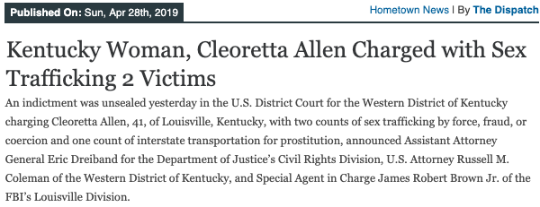
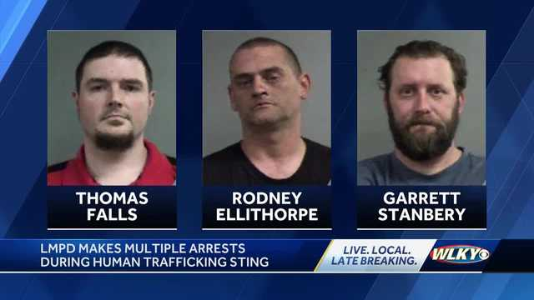

Slide 6
The Extent Of The Problem

Slide 7
Contributing Factors
Pornography, Sexual Immoralities, & Sex Trafficking
Ignoring The Problem/Labeling It A Purely Social Issue/Desensitization
Orphans & Broken Homes
This Is Part Of A Larger Continuum Of Problems

Slide 8
Does The Bible Address This Problem/These Problems?
The Patriarch Joseph Was A Victim (Genesis 37:25-28, 36; 39:1)
National Condemnations For Human Trafficking (e.g. Amos 1:6, 9)
Specified Prohibitions Of Kidnapping/Human Trafficking (e.g. Exodus 21:16; Deuteronomy 24:7; 1 Timothy 1:8-10)

Slide 9
What Can/Should Christians Do About Human Trafficking?
Develop a greater moral sensitivity
See people through God’s compassionate eyes
Cultivate and encourage, train and teach, sexual fulfillment through God’s intended mediums
Advocating, counseling, encouraging victims
Counseling and reforming former perpetrators and supporters
Understanding the concerns of parents for their children and being a community of protection for our loved ones.
Share the gospel of Jesus Christ broadly!

Slide 10
We Have Responsibilities Here Brothers & Sisters...

