Slide 1
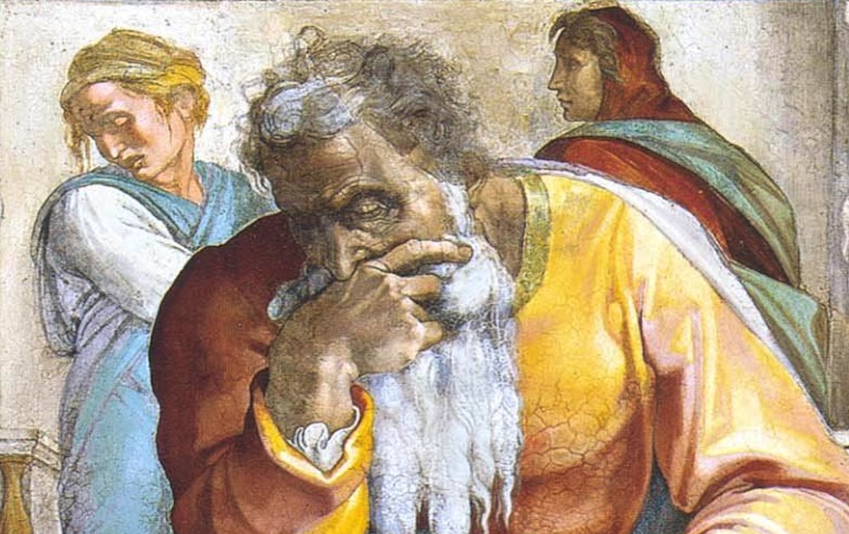
Jeremiah: Chapters 23-24

Slide 2
Jeremiah Memory Jogger:
Calling Of Jeremiah
Broken Cisterns
A Harlot’s Forehead
Formless & Void
Lusty Horses
Old Paths
A Den Of Thieves
Forgot How To Blush
Mourning Women
Scarecrow In A Cucumber Field
Broken Covenant
How Will You Run W/ Horses?
Ruined Waistband
Severe Drought
Check Yourself!
No Wife For Jeremiah
Sabbath Discourse
The Potter & The Clay
The Broken Bottle
Problems With Passhur
“Oh, Now You Want Help...”
Jeremiah @ The King’s House
Good & Evil Shepherds
Vision of the Figs

Slide 3
John Humphries, “The Books of Jeremiah and Lamentations,” Truth Commentaries, 240
“The first eight verses of this chapter present a striking contrast between the leadership of Judah, with its failure to measure up to God’s standard (cf. 22:3, 13), and the Messiah king, who will reign in justice and righteousness over the people of God (23:5, 6)...God will gather his people from captivity and send the Messiah to them (vv. 1-8)...The remainder of Jeremiah 23 (vv. 9-40) is a discussion of the disastrous role that the false prophets played in Judah’s downfall...

Slide 4
John Humphries, “The Books of Jeremiah and Lamentations,” Truth Commentaries, 240
“...There was complete failure in all of the offices of leadership in the nation (23:1). Prophet, priest, and king led the people away from God; sadly, the majority of the Jews loved to have it so (5:30-31; 6:13, 14; 18:18). In contrast to the failed leadership in Israel, the Messiah will combine the offices of prophet, priest, and king in a just and righteous way (v. 5; Zech. 6:12, 13; Deut. 18:18; Acts 3:19-26; Heb. 1:1, 2).”

Slide 5
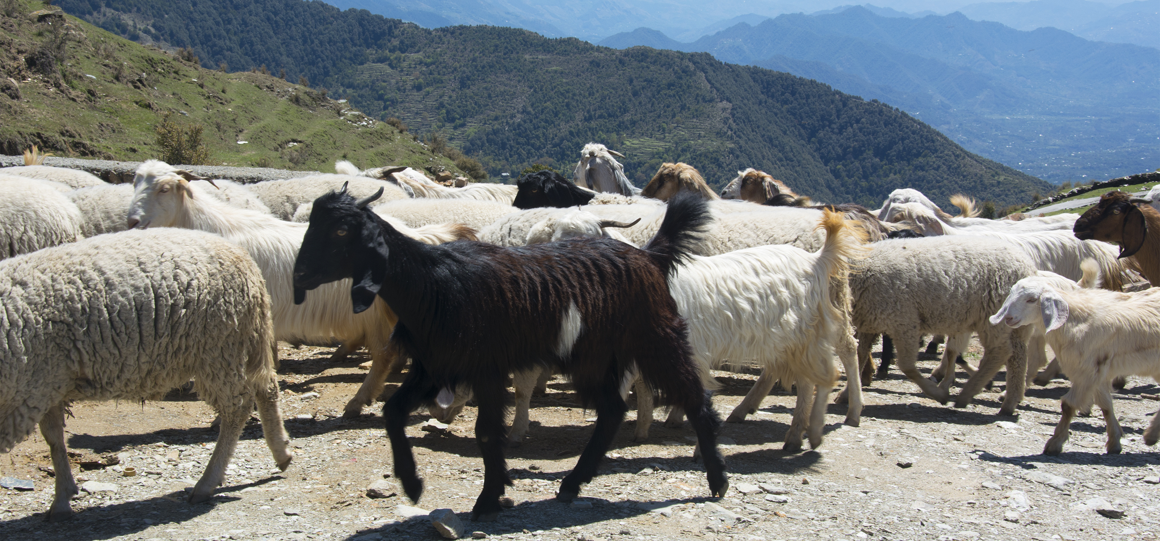
Chapter 23: Good & Evil Shepherds
Regathering Israel & The Righteous Branch Of David To Come (23:1-8)

Slide 6
Harkrider, Jeremiah & Lamentations, 64f
“The new exodus has been fulfilled in a two-fold manner. First, the literal return from exile occurred under the leadership of Zerubbabel, Ezra, Nehemiah (read the books of Ezra and Nehemiah). Second, this prophecy points to the ultimate fulfillment in Jesus Christ (cf. Gal. 3:8,24-29; Ezek. 37:24-28). Those who are the children of God by a spiritual birth dwell in ‘Mt. Zion’ which is the ‘land’ of God’s rule (Isa. 2:2; Heb. 12:18,22-24; Phil. 3:20). Christ is now king over those who have been born again spiritually (John 3:3-5; 18:36; Col. 1:13; Heb. 12:28; Rev. 17:14). The law of this spiritual kingdom is the new covenant of peace which was promised to the restored house of Israel and Judah (cf. Jer. 31:31 with Heb. 8:8-11). Through the spiritual reign of Christ over those who seek the Lord the house of David is set up again (cf. Amos 9:11 with Acts 15:15-17).”

Slide 7
Chapter 23: Good & Evil Shepherds
Denunciation Of The False Prophets (23:9-40)
They Enable Evil (vv. 9-15)
They Speak From Evil Hearts (vv. 16-22)
They Are Opposed By God (vv. 23-32)
They Have Become The Burden (vv. 33-40)

Slide 8
Chapter 23: Applications
Don’t simply take the word of someone who claims to speak in the name of the Lord. Personal investigation is so crucial because there are many who substitute falsehood for truth.
The Lord is near to all. This is a blessing for the righteous; a cause of fear for the unrighteous

Slide 9
Chapter 24
Vision of the Figs

Slide 10
John Humphries, “The Books of Jeremiah and Lamentations,” Truth Commentaries, 264
“The events described in this chapter took place sometime after Jeconiah had been taken to Babylon by Nebuchadnezzar in 597 B.C. (v. 1) but before the destruction of the city of Jerusalem and the capture of Zedekiah in 586 B.C. (vv. 8-10). Jeremiah has a vision of two baskets of figs. One basket contained very good figs and another basket had very bad figs that could not be eaten. Those who were taken into exile are considered the good figs, while those left behind are the bad figs. The good figs (potentially, cf. 29:13) will be the ones eventually brought back to the land after the seventy-year captivity (29:10-14). The bad figs, including Zedekiah (v. 8), will be swept forever from the land.”

Slide 11
John Humphries, “The Books of Jeremiah and Lamentations,” Truth Commentaries, 264
“The ones taken into exile will have their pride in the temple and city (7:7; 13:18, 19) shattered by their humiliating deportation and captivity experience. But a faithful remnant among them will be ready to turn wholeheartedly to the Lord and come back home (Ezra 1:5; 3:11; 9:8). Ezekiel, who was deported to Babylon in 597 B.C. was also called by the Lord to admonish the exiles (“good figs”) and prepare the faithful remnant among them for the return home after the exile (Ezek. 1:1-3; 3:15; 11:14-21; 28:25, 26).”

Slide 12
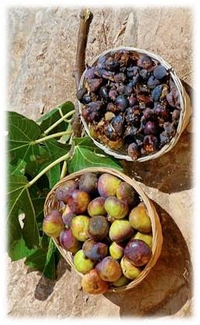
Chapter 24: Vision Of The Figs
Historical Context & Vision (24:1-3)
Interpretation: The Good Figs (24:4-7)
Interpretation: The Bad Figs (24:8-10)

Slide 13
Chapter 24: Applications
Bear good fruit for God and demonstrate your relationship with Jesus.
Things aren’t always as they seem. God can take people in terrible circumstances and accomplish great things through them. Hope may be found unexpectedly.

