Slide 1
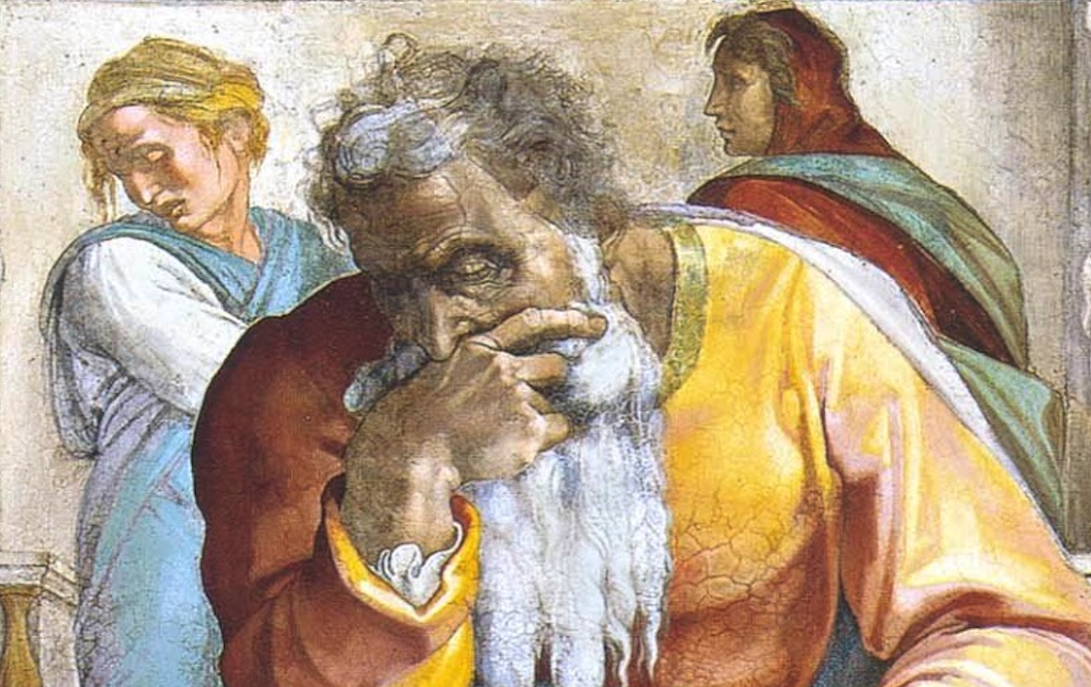
Jeremiah: Chapters 25-26

Slide 2
Jeremiah Memory Jogger:
Calling Of Jeremiah
Broken Cisterns
A Harlot’s Forehead
Formless & Void
Lusty Horses
Old Paths
A Den Of Thieves
Forgot How To Blush
Mourning Women
Scarecrow In A Cucumber Field
Broken Covenant
Will You Run W/ Horses?
Ruined Waistband
Severe Drought
Check Yourself!
No Wife For Jeremiah
Sabbath Discourse
The Potter & The Clay
The Broken Bottle
Problems With Passhur
“Oh, Now You Want Help...”
Jeremiah @ King’s House
Good & Evil Shepherds
Vision of the Figs
70 Years of Captivity
Arrested Again

Slide 3
John Humphries, “The Books of Jeremiah and Lamentations,” Truth Commentaries, 269
“In this chapter, Jeremiah reminds the people of Israel that he has been preaching to them for twenty-three years to no avail. They refuse to listen to him, just as they had ignored the messages of the other prophets of God. Jeremiah proclaims that Babylon will take Judah into exile for seventy years. Not only Judah and Jerusalem, but also many surrounding nations will come under the yoke of Babylon. God will judge nation after nation, holding them all to account for their wickedness. If Jerusalem and Judah will not escape the wrath of God, neither will the Gentile nations. There will be no escape from the fierce wrath of the Lord.”

Slide 4
L.A. Mott Jr., Thinking Through Jeremiah, 132
“The preciseness here is due to the importance of the fourth year of Jehoiakim. That year marked a notable turning point for Judah. It was the year Nebuchadnezzar defeated Egypt at Carchemish in a decisive battle which determined the destiny of the near eastern world for the next seventy years (Jer. 46:2). That battle ended Egypt’s hopes of empire (cf. 2 Kings 23:29-24:7) and established Babylon as the master of the ancient world. In the aftermath, the Babylonians swept sought and came down upon Judah for the first time, taking Daniel and some others to Babylon as hostages (Dan. 1:1-7). The year was 605 BC, the beginning of Babylon’s seventy year empire (v 11).”

Slide 5
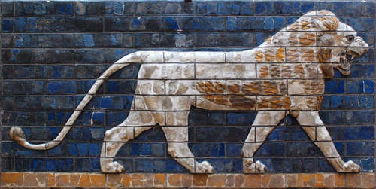
Chapter 25: 70 Years Of Captivity
Summary Of Jeremiah’s 23-Year Ministry (vv. 1-7)
70 Years Captivity for Judah (vv. 8-14)
Gentiles Will Also Drink God’s Cup of Wrath (25:15-38)

Slide 6
Chapter 25: Applications
“Jer. 25:9-11: When prophecy is fulfilled it corroborates the claim that the Bible is inspired. One might have guessed at this point in history that Babylon would overrun Judah, but surely no man could have guessed Babylon’s fall and accurately predicted Judah’s return would be seventy years later! (cf. Isa. 42:8-9; 41:21-22; 2 Pet. 1:20-21; 2 Tim. 3:16-17).” (Harkrider, 73)
God is the sovereign King of kings (25:15f, 28f; cf. 10:10-12; Dan. 4:17; 5:18-21).
The kingdoms of the world pass away (cf. Is. 13-23, 24-27, 34; Jer. 46-51; Ezek. 25-32; Joel 3:1-21; Amos 1:3-2:8; Obad. 15f; Zeph. 2:4-15; Rom. 3:29).

Slide 7
John Humphries, “The Books of Jeremiah and Lamentations,” Truth Commentaries, 284
“King Jehoiakim (609/8-597 B.C.) is now king over Judah. Unlike Josiah, he is a very wicked king and has no interest in hearing the truth. It is a very dangerous time for God’s prophets, but Jeremiah fulfills his grave responsibility and faithfully proclaims God’s warning to the people of Judah. He is arrested, tried, and spared – but only for the time being (cf. 38:1-6). However, other prophets during this same period of time do not escape the wrath of the king but are hunted down and executed.”

Slide 8
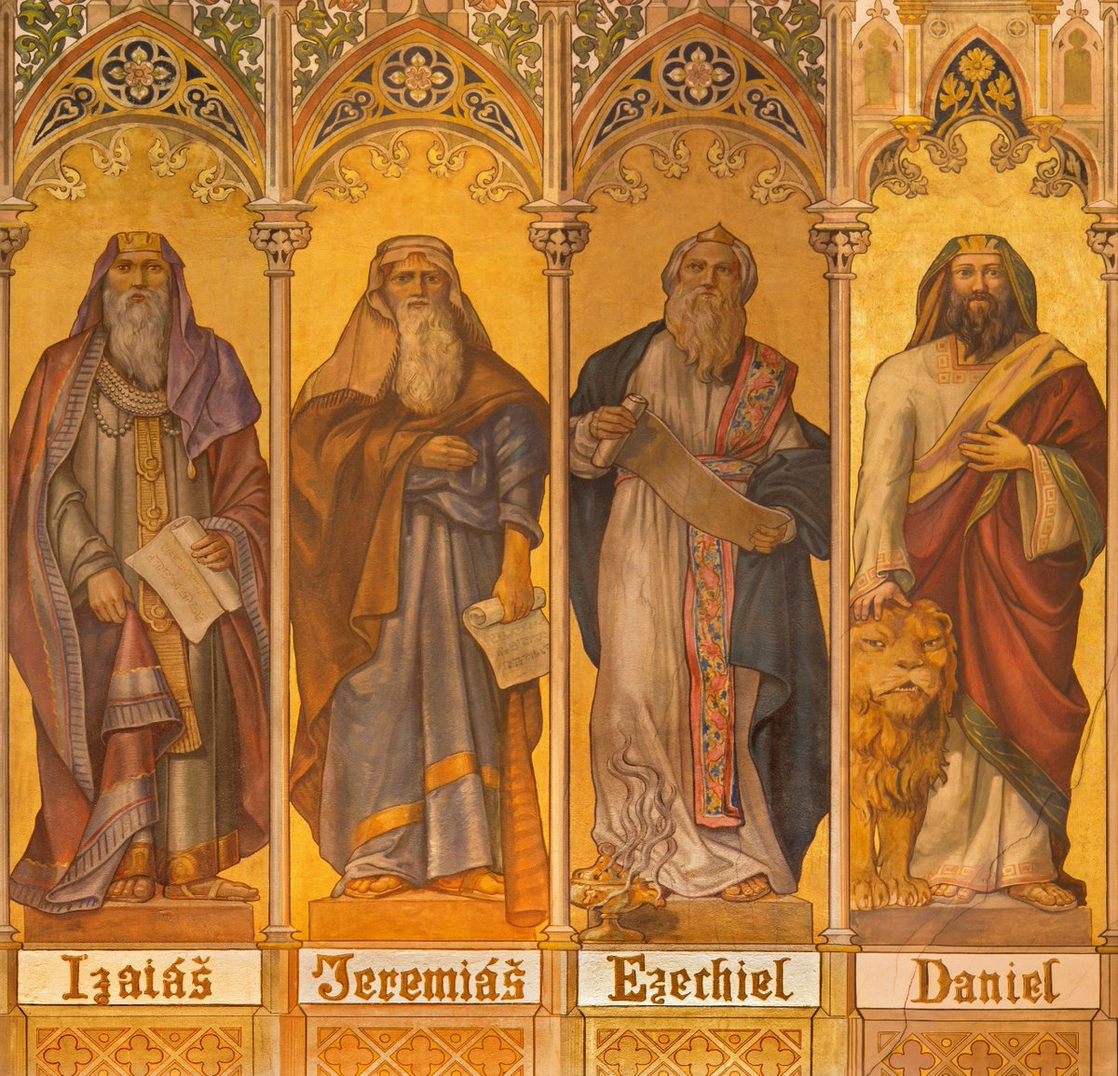
Chapter 26: Arrested Again
Jeremiah’s Sermon in the Temple (vv. 1-7)
Jeremiah Is Arrested (vv. 8-19)
Urijah Murdered By Jehoiakim (vv. 20-24)

Slide 9
Chapter 26: Applications
“[Jeremiah] is told by the Lord to speak all the words and not to leave out a single truth that is needed by the people (cf. 1:17; Ezek. 2:7). He was to proclaim the whole counsel of God (cf. Acts 20:20, 26-27; Deut. 4:2)...He was to preach what was needed, when it was needed, and to whom it was needed...God’s truth must be taught fully, bravely, and in a timely way by those who would be his spokesmen before the people.” (Humphries, 284f)
“...even religious teachers may be blind to learning the truth when it goes against their own agenda and orthodoxy (cf. Matt. 15:14; Rom. 2:17-24).” (286)
If you have influence in your community, use it to the advantage of God’s servants.

