Slide 1
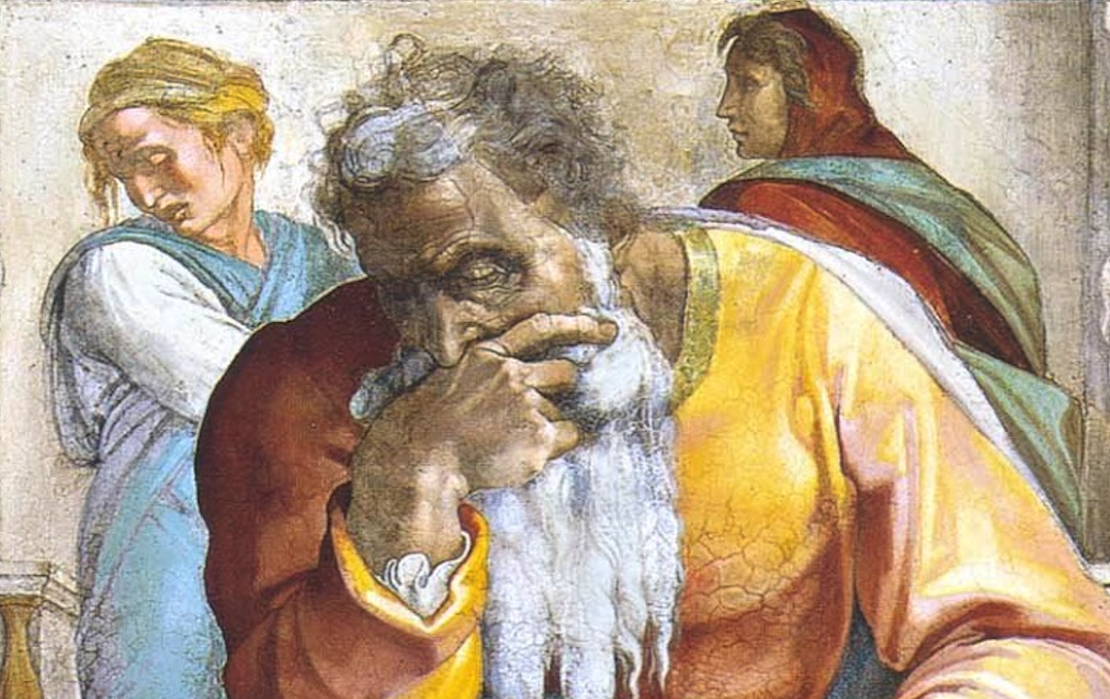
Jeremiah: Chapters 27-28

Slide 2
Jeremiah Memory Jogger:
The Yoke Of Babylon
Hananiah The Heretic

Slide 3
John Humphries, “The Books of Jeremiah and Lamentations,” Truth Commentaries, 293
“The time frame is the fourth year of Zedekiah (cf. 27:3, 12; 28:1), which would be 594/3 B.C. Jeremiah is counseling the nations and Judah to submit to the Babylonians. Jeremiah warns that for Judah and the nations to resist would be to fight against God, as the Lord is sending the Babylonians to punish them. The chapter illustrates the fact that the Lord is the God of the nations. It would appear that Judah and several nations are discussing the formation of a confederacy against Babylon. Their false prophets and pagan priests are encouraging resistance against Nebuchadnezzar…

Slide 4
John Humphries, “The Books of Jeremiah and Lamentations,” Truth Commentaries, 293
“…All of these efforts, however, will only result in horrible, prolonged suffering for the citizens of these kingdoms, as their resistance will not succeed in repelling the Babylonian threat. It is a great evil to give sinners false hope, as these prophets and priests are doing. The only true hope for these nations (to remain in their land) is for them to listen to the voice of God through his prophet Jeremiah. However, the chapter ends with the promise of Israel’s return from captivity.”

Slide 5
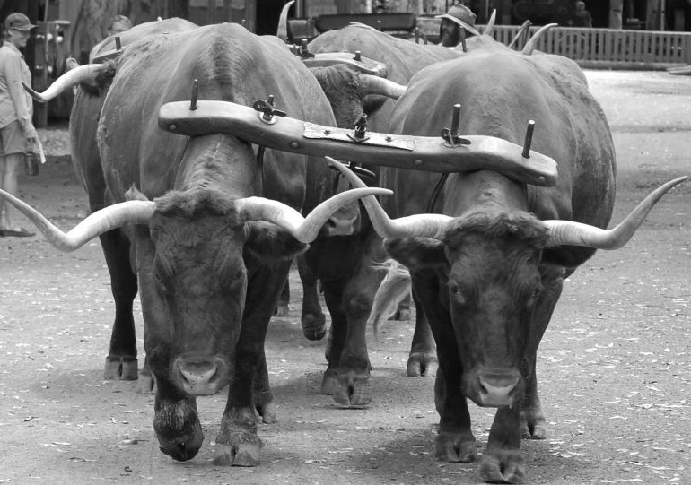
Chapter 27: The Yoke Of Babylon
Message to Foreign Ambassadors (vv. 1-11)
Same Message For Zedekiah (vv. 12-15)
Warning for the Priests & Prophets (vv. 16-22)

Slide 6
Chapter 27: Applications
The popular message of peace and comfort may tickle the ears, but it is far from the grave reality of sin’s plague upon the world (cf. 2Tim. 4:1-3).
We may get so wrapped up in preserving or healing the wounds of the past that we forget to attend to that which is in the present (cf. Eccl. 7:10; Is. 43:18f).
“Anyone who contradicts God and his word is a liar (Rom. 3:4).” (Humphries, 299)
“[T]o ignore the responsibility of exposing and rebuking the sins of the people is to fail as a watchman of God.” (Humphries, 304)

Slide 7
John Humphries, “The Books of Jeremiah and Lamentations,” Truth Commentaries, 301
“Jeremiah has been facing opposition to his work as a prophet of God. In this chapter we are given a specific example of this resistance, as one of the false prophets is named. This serves to illustrate the fact that truth will always have opposition. The false prophets will invoke the name of God and give a message of false promise that will appeal to the people. They will also publicly humiliate and contradict the true prophet of the Lord, going so far as to engage in violent physical action against the prophet of God. Jeremiah, on the other hand, demonstrates the godly conduct of the man of God, as he maintains his composure throughout the entire embarrassing ordeal (2 Tim. 2:24-26)…

Slide 8
John Humphries, “The Books of Jeremiah and Lamentations,” Truth Commentaries, 301
“…He continues to hold forth the truth of God even in the face of public opposition to his message. Finally, we see an example of the severe penalty against one who opposes and distorts the divine message of God. The wrath of God will fall upon the prophets who are guilty of leading the people into rebellion against the Lord. This should be a sobering example and warning to anyone who seeks to be a messenger of God (Jas. 3:1).”

Slide 9
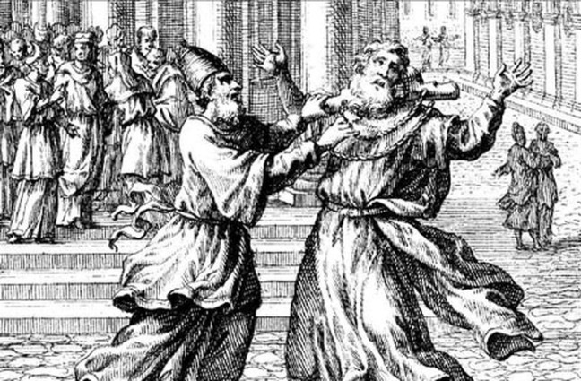
Chapter 28: Hananiah The Heretic
Hananiah’s False Comfort (vv. 1-4)
Jeremiah’s Retort & Hananiah’s Response (vv. 5-11)
Doom For Judah & For Hananiah (vv. 12-17)

Slide 10
John Humphries, “The Books of Jeremiah and Lamentations,” Truth Commentaries, 305f
“To any sincere lover of God, this must have been one of the saddest scenes imaginable. To see the people of Judah so caught up in wickedness and rebellion against the truth that the messenger of God (Jeremiah) had to leave the temple of God as if he were an unwelcome outcast must surely have brought despair to the heart of any righteous soul who might have been present…This sad scene is often repeated throughout the history of God’s people. Those comprising the faithful remnant are forced out, while the apostate majority takes control of the ‘house of God’ (cf. 1 Cor. 11:19).”

Slide 11
LA Mott Jr., Thinking Through Jeremiah, 141
“Jeremiah had said that the event would determine whether Hananiah had spoken the truth (v 9). Hananiah, however, did not live two years to see the outcome. His death occurred just two months after his prophecy (cf. v 1). One would think such a dramatic fulfillment of Jeremiah’s prediction would strengthen his authority as a spokesman of God. But the truth is, it was not a lack of evidence that kept the people from listening to Jeremiah. They were stubbornly committed to apostasy; they did not want to believe; and no amount of evidence would convince them. Cf. Luke 16:31. Seed must be planted in the right soil to germinate and bear fruit.”

Slide 12
Chapter 28: Applications
False teachers are shown to be false by what comes of what they say (28:9; cf. Deut. 13:1-3; 18:21f). Truth is not proven by sincerity or enthusiasm only.
Teachers who promote a spirit of licentiousness counsel rebellion against the Lord. It has and will always matter whether one obeys or not (28:16; cf. 1Sam. 15:22f; Matt. 7:21-23; Lk. 6:46).
Calmness and reliance upon the revelation of God always wins the day. “And the prophet Jeremiah went his way. With no bombastic and dramatic outburst to try to top that of Hananiah. The calmness of Jeremiah is noticeable. He would not speak or act without revelation from Jehovah. He simply waits upon Jehovah.” (Mott, 140)

