Slide 1
Psalm 22: A Psalm Of Troubles

Slide 2
Ps. 22 Is Relatable and Valuable!
It Is The Word Of God
It Is Messianic
It Connects With Everyone
It Conveys Lamentation
It Is A Journey For All

Slide 3
Psalm 22 Today: Situation #1

Slide 4
Psalm 22 Today: Situation #2

Slide 5
Psalm 22 Today: Situation #3

Slide 6
Lamentation and appeal from the valley of the shadow of death (22:1-21)

Slide 7
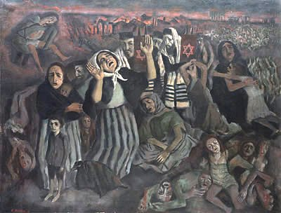
FORSAKEN—Verses 1-5
1st Lamentation (1-2)
1st Appeal (3-5)

Slide 8
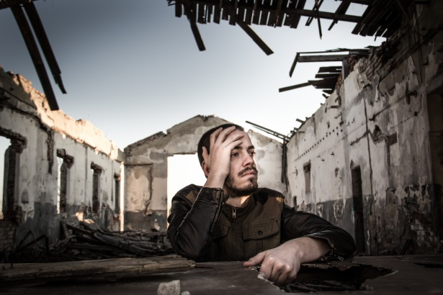
DESPISED—Verses 6-11
2nd Lamentation (6-8)
2nd Appeal (9-11)

Slide 9
AFFLICTED—Verses 12-21
3rd Lamentation (12-18)
3rd Appeal (19-21)

Slide 10
Praise from the peak of blessed life (22:22-31)

Slide 11
EMPOWERED—Verses 22-25
God Knows, Answers, Saves, Delivers!
We Will Honor And Praise Him For It!

Slide 12
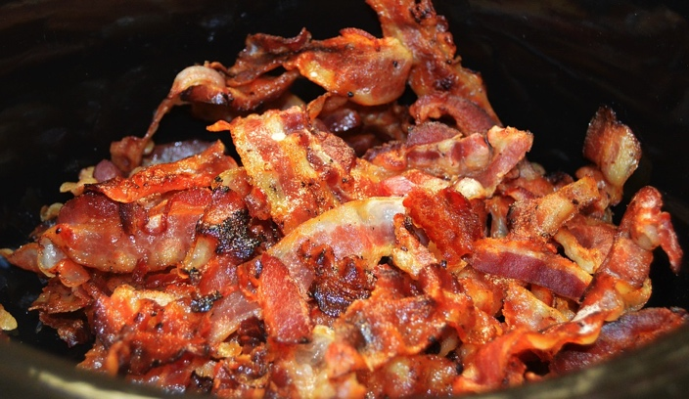
RESTORED—Verses 26-31
A Celebratory Feast!
Benefits Are Gained Through Affliction!
God Does Not Abandon His Holy Ones!

Slide 13
A Closing Benediction From Psalm 20

