Slide 1
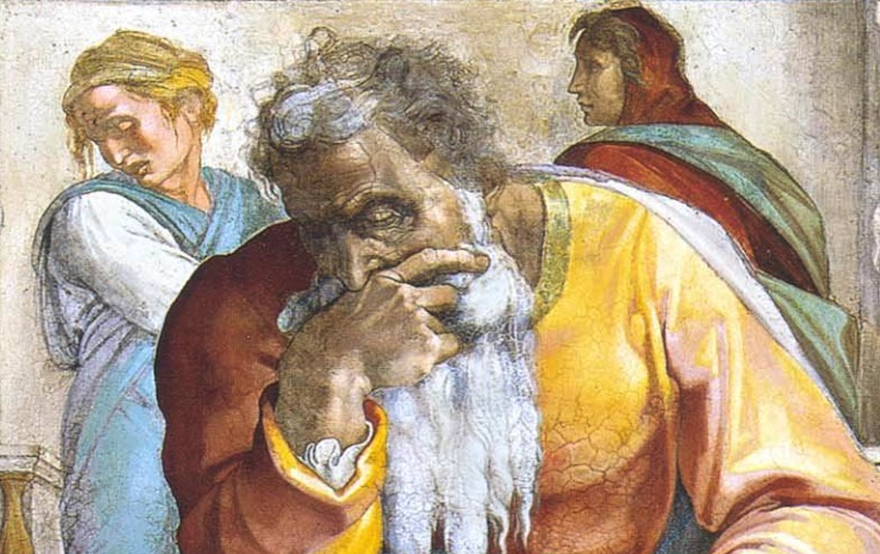
Jeremiah: Chapters 29-30

Slide 2
Jeremiah Memory Jogger:
The Yoke Of Babylon
Hananiah The Heretic
Letters to the Exiles
Glorious Future Ahead

Slide 3
John Humphries, “The Books of Jeremiah and Lamentations,” Truth Commentaries, 308
“Jeremiah not only had opposition at home, but he also had serious resistance from false prophets among the exiles in Babylon. Sometime after the second deportation to Babylon (597 B.C.), Jeremiah writes to the captives (cf. good figs of ch. 24) and counsels them to build houses and establish family life in Babylon, seeking the peace and well-being of the country where they are living. This would serve not only the best interests of Babylon, but those of the nation of Israel, as well. Jeremiah warns the people not to listen to the false prophets, who are giving them false hope by promising a quick return to Canaan. The captivity is to last for seventy years…

Slide 4
John Humphries, “The Books of Jeremiah and Lamentations,” Truth Commentaries, 308
“…Israel needs to accept the chastening of the Lord (24:5), returning home only when God allows such to happen (cf. Hab. 2:1-4). The ‘bad figs’ (cf. ch. 24) in Jerusalem will soon face another attack from Babylon (vv. 15-19). The false prophets among the captives are not only preaching their lies by alleging a quick return home from Babylon, but they are also actively fighting against the warnings of Jeremiah and seeking to harm him. By spoken word or by letter, at home or abroad, Jeremiah is quick to defend the truth and to announce the judgments of God against the wicked.”

Slide 5
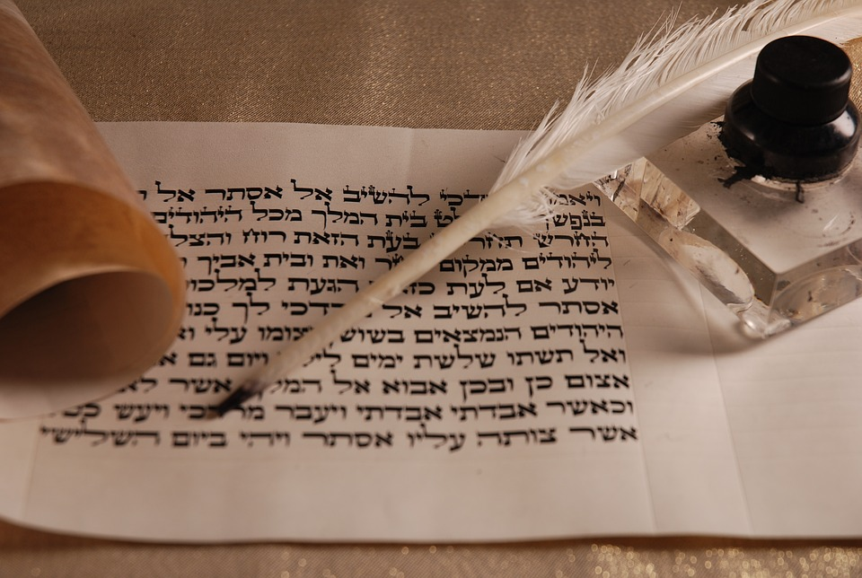
Chapter 29: Letters to the Exiles
The First Letter From Jeremiah (vv. 1-23)
Jeremiah’s Response To Shemaiah (vv. 24-32)

Slide 6
Chapter 29: Applications
It is biblical to, even passionately, seek the welfare of the nation in which you live, even if your values are quite different from the overall country in which you live, as was the case of Israel in captivity. Prayer plays a pivotal role in this (29:4-7; cf. 1Tim. 2:1-6; 1Pet. 2:13-17). “Jeremiah’s letter is a good model for any people at any time to be good, productive citizens of the nation where they live.” (Humphries, 310)
“If My people who are called by My name humble themselves and pray and seek My face and turn from their wicked ways, then I will hear from heaven, will forgive their sin and heal their land.” (2Chron. 7:14; cf. Jer. 29:12f)

Slide 7
John Humphries, “The Books of Jeremiah and Lamentations,” Truth Commentaries, 319
“The next four chapters (30-33) are fittingly called the ‘Book of Consolation’ by many expositors. In powerful language, Jeremiah presents a brilliant light of hope shining forth at the end of a terrible, dark tunnel of dismal captivity for Israel and Judah. Until this point in the book, Jeremiah had been speaking principally of Israel’s coming troubles, as God punishes the people for their wickedness. In contrast to this, these four chapters briefly remind the Jews as to why God is punishing them. Jeremiah then proclaims the glorious blessings that await Israel and Judah when the nations have been restored from captivity to await the coming of the Messiah.”

Slide 8
The Messiah In The Book Of Consolation
Will serve David, their king | 30:9; 33:14-16; cf. 23:5-8 | Luke 1:31-33; Acts 2:29-36
Their ruler shall come from their midst | 30:21; cf. Mic. 5:2 | Matt. 2:6
“You shall be My people” | 20:22; 31:1, 7, 14, 33; 32:28; 33:24 | 1Pet. 2:10; 2Cor. 6:16
Fulfilled in ”latter days” | 30:24; cf. Hos. 3:5; Is. 2:2 | Acts 2:16f; Heb. 1:1f
Israel shall go up to Zion | 31:6, 12; 32:36-44; cf. 3:14-18; Mic. 4:1-8 | Heb. 12:22-24; Gal. 4:26
Remnant shall be saved | 31:7; cf. Is. 20-22 | Rom. 9:27; 11:5
Weeping at Messiah’s birth | 31:15 | Matt. 2:17f
New Covenant | 31:31-34; 32:40 | Heb. 8:8-13
Jerusalem Rebuilt | 31:38-40; 32:36f; 33:4-9; cf. 3:17 | Heb. 12:22-24; Gal. 4:26
King and priest forever | 33:17-22; cf. Zech. 6:12f; Ps. 110:1, 4 | Heb. 1:13; 5:5f; 7:14-19; 8:1f; 9:11f; 10:11-13

Slide 9
John Humphries, “The Books of Jeremiah and Lamentations,” Truth Commentaries, 320
“In chapter 30, Israel and Judah are given the promise of a glorious return from (Assyrian/Babylonian) captivity. The Jews’ return from captivity (after God’s just punishment of them for their sins) blends into the glories of the Messiah in the latter days. Jeremiah also discusses the punishment of the unrighteous nations and the firm assurance that God will carry out the ‘intents of his heart’ toward those who fight against him.”

Slide 10
Chapter 30: Glorious Future Ahead
Assurances of Restoration (vv. 1-11)
Healing of Incurable Wounds (vv. 12-17)
The Restoration of Jerusalem (vv. 18-24)

Slide 11
Chapter 30: Applications
30:2 gives us a great definition of divine inspiration! It demonstrates verbal and plenary inspiration, two key aspects we should know and be equipped to defend (cf. Is. 30:8; 34:16; Jer. 1:4f; 25:13; 36:2; Ezek. 2:4-7; Dan. 9:2; Jonah 3:1f; Luke 1:1-4; 24:44-47; Jn. 16:12f; Acts 2:4; Ro. 15:4; 1Co. 10:11; 14:37; Eph. 3:3f; 2Ti. 3:15-17; Heb. 2:3f; 2Pet. 1:12-15; 20f; 3:1f 1Jn. 1:3f; Rev. 22:18f). His Word will never perish! (Ps. 100:5; 102:12; 119:152; Is. 40:6-8; Mt. 24:35; 1Pe. 1:22-25).
God heals the incurable! (30:12-17; cf. 8:22; Joel 2:25; Rom. 5:6-8; 6:23; Eph. 2:1-7)
“Jer. 30:9,21: Though Israel was cast off as a nation with an earthly king, out of its physical loins came the Christ through whom spiritual Israel now exists (cf. Rom. 9:7-8; Gal. 3:26-29). Those spiritually born again are now the ‘Israel of God’ (Gal. 6:16) who have Christ as their king (John 18:36; Luke 1:32-33; Rev. 17:14; Col. 1:13).” (Harkrider, 86)

