Slide 1
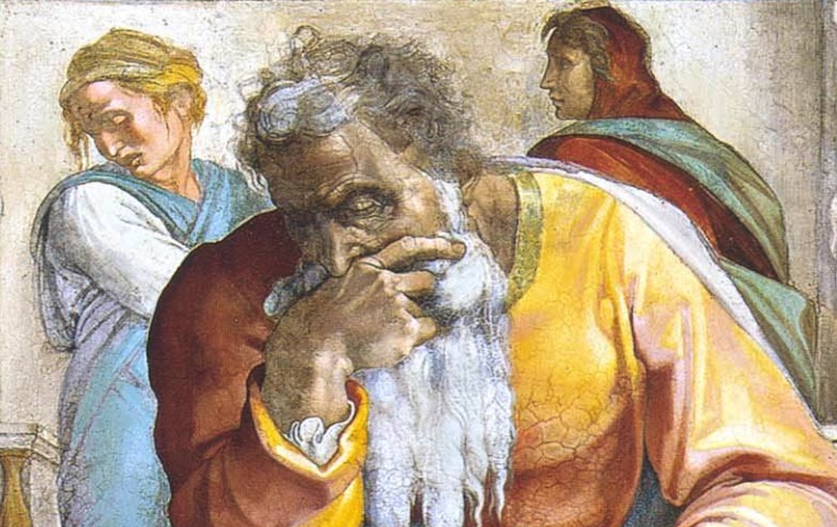
Jeremiah: Chapters 31-32

Slide 2
Jeremiah Memory Jogger:
The Yoke Of Babylon
Hananiah The Heretic
Letters to the Exiles
Glorious Future Ahead
The New Covenant
Kinsman Redeemer

Slide 3
The Messiah In The Book Of Consolation
Will serve David, their king | 30:9; 33:14-16; cf. 23:5-8 | Luke 1:31-33; Acts 2:29-36
Their ruler shall come from their midst | 30:21; cf. Mic. 5:2 | Matt. 2:6
“You shall be My people” | 20:22; 31:1, 7, 14, 33; 32:28; 33:24 | 1Pet. 2:10; 2Cor. 6:16
Fulfilled in ”latter days” | 30:24; cf. Hos. 3:5; Is. 2:2 | Acts 2:16f; Heb. 1:1f
Israel shall go up to Zion | 31:6, 12; 32:36-44; cf. 3:14-18; Mic. 4:1-8 | Heb. 12:22-24; Gal. 4:26
Remnant shall be saved | 31:7; cf. Is. 20-22 | Rom. 9:27; 11:5
Weeping at Messiah’s birth | 31:15 | Matt. 2:17f
New Covenant | 31:31-34; 32:40 | Heb. 8:8-13
Jerusalem Rebuilt | 31:38-40; 32:36f; 33:4-9; cf. 3:17 | Heb. 12:22-24; Gal. 4:26
King and priest forever | 33:17-22; cf. Zech. 6:12f; Ps. 110:1, 4 | Heb. 1:13; 5:5f; 7:14-19; 8:1f; 9:11f; 10:11-13

Slide 4
John Humphries, “The Books of Jeremiah and Lamentations,” Truth Commentaries, 332
“In this chapter, we learn of the restoration of Israel to Canaan to await the coming of the Messiah. The nations are also admonished to hear the good news that God is blessing his people. The physical blends into the spiritual, as this chapter concerns more than the nation’s future restoration from captivity…Another great highlight of this chapter is the promise of the new covenant under the Messiah. Also, there is the assurance that, although the physical kingdom of Israel is no more, there will always be a spiritual people of Israel (those who turn to the Messiah) whom God will accept into his fellowship.”

Slide 5
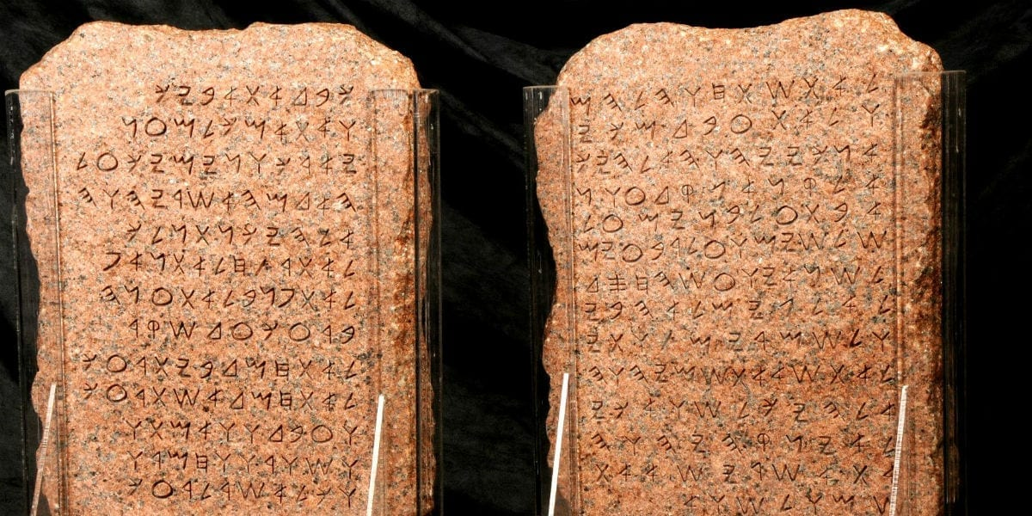
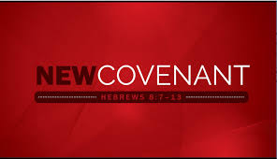
Chapter 31: The New Covenant
God’s Mercy (31:1-6)
Joyful Future Restoration (31:7-14)
God’s Mercy Toward Ephraim (31:15-22)
Judah’s Glorious Future (31:23-26)
Blessings When The Messiah Comes (31:27-34)
Spiritual Jerusalem Will Never Fall (31:35-40)

Slide 6
Chapter 31: Applications
God extends great mercy to wayward sinners who repent (cf. Luke 15:22-32)
Nobody can rightfully declare that we are guilty of the sins of our forefathers—“The fathers have eaten sour grapes, and the children’s teeth are set on edge.”
We are privileged people, having the New Covenant offered to us! “The new covenant is not a covenant with a physical nation, but with individuals who submit themselves to God’s law—converted, true believers.” (Mott, 152)

Slide 7
John Humphries, “The Books of Jeremiah and Lamentations,” Truth Commentaries, 347f
“Chapters 37 and 38 cover the same period as is covered in this chapter. The main point of this chapter is the importance of maintaining faith in God when all appears to be lost. The fact that the Babylonians are overrunning the land and conquering territory all around Jerusalem is no excuse to give up hope for the nation’s future (cf. 31:17). As promised, the people will return from exile, and God will send the Messiah. Jeremiah is to buy (redeem) some land at Anathoth (five miles northeast of Jerusalem), even though the Babylonians have occupied the area and taken it under their control. From the practical, human view, it is a foolish waste of money. However, Jeremiah’s purchase of the land is an exemplary act of faith on his part, as he believes that the Lord will make it possible for the exiles to return home and resume buying and selling of land.

Slide 8
John Humphries, “The Books of Jeremiah and Lamentations,” Truth Commentaries, 347f
“…The returning exiles will again work the land, the same as before the captivity of the nation of Judah by the Babylonians. Jeremiah has been preaching that, after God has punished sinful Judah, he will bring the nation back from captivity. Now Jeremiah is to engage in a symbolic action to ‘be an example to the believers’ not only in word, but also in conduct (cf. 1 Tim. 4:12). The prophet’s actions are, therefore, not those of a foolish man. He is motivated by deep faith in his God…After the redemption of the property is completed, Jeremiah prays a beautiful prayer for assurance. Jeremiah’s prayer (like so many other rpayers in the Bible) reviews the actions of God in the past that demonstrate not only his abiding love for Israel, but also his faithfulness to his promises (cf. Neh. 9). God responds to Jeremiah’s prayer by pointing out that the captivity occurred because of the sins of the nation. Furthermore, God makes it clear that he intends to bring his people back from captivity and eventually bless them with the coming of the Messiah.”

Slide 9
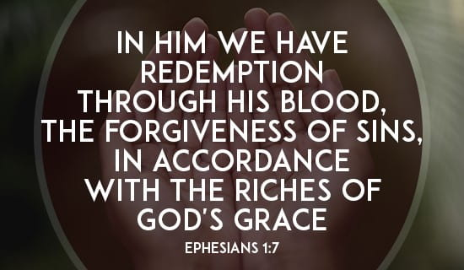
Chapter 32: Kinsman Redeemer
Historical Context (32:1-5)
Jeremiah As A Kinsman Redeemer (32:6-15)
Jeremiah Prays (32:16-25)
YHWH Answers (32:26-44)

Slide 10
Chapter 32: Applications
We may not understand the ways of God in our generation. He may be laying the groundwork for blessings to our descendants through what we are facing today.
When your faith is under fire, express confidence in the power of the Lord and pray to God for more nourishment to your faith.
Jesus is the greatest kinsman redeemer (Hebrew: go’el). See Eph. 1:7.

