Slide 1
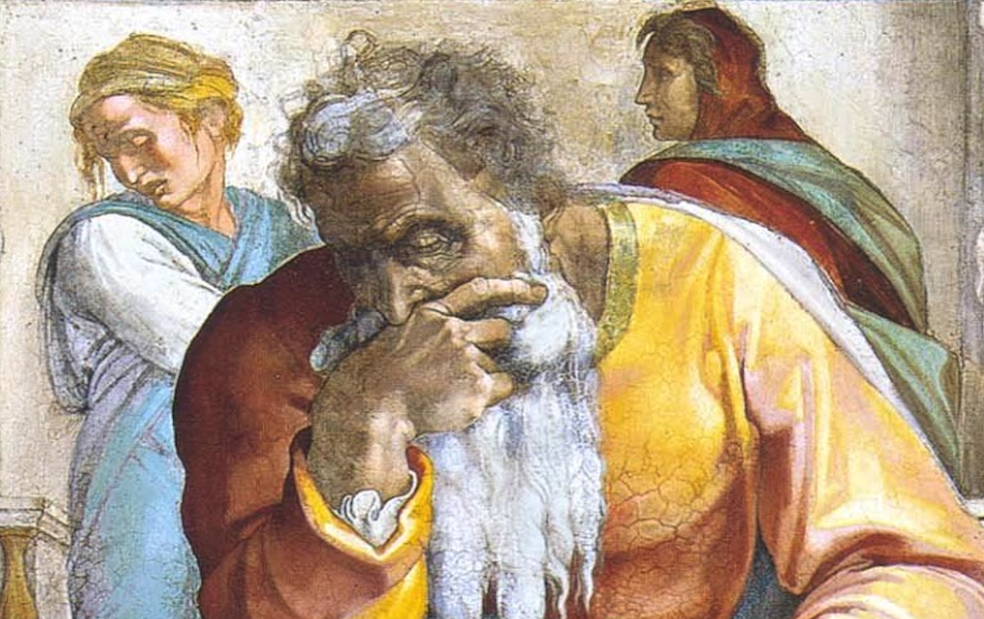
Jeremiah: Chapters 33-34

Slide 2
Jeremiah Memory Jogger:
The Yoke Of Babylon
Hananiah The Heretic
Letters to the Exiles
Glorious Future Ahead
The New Covenant
Kinsman Redeemer
I Will Cure Them
Violation of Sabbath Year

Slide 3
The Messiah In The Book Of Consolation
Will serve David, their king | 30:9; 33:14-16; cf. 23:5-8 | Luke 1:31-33; Acts 2:29-36
Their ruler shall come from their midst | 30:21; cf. Mic. 5:2 | Matt. 2:6
“You shall be My people” | 20:22; 31:1, 7, 14, 33; 32:28; 33:24 | 1Pet. 2:10; 2Cor. 6:16
Fulfilled in ”latter days” | 30:24; cf. Hos. 3:5; Is. 2:2 | Acts 2:16f; Heb. 1:1f
Israel shall go up to Zion | 31:6, 12; 32:36-44; cf. 3:14-18; Mic. 4:1-8 | Heb. 12:22-24; Gal. 4:26
Remnant shall be saved | 31:7; cf. Is. 20-22 | Rom. 9:27; 11:5
Weeping at Messiah’s birth | 31:15 | Matt. 2:17f
New Covenant | 31:31-34; 32:40 | Heb. 8:8-13
Jerusalem Rebuilt | 31:38-40; 32:36f; 33:4-9; cf. 3:17 | Heb. 12:22-24; Gal. 4:26
King and priest forever | 33:17-22; cf. Zech. 6:12f; Ps. 110:1, 4 | Heb. 1:13; 5:5f; 7:14-19; 8:1f; 9:11f; 10:11-13

Slide 4
John Humphries, “The Books of Jeremiah and Lamentations,” Truth Commentaries, 361
“While still in prison (32:1-2; 37:15), Jeremiah continues to receive the glorious promises of God concerning restoration from Babylonian captivity and the blessing of the Messiah. Through Babylon, God will smite the two kingdoms of Israel (Israel and Judah, 33:24; 32:29-30; Ezek. 37:16, 22). However, he will subsequently heal Israel by freeing the nation from exile in Babylon, then sending the Messiah (David (Ezek. 37:24) in the fullness of time (Gal. 4:4; Eph. 1:10). The blessings under the Messiah are described with ‘covenant coloring’ language…

Slide 5
John Humphries, “The Books of Jeremiah and Lamentations,” Truth Commentaries, 361
“…the Jews thought of God’s blessings for the nation of Israel in terms of the peaceful dwelling in the land of their inheritance, Canaan/Palestine (Deut. 28:1-14; Lev. 25:10; 1 Kings 4:24-25; Mic. 4:4; Ps. 37:3, 9-11, 22, 27, 29, 34; cf. Matt. 5:5). This promise concerning the peaceful enjoyment of the land repeatedly blends into the messianic expectations of the prophets (cf. Isa. 60-62; Mic. 4; Amos 9; Zech. 8; Ezek. 36-37). Also read the introduction to chapters 3 and 30.”

Slide 6
Chapter 33: I Will Cure Them
Rejoicing Upon Return (33:1-13)
Messianic Restoration (33:14-18)
God Is Faithful (33:19-26)

Slide 7
Chapter 33: Applications
“Christ now serves both as king and priest according to Jeremiah and Zechariah (cf. 6:12-13). Premillennialism offers only confusion on these prophecies as they deny He is now king, yet they acknowledge He is now our high priest. If He is serving in one work He is also serving in the other! (Heb. 8:1). In fact, He cannot serve as high priest on earth because He is from the wrong tribe (cf. Heb. 8:4; 7:14); therefore neither do we look for Him to serve as king on earth (cf. John 18:36).” (Harkrider, 93)
God’s faithfulness is displayed each day in the day and night (cf. Lam. 3:22f)

Slide 8
John Humphries, “The Books of Jeremiah and Lamentations,” Truth Commentaries, 370
“The moral and spiritual instability of the nation of Israel is illustrated in this chapter. The Jews entered into a covenant with king Zedekiah to allow their slaves to go free but then turned around and placed them in bondage again. This demonstrated the fickleness of the nation in honoring covenants. The people of Israel were doing to their slaves the same thing they had done to God; they betrayed them by going back on their word. Covenants meant nothing to the Jews, as they openly set them aside according to their own selfish whims. Because of this lack of respect for God and his covenant with the nation of Israel, the city of Jerusalem was going to be destroyed.”

Slide 9
Lachish Ostraca IV – Jer. 34:6-7; 6:1
“May Yahweh cause my lord to hear reports of good news this very day. And now, according to all that my lord sent thus your servant has done. I have written upon the tablet according to all that [you] have sent to me. And with respect to what my lord sent concerning the matter of Beth-Harapid, there is no man there. As for Semakyahu, Shemayahu has seized him and taken him up to the city. Your servant cannot send the witness there today; rather, it is during the morning tour that [he will come (to you)]. Then it will be known that we are watching the fire signals of Lachish according to the code which my lord gave us for we cannot see Azekah”

Slide 10
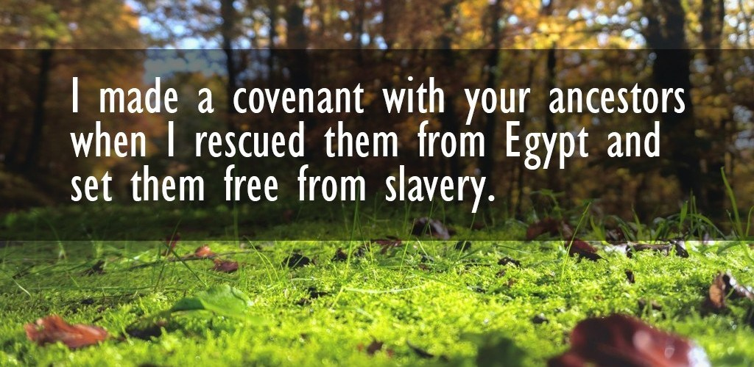
Chapter 34: Violation of Sabbath Year
In Disaster, They Obey Out Of Fear (34:1-10)
At The 1st Possibility Of Deliverance, They Disobey (34:11-22)

Slide 11
Chapter 34: Applications
“Jer. 34:15-18: Lip service and outward or visible action do not of themselves constitute obedience (cf. Matt. 15:7-9; 1 Cor. 13:1-3). However, when obedience comes from the heart, outward action will definitely follow (cf. 1 John 5:3; Rom. 6:17-18 cf. 6:3-5; Luke 6:46; James 1:22; Matt. 7:24-27).” (Harkrider, 98)
Serving God may begin in fear of judgment, but it should not remain there. Fear of reprisal must mature into obedience in love.
Let us not serve God, pray to God, expect of God in mere times of distress but also in prosperity!

