Slide 1
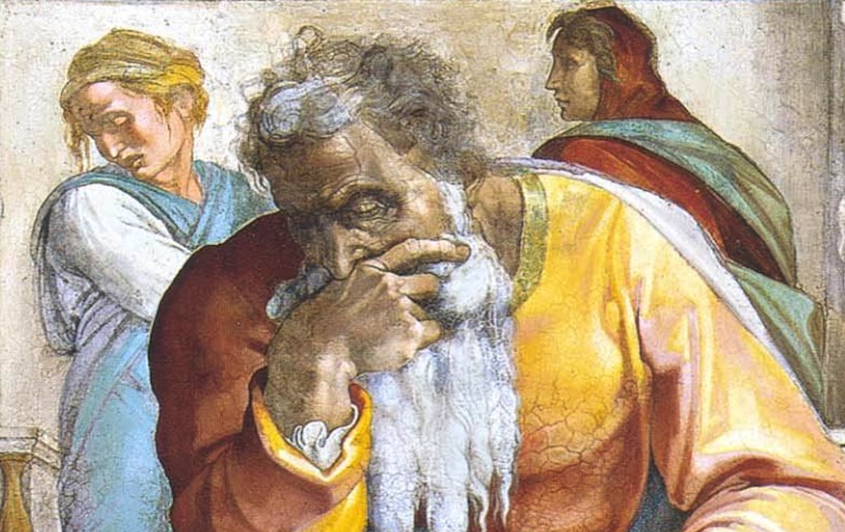
Jeremiah: Chapters 35-36

Slide 2
Jeremiah Memory Jogger:
The Yoke Of Babylon
Hananiah The Heretic
Letters to the Exiles
Glorious Future Ahead
The New Covenant
Kinsman Redeemer
I Will Cure Them
Violation of Sabbath Year
The Rechabites
Jehoiakim Burns The Scroll

Slide 3
John Humphries, “The Books of Jeremiah and Lamentations,” Truth Commentaries, 377
“Jeremiah records this incident regarding the Rechabites in order to demonstrate that the nation of Judah has not continued to maintain proper respect towards God. The Rechabites have shown greater respect to their family traditions, which date back hundreds of years, than the Israelites have toward the commandments of their heavenly father. The devotion and commitment of the Rechabites should shame the fickle, rebellious Israelites.”

Slide 4
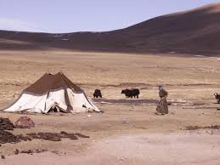
Chapter 35: The Rechabites
The Rechabites Obeyed Their Father (35:1-11)
Judah Should Have Obeyed Their Father (35:12-19)

Slide 5
Chapter 35: Applications
Apologetics: The Rechabites not only denied the offer of wine, but further explained their heritage & moral choices. When we deny something, we should explain why.
Influence: We must be a “living rebuke” to a faithless and disobedient nation.
Priorities: Let not our observance of customs & values outdo our service to God.

Slide 6
John Humphries, “The Books of Jeremiah and Lamentations,” Truth Commentaries, 382
“As was the case with the previous chapter, this chapter is inserted here to demonstrate Israel’s lack of respect for the word of God. One of the most blasphemous actions ever recorded in the Bible takes place in this chapter as Jehoiakim, king of Judah, deliberately takes the word of God, cuts it up, and throws it into the fire. Of course, this does not change the fact that judgment is coming upon the city and the people because of their wickedness. Such an attitude of unbelief only hastens the judgment of God against the kingdom of Israel. To his sorrow, Jehoiakim will learn the folly of fighting against God and his holy word. The word that Jehoiakim thinks that he is destroying will only be rewritten by Jeremiah and placed in the eternal record of God’s book. Jehoiakim’s insulting defiance toward God is actually only puny and weak posturing before the omnipotent God of all creation. All of the Jehoiakims of human history need to learn the utter futility of rebellion against God and his word (John 12:48).”

Slide 7
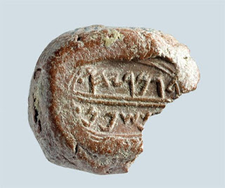
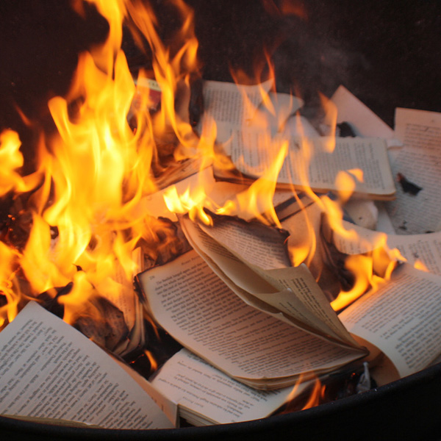
Chapter 36: Jehoiakim Burns The Scroll
Scroll Commissioned & Read In Temple (36:1-10)
Scroll Read In The Palace (36:11-19)
Scroll Read & Destroyed By Jehoiakim (36:20-26)
God’s Word Is Not Destroyed (36:27-32)
Seal Of Gemariah

Slide 8
Chapter 36: Applications
“We fervently wish that the destructive critics and liberal theologians would have enough faith to accept [divine inspiration] and cease their ungodly attacks upon the word of God.” (Humphries, 383)
When we sin by willfully disregarding what we know to be God’s command, we become like King Jehoiakim. Prejudice blinds one to the truth. Our struggle is to keep a soft heart. Let us root out our own areas of stumbling today!

