Slide 1
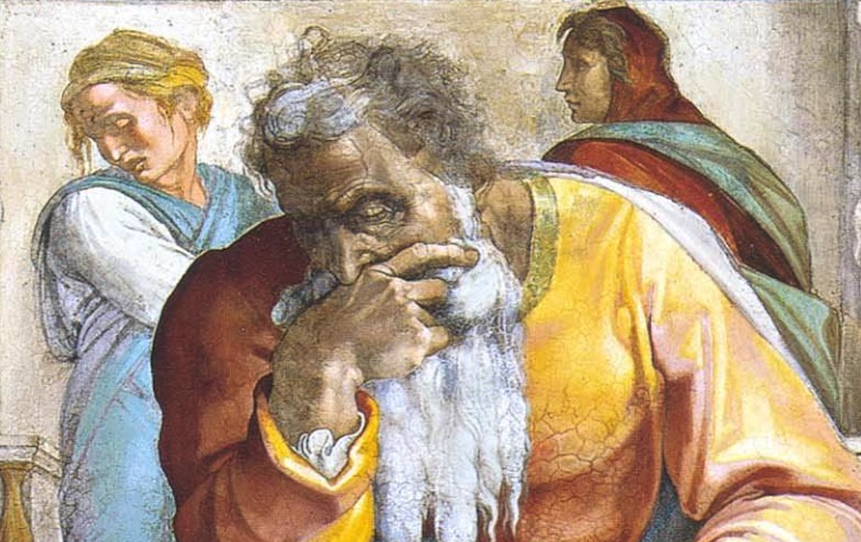
Jeremiah: Chapters 39-40

Slide 2
Jeremiah Memory Jogger:
The Yoke Of Babylon
Hananiah The Heretic
Letters to the Exiles
Glorious Future Ahead
The New Covenant
Kinsman Redeemer
I Will Cure Them
Violation of Sabbath Year
The Rechabites
Jehoiakim Burns The Scroll
Jonathan’s Cistern
Malchijah’s Cistern
Jerusalem Falls
The Aftermath

Slide 3
John Humphries, “The Books of Jeremiah and Lamentations,” Truth Commentaries, 407
“After an eighteen-month siege, the city of Jerusalem fell in 586 B.C. Zedekiah tried to escape but was captured, tortured and taken to Babylon, where he eventually died in prison (52:11). Jeremiah was released to the custody of Gedaliah, the new governor of what was left of the cities of Judah (40:5). Jeremiah comforts Ebed-meleck, the Ethiopian who rescued him from the cistern (38:11-13), with the promise that he would be safe from the revenge of the princes, who had so heartlessly imprisoned Jeremiah (39:18; cf. 38:4, 9).”

Slide 4
Josephus, Antiquities 10:8:2
“On the ninth day of the fourth month the famine was so severe in the city that there was no food for the people of the land. Then the city was broken into, and all the men of war fled by night by way of the gate between the two walls beside the king’s garden, though the Chaldeans were all around the city. And they went by way of the Arabah. But the army of the Chaldeans pursued the king and overtook him in the plains of Jericho and all his army was scattered from him. Then they captured the king and brought him to the king of Babylon at Riblah, and he passed sentence on him. During this siege, Zedekiah and the remnants of his army broke out of Jerusalem and fled east toward Jericho, only to be captured and brought to Riblah where Nebuchadnezzar still maintained his headquarters. When he was come Nebuchadnezzar began to call him a wicked wretch and a covenant-breaker and one that had forgotten his former words, when he promised to keep the country for him.”

Slide 5
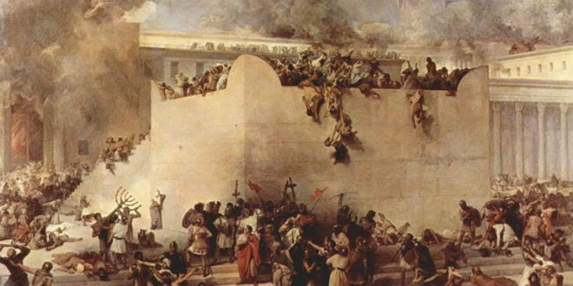
Chapter 39: Jerusalem Falls
Jerusalem Falls; Zedekiah Imprisoned (39:1-10)
Jeremiah Released By Babylonians (39:11-14)
Ebed-Melech’s Reward (39:15-18)

Slide 6
Chapter 39: Applications
Indecision brings consequences. Choose who you will serve or suffer (yourself and others) for an incorrect choice.
“God had honoured His promise to deliver Jeremiah (cf. 1:8), saving him when others were being destroyed. The Christian has a firm assurance of God’s loving concern and care for His faithful children (cf. Mt 10:30f; 1 Pet 5:7; etc.).” (Harrison, 158)

Slide 7
John Humphries, “The Books of Jeremiah and Lamentations,” Truth Commentaries, 413f
“In the confusion after the fall of Jerusalem, Jeremiah is mistakenly (cf. 39:11-14) taken five miles north of Jerusalem to Ramah. The mistake is soon corrected and Jeremiah is sent back to Gedaliah, the new governor of the cities of Judah. Gedaliah seems to be very conscientious in meeting his responsibilities but somewhat naïve (it would appear) concerning the personal risks he faces as the new governor. He is warned of the danger of being assassinated, but he does not heed the warning…Treachery and jealousy were afoot among the Ammonites and members of the royal family. Gedaliah was in danger of being assassinated, though he dismissed the warning. This would prove to be a fatal mistake.”

Slide 8
Chapter 40: The Aftermath
Jeremiah’s Release At Ramah (40:1-6)
Gedaliah, The Politician & Return Of Fugitives (40:7-12)
Johanan Warns Gedaliah Of Mutiny (40:13-16)

Slide 9
Chapter 40: Applications
“When God’s judgments fall, some will learn righteousness (cf. Ps. 119:67, 71; Isa. 26:9), while others will not (cf. Rev. 9:20, 21; 16:9-11, 16).” (Humphries, 415)
Jeremiah’s staying with the people despite great privileges that going to Babylon could offer shows that one should not seek great things for oneself (45:5). We must seek to do what we can, where we can, when we can, while we can.
“It is not unknown for Christians to be treated with greater respect by the world than by the fellowship of believers.” (Harrison, 160) Should never be the case!
Some aren’t as sincere as others; we need to be shrewd as serpents! (cf. Jn. 2:24f)

