Slide 1
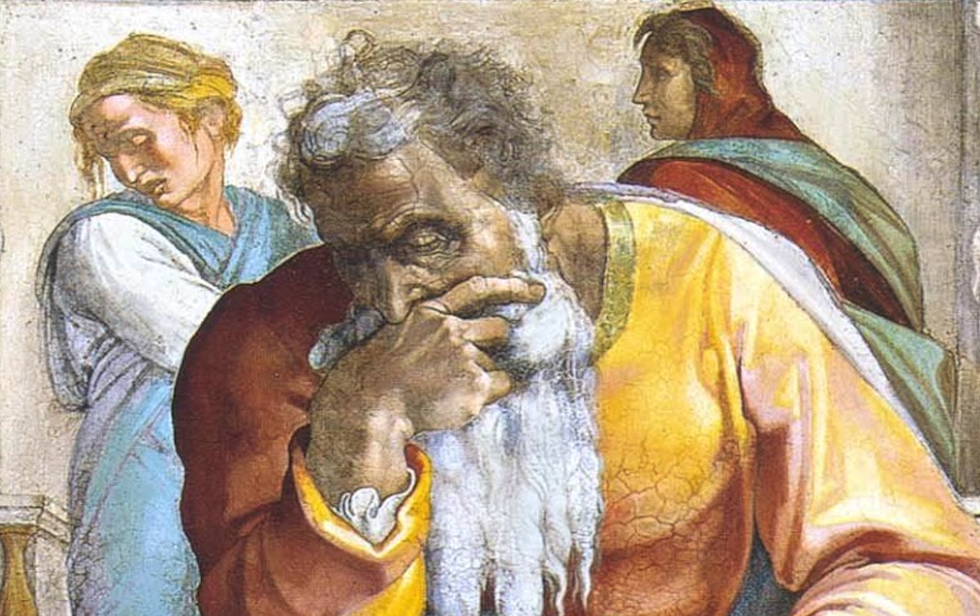
Jeremiah: Chapters 41-42

Slide 2
Jeremiah Memory Jogger:
The Yoke Of Babylon
Hananiah The Heretic
Letters to the Exiles
Glorious Future Ahead
The New Covenant
Kinsman Redeemer
I Will Cure Them
Violation of Sabbath Year
The Rechabites
Jehoiakim Burns The Scroll
Jonathan’s Cistern
Malchijah’s Cistern
Jerusalem Falls
The Aftermath
Murder Of Gedaliah
Don’t Go To Egypt!

Slide 3
John Humphries, “The Books of Jeremiah and Lamentations,” Truth Commentaries, 420
“Treachery, murder, and fear are all contained in this chapter, whose events are a continuation of those in chapter 40. Gedaliah, the governor, is betrayed and murdered at a feast. Also, pilgrims who came to worship are deceived and brutally killed. Ten of the pilgrims are able to save their lives by offering bribes to Ishmael. Finally, the ‘remnant of the people’ is fearful and in confusion because of the governor’s murder. The Jews anticipate Babylonian reprisals against them as punishment for the murder of Gedaliah and make plans to flee to Egypt.”

Slide 4
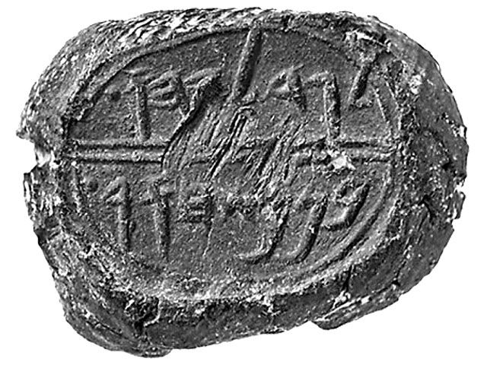
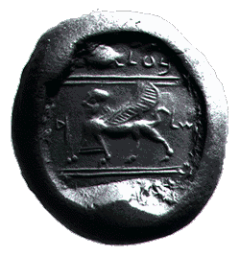
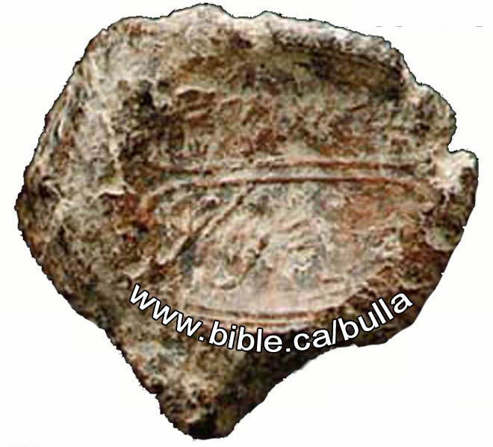
Chapter 41: Murder Of Gedaliah
“Gedaliah, who is over the house”
“Belonging to Baalis, King of Benei Ammon”
“Belonging to Ishmael, the King’s Son”
“The assassin Ishmael violated all the laws of oriental hospitality in murdering his host in a shocking act of perfidy. Such a reprehensible crime could only have been committed by a man utterly blinded by jealousy and by indifference to possible Chaldean reprisals.” (Harrison, 162)

Slide 5
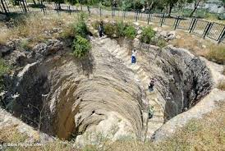
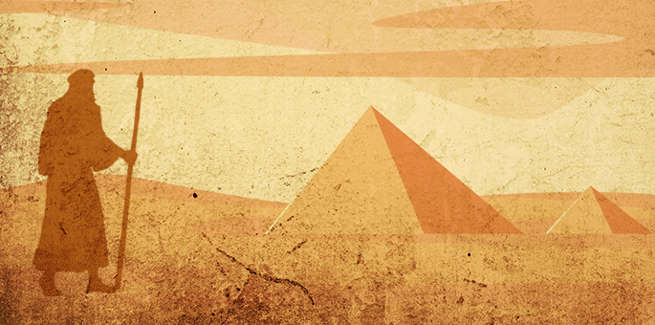
Chapter 41: Murder Of Gedaliah
Murder of Officials at Mizpah (41:1-3)
Slaughter of Pilgrims & Captivity of Those Remaining at Mizpah (41:4-10)
Johanan’s Response; Plan to Go to Egypt (41:11-18)

Slide 6
Chapter 41: Applications
We must not let personal ambition cause us to stumble!
“This section certainly illustrates the floundering efforts of worldly men who seek to make their own way through life, apart from seeking any guidance from the Lord (10:23). ‘The way of transgressors is hard’ and ‘evil pursueth sinners’ (Prov. 13:15, 21).” (Humphries, 425)

Slide 7
John Humphries, “The Books of Jeremiah and Lamentations,” Truth Commentaries, 426
“Johanan and others make an urgent prayer request to the prophet Jeremiah, who agrees to pray for them that they might have guidance from the Lord. However, the prophet solemnly warns the Jews that he will tell them exactly what God’s answer is—nothing more and nothing less. The Jews agree to abide by the answer from the Lord and do whatever God tells them to do. After some time, Jeremiah gives them God’s answer. The Jews are told that they are not to go to Egypt but are to remain in the land of Canaan. If they will obediently abide in the land, God promises to watch over and protect them…

Slide 8
John Humphries, “The Books of Jeremiah and Lamentations,” Truth Commentaries, 426
“…However, if they insist on disobeying God and going down to Egypt, they will suffer the same calamities of war that they have suffered already in the fall of Jerusalem.”
“Jeremiah rebukes the Jews for being insincere in their request for prayer, as they have already made up their minds that they must flee to Egypt. It would appear that the people’s prayer request—instead of being a genuine appeal for guidance—was, rather, a petition for God to bless their decision to go to Egypt. There was more superstition than faith in their asking for prayer in their behalf.”

Slide 9
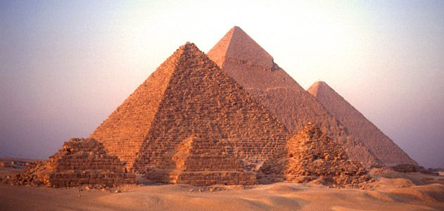
Chapter 42: Don’t Go To Egypt!
The People Insincerely Ask for Jeremiah’s Intercession (42:1-6)
YHWH’s Answer—Do Not Fear: Stay in The Land & Don’t Go To Egypt! (42:7-22)

Slide 10
Chapter 42: Applications
We should “keep nothing back” when we preach Jesus (v. 4; cf. Acts 20:27).
“God’s moral character and righteous standards of conduct do not change (Mal. 3:6; Jas. 1:17). However, he does change his actions toward men based upon their attitude and conduct (cf. Jer. 18:7-10). Man is called upon to measure up to God’s righteous standard (Lev. 11:44, 45; 19:2; 20:26; 1 Pet. 1:15, 16). Man falls short and needs to repent (Rom. 3:23; Acts 20:21), but God never falls short, and therefore, never needs to repent.” (John Humphries, 429)
We should not expect God to honor our own plans that are not of His making.

