Slide 1
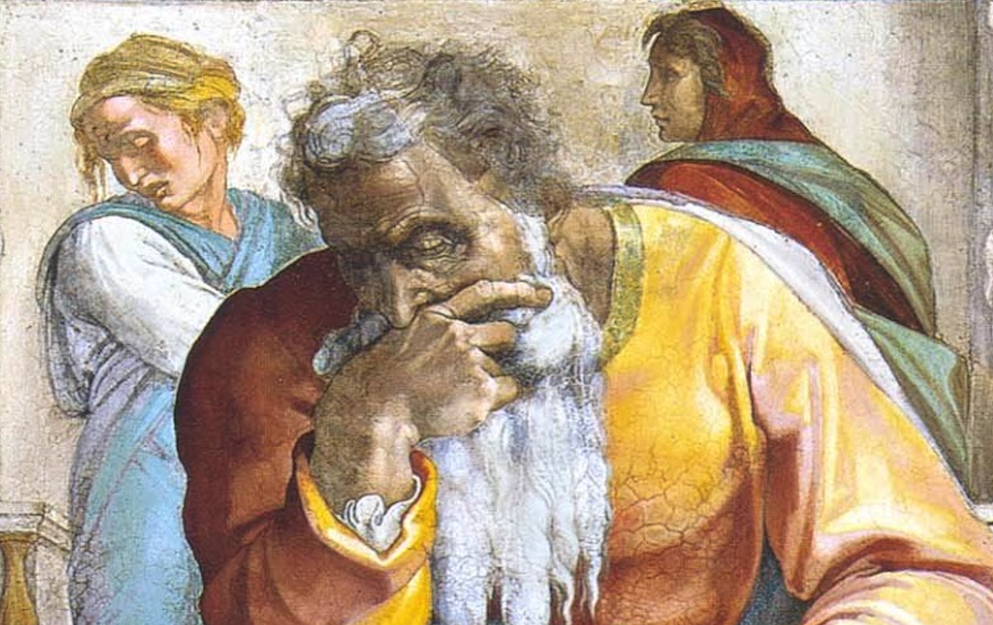
Jeremiah: Chapters 43-44

Slide 2
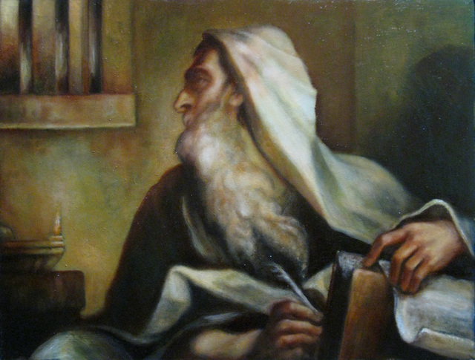
Jeremiah Memory Jogger:
The Yoke Of Babylon
Hananiah The Heretic
Letters to the Exiles
Glorious Future Ahead
The New Covenant
Kinsman Redeemer
I Will Cure Them
Violation of Sabbath Year
The Rechabites
Jehoiakim Burns The Scroll
Jonathan’s Cistern
Malchijah’s Cistern
Jerusalem Falls
The Aftermath
Murder Of Gedaliah
Don’t Go To Egypt!
They Go To Egypt
Queen of Heaven

Slide 3
John Humphries, “The Books of Jeremiah and Lamentations,” Truth Commentaries, 434
“The lack of faith on the part of the remnant of Israel is revealed. The people not only refuse to obey the Lord and remain in Canaan, but they also falsely accuse Jeremiah and Baruch of treachery. The blindness of unbelief and rebellion against the Lord is clearly demonstrated in the Jews’ harsh language and ill-advised decision to leave Canaan and flee from the word of the Lord, but they will find, to their pain and sorrow, that the word of God follows them into Egypt. There is no escape from the presence of the Lord (23:24; Amos 5:19; 9:2-4; Ps. 139:7; cf. Jonah 1:3). God will bring the Babylonians, whom the Jews fear, into Egypt. Therefore, destruction, pain, and suffering will soon come upon the Jews, just as Jeremiah had warned.”

Slide 4
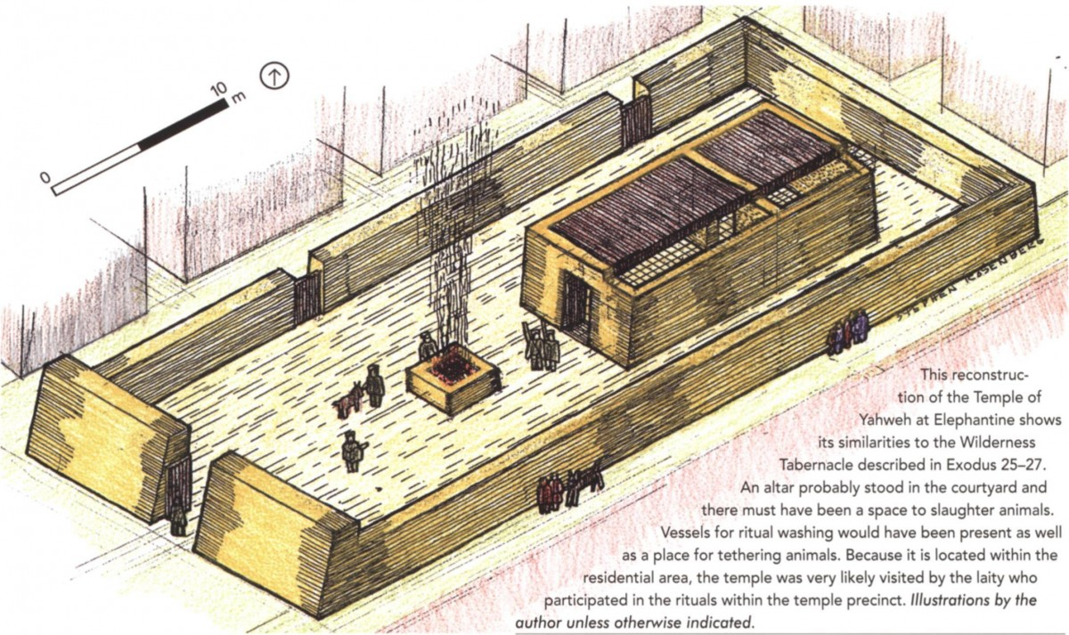
Chapter 43: They Go To Egypt
Jeremiah’s Warning Is Ignored (43:1-7)
Jeremiah Rebukes Them Down In Egypt (43:8-13)

Slide 5
Chapter 43: Applications
Effective and moral leadership is pivotal.
False gods are always false.
Those who labor for the Lord in sharing His instructions need to use effective, soul-reaching methods in order to keep hearts soft and strive to convict even the most calloused and scarred hearts.

Slide 6
John Humphries, “The Books of Jeremiah and Lamentations,” Truth Commentaries, 440
“The Jews have now settled into several Egyptian cities and are deeply involved in the idolatrous practices of the society around them. Jeremiah warns the Jews that they cannot depend upon Egypt for protection from the Babylonians. Jeremiah’s message is that the Jews will be severely punished in Egypt, where they foolishly and rebelliously fled for safety. The prophet Jeremiah reminds the Jews that they have failed miserably to learn from the mistakes of their fathers and have also rebelliously refused to listen to God’s spokesmen, the prophets.”
“The people are in serious trouble with the Lord because of their own sinful attitude and foolish actions. One of the most striking and shocking examples of man’s ability to twist and distort historical facts is seen in this chapter. In this case, the Jews manipulate the truth in order to make it appear that…

Slide 7
John Humphries, “The Books of Jeremiah and Lamentations,” Truth Commentaries, 440
“…they are experiencing difficulties because they stopped worshipping the queen of heaven, not because they had stopped honoring and obeying God (post hoc, ergo propter hoc, i.e., after this, therefore as a result of this). They were committing the common logical fallacy of assuming that what comes before an event must therefore be its cause.”
“Their claim is that the queen of heaven (rather than the Lord God) has stopped blessing them. Of course, Jeremiah sets the record straight and warns the Jews that God’s word will stand and that they will be severely punished. The fact that the Jews in Egypt will be punished will be a sign that God will keep his word. Just as the Lord gave Zedekiah into the hand of the Babylonians, so will he give Pharaoh Hophra (king of Egypt) into the hands of King Nebuchadnezzar.”

Slide 8
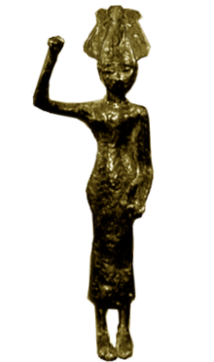
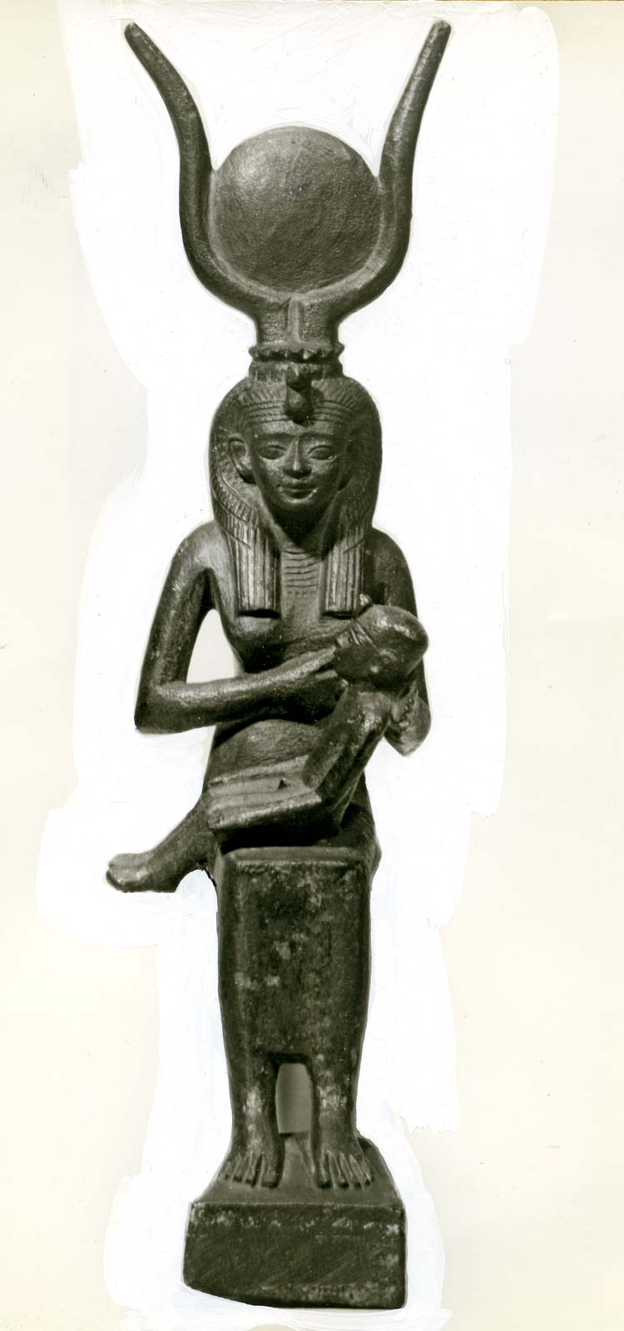
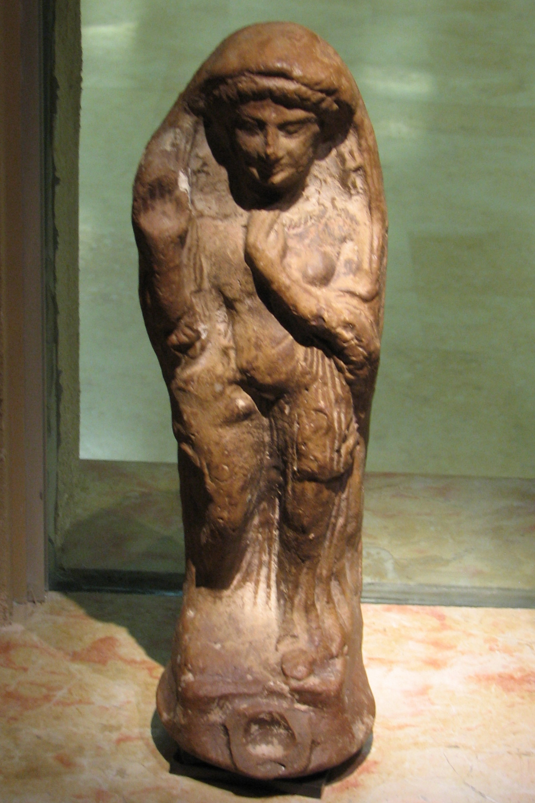
Chapter 44: Queen of Heaven
A Recap Of Recent Events (44:1-6)
Denunciation & Judgment (44:7-14)
Rebellious Persistence (44:15-19)
Condemnation Of Twisting The Facts (44:20-30)

Slide 9
Chapter 44: Applications
Leadership, headship, and submission in the home are so critical! (vv. 19)
God will render to all according to their deeds and priorities. Likewise, He will extend immeasurable grace to those who seek to do His will.
“If we do not learn from history, we are doomed to repeat it.”

