Slide 1
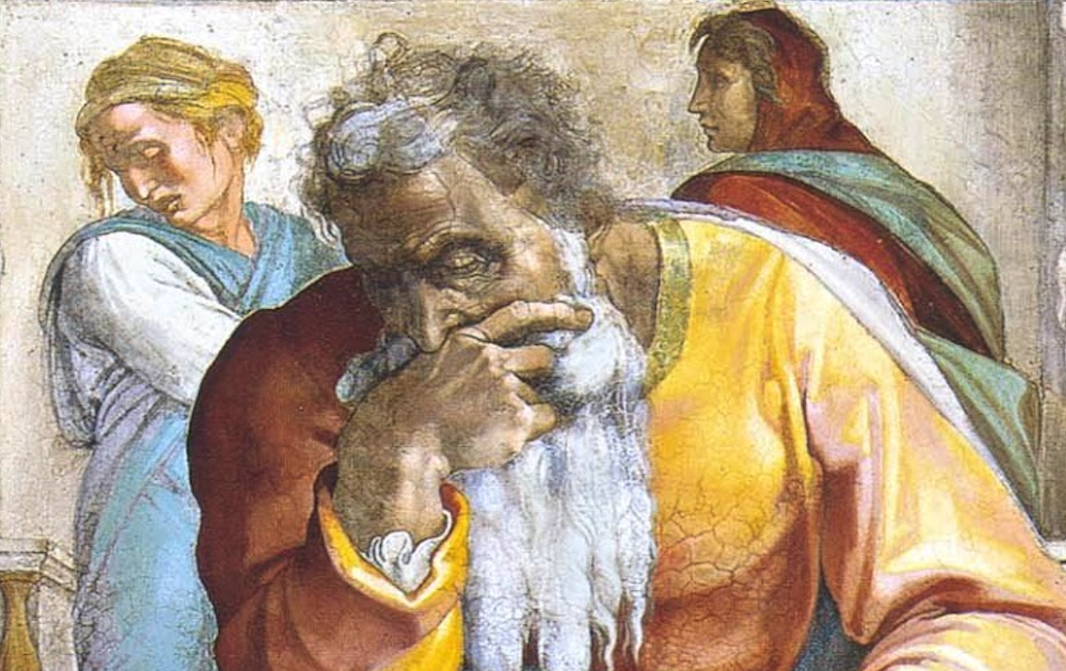
Jeremiah: Chapters 45-46

Slide 2
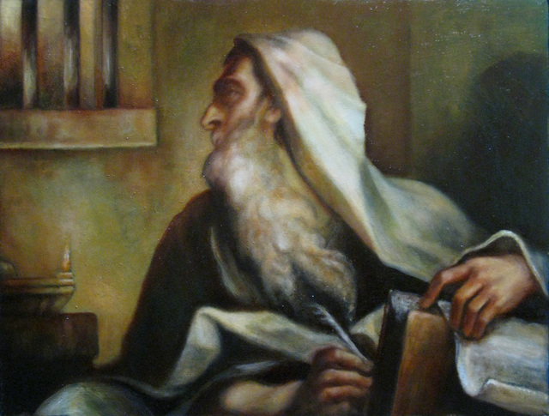
Jeremiah Memory Jogger:
The Yoke Of Babylon
Hananiah The Heretic
Letters to the Exiles
Glorious Future Ahead
The New Covenant
Kinsman Redeemer
I Will Cure Them
Violation of Sabbath Year
The Rechabites
Jehoiakim Burns The Scroll
Jonathan’s Cistern
Malchijah’s Cistern
Jerusalem Falls
The Aftermath
Murder Of Gedaliah
Don’t Go To Egypt!
They Go To Egypt
Queen of Heaven
Woes of Baruch
Judgment on Egypt

Slide 3
Chapter 45: Woes of Baruch
Baruch’s Complaint (45:1-3)
God’s Response (45:4-5)

Slide 4
Chapter 45: Thought Questions
What principles for ministry can we derive from this chapter?
Compare & contrast the feelings of Baruch with Jeremiah (15:18-21; 20:14-18).
Why is it important to let God be God? What happens when we lose sight of this?

Slide 5
Chapter 45: Applications
“Therefore my beloved brethren, be steadfast, immovable, always abounding in the work of the Lord, knowing that your toil is not in vain in the Lord.” (1Cor. 15:58)
The work of a servant of God is not always glamorous (2:30; 36:26; Acts 7:52; 1Cor. 4:9-13; 2Tim. 3:12). We must therefore live by faith (Hab. 2:2-4).

Slide 6
Introduction to Chapters 46-51 (in LXX, after 25:13a)
Messianic Assurances Built into These Oracles.
God Is King of the Nations (10:7; Ps. 97:1-3; Acts 17:26), So All Are Accountable.
A Remnant for Israel (31:7; Rom. 9:27; 11:5); a Remnant for the Gentiles (Is. 11:10; Rom. 15:12; Zech. 14:16; Mal. 1:11; Matt. 7:13f; Lk. 13:23f).
Compare Is. 13-23; Ezek. 25-32; Amos 1-2; Zeph. 2 for oracles against nations.

Slide 7
John Humphries, “The Books of Jeremiah and Lamentations,” Truth Commentaries, 459f
“Egypt is shown to be weak and vulnerable before the powerful Babylonian army. Human wisdom might look to Egypt and think that, with her long history as a powerful nation, she would be stronger than this new, rising nation (Neo-Babylon). In fact, Israel had a long history of turning to (once powerful) Egypt for political protection, but it was a serious mistake (Deut. 17:16; Isa. 30:1-5; 31:1-3; Jer. 2:13, 18, 36-37; Ezek. 17:7, 15; 29:6, 7; Pss. 118:8, 9; 146:3, 4). Egypt would be no match for Babylon ‘because the Lord drove them away’ (v. 15, NKJV) in defeat. God would smite (scatter) Egypt among the nations, but then healing (restoration) would be offered to those in Egypt who would turn to the Lord. In its ultimate application, the passage is messianic (cf. Isa. 19:22-25; Ezek. 29:12-13; 30:26). The closing paragraph in the chapter is God’s promise to preserve Israel in spite of his punishment of her.”

Slide 8
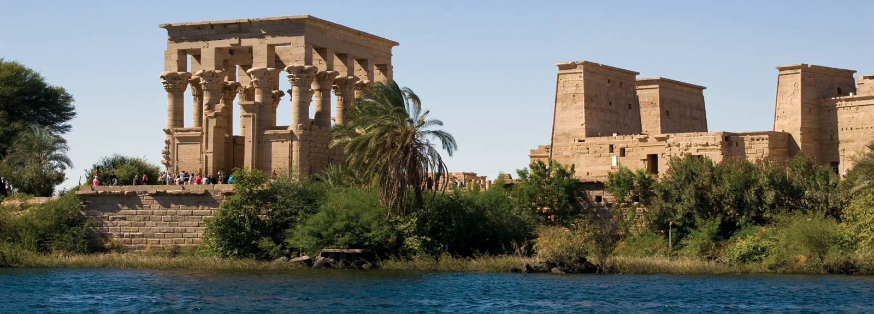
Chapter 46: Judgment On Egypt
Humiliating Defeat of Egypt @ Carchemish (46:1-12)
Egypt Plucked Up & Then Built Back Up (46:13-26)
Discipline, Yet Deliverance for Israel (46:27-28)

Slide 9
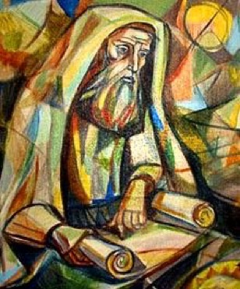
Chapter 46: Thought Questions
Can you think of any North African peoples who found restoration via the gospel?
What is meant by the passing of the appointed time for Pharaoh? (v. 17)
What national and personal applications may be made from this oracle?

Slide 10
John Humphries, “The Books of Jeremiah and Lamentations,” Truth Commentaries, 468
“These pagan nations did, indeed, pass away in time. Assyria, Babylon, Medo-Persia, and many others are all gone from the face of the earth. The only physical evidence that these nations ever existed is in the fragmented historical information that they left behind, written on pieces of clay or engraved on rocks. The remains of once mighty cities rest in piles of rubble, the most interesting pieces having been carried off to the great museums of the world to be examined by the curious. Even the mighty Egyptian pyramids, temples, and monuments — as impressive as they remain today—do not manifest their former splendor…

Slide 11
John Humphries, “The Books of Jeremiah and Lamentations,” Truth Commentaries, 468
“…They were plundered by grave robbers long ago, and, in the case of the pyramids, their magnificent outer surfaces have been removed to provide building material for other structures in nearby settlements. The Bible and the writings of a few ancient historians contain much concerning these once mighty nations, but ‘their glory has departed’ (cf. 1 Sam. 4:22). These powerful nations, ‘pass away one by one’ (25:30-33 notes), but there will always be an ‘Israel of God’ (Isa. 54:7, 8; Amos 9:8; Gal. 6:16; Jer. 31:17 notes). God chastens his people that they might yield the ‘peaceable fruit of righteousness’ to his glory and praise (Heb. 12:5-6, 11; Eph. 1:12).”

Slide 12
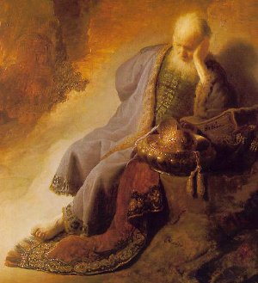
Chapter 46: Applications
Nations that shed innocent blood will have their blood shed (cf. Rev. 13:10).
“Jer. 46:27-28: Judah might seem to be only a small state tossed about by great powers, but the truth is, God is in control and working out His purposes. Jehovah is revealed as the God of history and the God of all the earth, not just a tribal or national deity. It is He who controls the universe (cf. Dan. 4:24,32; 5:20-21; Rev. 1:5).” (Harkrider, 118)

