Slide 1
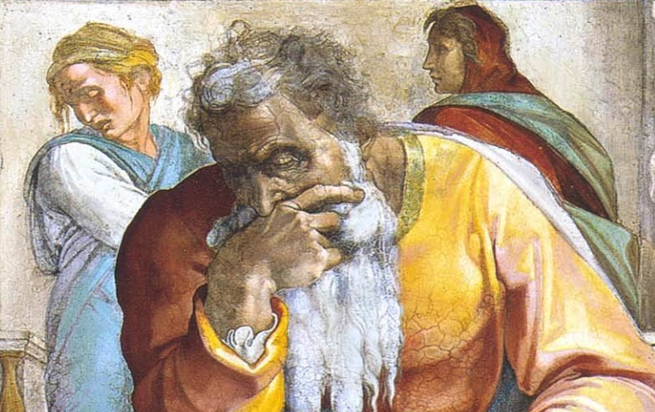
Jeremiah: Chapters 47-48

Slide 2
Jeremiah Memory Jogger:
The Yoke Of Babylon
Hananiah The Heretic
Letters To The Exiles
Glorious Future Ahead
The New Covenant
Kinsman Redeemer
I Will Cure Them
Violation of Sabbath Year
The Rechabites
Jehoiakim Burns The Scroll
Jonathan’s Cistern
Malchijah’s Cistern
Jerusalem Falls
The Aftermath
Murder Of Gedaliah
Don’t Go To Egypt!
They Go To Egypt
Queen Of Heaven
Woes Of Baruch
Judgment On Egypt
Judgment On Philistia
Judgment On Moab

Slide 3
John Humphries, “The Books of Jeremiah and Lamentations,” Truth Commentaries, 469
“The Philistines (Sea Peoples) settled in the coastal region known as the Philistine plain and were powerful and persistent enemies of Israel (Judg. 3:1-3; 1 Sam. 4:1; 31:1; Ezek. 25:15-17). The Philistines (forced out by the Greeks) arrived in Canaan from the Aegean Sea area (Crete) as hostile invaders, destroying the Canaanite cities and settling in their ruins. Egypt also used them as mercenaries to man the garrison towns which protected the northeastern frontier of Egypt. It is also possible that some of the Philistines (as Aegean traders) had arrived much earlier (cf. Gen. 21:32, 34) but were not sufficiently prominent to merit special mention in the contemporaneous secular histories. They were doubtless among the ‘Sea Peoples’ who not only plied their trade on the high seas, but also settled in southwest Canaan. Philistia eventually was dominated by five city-states. These five cities (pentapolis) of the Philistines (1 Sam. 6:16-18) were Ekron, Ashdod, Gaza, Ashkelon, and Gath…

Slide 4
John Humphries, “The Books of Jeremiah and Lamentations,” Truth Commentaries, 469
“…By the twelfth century B.C., the Philistines were established as a powerful, formidable force in Canaan. As noted, they became the bitter enemies of Israel. Even though the Philistines were eventually subdued by the campaigns of David against them (2 Sam. 8:1), they later asserted their independence of Judah during the time of the divided kingdom (2 Chron. 21:16, 17; 28:18). Military conflicts with the Assyrians (and others), which continued during the time of Alexander the Great (336-323 B.C.), greatly weakened the Philistines. They were, therefore, conquered by the Maccabees (second century B.C.) and assimilated into Israel. Other prophets spoke of Philistia, not only delivering warnings of God’s judgments against the people (Jer. 47:1-7), but also extending hope in the Messiah (Isa. 14:28; 20:1; Amos 1:6-8; Zeph. 2:4-7; Zech. 9:6-8; cf. Acts 8:40).”

Slide 5
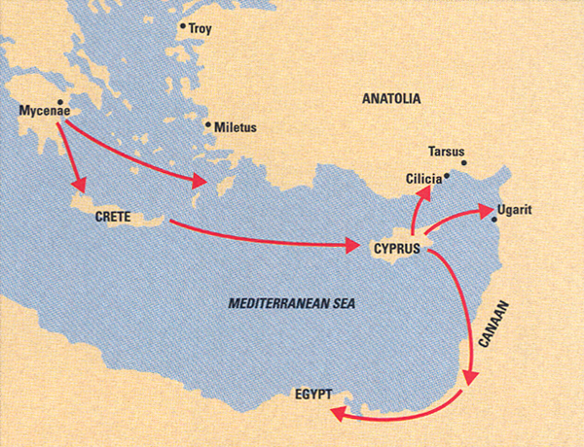

Slide 6
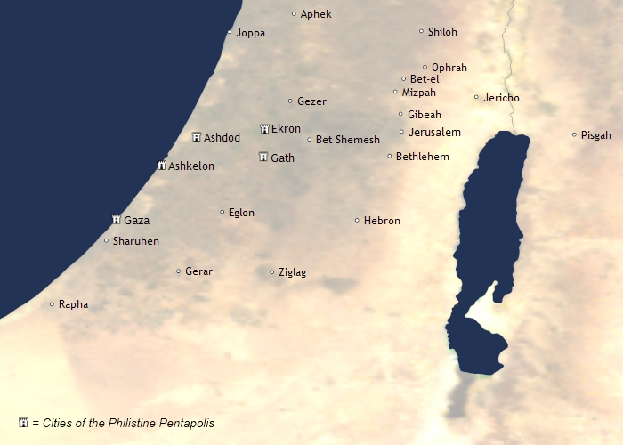
Chapter 47: Judgment On Philistia
Introduction (v. 1)
Destruction (vv. 2-5a)
Compassion (vv. 5b-7)

Slide 7
Chapter 47: Applications
Chapter 47: Thought Questions
Explain the starkness of the imagery of fathers abandoning their children.
Will fleshly allies be able to withstand the Lord?
Is it proper for Christians to mourn for the destruction of the ungodly?
Rather than to offer children as objects of brutal appeasement for false gods, we should be dedicating them to the LORD (1Sam. 1-2; Eph. 6).
Those who do not know God see flaming fire (cf. 2Thess. 1:7b-9)

Slide 8
John Humphries, “The Books of Jeremiah and Lamentations,” Truth Commentaries, 473
“There was much contact between Moab and Israel through the centuries (Num. 20:14; 22:1; 25:1; Judg. 3:12; 2 Kings 3:4; Jer. 27:3). Saul, king of Israel, fought against Moab (1 Sam. 14:47), but King David eventually brought the Moabites into subjection and had them render tribute (2 Sam. 8:2). A black basalt inscription called ‘The Moabite Stone’ (ca. 840 B.C. at Dibon) was left by King Mesha of Moab to commemorate his revolt against Jehoram, king of Israel (2 Kings 3:4-5). Many years later, when Assyria was conquering much of the eastern Mediterranean world in the late eight century B.C., Assyria also subdued Moab. Then, as the Assyrian Empire collapsed, Moab regained her independence for a time. However, after 581 B.C., Babylon, under Nebuchadnezzar, again brought Moab into subjection (Josephus, Antiquities, IX, 7). Following the demise of the Babylonian Empire, Moab first came under the influence of Persia and then the Arabs. During the Byzantine period (A.D. 395-1453), Moab’s predicted extinction as a nation was completed (Num. 24:17).”

Slide 9
Moabite Stone/Mesha Stele
“I am Mesha, son of Chemosh-gad, king of Moab, the Dibonite. My father reigned over Moab thirty years, and I have reigned after my father. And I have built this sanctuary for Chemosh in Karchah, a sanctuary of salvation, for he saved me from all aggressors, and made me look upon all mine enemies with contempt. Omri was king of Israel, and oppressed Moab during many days, and Chemosh was angry with his aggressions. His son succeeded him, and he also said, I will oppress Moab. In my days he said, Let us go, and I will see my desire upon him and his house, and Israel said, I shall destroy it for ever. Now Omri took the land of Madeba, and occupied it in his day, and in the days of his son, forty years. And Chemosh had mercy on it in my time. And I built Baal-meon and made therein the ditch, and I built Kiriathaim. And the men of Gad dwelled in the country of Ataroth from ancient times, and the king of Israel fortified Ataroth…

Slide 10
Moabite Stone/Mesha Stele
“…I assaulted the wall and captured it, and killed all the warriors of the city for the well-pleasing of Chemosh and Moab, and I removed from it all the spoil, and offered it before Chemosh in Kirjath; and I placed therein the men of Siran, and the men of Mochrath. And Chemosh said to me, Go take Nebo against Israel, and I went in the night and I fought against it from the break of day till noon, and I took it: and I killed in all seven thousand men, but I did not kill the women and maidens, for I devoted them to Ashtar-Chemosh and I took from it the vessels of Jehovah, and offered them before Chemosh. And the king of Israel fortified Jahaz, and occupied it, when he made war against me, and Chemosh drove him out before me, and I took from Moab two hundred men in all, and placed them in Jahaz, and took it to annex it to Dibon. I built Karchah the wall of the forest, and the wall of the Hill. I have built its gates and I have built its towers…

Slide 11
Moabite Stone/Mesha Stele
…I have built the palace of the king, and I made the prisons for the criminals within the wall. And there were no wells in the interior of the wall in Karchah. And I said to all the people, ‘Make you every man a well in his house.’ And I dug the ditch for Karchah with the chosen men of Israel. I built Aroer, and I made the road across the Arnon. I took Beth-Bamoth for it was destroyed. I built Bezer for it was cut down by the armed men of Daybon, for all Daybon was now loyal; and I reigned from Bikran, which I added to my land. And I built Beth-Gamul, and Beth-Diblathaim, and Beth Baal-Meon, and I placed there the poor people of the land. And as to Horonaim, the men of Edom dwelt therein, on the descent from old. And Chemosh said to me, Go down, make war against Horonaim, and take it. And I assaulted it, And I took it, for Chemosh restored it in my days. Wherefore I made.... ...year...and I....”

Slide 12
The King’s Highway

Slide 13
The King’s Highway
“The ‘King’s Highway’ (Num. 20:17), extending north and south across the Moabite plateau, provided a bountiful source of income, as large, rich caravans, loaded with their wares, moved through the country. This ancient caravan and military route extended from the Gulf of Akabah to Damascus, a distance of about 300 miles. In addition to this, Moab enjoyed good agricultural and pastoral success. There was much building activity, and the Moabites produced their own distinctive poetry. Strategically placed along the boundaries of Moab were strong fortifications in the form of small fortresses.” (Humphries, 473)

Slide 14
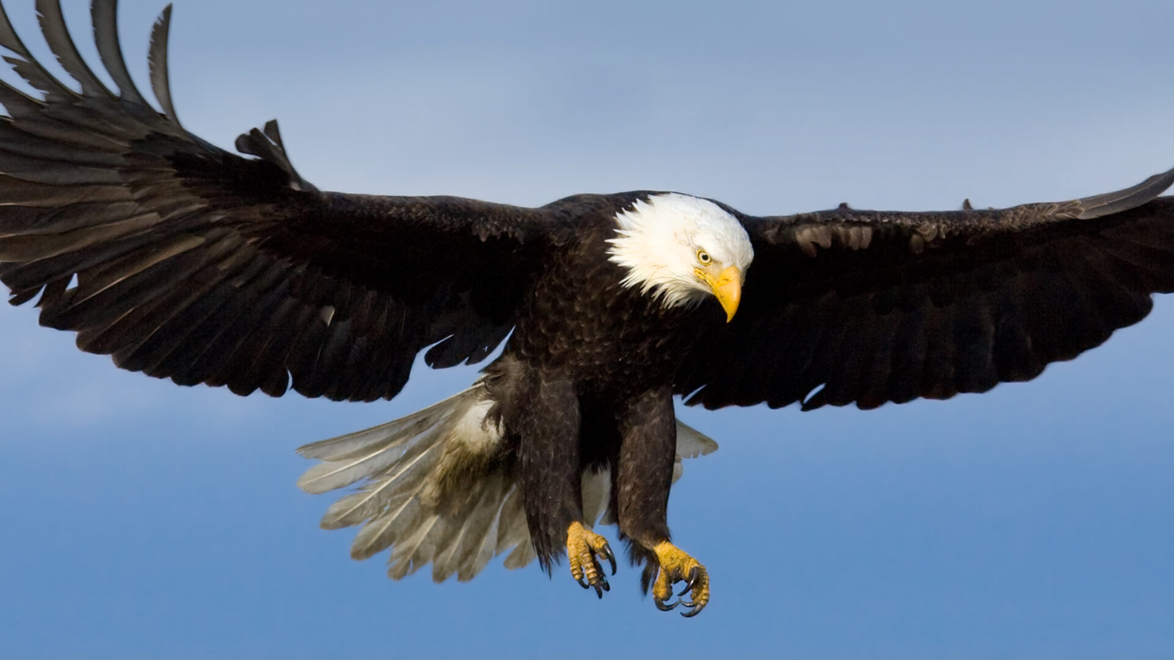
Chapter 48: Judgment On Moab
Desolation of Moab (48:1-10)
The Pride & Complacency of Moab (48:11-39)
Total Domination By Babylon (48:40-46); Hope (48:47)

Slide 15
Chapter 48: Applications
Chapter 48: Thought Questions
What will happen to those who mock God’s people? (vv. 26f)
Why is pride opposite to the nature of a true servant? (v. 29)
“Jer. 48:10: Cursed be the man who does God’s work ‘negligently’ (ASV) or ‘deceitfully.’ Whatever God commands of us should be done wholeheartedly in the way He has purposed. Anything less is ‘negligent’ or ‘deceitful’ and will be punished by God (cf. Acts 5:1-11; Col. 3:17, 23; Rev. 3:15-17).” (Harkrider, 118)
“Misplaced confidence in the arm of flesh will destroy any nation (9:23; 17:5; Pss. 44:3; 118:8, 9; 146:3-7; Luke 12:15-21; 1 Tim. 6:17).” (Humphries, 475)

