Slide 1
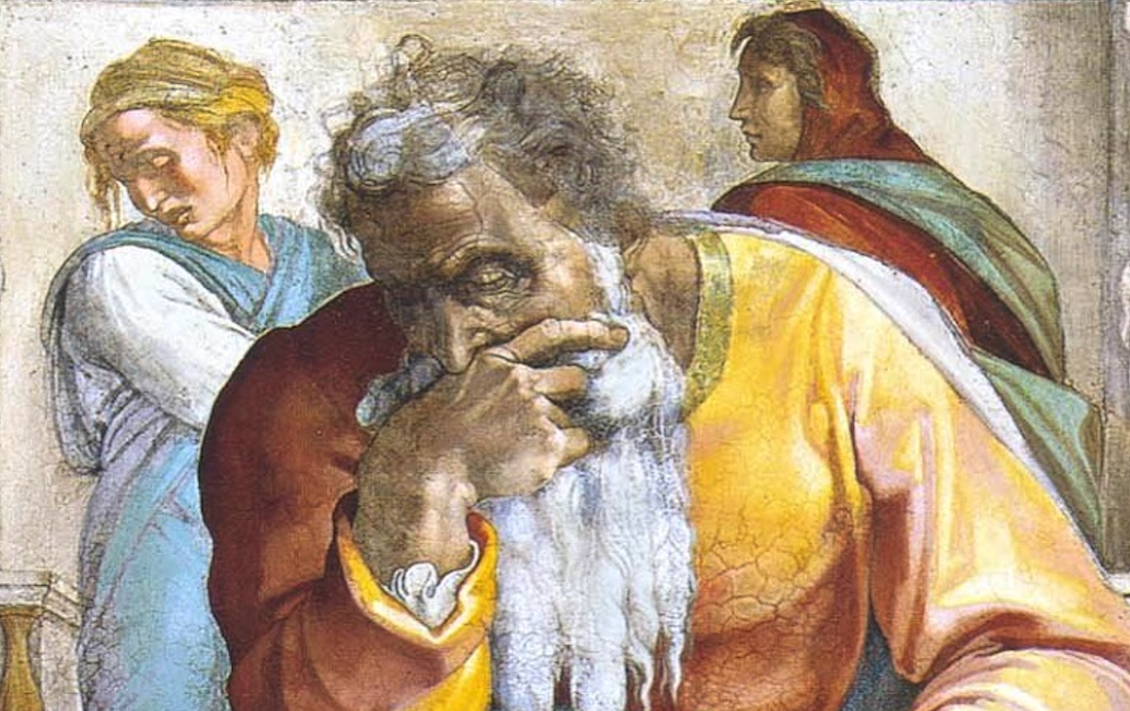
Jeremiah: Chapters 49-50

Slide 2
Jeremiah Memory Jogger:
The Yoke Of Babylon
Hananiah The Heretic
Letters To The Exiles
Glorious Future Ahead
The New Covenant
Kinsman Redeemer
I Will Cure Them
Violation of Sabbath Year
The Rechabites
Jehoiakim Burns The Scroll
Jonathan’s Cistern
Malchijah’s Cistern
Jerusalem Falls
The Aftermath
Murder Of Gedaliah
Don’t Go To Egypt!
They Go To Egypt
Queen Of Heaven
Woes Of Baruch
Judgment On Egypt
Judgment On Philistia
Judgment On Moab
Judgment On Ammon, etc.
Judgment On Babylon

Slide 3
Chapter 49: Judgment On Ammon, et al.

Slide 4
Chapter 49: Judgment On Ammon, et al.
Against Ammon (49:1-6)
Against Edom (49:7-22)
Against Damascus (49:23-27)
Against Kedar & Hazor (28-33)
Against Elam (49:34-39)

Slide 5
Chapter 49: Applications
“The sea of humanity can never be at rest or quiet…” (Humphries, 493)
Being son of a false god (a “Ben-hadad”) will bring destruction (cf. 1Kgs. 15:18; 20:1, 9; 2Kgs. 6:24; 8:7; 13:3; 2Chron. 16:2)

Slide 6
Chapter 50: Judgment On Babylon
Pronouncement Against Babylon (50:1-10; cf. 25:11f, 26; Rev. 14:8; 16:19; 17-18)
Babylon & Israel Contrasted (50:11-20)
Pride & Power Of Babylon Broken (50:21-46; cf. Dan. 4-5)

Slide 7
“In [Nabonidus's] mind, reverential fear of Marduk, king of the gods, came to an end. He did yet more evil to his city every day…he brought ruin on them all by a yoke without relief … [Marduk] inspected and checked all the countries, seeking for the upright king of his choice. He took the hand of Cyrus, king of the city of Anshan, and called him by his name, proclaiming him aloud for the kingship over all of everything.”

Slide 8
Chapter 50: Applications
The Lord is the habitation of righteousness/justice (v. 7)
“Jer. 50:9,21,25; 51:7,20: The great nations are only tools in God’s hands. He uses them to accomplish His purposes, then holds them accountable for their own misdeeds, just as individuals will be held accountable at the end of time (cf. Rev. 18:1-10; 20:11-15).” (Harkrider, 125) (cf. Is. 40:15)

