Slide 1
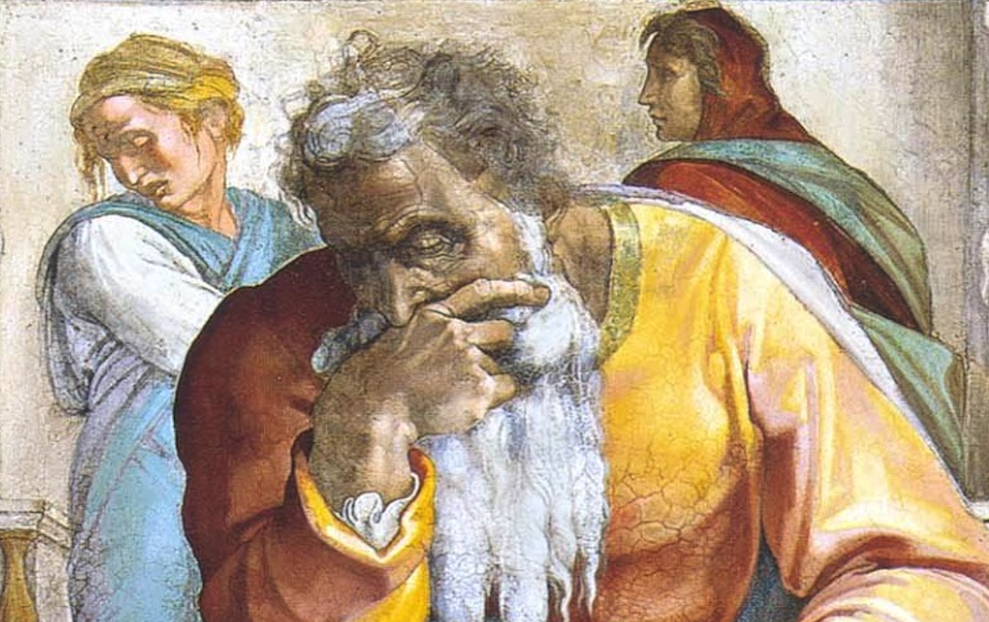
Jeremiah: Chapters 51-52

Slide 2
Jeremiah Memory Jogger:
The Yoke Of Babylon
Hananiah The Heretic
Letters To The Exiles
Glorious Future Ahead
The New Covenant
Kinsman Redeemer
I Will Cure Them
Violation of Sabbath Year
The Rechabites
Jehoiakim Burns The Scroll
Jonathan’s Cistern
Malchijah’s Cistern
Jerusalem Falls
The Aftermath
Murder Of Gedaliah
Don’t Go To Egypt!
They Go To Egypt
Queen Of Heaven
Woes Of Baruch
Judgment On Egypt
Judgment On Philistia
Judgment On Moab
Judgment On Ammon, etc.
Judgment On Babylon
Judgment On Babylon Is Just
Epilogue: Jerusalem Falls

Slide 3
John Humphries, “The Books of Jeremiah and Lamentations,” Truth Commentaries, 512
“The utter destruction of Babylon is continued from chapter 50. The last paragraph (vv. 59-64) concerns Jeremiah’s command to Seraiah, who was Baruch’s brother (32:12). Seraiah was in charge of the ‘resting place’ where the travelers to Babylon stopped. Seraiah was to read a copy of Jeremiah’s prophecy detailing the complete fall of Babylon and then toss the scroll into the River Euphrates. This action was to symbolize the destruction of Babylon.”

Slide 4
Chapter 51: Judgment On Babylon Is Just
The Medes: God’s Newest Instrument (51:1-14)
God Versus Idols (51:15-24)
Doom for Babylon (51:25-58)
Jeremiah’s Task for Seraiah (51:59-64)

Slide 5
Herodotus, Histories, I.191
“Therefore, whether it was some other man who suggested it to him when he was in a strait what to do, or whether he of himself perceived what he ought to do, he did as follows:—The main body of his army he posted at the place where the river runs into the city, and then again behind the city he set others, where the river issues forth from the city; and he proclaimed to his army that so soon as they should see that the stream had become passable, they should enter by this way into the city. Having thus set them in their places and in this manner exhorted them he marched away himself with that part of his army which was not fit for fighting: and when he came to the lake, Cyrus also did the same things which the queen of the Babylonians had done as regards the river and the lake; that is to say, he conducted the river by a channel into the lake, which was at that time a swamp, and so made the former course of the river passable by the sinking of the stream…

Slide 6
Herodotus, Histories, I.191
…When this had been done in such a manner, the Persians who had been posted for this very purpose entered by the bed of the river Euphrates into Babylon, the stream having sunk so far that it reached about to the middle of a man's thigh. Now if the Babylonians had had knowledge of it beforehand or had perceived that which was being done by Cyrus, they would have allowed the Persians to enter the city and then destroyed them miserably; for if they had closed all the gates that led to the river and mounted themselves upon the ramparts which were carried along the banks of the stream, they would have caught them as it were in a fish-wheal: but as it was, the Persians came upon them unexpectedly; and owing to the size of the city (so it is said by those who dwell there) after those about the extremities of the city had suffered capture, those Babylonians who dwelt in the middle did not know that they had been captured; but as they chanced to be holding a festival, they went on dancing and rejoicing during this time until they learnt the truth only too well.”

Slide 7
Xenophon, Cyropaedia, VII.C.15-21
“However by this time the trenches were dug. And Cyrus heard that it was a time of high festival in Babylon when the citizens drink and make merry the whole night long. As soon as the darkness fell, he set his men to work. The mouths of the trenches were opened, and during the night the water poured in, so that the river-bed formed a highway into the heart of the town. When the great stream had taken to its new channel, Cyrus ordered his Persian officers to bring up their thousands, horse and foot alike, each detachment drawn up two deep, the allies to follow in their old order. They lined up immediately, and Cyrus made his own bodyguard descend into the dry channel first, to see if the bottom was firm enough for marching. When they said it was, he called a council of all his generals and spoke as follows: “My friends, the river has stepped aside for us; he offers us a passage by his own high-road into Babylon. We must take heart and enter fearlessly, remembering that those against whom we are to march this night are the very men we have conquered before, and that too when they had their allies to help them, when they were awake, alert, and sober, armed to the teeth, and in their battle order. To-night we go against them when some are asleep and some are drunk, and all are unprepared: and when they learn that we are within the walls, sheer astonishment will make them still more helpless than before.”

Slide 8
Chapter 51: Applications
God’s foreknowledge and appointment of Cyrus is an incredible string of fulfilled prophecies that aid the Christian historical apologetic.
God doesn’t force people to obey Him; He may hand them over to their own path.
Even though we may do good things and be involved in God’s work, that does not necessitate that we will not be affected by evil. In fact, quite the opposite is often true. Even so, comforts are afforded Christians that enable & empower.

Slide 9
John Humphries, “The Books of Jeremiah and Lamentations,” Truth Commentaries, 526
“This chapter is a historical appendix to the Book of Jeremiah and begins with the fall of Jerusalem. It then details what the Babylonians did to the temple, its furniture, and its vessels. It also mentions the treatment of the poor of the land of Judah and the taking of the two bronze pillars. In this chapter, we have a description of the deportations (though not intended to include a complete tally of all people and items taken) to Babylon and an explanation of how Nebuchadnezzar treated Zedekiah, Jehoiachin, and other Jewish officials. There are listings of the number of Jews taken into exile.”

Slide 10
Chapter 52: Epilogue: Jerusalem Falls
Fate Of Zedekiah (52:1-11)
Jerusalem & Temple Destroyed (52:12-23)
Chief Officers Arrested (52:24-30)
Jehoiachin’s Favor (52:31-34)
Hagab Seal, Dated To End Of 1st Temple Period, Recently Found In A Massive 7th Century Upper Class Home Near The Western Wall

Slide 11
Making Sense Of The Deportations
2 Chronicles 35-36//2 Kings 24-25
Under Jehoiakim (606/5 B.C.)
Under Jehoiachin (597 B.C.)* – 10,000 people (7,000 soldiers)
Under Zedekiah (586 B.C.)**
Jeremiah 52:12, 28-30
7th year of Nebuchadnezzar (597 B.C.)* – 3,023 people (+ 7,000 soldiers)
18/19th year of Nebuchadnezzar (586 B.C.)** – 832 people
23rd year of Nebuchadnezzar (582/1 B.C.) – 745 people (cf. Jer. 43:12f?)
Some suggest the use of different dating and counting methods between the biblical writers in order to make all these harmonize. However we resolve this, we must keep in mind that these lists may not be intended to be absolute, but may be stylized to suit a specific emphasis in each text.

Slide 12
Jehoiachin Rations Tablets
"...t[o] Ia-'-u-kin, king...” (Babylon 28122)
"10 (sila of oil) to ...Ia-'-kin, king of Ia[...] 2 ½ sila to [...so]ns of the king of Ia-a-hu-du” (Babylon 28178)
“10 sila to Ia-ku-u-ki-nu, the king of Judah’s son, 2 ½ sila for the five sons of the Judean king” (Babylon 28186)

Slide 13
Chapter 52: Applications
Our peers, family, and friends can be HUGELY impacted by our choices.
You reap what you sow (Gal. 6). The way of the transgressor is hard (Prov. 13:15).
God can do incredible things with you and for you in the heart of difficulty.

