Slide 1
Ezra, Nehemiah, and Esther
Review of Ezra Chapters 1-7

Slide 3
Intro to the Book
Originally, Ezra and Nehemiah were one book
Ezra was seen as a second Moses
Possibly wrote 1 and 2 Chronicles as well
1st person used in Ezra 7:27-28; 8:1-34; 9:1-15
The Elephantine Papyri, Samaria papyri, and Josephus give us some insight into this period and the period immediately following this.

Slide 4
Intro to the Book
Major themes: God’s sovereignty, covenant, divine steadfastness, continuity of the people of God, separation of people of God/religious purity, community, grace, prayer, & Scripture as law to be obeyed, revelation to be understood, & as promises & warnings to evoke prayer & action
Lists, correspondences, & legal records are also significant to the books
Aramaic sections in Ezra (4:8-6:18; 7:12-26; cf. Dan. 2-7)
Thematic Names

Slide 5
Timeline of Events
586 B.C. – Nebuchadnezzar Besieges Jerusalem
539 B.C. – The Defeat of Babylon
538 B.C. – 1st Return under Zerubbabel
536 B.C. – Construction Begins on Temple; Stops
520 B.C. – Construction Recommences
516 B.C. – Temple Completed
486-479 B.C. – Esther Becomes Queen
458 B.C. – 2nd Return under Ezra
445 B.C. – 3rd Return under Nehemiah

Slide 6
Ezra Chapter 1
1st year of Cyrus was transition year, not 1st year to reign
Fulfilled Jeremiah 25:12-13; 29; 50-51
70 years seen from several different perspectives
God stirred up Cyrus
Cyrus made sure everyone knew about this decree

Slide 7
The Cyrus Cylinder
“I returned the images of the gods, who had resided there, to their places and I let them dwell in eternal abodes. I gathered all their inhabitants and returned to them their dwellings. In addition, at the command of Marduk, the great lord, I settled in their habitations, in pleasing abodes, the gods of Sumer and Akkad, whom Nabonidus, to the anger of the lord of the gods, had brought into Babylon. May all the gods whom I settled in their sacred centers ask daily of Bêl and Nâbu that my days be long and may they intercede for my welfare…The people of Babylon blessed my kingship, and I settled all the lands in peaceful abodes.”

Slide 8
Josephus, Anti. of the Jews, xi. 1-2
“Thus saith Cyrus the King: since God Almighty hath appointed me to be King of the habitable earth, I believe that He is that God, which the nation of the Israelites worship. For indeed he foretold my name by the Prophets, and that I should build him an house at Jerusalem, in the country of Judea.” This was known to Cyrus by his reading the book which Isaiah left behind him of his Prophecies. For this Prophet said, that God had spoken thus to him in a secret vision: “My will is, that Cyrus, whom I have appointed to be King over many and great nations, send back my people to their own land, and build my temple.” This was foretold by Isaiah one hundred and forty years before the temple was demolished. Accordingly when Cyrus read this, and admired the divine power, an earnest desire and an ambition seized upon him, to fulfil what was so written.

Slide 9
Ezra Chapter 1
Remnant theme partially fulfills various prophecies
Exodus theme – gold, silver, vessels, assisted by others, leader of civil power used by God
Cyrus enabled all to be involved
A fraction of those who came out of the 1st exodus
Sheshbazzar may either be Zerubbabel or another governor, or even Zerubbabel’s uncle
What an occasion!
Understandable difficulties in the listings here

Slide 11
Ezra Chapter 2
Leaders (vv. 1-2a)
Laymen (vv. 2b-35)
Priests (vv. 36-39)
Levites (vv. 40-42)
Temple Servants (vv. 43-58)
Unconfirmed (vv. 59-63)
Totals (vv. 64-67)
Gifts and Settling (vv. 68-70)

Slide 12
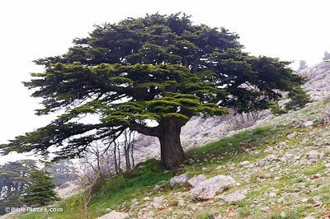
Ezra Chapter 3
vv. 1-6a – 1st Things 1st
vv. 6b-9 – Preparations for the Temple
vv. 10f – Climax
vv. 12f – Anticlimax

Slide 13
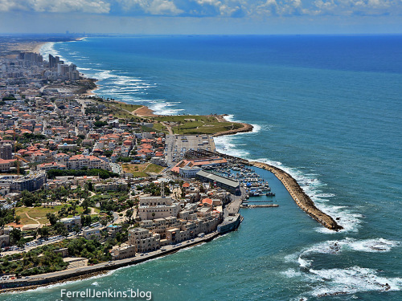

Slide 14
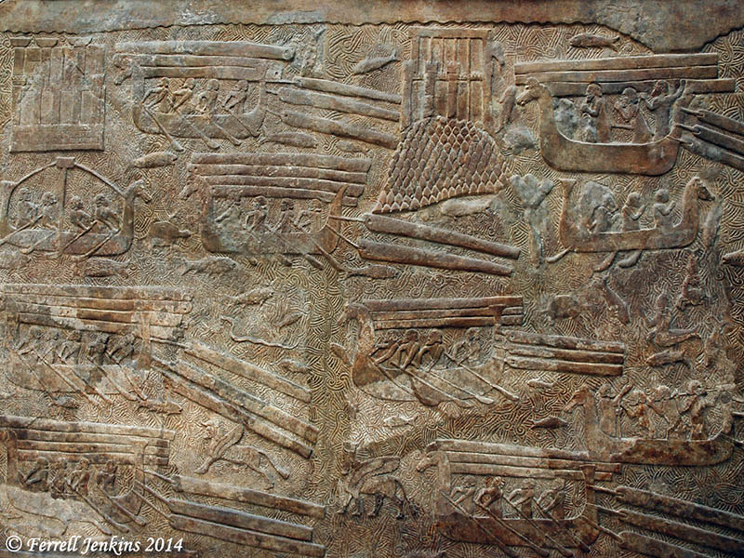

Slide 15
Ezra Chapter 4
Attempts to compromise restored Israel (4:1-3)
Threats and attacks on the people of the land (4:4-5)
Persecutory legislation appealed for & granted (4:6-24)

Slide 16
Ezra Chapter 5
vv. 1f – Haggai and Zechariah Encourage Restart
vv. 3-5 – Political Intervention
vv. 6-17 – Tattenai’s Letter to Darius the Great
Ecbatana/Achmetha
Where the decree of Cyrus will actually be found (6:2)

Slide 17
Behistun Inscription with Darius trampling Bardiya and Zoroastrianism symbol overhead also in Old Persian, Elamite, and Akkadian/Babylonian. The inscription is nearly 350 feet off the ground on a rock face)

Slide 18
Pasagardae Citadel built up significantly during the days of Darius

Slide 19
Pasagardae Citadel

Slide 20
Tombs of the Kings at Naqsh-e Rostam (Darius I, Xerxes I, Artaxerxes I, Darius II, unfinished tomb for Artaxerxes III or Darius III)

Slide 21
Ezra Chapter 6
vv. 1-5 – Cyrus’ Decree Rediscovered
vv. 6-12 – Darius Encourages the Work
vv. 13-18 – The Temple Completed and Dedicated
vv. 19-22 – Passover and the Feast of Unleavened Bread Are Observed

Slide 22
Susa (aka Shushan) – where Esther was queen, where Nehemiah served as cupbearer, and also mentioned by Daniel

Slide 23
Palace at Susa (aka Shushan) – where Esther was queen, where Nehemiah served as cupbearer, and also mentioned by Daniel

Slide 24
Ezra Chapter 7
vv. 1-10 – Introducing Ezra the Priest and Scribe
vv. 11-26 – Ezra’s Mission from Artaxerxes
The Gadatas Stele, Uzahor Inscription, and Delian Decree attest to Darius’ care for proper religious observance during his reign.

Slide 25
Diodorus Siculus, I.95.4-5
A sixth man to concern himself with the laws of the Egyptians, it is said, was Darius the father of Xerxes; for he was incensed at the lawlessness which his predecessor, Cambyses, had shown in the treatment of the sanctuaries of Egypt, and aspired to live a life of virtue and of piety towards the gods. Indeed he associated with the priests of Egypt themselves, and took part with them in the study of theology and of the events recorded in their sacred books; and when he learned from these books about the greatness of soul of the ancient kings and about their goodwill towards their subjects he imitated their manner of life. For this reason he was the object of such great honour that he alone of all the kings was addressed as a god by the Egyptians in his lifetime, while at his death he was accorded equal honours with the ancient kings of Egypt who had ruled in strictest accord with the laws.

